Slide 1

Object-Oriented Programming Discussion, Lecture, & Lab Eric Pogue
Agenda for Tuesday, January 29th from 2 to 315pm CST:
Friendly Conversation Topic – OOP Web Programming with TypeScript & WebAssembly
Q&A: More Object-Oriented Programming
Sprint 2 Sprint Planning
Lab
Discussion & Questions welcome at any time… please be present with no phones or email during our time together

Slide 2
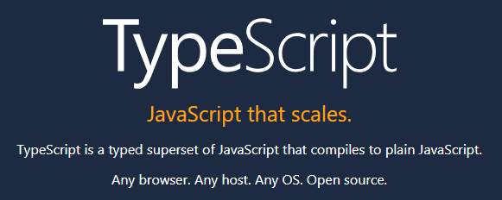

Slide 3
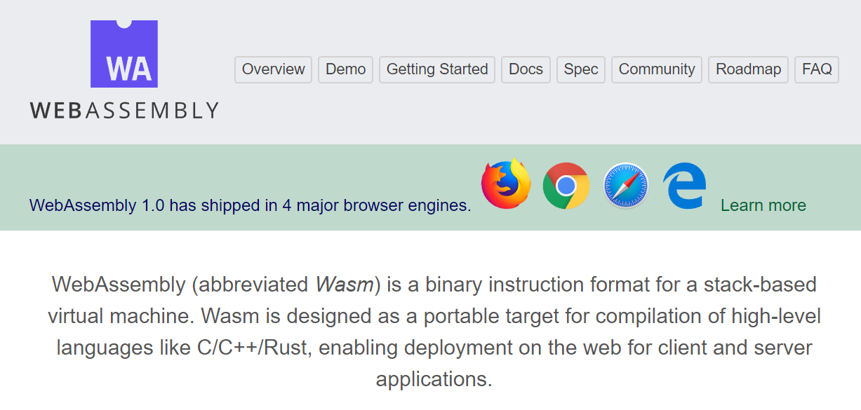

Slide 4
Q&A: More Object-Oriented Programming

Slide 5
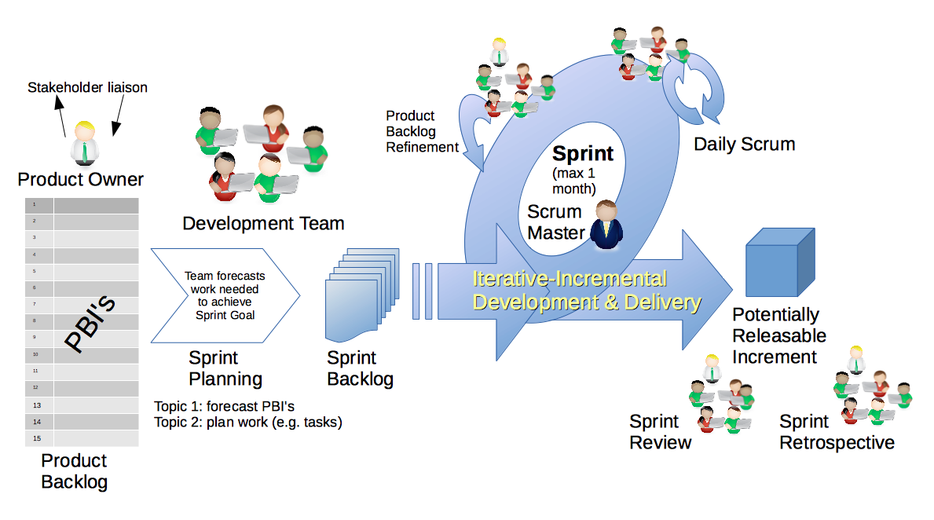
Scrum & Scrum Roles – Sprint Planning
By Dr ian mitchell - Own work, CC BY-SA 4.0, Link

Slide 6
Review Sprint 2 Activities List, Programming Assignment, Quiz, and Discussion Board

Slide 7
Lab
Activates:
Work with the members of your Scrum Team to:
Update your copy of our course materials using “git pull”
Verify that our source code from last week is in “source-lite\inclass”
Discussion: BMI Calculator Plus coding together from last week
As a team make sure that everyone on the team has completed BMI Calculator Plus
As a team complete a Detailed Review of our Sprint 2 Activities List, Programming Assignment, Quiz, and Discussion Board
Daily Scrum and Report Out starting at 3:05

Slide 8
Discussion: BMI Calculator Plus

Slide 9
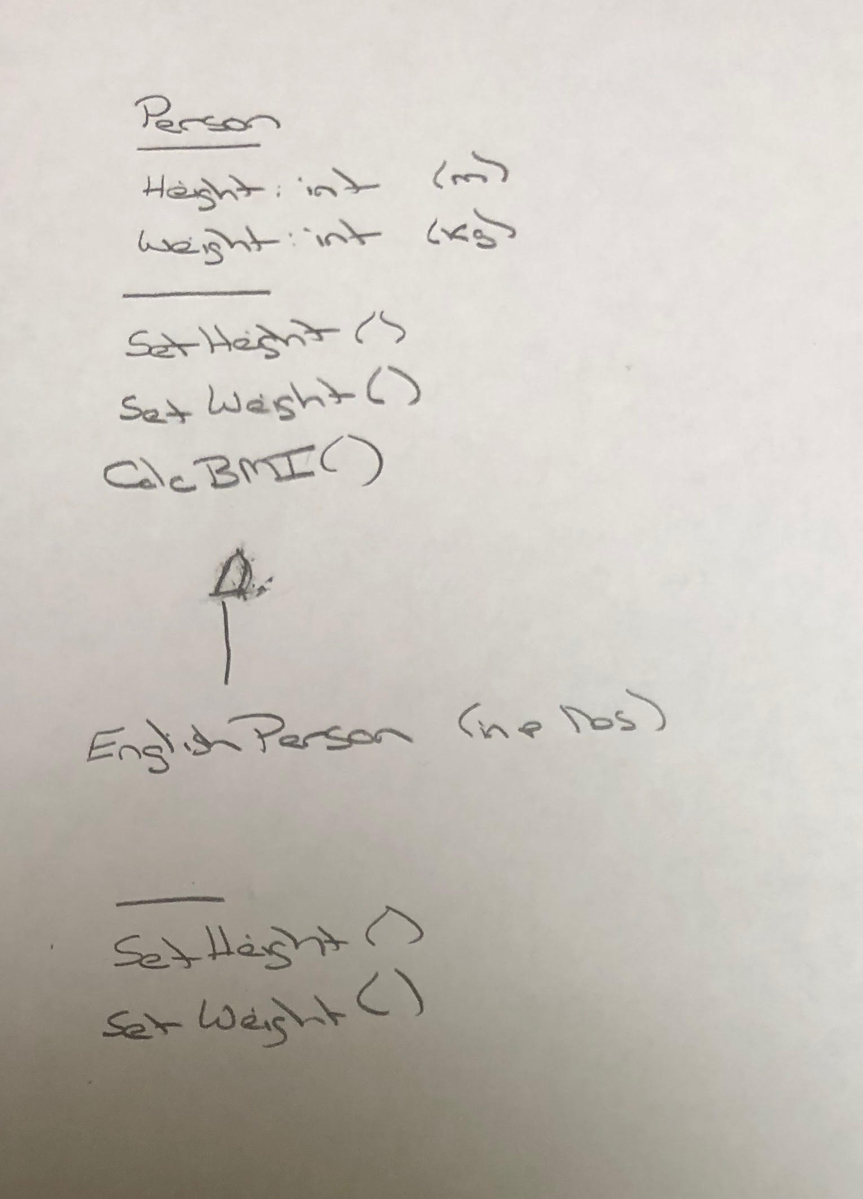
BMI Calculator Plus – UML

Slide 10
As a Team Review Sprint 2 Activities List, Programming Assignment, Quiz, and Discussion Board
Notes:
Optimism, good natured humor, and effectively working together is immensely important to delivering good software… and likely equally important to delivering just about any quality product
Even if you don’t intend to be a professional software developer, many of the things that we learn will be valuable in related areas.
Soooo… We have 16 weeks to learn something valuable and interesting. Let’s enjoy our time together and make the most out of it.

Slide 11
Daily Scrum and Report Out starting at 3:10
Scrum Master stand up, give your name, your team name, and briefly answer the following questions:
What did you accomplish since the last meeting?
What will you working on until the next meeting?
Is the team committed to completing the Sprint 1 assignments? All/Most/Some
What is getting in your way or keeping you from completing the assignments?

Slide 12
End of Session

