Slide 1

Object-Oriented Programming Discussion, Lecture, & Lab Eric Pogue
Agenda for Thursday, January 24nd from 2 to 315pm CST:
Friendly Conversation Topic – TypeScript
Q&A: Sprint 1
Q&A: Concepts & Practices
Q&A: Patterns
Q&A: Principles
Discussion: More Object-Oriented Programming
Lab
Discussion & Questions welcome at any time… please be present with no phones or email during our time together

Slide 2
TypeScript

Slide 3
Q&A: Sprint 1

Slide 4
Q&A: Patterns

Slide 5
Q&A: Principles

Slide 6
Lab
Activates:
Work with the members of your Scrum Team to:
Install and verify Java SDK
Install Visual Studio Code… or other preferred text editor
BMI Calculator Plus coding together
Daily Scrum and Report Out starting at 3:05

Slide 7
BMI Calculator Plus

Slide 8
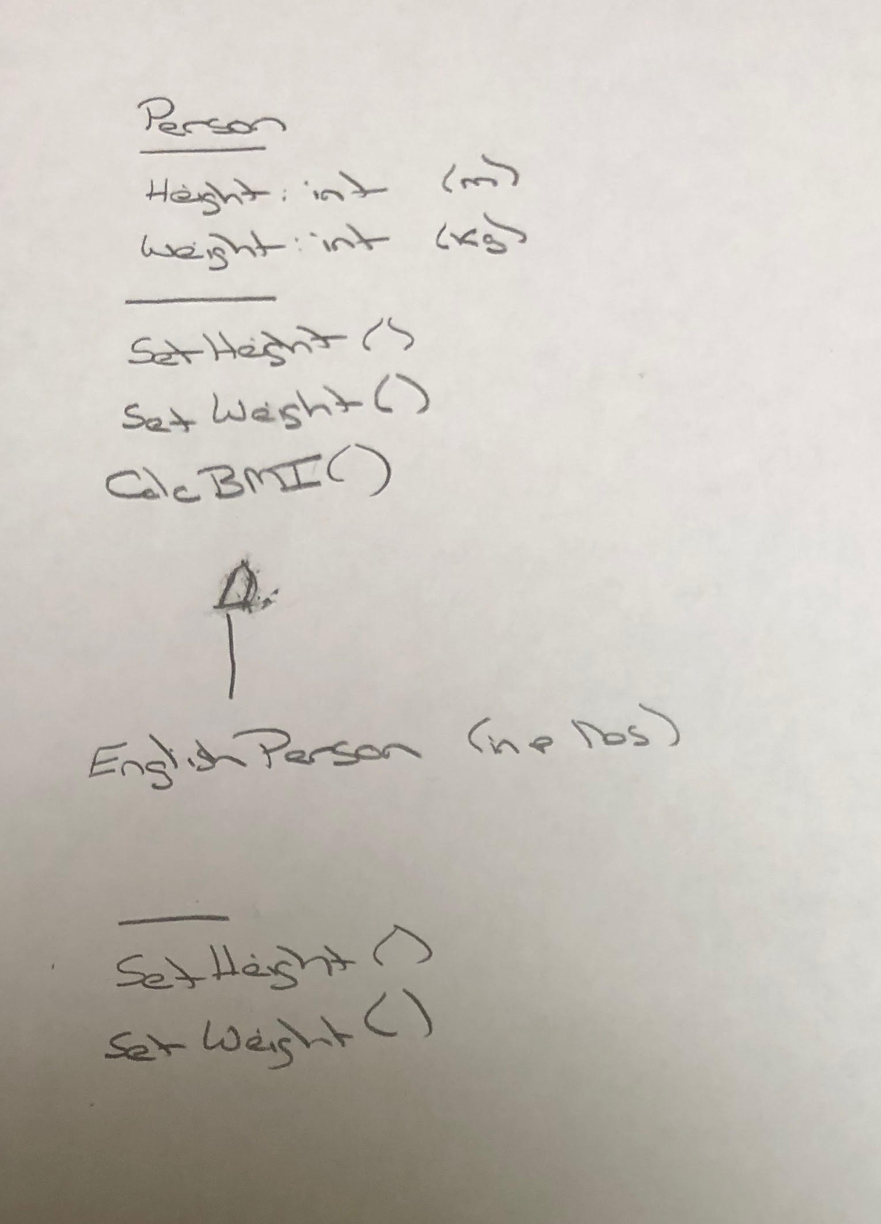
BMI Calculator Plus – UML

Slide 9
Daily Scrum and Report Out starting at 3:10
Scrum Master stand up, give your name, your team name, and briefly answer the following questions:
What did you accomplish since the last meeting?
What will you working on until the next meeting?
Is the team committed to completing the Sprint 1 assignments? All/Most/Some
What is getting in your way or keeping you from completing the assignments?

Slide 10
End of Session

