Slide 1

Object-Oriented Programming Discussion, Lecture, & Lab Eric Pogue
Agenda for Tuesday, January 29th from 2 to 315pm CST:
Friendly Conversation Topic – TypeScript
Sprint Review for Sprint 2
Q&A: Concepts & Practices
Q&A: Patterns
Q&A: Principles
Q&A: More Object-Oriented Programming
Lab
Discussion & Questions welcome at any time… please be present with no phones or email during our time together

Slide 2
TypeScript

Slide 3
Q&A: Sprint 1

Slide 4
Q&A: Patterns

Slide 5
Q&A: Principles

Slide 6
Q&A: More Object-Oriented Programming

Slide 7
Lab
Activates:
Work with the members of your Scrum Team to:
Discussion: BMI Calculator Plus coding together from last week
As a team complete a Detailed Review of our Sprint 2 Activities List, Programming Assignment, Quiz, and Discussion Board
Daily Scrum and Report Out starting at 3:05

Slide 8
Discussion: BMI Calculator Plus

Slide 9
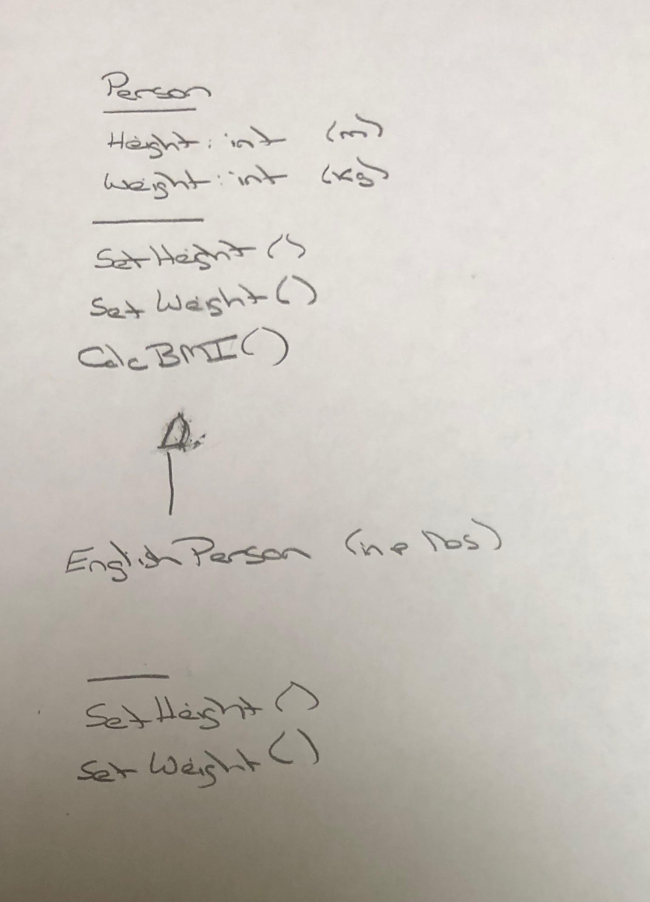
BMI Calculator Plus – UML

Slide 10
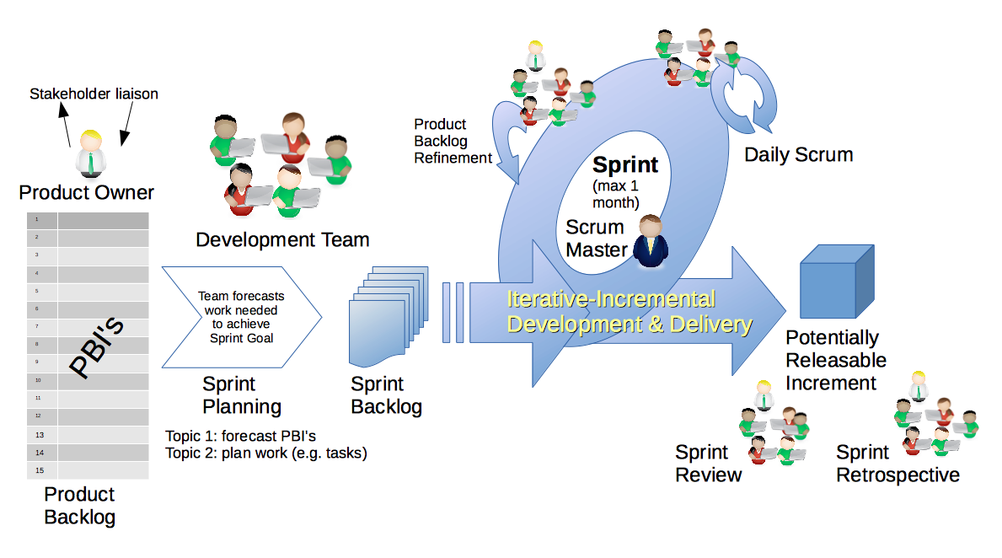
Scrum & Scrum Roles – Sprint Planning
By Dr ian mitchell - Own work, CC BY-SA 4.0, Link

Slide 11
Daily Scrum and Report Out starting at 3:10
Scrum Master stand up, give your name, your team name, and briefly answer the following questions:
What did you accomplish since the last meeting?
What will you working on until the next meeting?
Is the team committed to completing the Sprint 1 assignments? All/Most/Some
What is getting in your way or keeping you from completing the assignments?

Slide 12
End of Session

