Slide 1

Object-Oriented Programming Discussion, Lecture, & Lab Eric Pogue
Agenda for Tuesday, January 22nd from 2 to 315pm CST:
Friendly Conversation Topic – Text Files including encoding, end-of-line, tabs vs. spaces, and spaces after a period
Q&A: Sprint 1
Discussion: Object-Oriented Programming Patterns
Discussion: Object-Oriented Programming Principles
Lab… starting no later than 2:45
Wrap-up and Final Questions/Comments?
Discussion & Questions welcome at any time… please be present with no phones or email during our time together

Slide 2
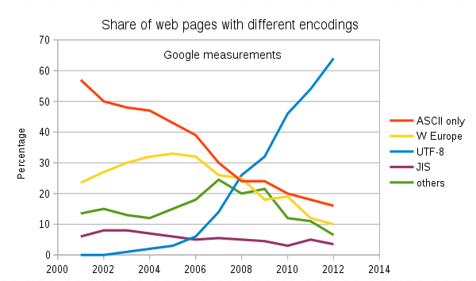
Text File Encoding Standards
ASCII
Unicode
UTF-8
Others

Slide 3
Text File End-Of-Line (EOL) and Encoding
Industry adoption of end-of-line encoding includes:
Windows: Both Carriage Return (CR, \r, 0x0d) and Line Feed (LF, \n, 0x0a) together.
Unix/Linux/OSX: Just Line Feed (LF, \n, 0x0a)
Mac (pre-OSX): Just Carriage Return (CR, \r, 0x0d)
Article on Windows Notepad supporting non-Windows EOF conventions [link]

Slide 4
Source Code Indenting and Tabs vs Spaces
Source code should be indented consistently in order to promote readability.
Tabs versus Spaces has been a holy war among programmers since source files were created:
“Should source-code lines be indented using tab characters or space characters? … and if spaces, how many spaces?” [link]
Rules:
Be consistent with yourself
Be consistent with your project… and fellow developers on the project
Be consistent with your organization
For this class, please use four spaces and never utilize tabs.
Notes:
Be sure to watch the video at the link… very funny.

Slide 5
And Only One Space After a Period
Rule: Utilize one space after a period or similar punctuation [link]

Slide 6
Q&A: Sprint 1

Slide 7
Discussion: Object-Oriented Programming Patterns

Slide 8
Discussion: Object-Oriented Programming Principles

Slide 9
Lab
Activates:
Work with the members of your Scrum Team to:
Install and verify Java SDK
Install Visual Studio Code… or other preferred text editor
Review hierarchical directory structures, create a director for all work for this class, download course materials, and create a lab area
BMI Calculator Plus coding together
Inheritance
Ownership
Getters & Setters
Constructors
Daily Scrum and Report Out starting at 3:05

Slide 10
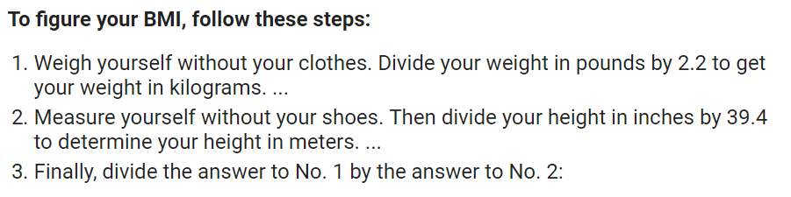
BMI Calculator Plus

Slide 11
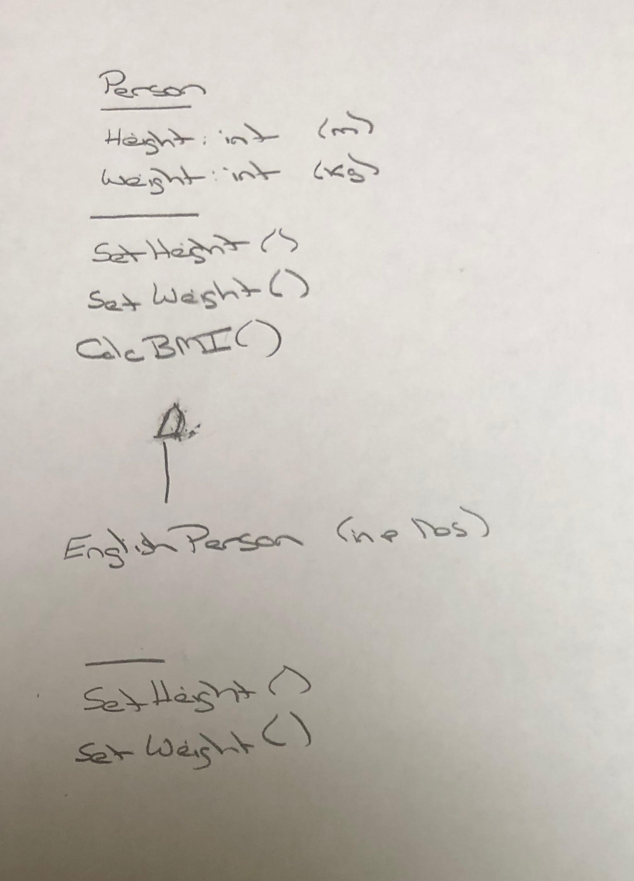
BMI Calculator Plus – UML

Slide 12
Daily Scrum and Report Out starting at 3:10
Scrum Master stand up, give your name, your team name, and briefly answer the following questions:
What did you accomplish since the last meeting?
What will you working on until the next meeting?
Is the team committed to completing the Sprint 1 assignments? All/Most/Some
What is getting in your way or keeping you from completing the assignments?

Slide 13
End of Session

