Slide 1

Object-Oriented Programming Discussion, Lecture, & Lab Eric Pogue
Agenda for Tuesday, February 5th from 2 to 315pm CST:
Friendly Conversation Topic – Agile Development and Unexpected Events
Q&A: More Object-Oriented Programming
Q&A: Sprint 2 Sprint Planning
Foreshadowing FaceDraw
Review Quiz 1
UML Class Diagrams, BMI Calculator Plus, and Phone Example
Shapes Tutorial Expectations
Lab: Sprint 2
Discussion & Questions welcome at any time… please be present with no phones or email during our time together

Slide 2
Friendly Conversation Topic – Agile Development and Unexpected Events

Slide 3
Q&A: More Object-Oriented Programming

Slide 4
Q&A: Sprint 2 Sprint Planning

Slide 5
Review Quiz 1

Slide 6
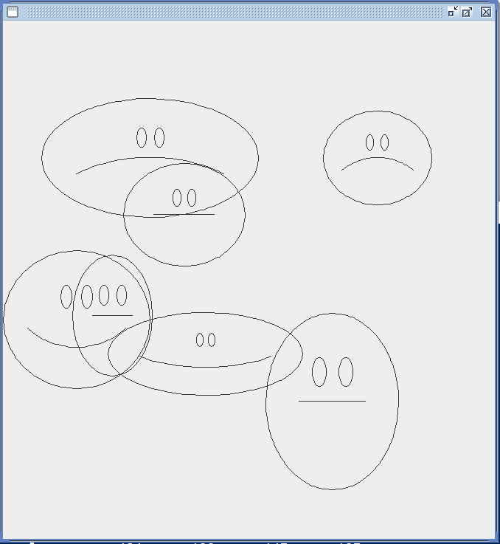
Foreshadowing FaceDraw
In the sprint 3 FaceDraw assignment, you will need to:
Create an graphical Java application
Draw 3 to 10 random faces on a window
Make each face a random width and height
Give each face a random emotion
Make it all visually appealing
And more
It will be challenging!

Slide 7

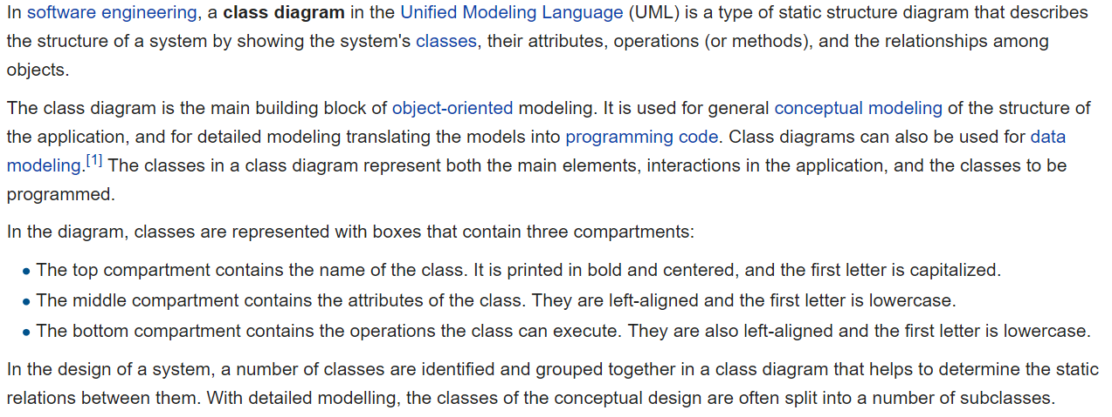
UML Class Diagram [link]

Slide 8
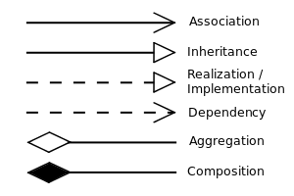


UML Class Diagram (continued) [link]

Slide 9
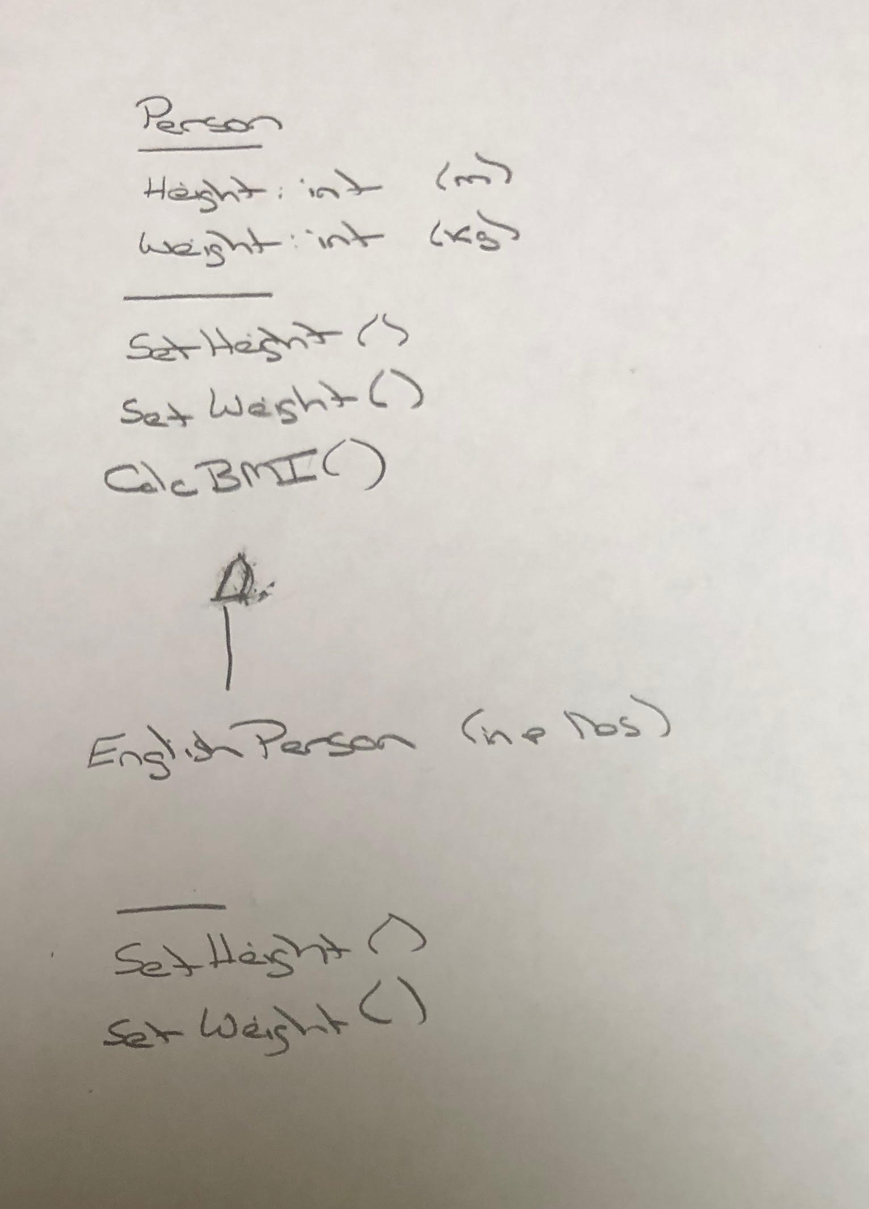
UML – BMI Calculator Plus

Slide 10
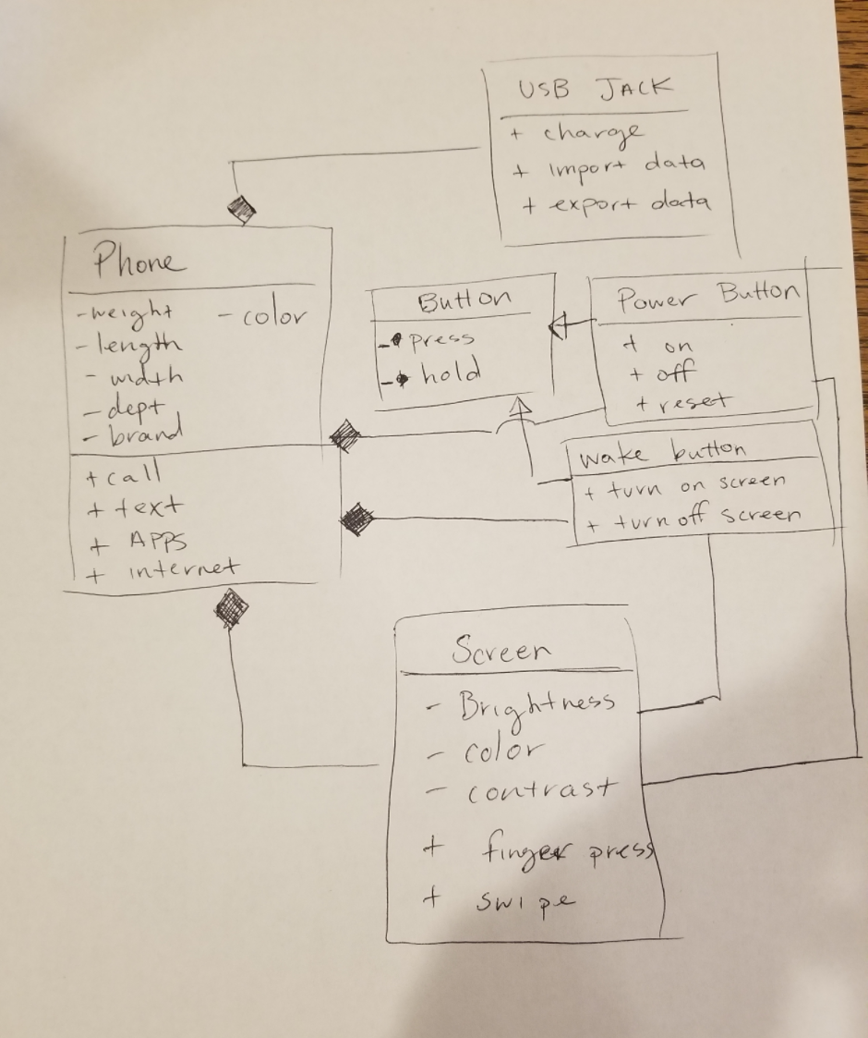
UML Phone Example

Slide 11
Shapes Tutorial Expectations
After you complete the Shapes Step 1 and Shapes Step 2 Tutorials you should be able to:
Declare an abstract class and explain why it is useful
Use Inheritance to build classes and objects that extend base class functionality
Implement Encapsulation and Data Hiding by using setters and getters
Write default and non-default constructors
Override the toString function
Store multiple objects in an ArrayList using generic data types
Distinguish between using an array and an ArrayList
Work with a collection of related objects polymorphically
Explain how Polymorphism is implemented behind the scenes

Slide 12
Lab: Sprint 2
Note that these lab items utilize topics that we will cover in the sprints 1-3. Many of the topics may be unfamiliar and may make you uncomfortable. My hope is that by giving you an early preview to them, our week 3 FaceDraw assignment will be more enjoyable.
Review of hierarchical file systems and where to store material for this class
Clone & Pull the current course materials… you should do this regularly
Compile, run, and review the ShapeDraw application in the source-lite folder
Note: You still need to complete the “Shapes Step 1” and “Shapes Step 2” tutorials!
Review pre-OOP Graphical Hello World Windows C code
Code HelloWorldPlus together
Complete OvalDraw Tutorial Using GitHub and Git together (next slide)

Slide 13
Lab: Sprint 2 (continued)
OvalDraw Tutorial Using GitHub and Git:
Discuss Configuration Management
Review Common Git/GitHub Command Branching Pattern
Create a GitHub project
Clone Empty GitHub project
Step 1: Implement “Hello World” type application
Step 2: Implement JFrame
Step 3: Implement JPanel
Step 4: Implement Oval that draws itself
Commit and Push to GitHub

Slide 14
Daily Scrum and Report Out starting at 3:10
Scrum Master stand up, give your name, your team name, and briefly answer the following questions:
What did you accomplish since the last meeting?
What will you working on until the next meeting?
Is the team committed to completing the Sprint 1 assignments? All/Most/Some
What is getting in your way or keeping you from completing the assignments?

Slide 15
End of Session

