Slide 1

Object-Oriented Programming Discussion, Lecture, & Lab Eric Pogue
Agenda for Thursday, January 17 from 2 to 315pm CST:
Friendly Conversation Topic – Agile Manifesto
Q&A: Syllabus
Q&A: Object-Oriented Programming Concepts & Practices
Discussion: How to Be a Successful Programmer
Discussion: Scrum & Scrum Roles
Sprint 1 Planning
Lab… starting no later than 2:45
Wrap-up and Final Questions/Comments?
Discussion & Questions welcome at any time… please be present with no phones or email during our time together

Slide 2
The Agile Manifesto
“We are uncovering better ways of developing software by doing it and helping others do it. Through this work we have come to value:
Individuals and interactions over processes and tools
Working software over comprehensive documentation
Customer collaboration over contract negotiation
Responding to change over following a plan
That is, while there is value in the items on the right, we value the items on the left more.”
Notes:
This was kind of “hippy-ish” and egalitarian in its day… quite controversial in its day
“Everyone is a team member and is responsible for the work getting done”… we don’t need no titles or positions… self-organizing… we will make our own commitments… transparency (let’s share the information)… flexible/organic teams, organic architecture (minimal documentation/standards)… no contracts (let’s talk it over)
The flip side:
We will actively and voluntarily play important roles on our team
The rules (rituals) that we do have… we WILL follow
We will create, demo, and release working software/products
We will utilize practical processes, tools, documentation, and planning
When we make commitments, we will live up to those commitments… as a team (“No winners on a losing team, and no losers on a winning team”)
We will be responsive and continuously improve (Retrospectives)
We will be transparent with how WE work and share our information

Slide 3
Q&A: Syllabus Overview

Slide 4
Discussion: Scrum & Scrum Roles

Slide 5
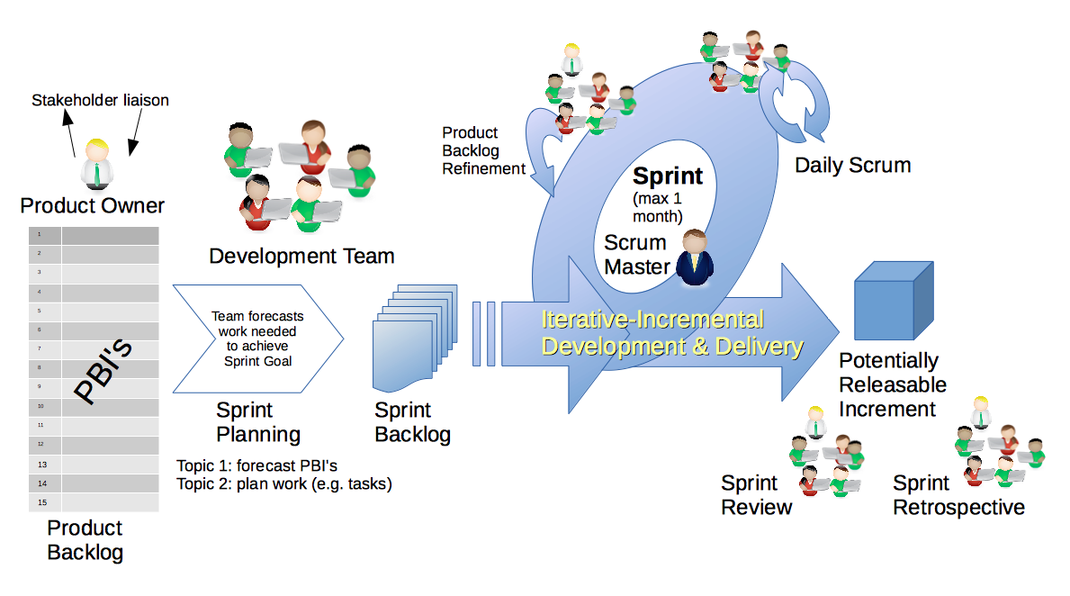
Scrum & Scrum Roles – Sprint Review
By Dr ian mitchell - Own work, CC BY-SA 4.0, Link

Slide 6
Lab
Lab Activates:
Split up into 4-6 person Scrum teams, identify a Scrum Master, select a adjective/noun team name (i.e. Brown Bears, Backrow Bobcats, etc.)
Make sure that the team has a mix of skillsets
Add your team name to your name card
Work with the members of your Scrum Team to:
Verify Sprint 1 Planning Understanding and Commitment
Install and verify Java SDK
Install Visual Studio Code… or other preferred text editor
BMI Calculator Plus coding together
Daily Scrum and Report Out starting at 3:05

Slide 7
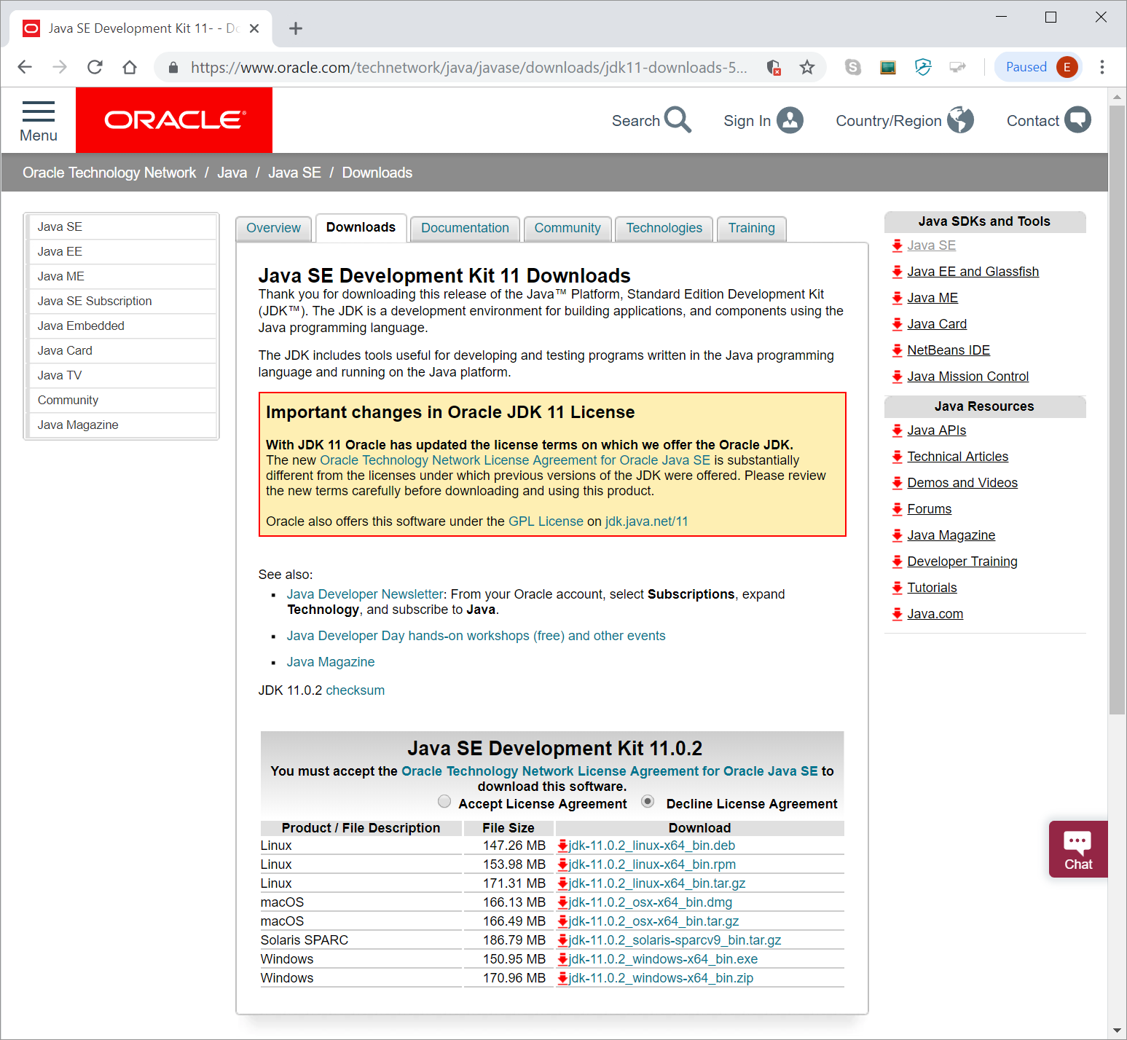
Java Development Environment Overview
Standard Java tools for this class include:
Java SE Development Kit (SDK) [link]
Text Editor (Microsoft Visual Studio Code)
Additional Tools:
Git and GitHub
Eclipse
You are welcome to use addition tools, but please don’t make your assignments dependent on those tools.
Notes:
Adding javac to path – https://www.java.com/en/download/help/path.xml

Slide 8
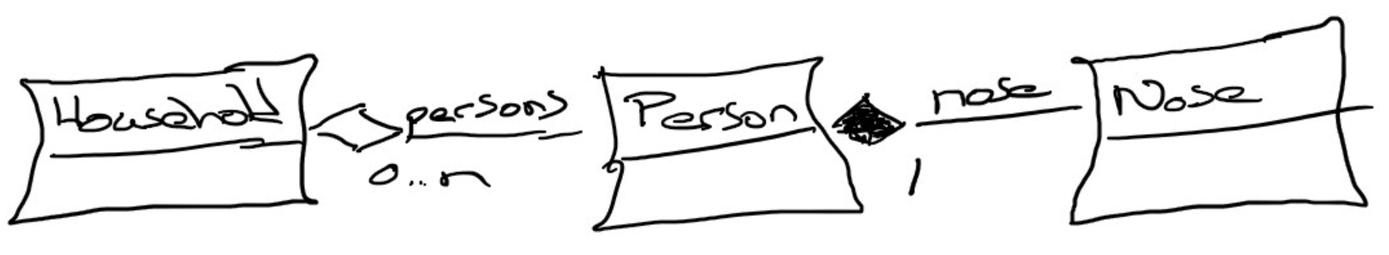
Composition & Aggregation (and UML)
Composition: A relationship where an object will not exist without the parent object. For example, it is unlikely that the “Nose” object will exist after the “Person” object is gone.
Aggregation: A relationship where multiple objects will likely continue to exist independent of each other. For example, we might have a “Household” object and a “Person” object. It would be very reasonable to expect our “Person” object to continue to exist even if our “Household” object was deleted.
Our First UML:
Notes:
Composition: An example of composition: the relationship between Face and Nose, Mouth, and Eye
class Face {
Nose n;
Mouth m;
Eye le;
Eye re;
}
We probably wouldn’t let the Nose, Mouth, or Eye objects live beyond the Face. They are owned exclusively by the Face. That’s what composition is: exclusive ownership.
One clear sign that we are dealing with composition is if the owner (Face, for example) is responsible for actually creating the objects it owns. Then, clearly, the things that are owned – the Nose, Mouth, etc. – could not have existed on their own and are therefore exclusively owned by the owner object.
Aggregation: Aggregation is also a form of ownership, but it’s non-exclusive ownership. The owned objects can live on and perhaps existed prior to the owned object.
An example of aggregation: A library patron borrows a book. That’s not exclusive ownership, since several people can borrow a book over its lifetime.
The easy way to tell if something is composition or aggregation is to ask if the owner is responsible for creating and destroying the thing that is owned. If so, it’s a composition relationship.

Slide 9
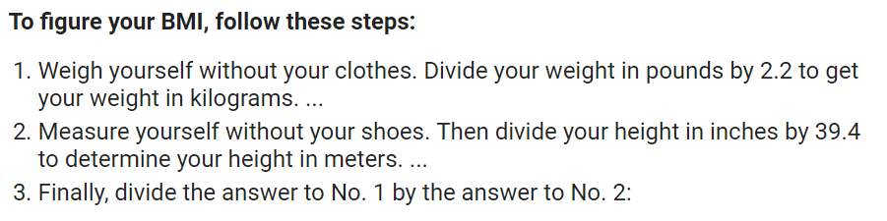
BMI Calculator Plus

Slide 10
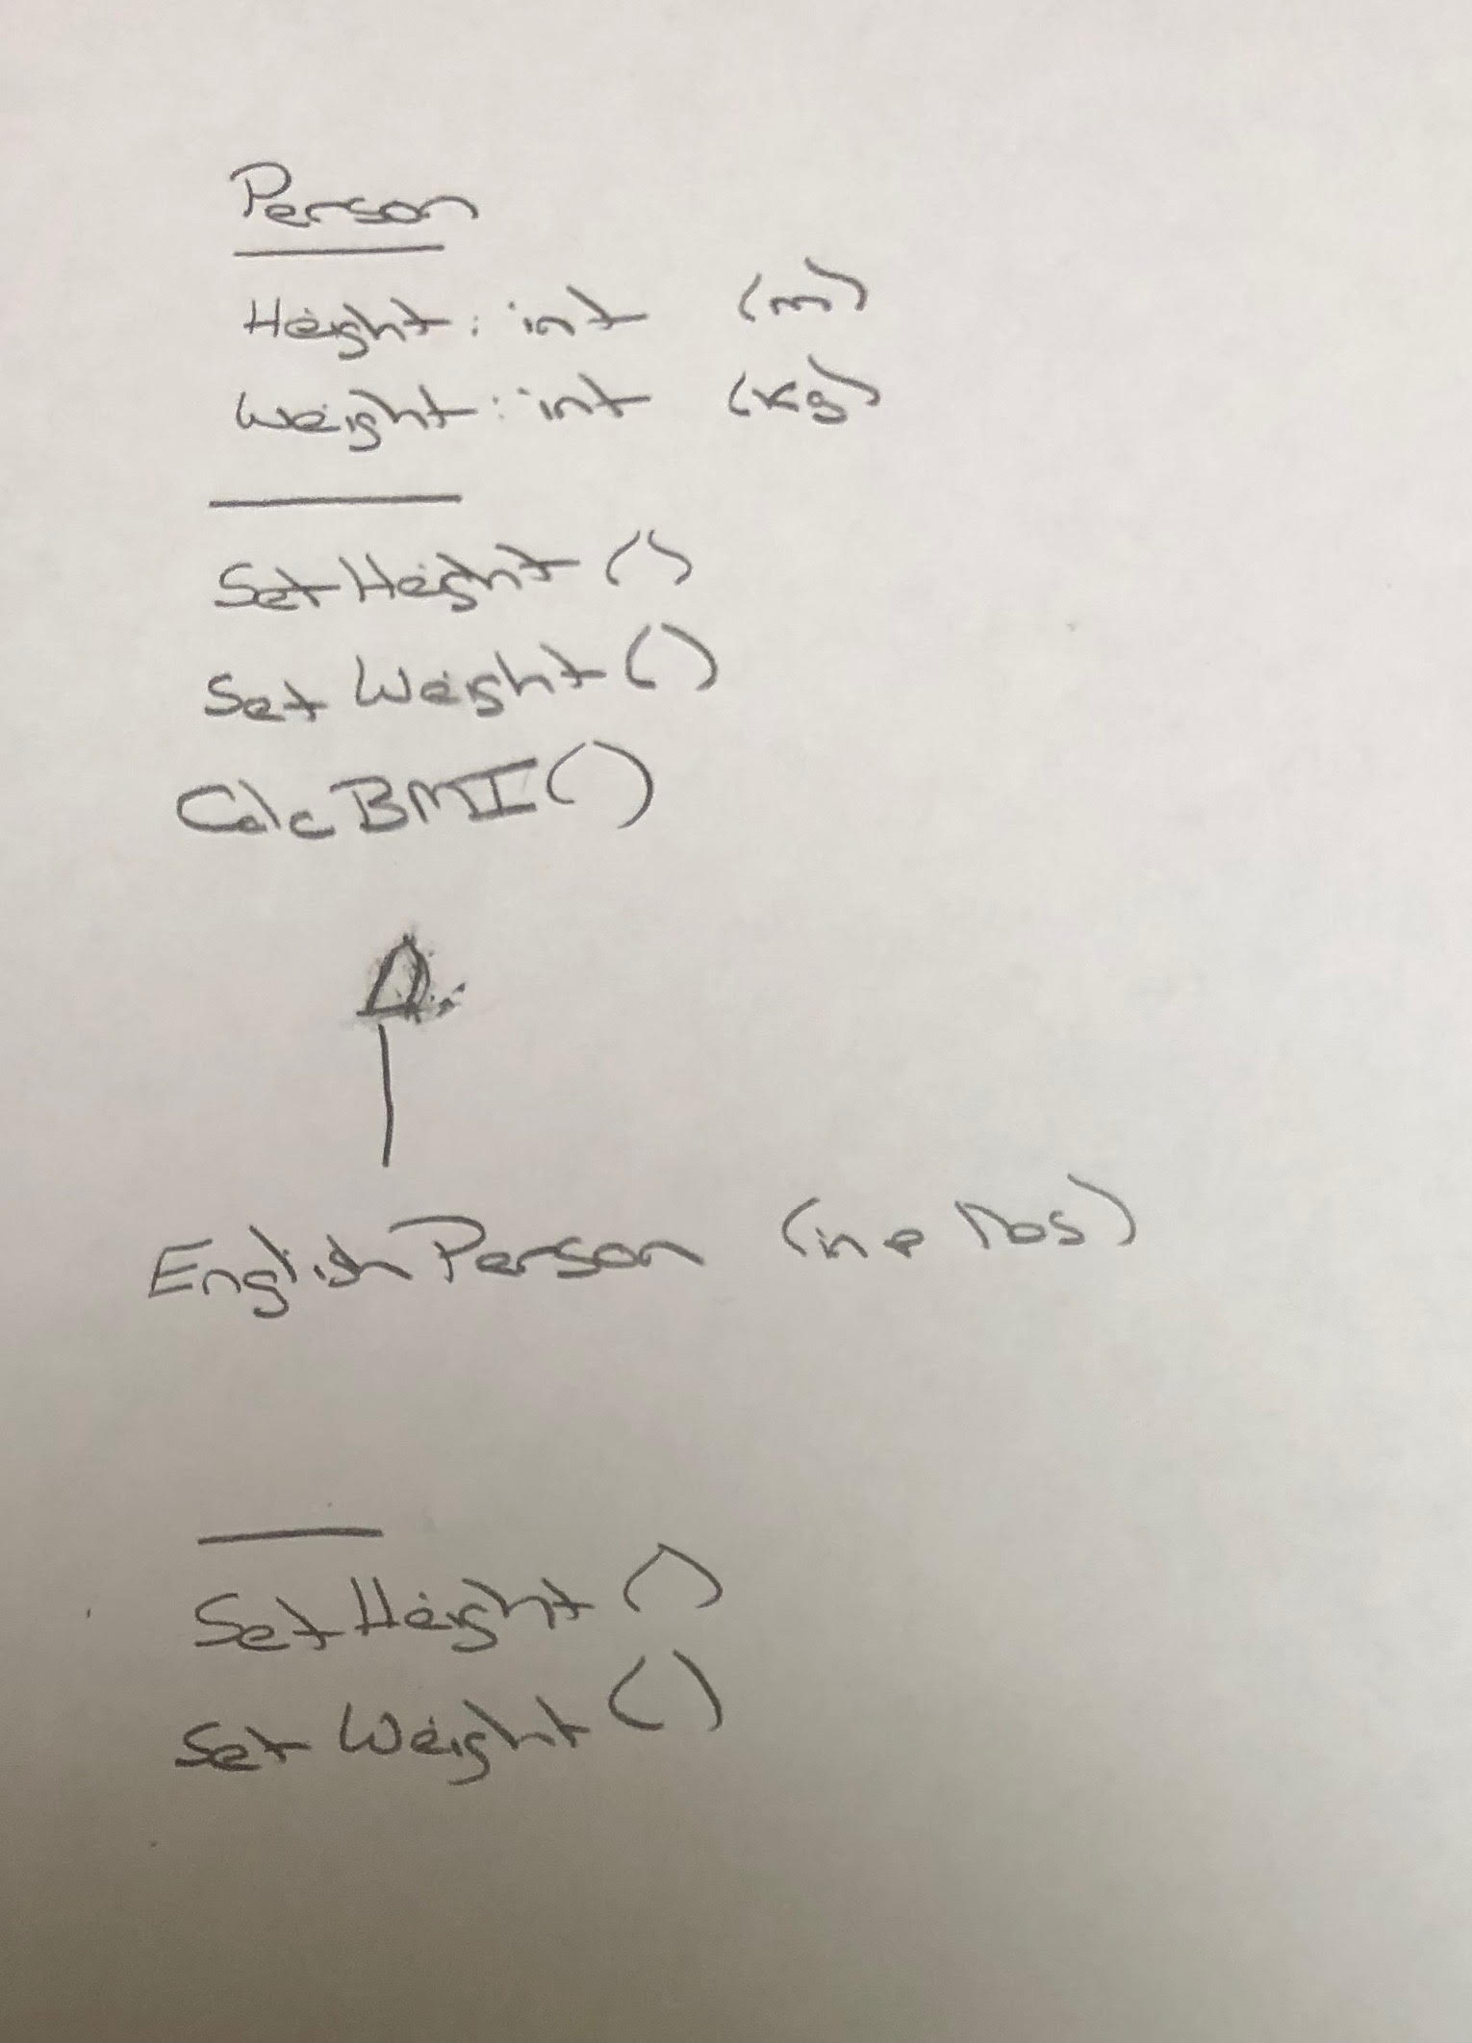
BMI Calculator Plus – UML

Slide 11
Daily Scrum and Report Out starting at 3:10
Scrum Master stand up, give your name, your team name, and briefly answer the following questions:
What did you accomplish since the last meeting?
What will you working on until the next meeting?
Is the team committed to completing the Sprint 1 assignments? All/Most/Some
What is getting in your way or keeping you from completing the assignments?

Slide 12
End of Session

