Slide 1

Object-Oriented Programming Discussion, Lecture, & Lab Eric Pogue
Agenda for Tuesday, January 29th from 2 to 315pm CST:
Friendly Conversation Topic – TypeScript
Q&A: Principles
Q&A: More Object-Oriented Programming
Discuss: UML and Phone Example (from Quiz 1)
Sprint Planning for Sprint 2
Lab
Discussion & Questions welcome at any time… please be present with no phones or email during our time together

Slide 2
TypeScript

Slide 3
Q&A: Principles

Slide 4
Q&A: More Object-Oriented Programming

Slide 5
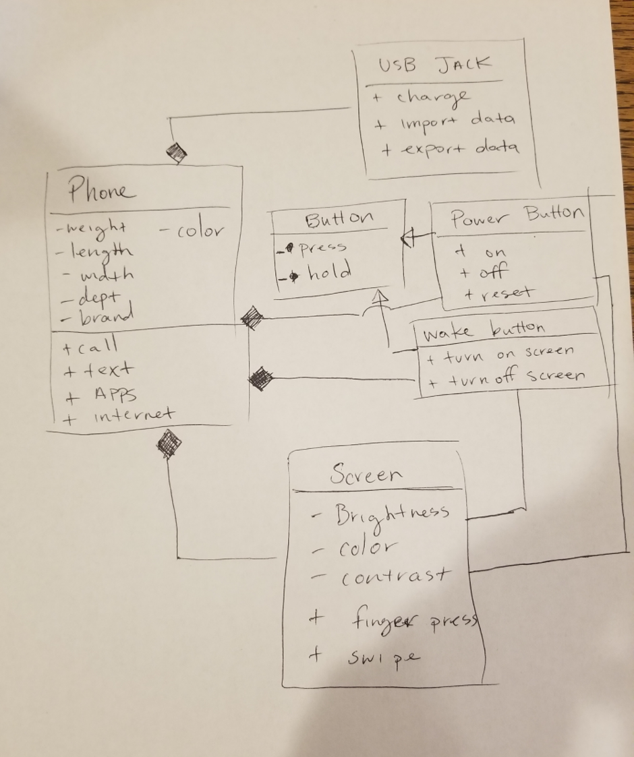
UML Phone Example

Slide 6
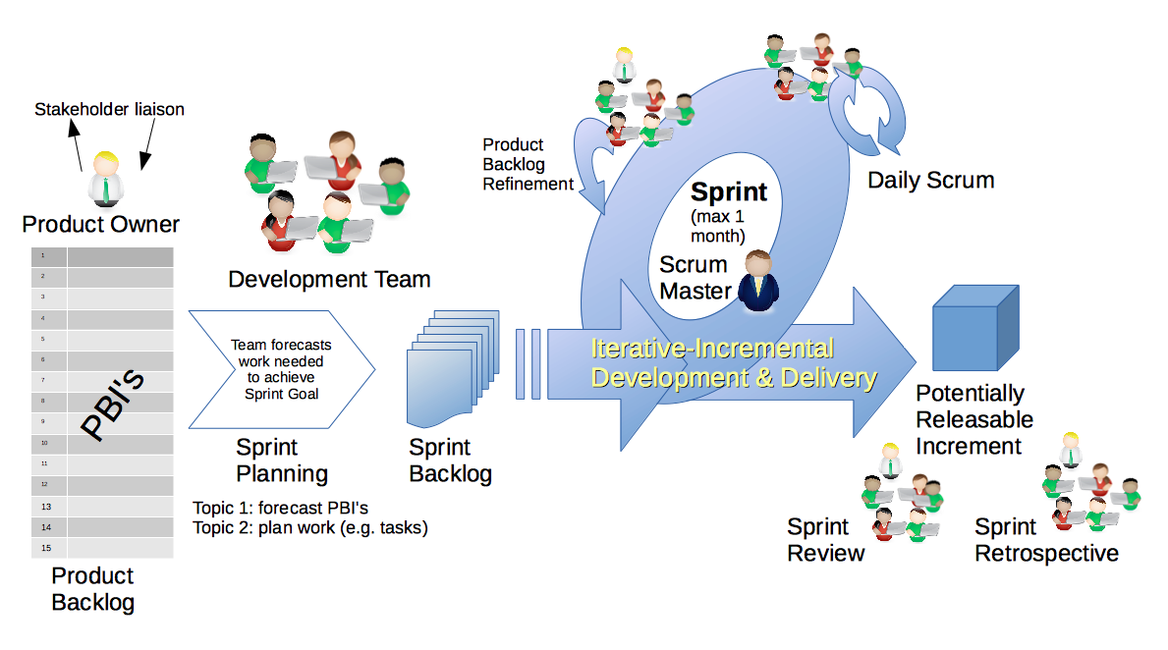
Scrum & Scrum Roles – Sprint Planning
By Dr ian mitchell - Own work, CC BY-SA 4.0, Link

Slide 7
Review Sprint 2 Activities List, Programming Assignment, and Quiz
Notes:
Optimism, good natured humor, and effectively working together is immensely important to delivering good software… and likely equally important to delivering just about any quality product
Even if you don’t intend to be a professional software developer, many of the things that we learn will be valuable in related areas.
Soooo… We have 16 weeks to learn something valuable and interesting. Let’s enjoy our time together and make the most out of it.

Slide 8
Lab
Activates:
Work with the members of your Scrum Team to:
Discussion: BMI Calculator Plus coding together from last week
As a team complete a Detailed Review of our Sprint 2 Activities List, Programming Assignment, Quiz, and Discussion Board
Daily Scrum and Report Out starting at 3:05

Slide 9
Discussion: BMI Calculator Plus

Slide 10
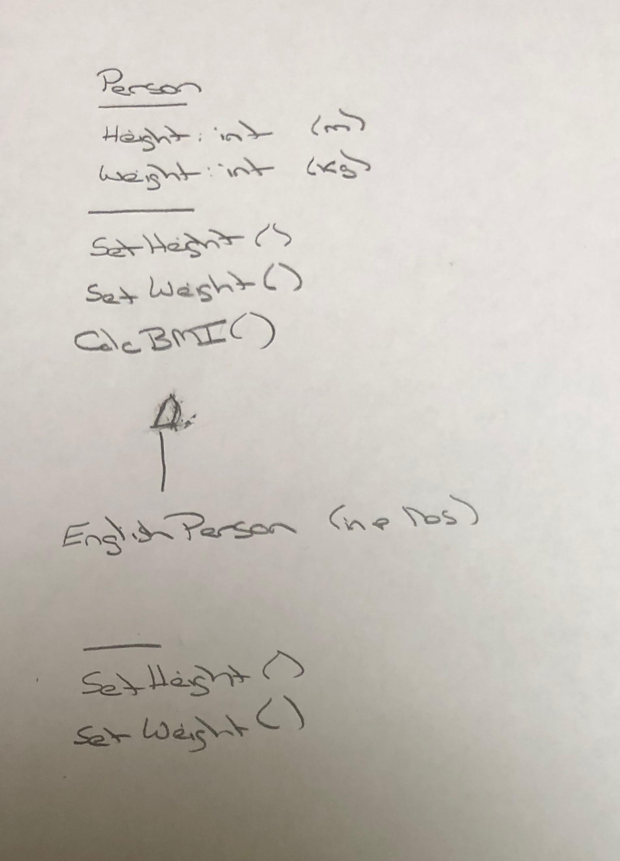
BMI Calculator Plus – UML

Slide 11
As a Team Review Sprint 2 Activities List, Programming Assignment, Quiz, and Discussion Board
Notes:
Optimism, good natured humor, and effectively working together is immensely important to delivering good software… and likely equally important to delivering just about any quality product
Even if you don’t intend to be a professional software developer, many of the things that we learn will be valuable in related areas.
Soooo… We have 16 weeks to learn something valuable and interesting. Let’s enjoy our time together and make the most out of it.

Slide 12
Daily Scrum and Report Out starting at 3:10
Scrum Master stand up, give your name, your team name, and briefly answer the following questions:
What did you accomplish since the last meeting?
What will you working on until the next meeting?
Is the team committed to completing the Sprint 1 assignments? All/Most/Some
What is getting in your way or keeping you from completing the assignments?

Slide 13
End of Session

