Slide 1

Object-Oriented Programming Discussion, Lecture, & Lab Eric Pogue
Agenda for Thursday, January 17 from 2 to 315pm CST:
Friendly Conversation Topic – Agile Manifesto
Q&A: Syllabus
Discussion: Object-Oriented Programming Concepts & Practices
Discussion: How to Be a Successful Programmer
Discussion: Scrum & Scrum Roles
Sprint 1 Planning
Lab… starting no later than 2:45
Wrap-up and Final Questions/Comments?
Discussion & Questions welcome at any time… please be present with no phones or email during our time together

Slide 2
The Agile Manifesto
“We are uncovering better ways of developing software by doing it and helping others do it. Through this work we have come to value:
Individuals and interactions over processes and tools
Working software over comprehensive documentation
Customer collaboration over contract negotiation
Responding to change over following a plan
That is, while there is value in the items on the right, we value the items on the left more.”
Notes:
This was kind of “hippy-ish” and egalitarian in its day… quite controversial in its day
“Everyone is a team member and is responsible for the work getting done”… we don’t need no titles or positions… self-organizing… we will make our own commitments… transparency (let’s share the information)… flexible/organic teams, organic architecture (minimal documentation/standards)… no contracts (let’s talk it over)
The flip side:
We will actively and voluntarily play important roles on our team
The rules (rituals) that we do have… we WILL follow
We will create, demo, and release working software/products
We will utilize practical processes, tools, documentation, and planning
When we make commitments, we will live up to those commitments… as a team (“No winners on a losing team, and no losers on a winning team”)
We will be responsive and continuously improve (Retrospectives)
We will be transparent with how WE work and share our information

Slide 3
Q&A: Syllabus Overview

Slide 4
Discussion: Object-Oriented Programming Concepts & Practices

Slide 5
Topics
Define object-oriented programming (OOP)
Review object-oriented languages, history, and adoption
Demonstrate object-oriented programming concepts
Distinguish between a class and an object
Identify the three primary (and several related) object-oriented concepts
Identify the superclass and the subclass in an inheritance relationship
Demonstrate inheritance, ownership, and abstraction with Java code
Distinguish between aggregation and composition
Recap

Slide 6
Identify the “Big Three” Object-Oriented Concepts
Encapsulation… and Information Hiding
Inheritance… and Abstraction
Polymorphism
Plus… Composition & Aggregation
Notes:
Helpful Interview Hint: Whenever you are asked a conceptual question about object-programming in an software development interview (and you will be), answer confidently “Encapsulation”, “Inheritance”, and “Polymorphism”.
When asked what is Encapsulation (or how would you implement it), say, “I would limit or minimize variable scope and keep data attributes private as often as possible.”
Now as we are going through our object-oriented examples, be thinking about how you would answer the “What is Inheritance?” and “What is Polymorphism?” interview questions. Note that answering them both with very brief examples can be very effective… and it is always best to use animals in you OOP interview examples.
Now we just need to make sure that we are able to effectively utilize these concepts after we get the job. Let’s start by walking through an example.

Slide 7
Discussion: How to Be a Successful Programmer

Slide 8
Discussion: Scrum & Scrum Roles

Slide 9
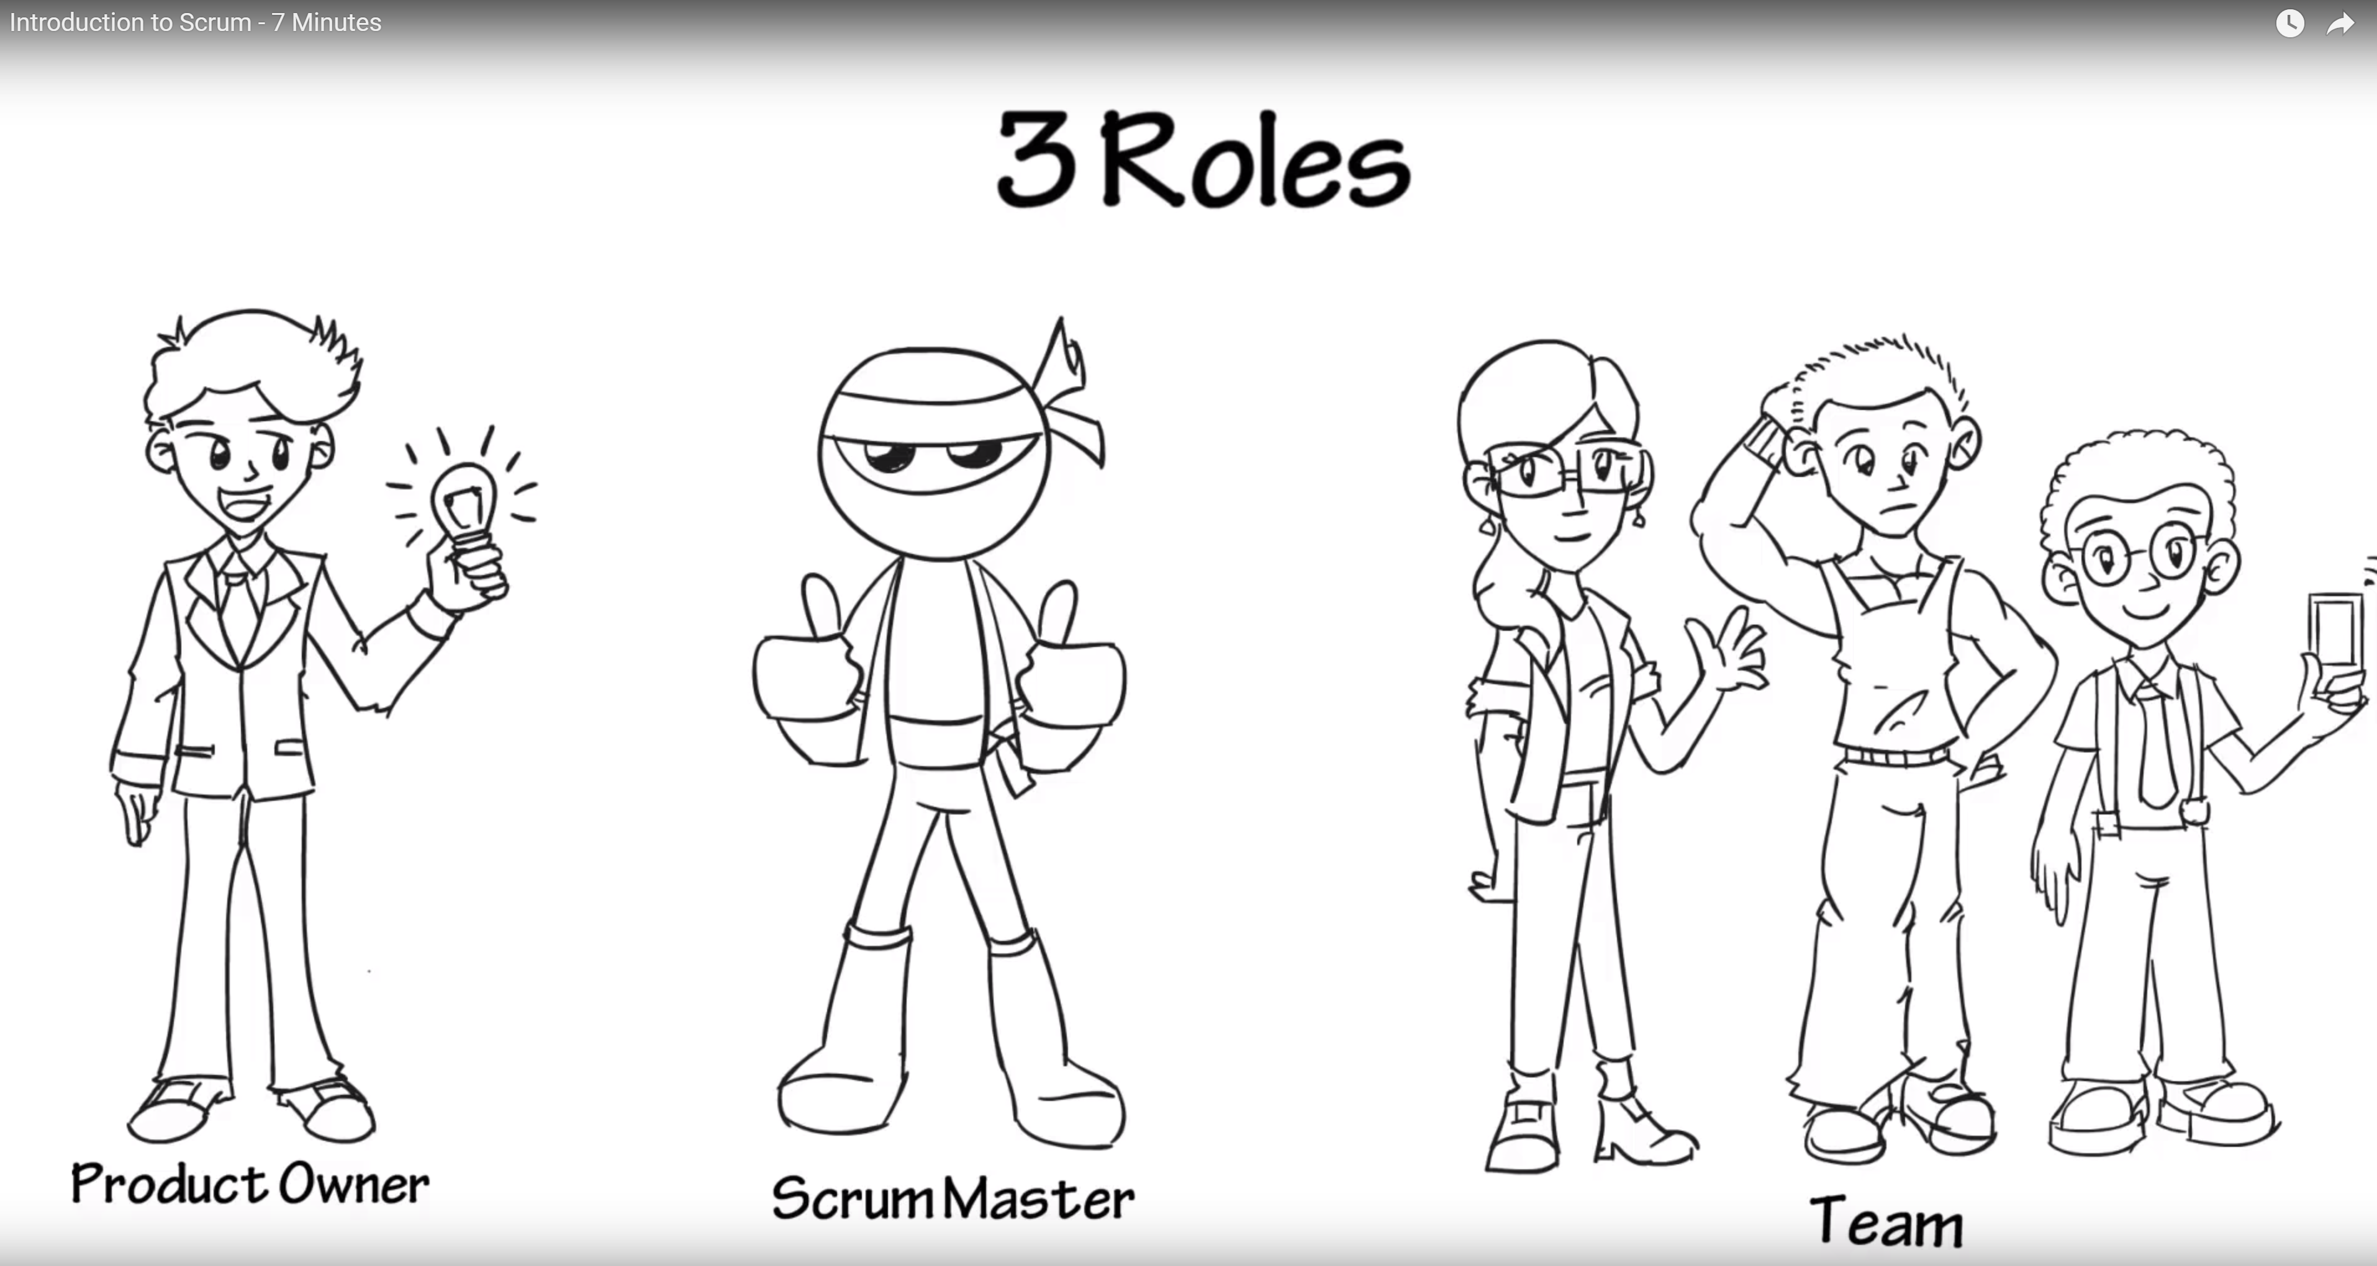
Scrum Roles from Introduction to Scrum - 7 Minutes YouTube video [link]

Slide 10
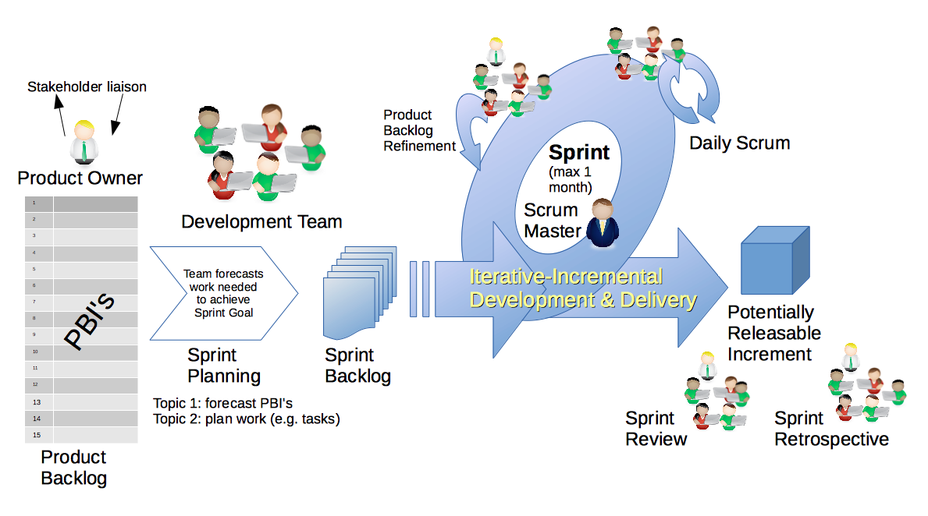
Scrum & Scrum Roles – Sprint Planning
By Dr ian mitchell - Own work, CC BY-SA 4.0, Link

Slide 11
Lab
Activates:
Split up into 4-6 person Scrum teams, identify a Scrum Master, select a adjective/noun team name (i.e. Brown Bears, Backrow Bobcats, etc.)
Make sure that the team has a mix of programming experience levels
Co-locate your team
Add your team name to your name card
Work with the members of your Scrum Team to:
Review & Verify Sprint 1 Planning Understanding and Commitment
Install and verify Java SDK
Install Visual Studio Code… or other preferred text editor
BMI Calculator Plus coding together
Daily Scrum and Report Out starting at 3:05

Slide 12
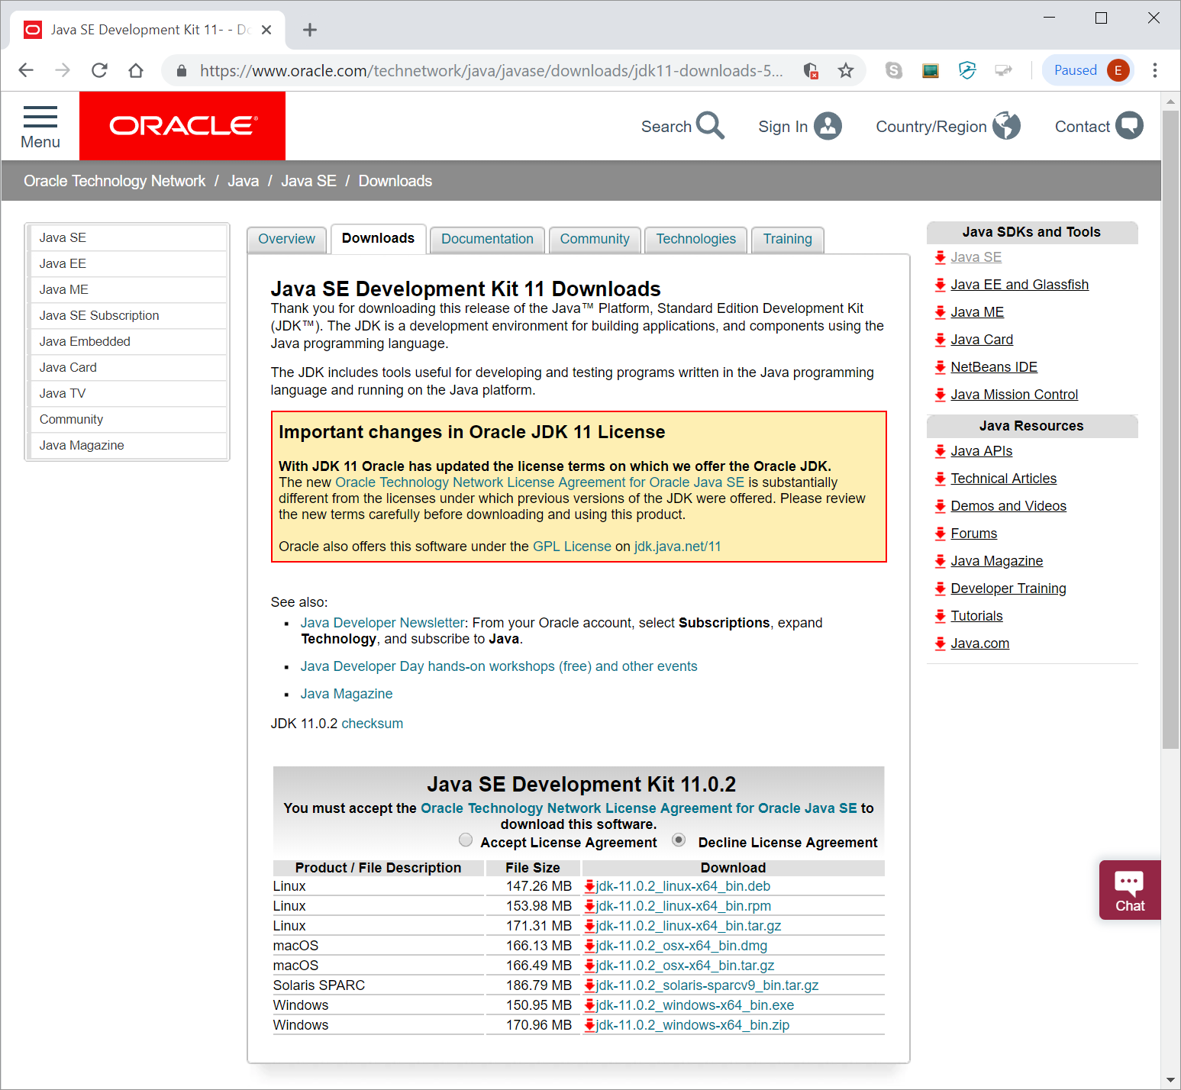
Java Development Environment Overview
Standard Java tools for this class include:
Java SE Development Kit (SDK) [link]
Text Editor (Microsoft Visual Studio Code)
Additional Tools:
Git and GitHub
Eclipse
You are welcome to use addition tools, but please don’t make your assignments dependent on those tools.
Notes:
Adding javac to path – https://www.java.com/en/download/help/path.xml

Slide 13
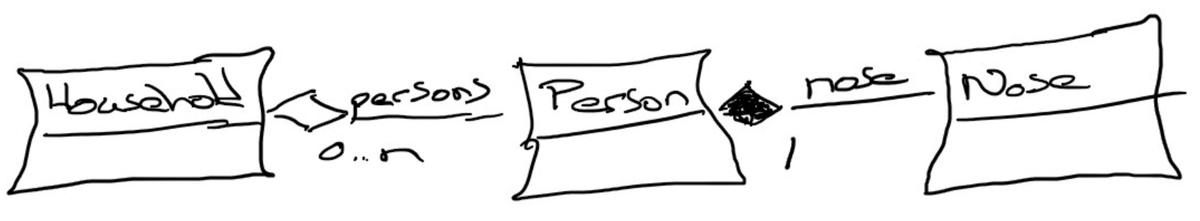
Composition & Aggregation (and UML)
Composition: A relationship where an object will not exist without the parent object. For example, it is unlikely that the “Nose” object will exist after the “Person” object is gone.
Aggregation: A relationship where multiple objects will likely continue to exist independent of each other. For example, we might have a “Household” object and a “Person” object. It would be very reasonable to expect our “Person” object to continue to exist even if our “Household” object was deleted.
Our First UML:
Notes:
Composition: An example of composition: the relationship between Face and Nose, Mouth, and Eye
class Face {
Nose n;
Mouth m;
Eye le;
Eye re;
}
We probably wouldn’t let the Nose, Mouth, or Eye objects live beyond the Face. They are owned exclusively by the Face. That’s what composition is: exclusive ownership.
One clear sign that we are dealing with composition is if the owner (Face, for example) is responsible for actually creating the objects it owns. Then, clearly, the things that are owned – the Nose, Mouth, etc. – could not have existed on their own and are therefore exclusively owned by the owner object.
Aggregation: Aggregation is also a form of ownership, but it’s non-exclusive ownership. The owned objects can live on and perhaps existed prior to the owned object.
An example of aggregation: A library patron borrows a book. That’s not exclusive ownership, since several people can borrow a book over its lifetime.
The easy way to tell if something is composition or aggregation is to ask if the owner is responsible for creating and destroying the thing that is owned. If so, it’s a composition relationship.

Slide 14
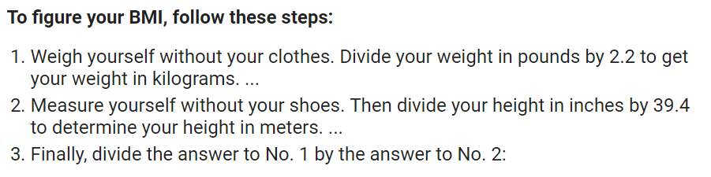
BMI Calculator Plus

Slide 15
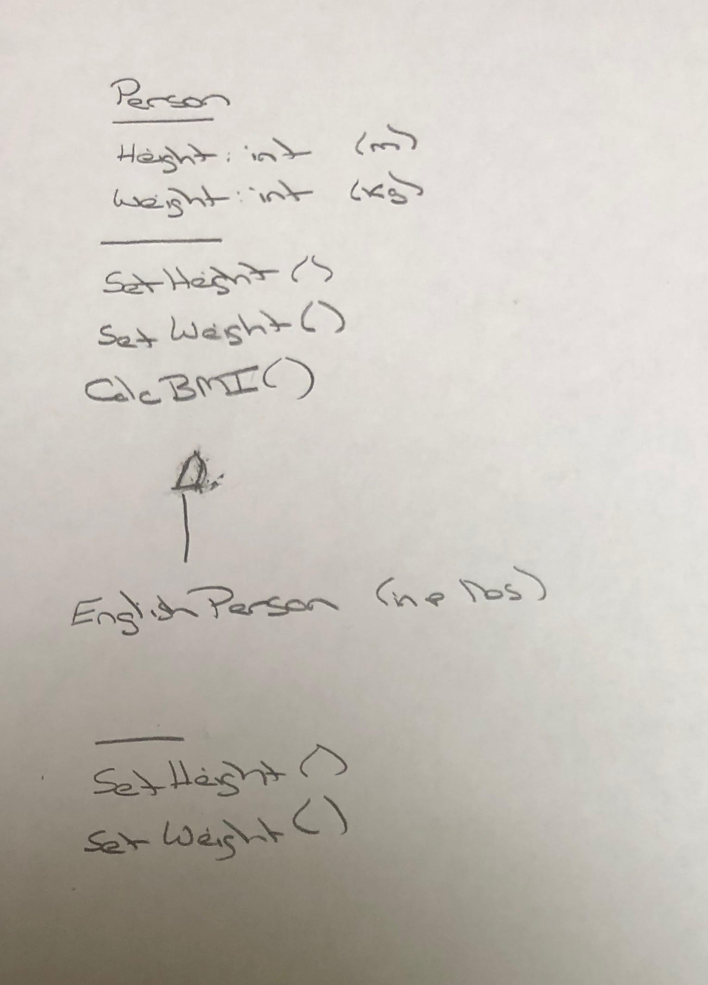
BMI Calculator Plus – UML

Slide 16
Daily Scrum and Report Out starting at 3:10
Scrum Master stand up, give your name, your team name, and briefly answer the following questions:
What did you accomplish since the last meeting?
What will you working on until the next meeting?
Is the team committed to completing the Sprint 1 assignments? All/Most/Some
What is getting in your way or keeping you from completing the assignments?

Slide 17
End of Session

