Slide 1

Object-Oriented Programming Discussion, Lecture, & Lab Eric Pogue
Agenda for Wednesday, January 16 at 12 (noon):
Welcome!
Friendly Conversation Topic… let’s make sure that everyone can hear and speak
Introductions*
Review Course Syllabus
The Agile Manifesto & Sprint Reviews
Review Weeks 1&2 (Sprint 1) Activities & Assignments
Review Select Topics… OOP Concepts, Patterns, and Principles
Lab… starting no later than 1:45
Wrap-up and Final Questions/Comments?
Discussion & Questions welcome at any time… please be present with no phones or email during our time together

Slide 2
- Verify Chat Session Open & Working - Mute Lines - Start Recording

Slide 3
Object-Oriented Programming Discussion, Lecture, & Lab Eric Pogue
Agenda for Wednesday, January 16 at 12 (noon):
Welcome!
Friendly Conversation Topic… let’s make sure that everyone can hear and speak
Introductions*
Review Course Syllabus
The Agile Manifesto & Sprint Reviews
Review Weeks 1&2 (Sprint 1) Activities & Assignments
Review Select Topics… Concepts, Patterns, and Principles
Lab… starting no later than 1:45
Wrap-up and Final Questions/Comments?
Discussion & Questions welcome at any time… please be present with no phones or email during our time together

Slide 4
This is:
Object-Oriented Programming
CPSC 24500 - LT1
And I am:
Eric Pogue
Review Welcome Announcement

Slide 5
Welcome!
This is:
Object-Oriented Programming
CPSC 24500 - LT1
And I am:
Eric Pogue
Review Welcome Announcement

Slide 6
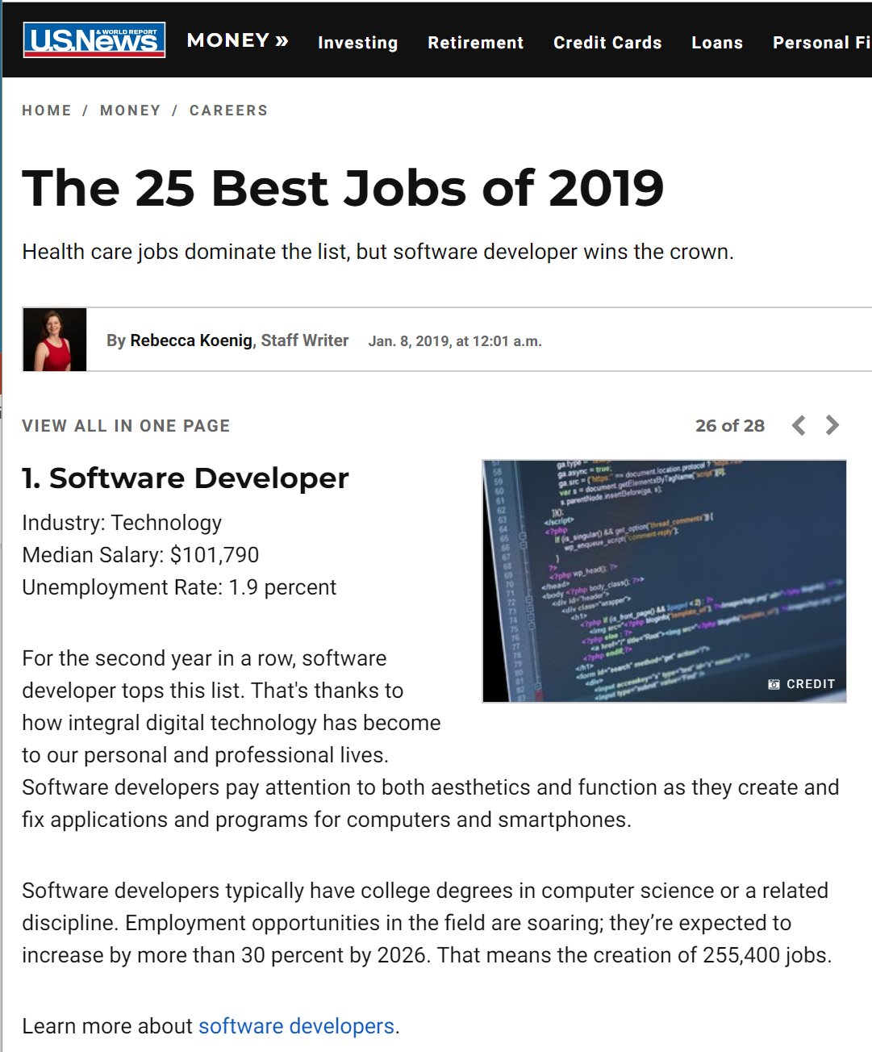
Today’s “Friendly Conversation” topic

Slide 7
Introductions – Discussion Board (DB) 1
Please use this discussion forum to introduce yourself and to learn about your classmates.
Please post a message which includes the following information:
Your Full Name / Preferred Name
A little about your Family, Home, and College background
Likely programming environment that you will be utilizing... do you have access to a Windows 10 environment?
A Hobby or Special Interest
Top two or three things you would like to get out of this class
A couple of times during the week would be most convenient for you to participate in a Live Lecture & Discussion session and/or to meet (virtually) with a small group of classmates
A Fun Fact about yourself
Please post your initial submission by the end of the day Sunday (11:59pm) and respond to one or more of your classmates' posts by the end of the day the following Sunday.
Notes:
Hand out name tags and introduction forms before Syllabus Overview

Slide 8
Introductions
Full and Preferred Name:
Eric Pogue
Eric, Mr. Pogue, or Professor
Family, Home, College background:
Married with five children, recently relocated from Davenport, IA to Chicago area
Undergraduate in CS and Masters in Business… teaching online/evening for many years
Programming experience:
Decades in the industry as a developer, architect, project manager, division manager, and vice president of various software development organizations.
Part of many teams that have delivered products to ten’s of millions of customers globally
Parsons Technology, Intuit, The Learning Company, Jasc Software, and John Deere
… and most recently working on a startup product “Stadia” with my oldest son

Slide 9
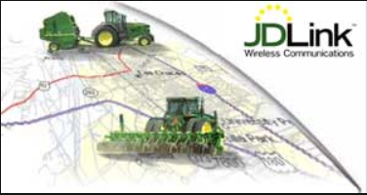

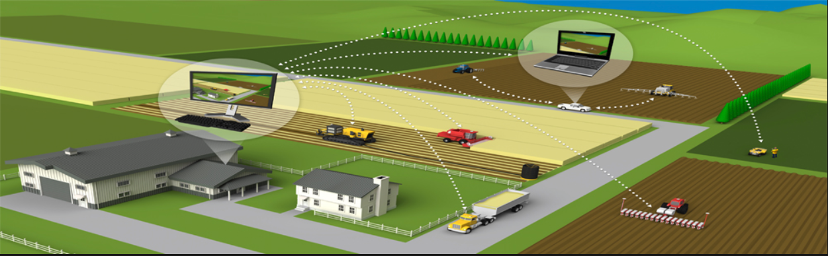



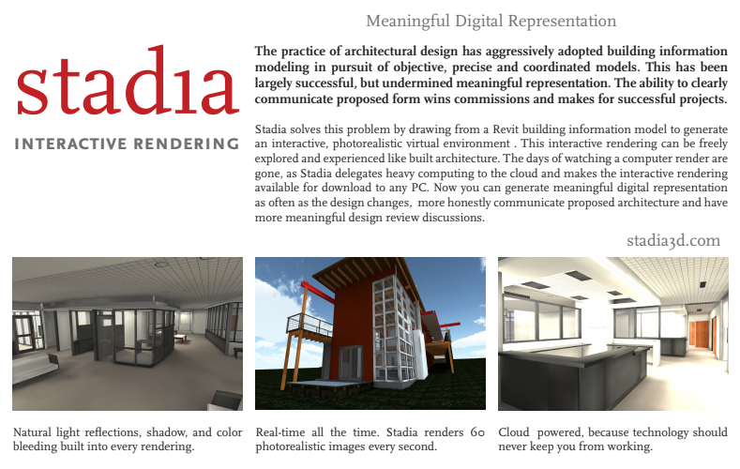

Slide 10
Welcome & Introductions
Likely programming environment
Personal Laptop, Windows 10, Chrome browser, and Visual Studio Code text editor
Hobbies:
Wilderness Canoeing & Camping (Quetico) and Triathlons
Top two or three things that you would like to get out of this class
help each of you be successful in this class
explore software development processes and techniques together and motivate you to look deeper
and for us to find a little enjoyment and fun along the way*
… oh yes, and it would be wonderful if I could help you build something that made you proud during the semester
Fun Fact:
At one point I had the very dubious “honor” or being the most traveled John Deere employee to India with 40+ trips over a 5-6 year period while setting up the 400+ person John Deere Technology Center – India application development organization.

Slide 11
Syllabus Overview

Slide 12
The Agile Manifesto
“We are uncovering better ways of developing software by doing it and helping others do it. Through this work we have come to value:
Individuals and interactions over processes and tools
Working software over comprehensive documentation
Customer collaboration over contract negotiation
Responding to change over following a plan
That is, while there is value in the items on the right, we value the items on the left more.”
Notes:
This was kind of “hippy-ish” and egalitarian in its day… quite controversial in its day
“Everyone is a team member and is responsible for the work getting done”… we don’t need no titles or positions… self-organizing… we will make our own commitments… transparency (let’s share the information)… flexible/organic teams, organic architecture (minimal documentation/standards)… no contracts (let’s talk it over)
The flip side:
We will actively and voluntarily play important roles on our team
The rules (rituals) that we do have… we WILL follow
We will create, demo, and release working software/products
We will utilize practical processes, tools, documentation, and planning
When we make commitments, we will live up to those commitments… as a team (“No winners on a losing team, and no losers on a winning team”)
We will be responsive and continuously improve (Retrospectives)
We will be transparent with how WE work and share our information

Slide 13
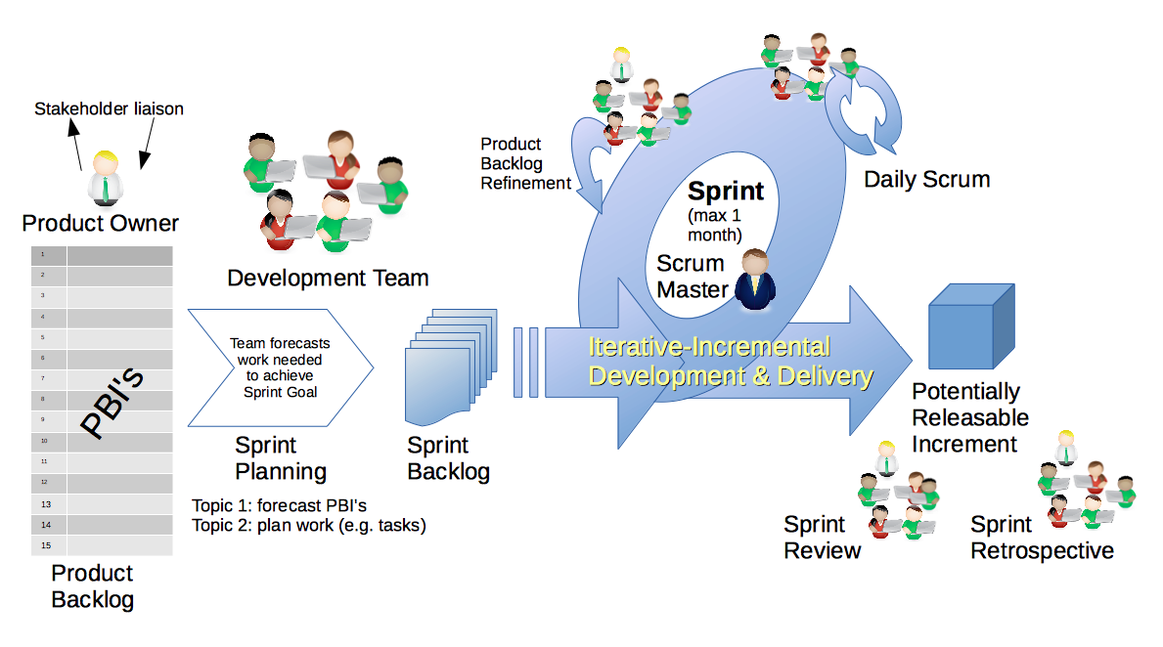
Scrum & Scrum Roles – Sprint Review
By Dr ian mitchell - Own work, CC BY-SA 4.0, Link

Slide 14
Week 1 (Sprint 1) Activities & Assignments

Slide 15
Review Selected Topics & Activities
The following topics are covered in other sessions so we will be very selective about the which portions we cover:
Java Development Environment Overview
Concepts & Practices
Patterns
Principles

Slide 16
Object-Oriented Programming Discussion, Lecture, & Lab Eric Pogue
Agenda for Tuesday, January 15 from 2 to 315pm CST:
Welcome!
Friendly Conversation Topic… let’s make sure that everyone can hear and speak
Introductions*
Review Course Syllabus
Review Weeks 1&2 (Sprint 1) Activities & Assignments
Lab… starting no later than 2:45
Wrap-up and Final Questions/Comments?
Discussion & Questions welcome at any time… please be present with no phones or email during our time together

Slide 17
Lab
Lab Activates:
Safari Books registration
Verify and/or Install Java environment
Install Visual Studio Code… or other preferred text editor
UML Design Overview
BMI Calculator Plus

Slide 18
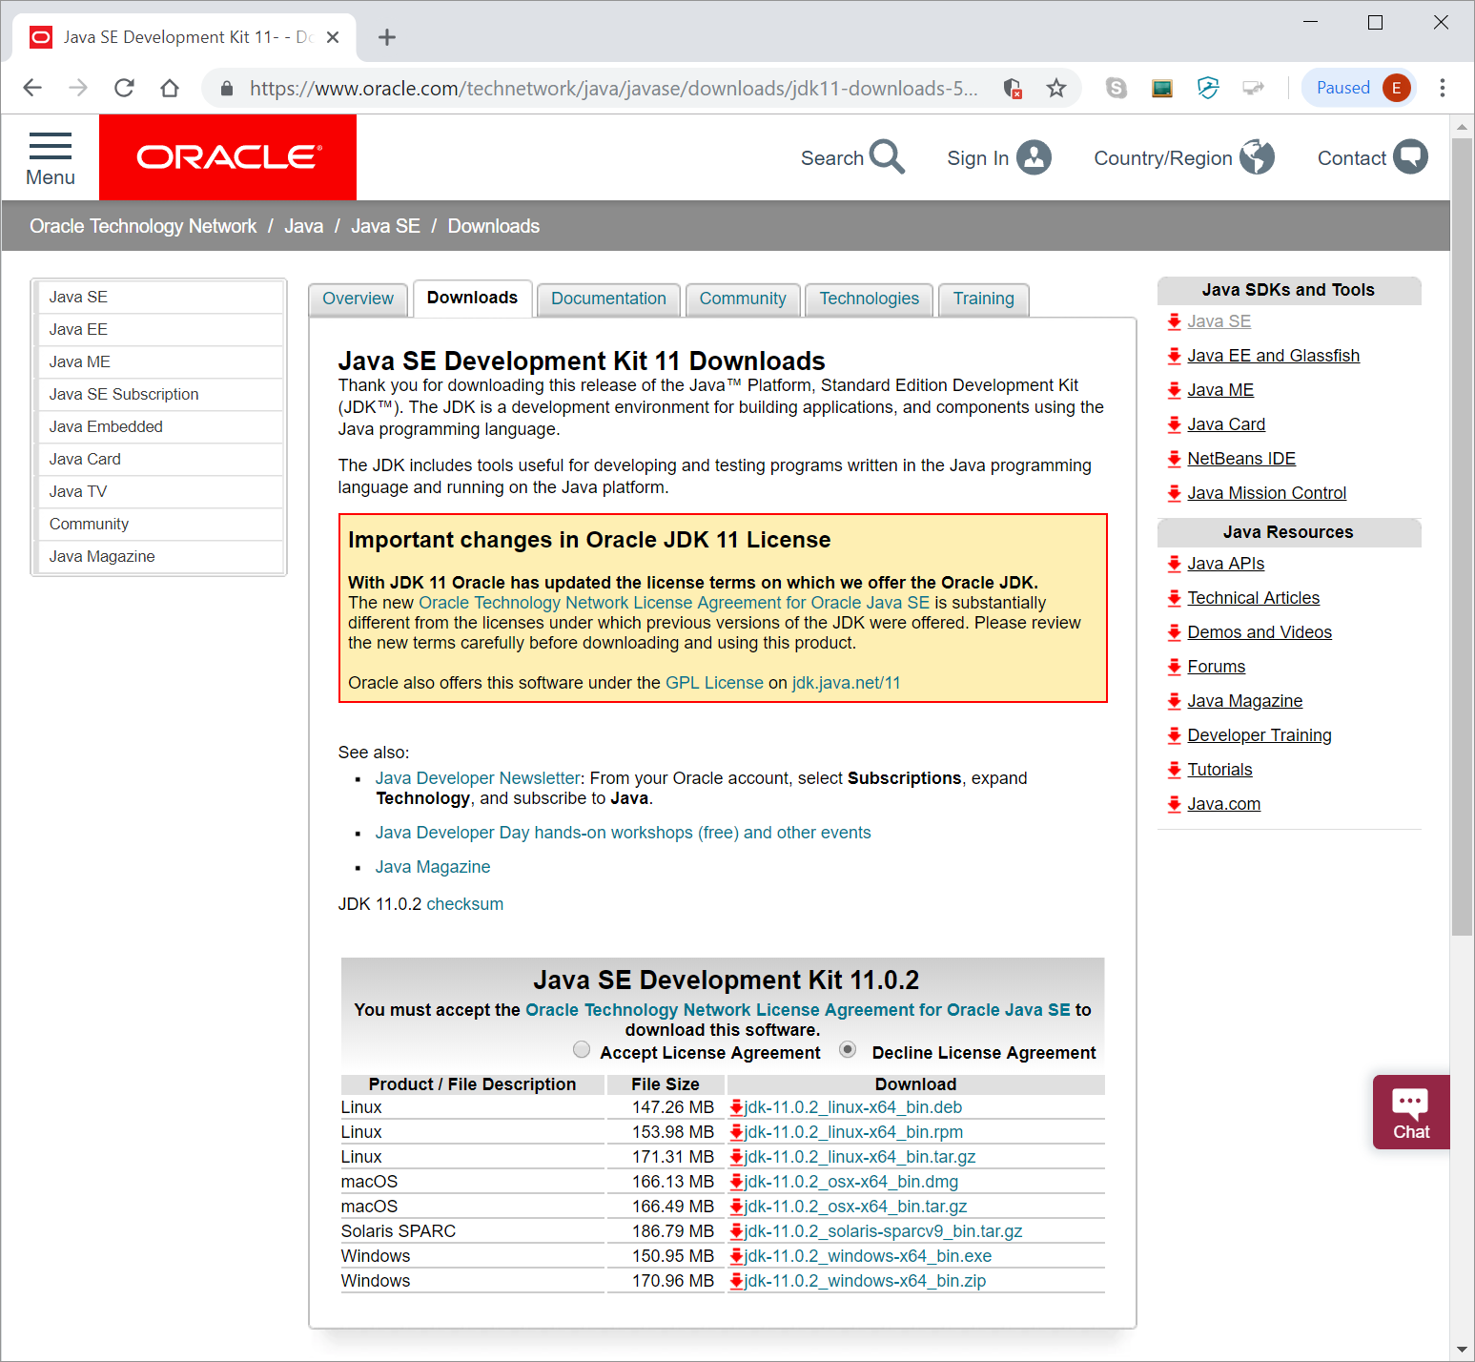
Java Development Environment Overview
Standard Java tools for this class include:
Java SE Development Kit (SDK) [link]
Text Editor (Microsoft Visual Studio Code)
Additional Tools:
Git and GitHub
Eclipse
You are welcome to use addition tools, but please don’t make your assignments dependent on those tools.
Notes:
Adding javac to path – https://www.java.com/en/download/help/path.xml

Slide 19
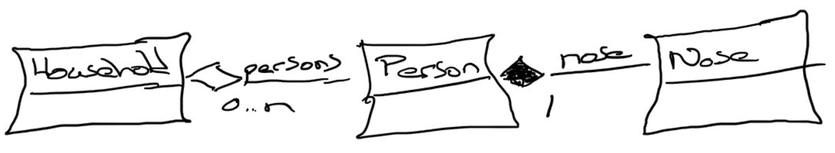
Composition & Aggregation (and UML)
Composition: A relationship where an object will not exist without the parent object. For example, it is unlikely that the “Nose” object will exist after the “Person” object is gone.
Aggregation: A relationship where multiple objects will likely continue to exist independent of each other. For example, we might have a “Household” object and a “Person” object. It would be very reasonable to expect our “Person” object to continue to exist even if our “Household” object was deleted.
Our First UML:
Notes:
Composition: An example of composition: the relationship between Face and Nose, Mouth, and Eye
class Face {
Nose n;
Mouth m;
Eye le;
Eye re;
}
We probably wouldn’t let the Nose, Mouth, or Eye objects live beyond the Face. They are owned exclusively by the Face. That’s what composition is: exclusive ownership.
One clear sign that we are dealing with composition is if the owner (Face, for example) is responsible for actually creating the objects it owns. Then, clearly, the things that are owned – the Nose, Mouth, etc. – could not have existed on their own and are therefore exclusively owned by the owner object.
Aggregation: Aggregation is also a form of ownership, but it’s non-exclusive ownership. The owned objects can live on and perhaps existed prior to the owned object.
An example of aggregation: A library patron borrows a book. That’s not exclusive ownership, since several people can borrow a book over its lifetime.
The easy way to tell if something is composition or aggregation is to ask if the owner is responsible for creating and destroying the thing that is owned. If so, it’s a composition relationship.

Slide 20
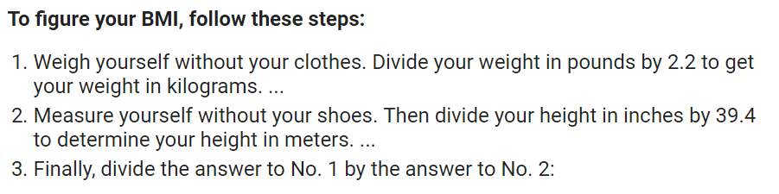
BMI Calculator Plus

Slide 21
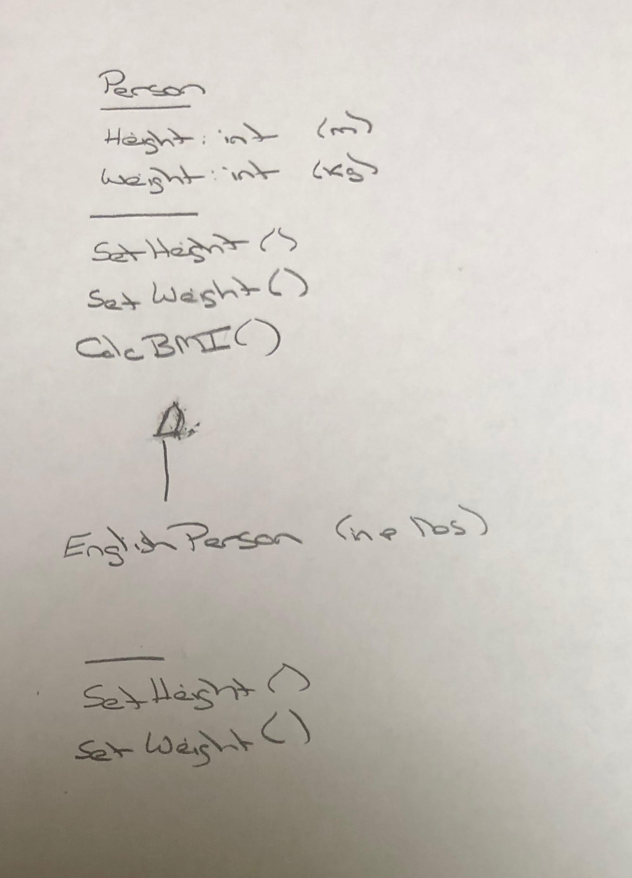
BMI Calculator Plus – UML

Slide 22
BMI Calculator Plus

Slide 23
Wrap-up and Final Questions/Comments

Slide 24
End of Session

