Slide 1

Object-Oriented Programming Discussion, Lecture, & Lab Eric Pogue
Agenda for Sprint 4 Discussion, Lecture, and Lab:
Discuss Quiz 3 Review
Review Learning Objectives
Complete Sprint 4 Planning
Review Files & JSON
Lab
Final Questions/Comments
Discussion & Questions welcome at any time… please be present with no phones or email during our time together

Slide 2
Recorded Sessions
Checklist for recorded sessions:
Verify recorded screen resolution of 1080p (1920x1080)
Verify chat session open & working
Optionally mute lines to eliminate background noise
Start recording
Remember to stop recording before exiting session
Notes:
Some people would say that binary files include all files, and that text files are just binary files that are being interpreted in a specific way.

Slide 3
Object-Oriented Programming Discussion, Lecture, & Lab Eric Pogue
Agenda for Sprint 4 Discussion, Lecture, and Lab:
Discuss Quiz 3 Review
Review Learning Objectives
Complete Sprint 4 Planning
Review Files & JSON
Lab
Final Questions/Comments
Discussion & Questions welcome at any time… please be present with no phones or email during our time together

Slide 4
Discuss Quiz 3 Review

Slide 5
Learning Objectives
By the end of this sprint we will be able to:
Develop graphical interactive Java applications utilizing listeners
Describe how to develop interactive command-line Java applications utilizing Scanner
Describe different types of binary and text files
Develop Java applications that read and write files including JSON files
Understand JavaDoc and how it can create self-documenting source code
Notes:
Some people would say that binary files include all files, and that text files are just binary files that are being interpreted in a specific way.

Slide 6
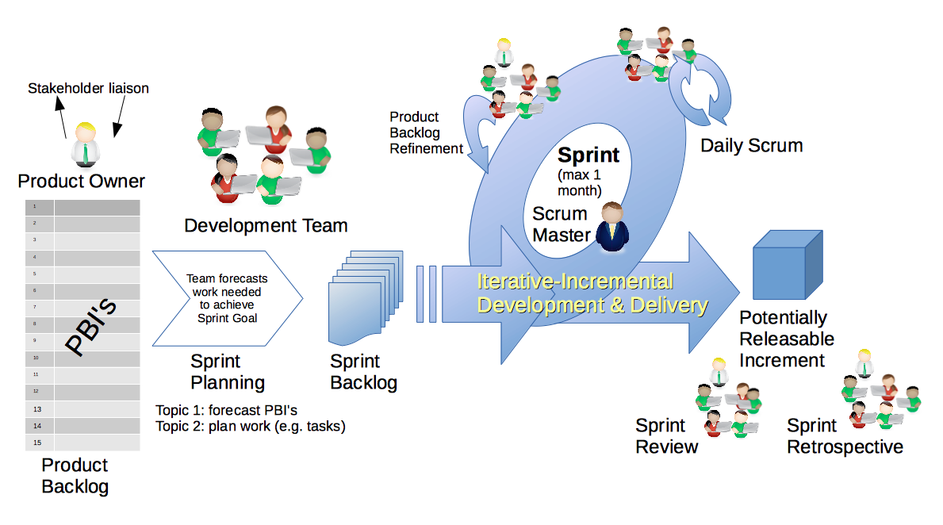
Scrum Process & Roles – Sprint Planning
By Dr ian mitchell - Own work, CC BY-SA 4.0, Link

Slide 7
Sprint Planning
Review:
Activities List
Programming Assignment
Quiz
Discussion Board
Notes:
Some people would say that binary files include all files, and that text files are just binary files that are being interpreted in a specific way.

Slide 8
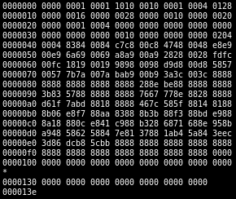
Binary Files
A binary file is a computer file that is not a text file. The term "binary file" is often used as a term meaning "non-text file". The can be open or closed formats that are generally:
Fast, small, and efficient*
Often not very portable across applications and platforms
Difficult to maintain backward compatibility
Notes:
Some people would say that binary files include all files, and that text files are just binary files that are being interpreted in a specific way.

Slide 9
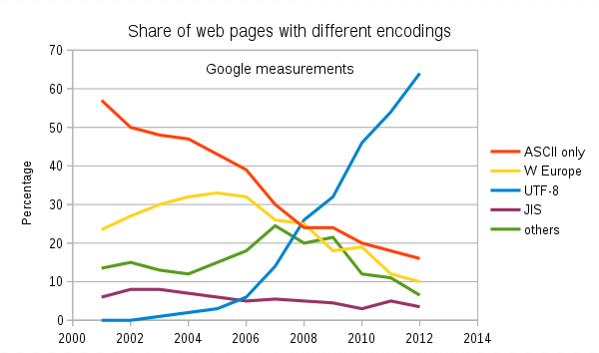
Text File Encoding Standards
ASCII
Unicode
UTF-8
Others

Slide 10
Text File End-Of-Line (EOL) and Encoding
Industry adoption of end-of-line encoding includes:
Windows: Both Carriage Return (CR, \r, 0x0d) and Line Feed (LF, \n, 0x0a) together.
Unix/Linux/OSX: Just Line Feed (LF, \n, 0x0a)
Mac (pre-OSX): Just Carriage Return (CR, \r, 0x0d)
Article on Windows Notepad supporting non-Windows EOF conventions [link]

Slide 11
Special Types of Text Files
Most programming is made up of different types of Text Files including:
HTML
CSS
JavaScript… and other coding languages
XML
JSON

Slide 12
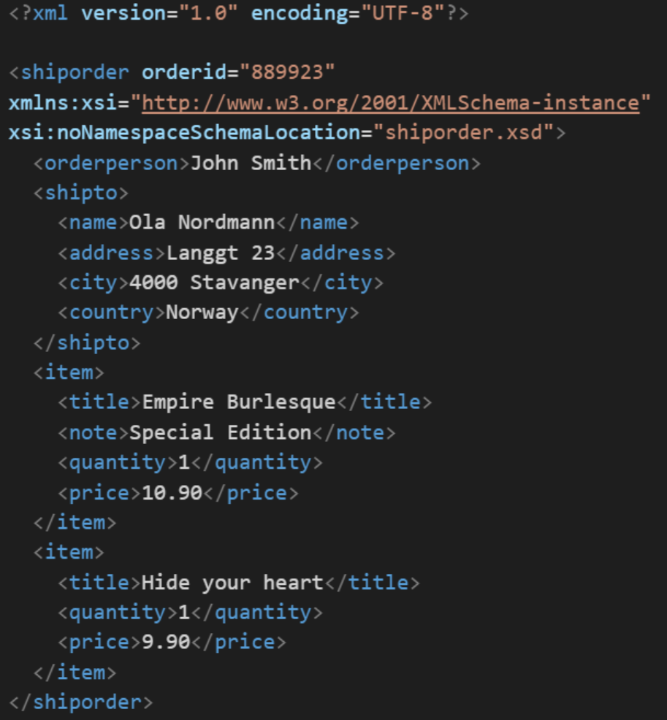
XML Example
In computing, XML (Extensible Markup Language) is a markup language that defines a set of rules for encoding documents in a format that is both human-readable and machine-readable. It is an open standard that:
Supports nearly all development languages and platforms
Allows us to cross between many applications
Can result in large files
Supports schema to validate data directly

Slide 13
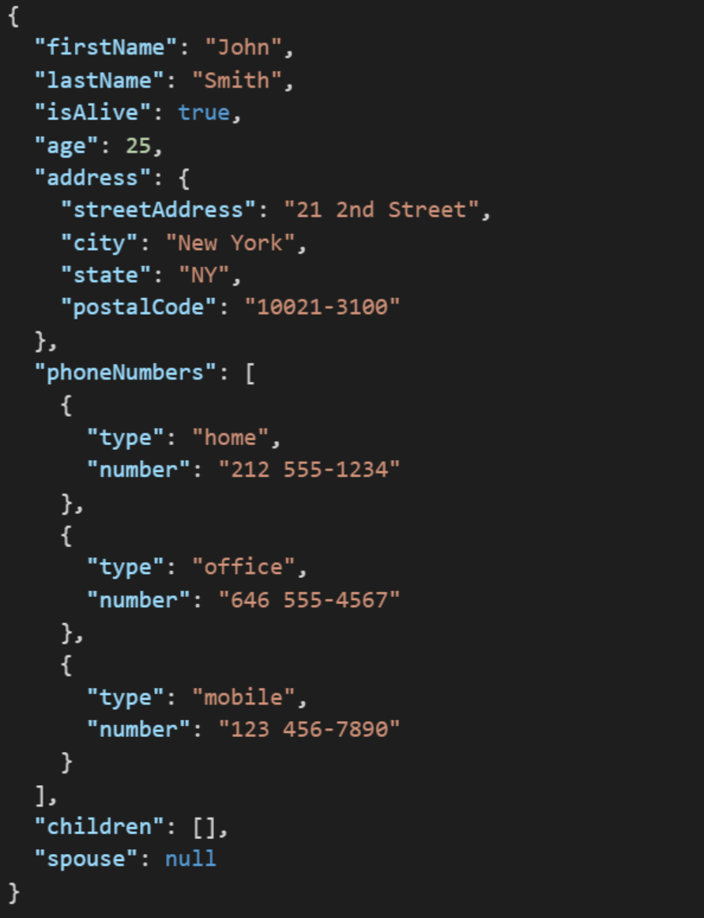
JSON Example
JSON (JavaScript Object Notation) is a lightweight data-interchange format. It is easy for humans to read and write. It is easy for machines to parse and generate. It is an open standard that:
Supports nearly all development languages and platforms
Allows us to cross between many applications
Can result in large files
Notes:
JSON is an open-standard format that uses human-readable text to transmit data objects consisting of attribute–value pairs. It is a very common data format used for asynchronous browser/server communication, including as a replacement for XML in some web service style systems.

Slide 14
Lab

Slide 15
Tutorial Expectations
After completing each tutorial you should:
Understand the code introduced during the tutorial
Write your own application from scratch during the tutorial… do not copy/past this tutorial code
Start with a “blank sheet of paper” when you develop your programming assignment for this sprint

Slide 16
Lab
In today’s lab we will:
Review “OvalDrawPlus with ActionListeners” code which is in the “ShapeDraw” folder
Review the “OvalDrawPlus with Menus & Colors” code which is in the “ShapeDrawPlus” folder
Complete the “OvalDrawPlus with ActionListeners” tutorial
Note you should have completed “MosaicLite” already and that you still need to complete “OvalDrawPlus with Menus & Colors”

Slide 17
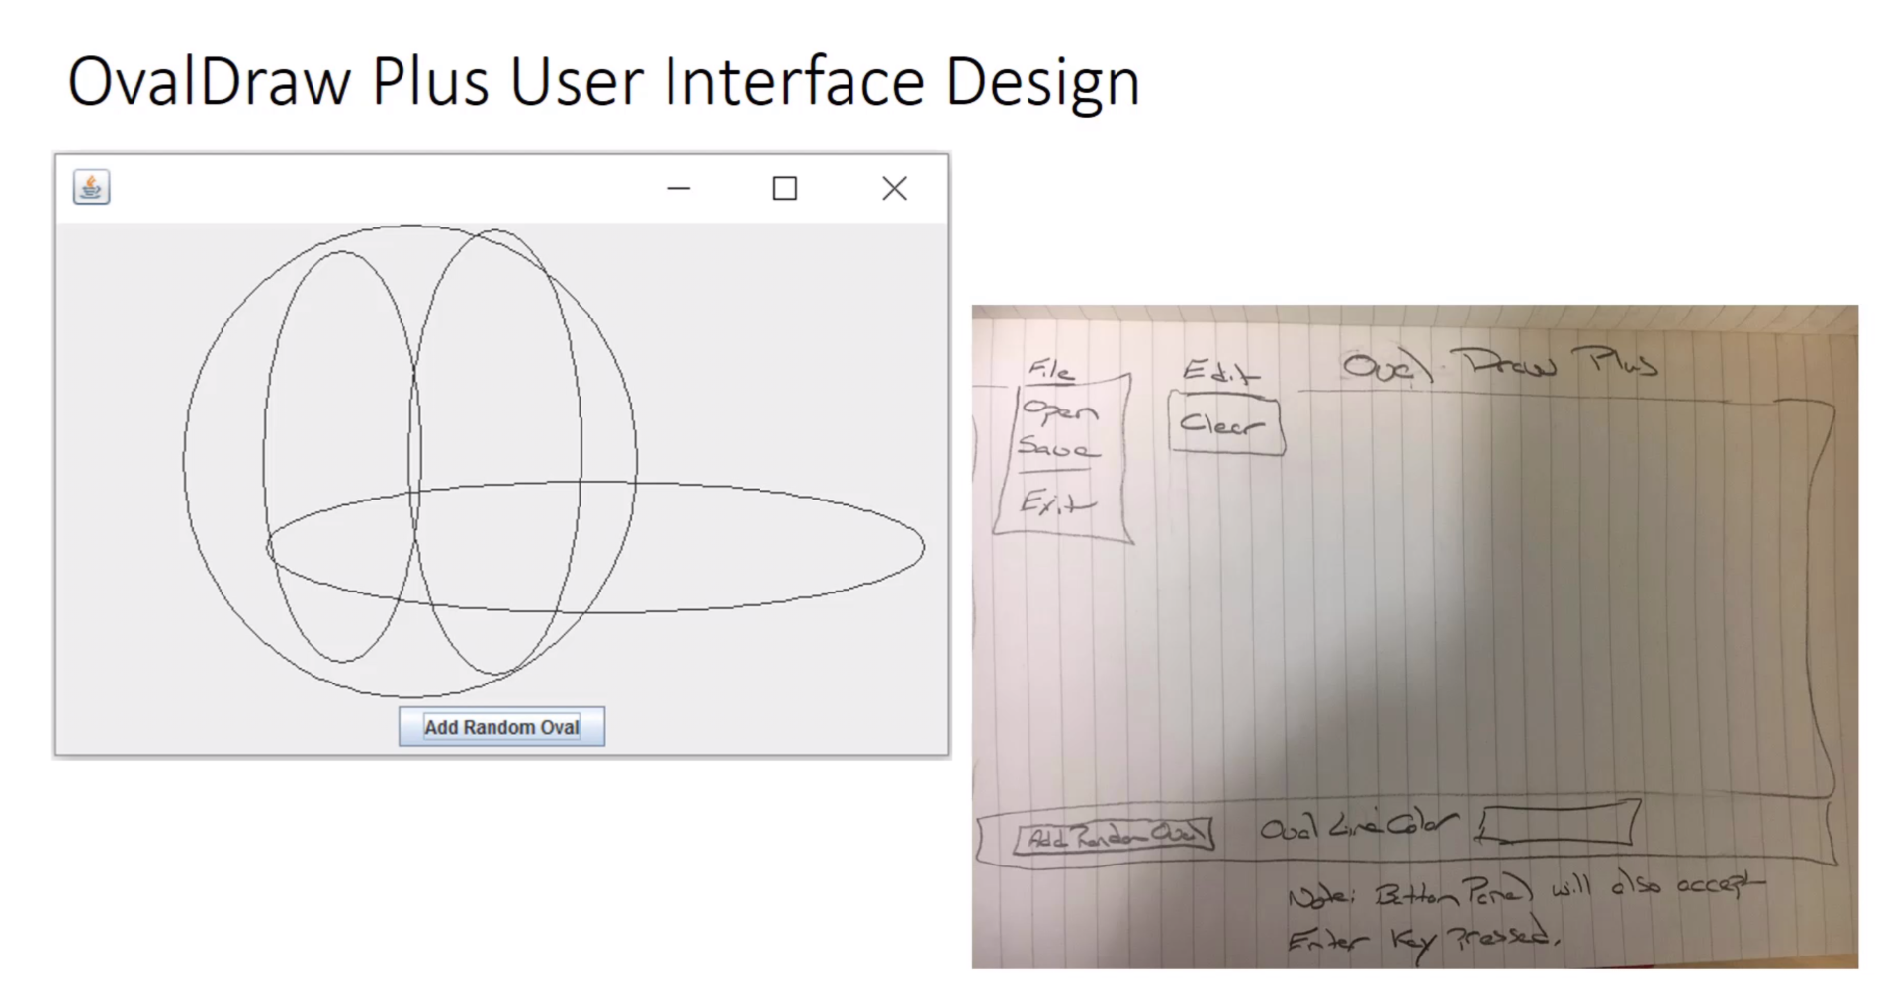
Review “OvalDrawPlus with ActionListeners” code

Slide 18
Review the “OvalDrawPlus with Menus & Colors” Code

Slide 19
Complete the “OvalDrawPlus with ActionListeners” tutorial [link]

Slide 20
Compete MosaicLite Tutorial… If you have not completed it already

Slide 21
End of Session

