Slide 1

Object-Oriented Programming Discussion, Lecture, & Lab Eric Pogue
Agenda for Wednesday, January 16 at 12 (noon):
Welcome!
Friendly Conversation Topic… let’s make sure that everyone can hear and speak
Introductions*
Review Course Syllabus
Review Weeks 1&2 (Sprint 1) Activities & Assignments
Review Select Topics
Lab… starting no later than 1:45
Wrap-up and Final Questions/Comments?
Discussion & Questions welcome at any time… please be present with no phones or email during our time together

Slide 2
Welcome!
This is:
Object-Oriented Programming
CPSC 24500 - LT1
And I am:
Eric Pogue
Review Welcome Announcement

Slide 3
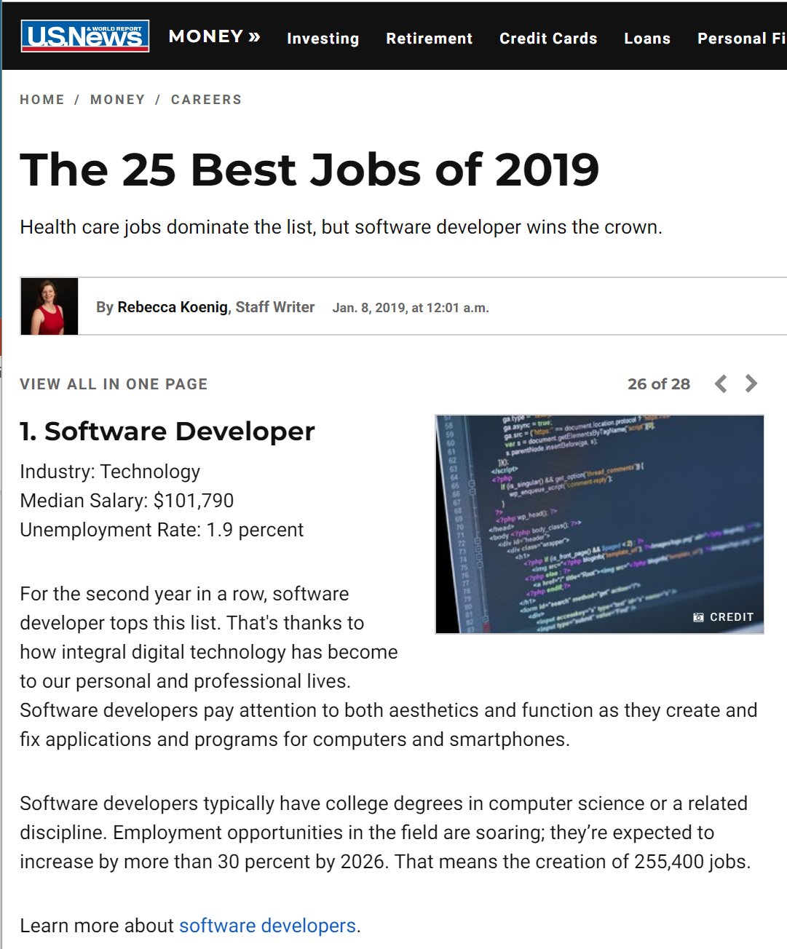
Today’s “Friendly Conversation” topic

Slide 4
Introductions – Discussion Board (DB) 1
Please use this discussion forum to introduce yourself and to learn about your classmates.
Please post a message which includes the following information:
Your Full Name / Preferred Name
A little about your Family, Home, and College background
Likely programming environment that you will be utilizing... do you have access to a Windows 10 environment?
A Hobby or Special Interest
Top two or three things you would like to get out of this class
A couple of times during the week would be most convenient for you to participate in a Live Lecture & Discussion session and/or to meet (virtually) with a small group of classmates
A Fun Fact about yourself
Please post your initial submission by the end of the day Sunday (11:59pm) and respond to one or more of your classmates' posts by the end of the day the following Sunday.
Notes:
Hand out name tags and introduction forms before Syllabus Overview

Slide 5
Introductions
Full and Preferred Name:
Eric Pogue
Eric, Mr. Pogue, or Professor
Family, Home, College background:
Married with five children, recently relocated from Davenport, IA to Chicago area
Undergraduate in CS and Masters in Business… teaching online/evening for many years
Programming experience:
Decades in the industry as a developer, architect, project manager, division manager, and vice president of various software development organizations.
Part of many teams that have delivered products to ten’s of millions of customers globally
Parsons Technology, Intuit, The Learning Company, Jasc Software, and John Deere
… and most recently working on a startup product “Stadia” with my oldest son

Slide 6


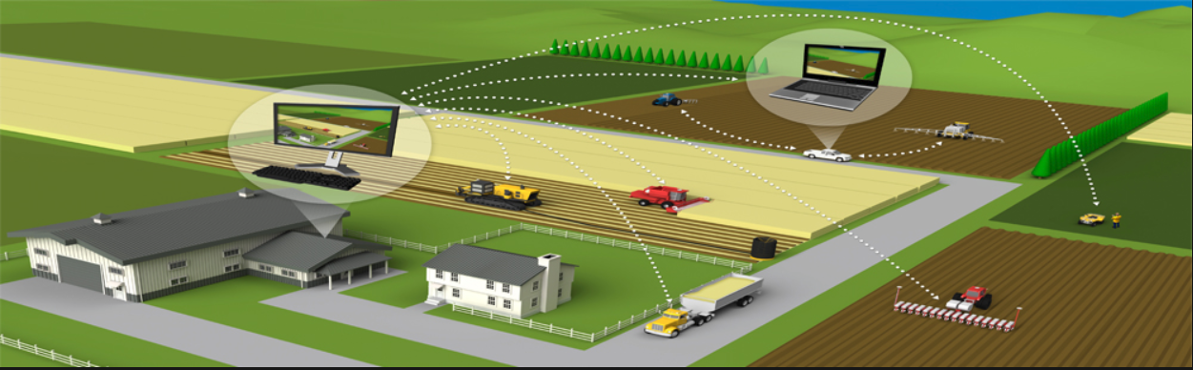



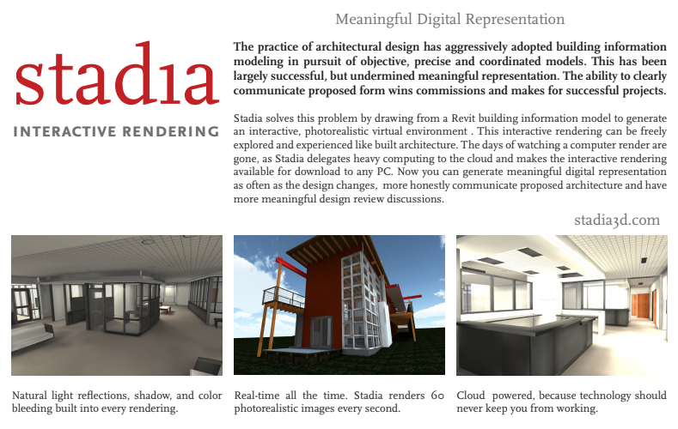

Slide 7
Welcome & Introductions
Likely programming environment
Personal Laptop, Windows 10, Chrome browser, and Visual Studio Code text editor
Hobbies:
Wilderness Canoeing & Camping (Quetico) and Triathlons
Top two or three things that you would like to get out of this class
help each of you be successful in this class
explore software development processes and techniques together and motivate you to look deeper
and for us to find a little enjoyment and fun along the way*
… oh yes, and it would be wonderful if I could help you build something that made you proud during the semester
Fun Fact:
At one point I had the very dubious “honor” or being the most traveled John Deere employee to India with 40+ trips over a 5-6 year period while setting up the 400+ person John Deere Technology Center – India application development organization.

Slide 8
Syllabus Overview

Slide 9
Weeks 1&2 (Sprint 1) Activities & Assignments

Slide 10
Object-Oriented Programming Discussion, Lecture, & Lab Eric Pogue
Agenda for Tuesday, January 15 from 2 to 315pm CST:
Welcome!
Friendly Conversation Topic… let’s make sure that everyone can hear and speak
Introductions*
Review Course Syllabus
Review Weeks 1&2 (Sprint 1) Activities & Assignments
Lab… starting no later than 2:45
Wrap-up and Final Questions/Comments?
Discussion & Questions welcome at any time… please be present with no phones or email during our time together

Slide 11
Lab
Lab Activates:
Your turn for Introductions
Safari Books registration
Verify and/or Install Java environment
Install Visual Studio Code… or other preferred text editor
Hello World or BMI Calculator coding together

Slide 12
Start Here to Edit

Slide 13
Wrap-up and Final Questions/Comments

Slide 14
End of Session

Slide 15
Object-Oriented Programming Discussion & Lecture Eric Pogue
Agenda for 14 Mar 18 from 12 to 2:30pm CST:
Welcome
Friendly Conversation & Good Natured Banter… let’s make sure that everyone can hear and speak in the virtual Join.me meeting
Introductions*
Review Course Syllabus
Your turn for Introductions
Review Week 1 Activities & Assignment
Review Selected Topics & Activities
Lab Time plus Q&A starting no later than 1:45pm
Wrap-up and Final Questions/Comments?
Discussion & Questions welcome at any time… please be present with no phones or email during our discussion time
Notes:
*Your opportunity to give introductions will come after the syllabus overview.
I would like to start our Lab time around 1:45 today… please help me keep us on track.
We will optionally take a 10 minute break at some point.

Slide 16
Welcome
This is:
Object-Oriented Programming
Wednesday 12(noon) to 2:30pm CST… live Discussion & Lecture
Virtual
And I am:
Eric Pogue
Review Welcome Letter**

Slide 17
Today’s “Friendly Conversation” topic
The Agile Manifesto
“We are uncovering better ways of developing software by doing it and helping others do it. Through this work we have come to value:
Individuals and interactions over processes and tools
Working software over comprehensive documentation
Customer collaboration over contract negotiation
Responding to change over following a plan
That is, while there is value in the items on the right, we value the items on the left more.”
Notes:
This was kind of “hippy-ish” and egalitarian in its day… quite controversial in its day
“Everyone is a team member and is responsible for the work getting done”… we don’t need no titles or positions… self-organizing… we will make our own commitments… transparency (let’s share the information)… flexible/organic teams, organic architecture (minimal documentation/standards)… no contracts (let’s talk it over)
The flip side:
We will actively and voluntarily play important roles on our team
The rules (rituals) that we do have… we WILL follow
We will create, demo, and release working software/products
We will utilize practical processes, tools, documentation, and planning
When we make commitments, we will live up to those commitments… as a team (“No winners on a losing team, and no losers on a winning team”)
We will be responsive and continuously improve (Retrospectives)
We will be transparent with how WE work and share our information

Slide 18
Introductions
Please use this discussion forum to introduce yourself and to learn about your classmates.
Please post a message which includes the following information:
Your Full Name / Preferred Name
A little about your Family, Home, and College background
Likely programming environment that you will be utilizing... do you have access to a Windows 10 environment?
A Hobby or Special Interest
Top two or three things you would like to get out of this class
A couple of times during the week would be most convenient for you to participate in a Live Lecture & Discussion session and/or to meet (virtually) with a small group of classmates
A Fun Fact about yourself
Please post your initial submission by the end of the day Wednesday (11:59pm) and respond to one or more of your classmates' posts by the end of the day Sunday.
Notes:
Hand out name tags and introduction forms before Syllabus Overview

Slide 19
Introductions
Full and Preferred Name:
Eric Pogue
Eric, Mr. Pogue, or Professor
Family, Home, College background:
Married with five children, recently relocated from Davenport, IA to Chicago area
Undergraduate in CS and Masters in Business… teaching online/evening for many years
Programming experience:
Decades in the industry as a developer, architect, project manager, division manager, and vice president of various software development organizations.
Part of many teams that have delivered products to ten’s of millions of customers globally
Parsons Technology, Intuit, The Learning Company, Jasc Software, and John Deere
… and most recently working on a startup with my oldest son.
Notes:
Remind me to tell you a story about Bob Parsons who I worked for at Parsons Technology when we get to the section on DNS… Domain Name Services

Slide 21
Welcome & Introductions
Likely programming environment
Personal Laptop, Windows 10, Chrome browser, and Visual Studio Code text editor
Hobbies:
Wilderness Canoeing & Camping (Quetico) and Triathlons
Top two or three things that you would like to get out of this class
help each of you be successful in this class
explore software development processes and techniques together and motivate you to look deeper
and for us to find a little enjoyment and fun along the way*
… oh yes, and it would be wonderful if I could help you build something that made you proud during the semester
Fun Fact:
At one point I had the very dubious “honor” or being the most traveled John Deere employee to India with 40+ trips over a 5-6 year period while setting up the 400+ person John Deere Technology Center – India application development organization.

Slide 22
Syllabus Overview
Notes:
Optimism, good natured humor, and effectively working together is immensely important to delivering good software… and likely equally important to delivering just about any quality product
Even if you don’t intend to be a professional software developer, many of the things that we learn will be valuable in related areas.
Soooo… We have 16 weeks to learn something valuable and interesting. Let’s enjoy our time together and make the most out of it.

Slide 23
Object-Oriented Programming Discussion & Lecture Eric Pogue
Agenda for 14 Mar 18 from 12 to 2:30pm CST:
Welcome
Friendly Conversation & Good Natured Banter… let’s make sure that everyone can hear and speak in the virtual Join.me meeting
Introductions*
Review Course Syllabus
Your turn for Introductions
Review Week 1 Activities & Assignment
Review Selected Topics & Activities
Lab Time plus Q&A starting no later than 1:45pm
Wrap-up and Final Questions/Comments?
Discussion & Questions welcome at any time… please be present with no phones or email during our discussion time
Notes:
*Your opportunity to give introductions will come after the syllabus overview.
Lab Time needs to start no later than 2:40 today… please help me keep us on track

Slide 24
Your Introductions
Please use this discussion forum to introduce yourself and to learn about your classmates.
Please post a message which includes the following information:
Your Full Name / Preferred Name
A little about your Family, Home, and College background
Likely programming environment that you will be utilizing... do you have access to a Windows 10 environment?
A Hobby or Special Interest
Top two or three things you would like to get out of this class
A couple of times during the week would be most convenient for you to participate in a Live Lecture & Discussion session and/or to meet (virtually) with a small group of classmates
A Fun Fact about yourself
Please post your initial submission by the end of the day Wednesday (11:59pm) and respond to one or more of your classmates' posts by the end of the day Sunday.
Notes:
Hand out name tags and introduction forms before Syllabus Overview

Slide 25
Review Week 1 Activities & Assignment
Notes:
Optimism, good natured humor, and effectively working together is immensely important to delivering good software… and likely equally important to delivering just about any quality product
Even if you don’t intend to be a professional software developer, many of the things that we learn will be valuable in related areas.
Soooo… We have 16 weeks to learn something valuable and interesting. Let’s enjoy our time together and make the most out of it.

Slide 26
Review Selected Topics & Activities
The following topics are covered in other sessions so we will be very selective about the which portions we cover:
Java Development Environment Overview
Concepts & Practices
Patterns
Principles
Notes:
As a Class commit each Team to research, discuss, and present at least one of the following topics:
Databases on Azure including “Azure tables vs Azure MongoDB vs Azure other DBs”**
Cloud/Azure based Authentication/Authorization services and who they could be integrated into a NodeJS based application*
JavaScript and NodeJS with a focus on Azure and including the best Internet based tutorials and/or books on the topic
SaaS Frameworks including “MEAN vs LAMP vs Ruby on Rails”
Service Oriented Architectures including “Web Services and SOAP/WSAD vs REST vs Sockets”
SaaS Client Frameworks including “HTML/JavaScript vs AngularJS vs Angular2 vs React vs others”
File Formats including “HTML vs XML vs JSON vs Key/Value Pair Text Files”

Slide 27
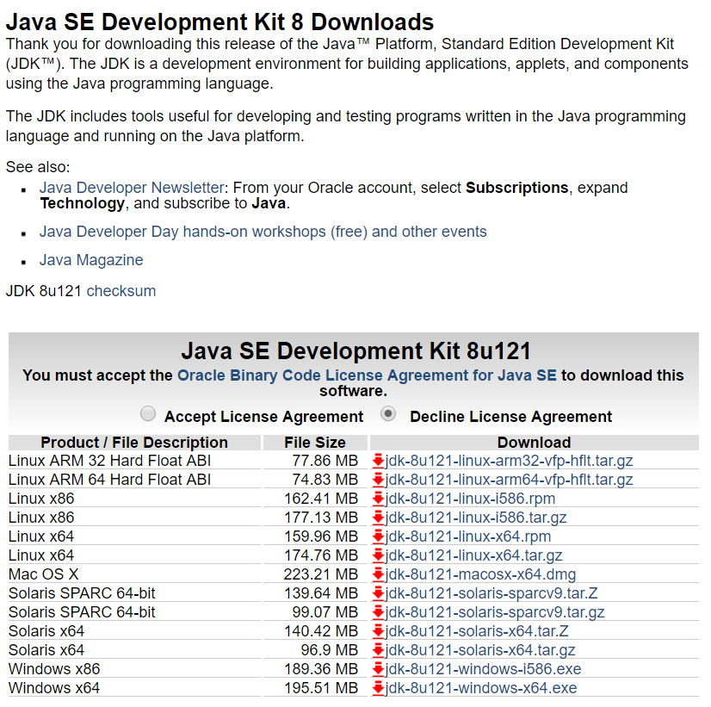
Java Development Environment Overview
Standard Java tools for this class include:
Java SE Development Kit (SDK) from Oracle
Text Editor (Microsoft Visual Studio Code)
Additional Tools:
Git and GitHub
Eclipse
You are welcome to use addition tools, but please don’t make your assignments dependent on those tools.
Notes:
Getting ready for next week… Get this set up for yourself this week by compiling and running “HelloWorld”.
I will be using the Microsoft Code Editor and the command line Java JDK to review and grade your assignments. Make CERTAIN that the assignments you submit compile an run in these environments. Lets start by submitting a single .java file for at least the first two weeks. Then we will consider extending our practices.
I will be compiling your applications with the standard javac and java command line tools. For example, if you submitted a file named “ShapesApp.java”, I would expect:
To compile it with the command “javac .\ShapesApp.java”
To run it with the command “java -cp . ShapesApp”
You should test all assignments using this configuration BEFORE you turn them in for review and grading.

Slide 28
Review Selected Learning Objectives
Notes:
Optimism, good natured humor, and effectively working together is immensely important to delivering good software… and likely equally important to delivering just about any quality product
Even if you don’t intend to be a professional software developer, many of the things that we learn will be valuable in related areas.
Soooo… We have 16 weeks to learn something valuable and interesting. Let’s enjoy our time together and make the most out of it.

Slide 29
Object-Oriented Programming Discussion & Lecture Eric Pogue
Agenda for 14 Mar 18 from 12 to 2:30pm CST:
Welcome
Friendly Conversation & Good Natured Banter… let’s make sure that everyone can hear and speak in the virtual Join.me meeting
Introductions*
Review Course Syllabus
Your turn for Introductions
Review Week 1 Activities & Assignment
Review Selected Learning Objectives
Lab Time plus Q&A starting no later than 1:45pm
Wrap-up and Final Questions/Comments?
Discussion & Questions welcome at any time… please be present with no phones or email during our discussion time
Notes:
*Your opportunity to give introductions will come after the syllabus overview.
Lab Time needs to start no later than 2:40 today… please help me keep us on track

Slide 30
Object-Oriented Programming Session: Week 1 Session 1 Instructor: Eric Pogue
Agenda:
Friendly Conversation & Good Natured Banter… let’s make sure that everyone gets a good seat where they can hear and speak comfortably
Welcome & Introductions*
Review Course Syllabus
Your Time for Introductions
Introduction to Object-Oriented Programming
Assignment
Lab
Wrap-up and Final Questions/Comments?
Discussion & Questions welcome at any time… please be present with no phones or email during our discussion time
Notes:
*Your opportunity to give introductions will come after the syllabus overview.

Slide 31
Review Selected Learning Objectives

Slide 32
Lab
Possible Lab Activates:
Install Java environment
Install Visual Studio Code… or other preferred text editor
Hello World or BMI Calculator coding together
Others lab activities?

Slide 33
Wrap-up and Final Questions/Comments?

Slide 34
End of Session
Eric Pogue

Slide 35
Today’s “Friendly Conversation” topic
Agile Manifesto
“We are uncovering better ways of developing software by doing it and helping others do it. Through this work we have come to value:
Individuals and interactions over processes and tools
Working software over comprehensive documentation
Customer collaboration over contract negotiation
Responding to change over following a plan
That is, while there is value in the items on the right, we value the items on the left more.”
Notes:
This was kind of “hippy-ish” and egalitarian in its day… quite controversial in its day
“Everyone is a team member and is responsible for the work getting done”… we don’t need no titles or positions… self-organizing… we will make our own commitments… transparency (let’s share the information)… flexible/organic teams, organic architecture (minimal documentation/standards)… no contracts (let’s talk it over)
The flip side:
We will actively and voluntarily play important roles on our team
The rules (rituals) that we do have… we WILL follow
We will create, demo, and release working software/products
We will utilize practical processes, tools, documentation, and planning
When we make commitments, we will live up to those commitments… as a team (“No winners on a losing team, and no losers on a winning team”)
We will be responsive and continuously improve (Retrospectives)
We will be transparent with how WE work and share our information

