Slide 1

Object-Oriented Programming Discussion, Lecture, & Lab Eric Pogue
Sprint 3 Discussion, Lecture, and Lab session(s) Agenda:
Friendly Conversation Topic – Why might we choose not to use Object-Oriented Programming?
Sprint 3 Planning
Foreshadowing Sprint 4 Mosaic Assignment
Files & JSON
Lab: FaceDrawLite
Final Questions/Comments
Discussion & Questions welcome at any time… please be present with no phones or email during our time together

Slide 2
- Verify Screen Resolution 1920x1080 - Verify Chat Session Open & Working - Mute Lines - Start Recording

Slide 3
Why might we choose not to use Object-Oriented Programming?

Slide 4
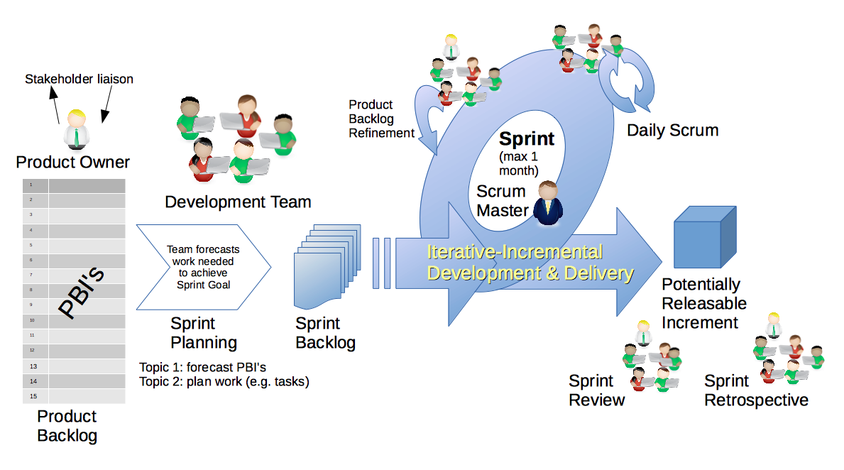
Scrum Process & Roles – Sprint Planning
By Dr ian mitchell - Own work, CC BY-SA 4.0, Link

Slide 5
Sprint Planning
Review:
Activities List
Programming Assignment
Quiz,
Discussion Board
Notes:
Some people would say that binary files include all files, and that text files are just binary files that are being interpreted in a specific way.

Slide 6
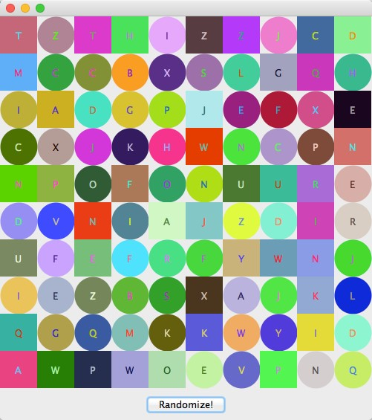
Mosaic Preview
In this sprint 4, you will need to create an application in Java that:
Draw a Random set of shapes, colors, and letters
Shuffle the pattern each time the “Randomize!” button is pressed
Add a substantial feature of your own to the application
Notes:
The first of many “Shape” examples. We will get to a Abstraction example in a few minutes.

Slide 7
Files & JSON

Slide 8
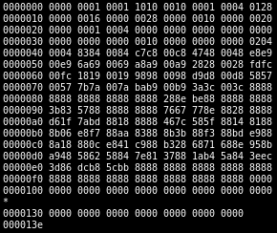
Binary Files
A binary file is a computer file that is not a text file. The term "binary file" is often used as a term meaning "non-text file". The can be open or closed formats that are generally:
Fast, small, and efficient*
Often not very portable across applications and platforms
Difficult to maintain backward compatibility
* Many developers would say that binary files include all files, and that text files are just binary files that are being interpreted in a specific way.

Slide 9
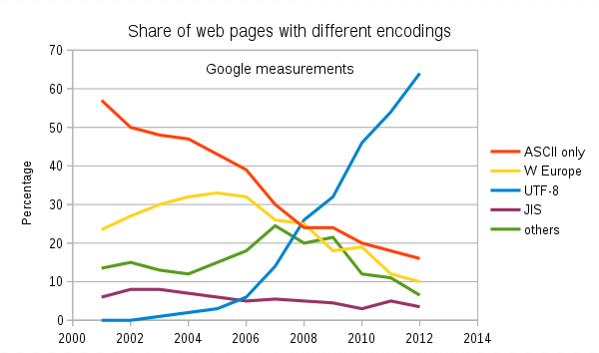
Text File Encoding Standards
ASCII
Unicode
UTF-8
Others

Slide 10
Text File End-Of-Line (EOL) and Encoding
Industry adoption of end-of-line encoding includes:
Windows: Both Carriage Return (CR, \r, 0x0d) and Line Feed (LF, \n, 0x0a) together.
Unix/Linux/OSX: Just Line Feed (LF, \n, 0x0a)
Mac (pre-OSX): Just Carriage Return (CR, \r, 0x0d)
Article on Windows Notepad supporting non-Windows EOF conventions [link]

Slide 11
Special Types of Text Files
Most programming is made up of different types of Text Files including:
HTML
CSS
JavaScript… and other coding languages
XML
JSON

Slide 12
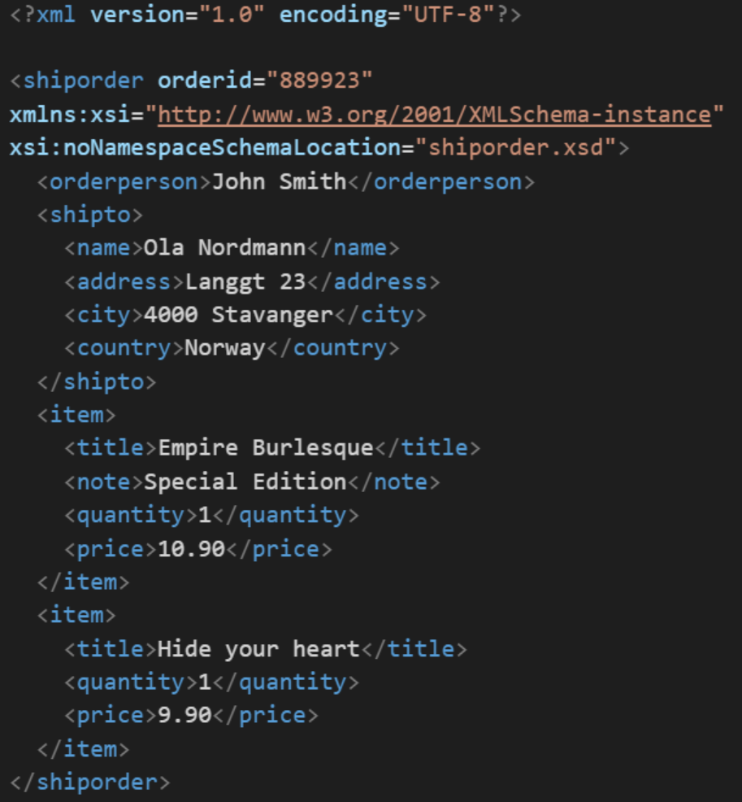
XML Example
In computing, XML (Extensible Markup Language) is a markup language that defines a set of rules for encoding documents in a format that is both human-readable and machine-readable. It is an open standard that:
Supports nearly all development languages and platforms
Allows us to cross between many applications
Can result in large files
Supports schema to validate data directly

Slide 13
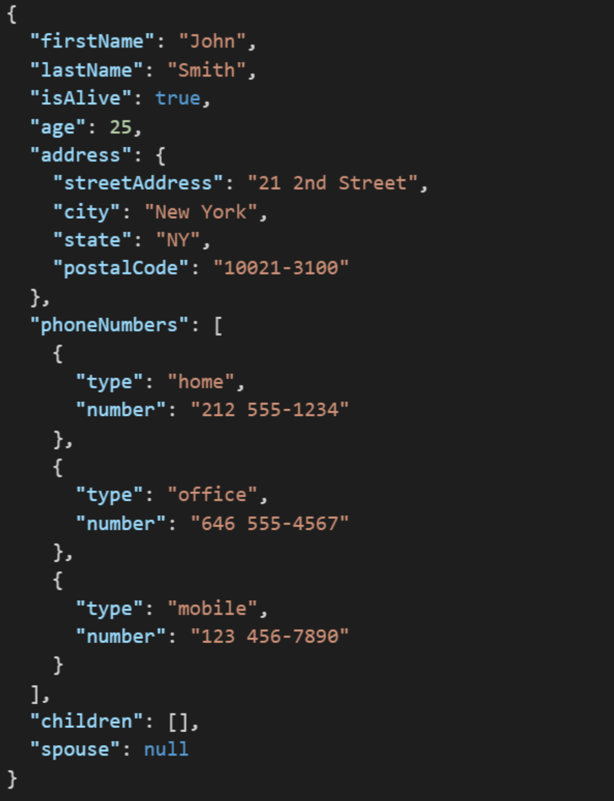
JSON Example
JSON (JavaScript Object Notation) is a lightweight data-interchange format. It is easy for humans to read and write. It is easy for machines to parse and generate. It is an open standard that:
Supports nearly all development languages and platforms
Allows us to cross between many applications
Can result in large files
Notes:
JSON is an open-standard format that uses human-readable text to transmit data objects consisting of attribute–value pairs. It is a very common data format used for asynchronous browser/server communication, including as a replacement for XML in some web service style systems.

Slide 14
FaceDrawLite

Slide 15
FaceDrawLite Tutorial Expectations
After you complete the FaceDrawLite tutorial you should be able to:
Draw 2 Sad Cyclops (one red eye) Faces in a Java graphical application
Understand the code… let’s do an overview of the Java code
Write your own application from scratch utilizing what you have learned… Do not copy/past this code
When you start your FaceDraw programming assignment, start with a “blank sheet of paper” as well

Slide 16
Lab: FaceDrawLite Tutorial

Slide 18
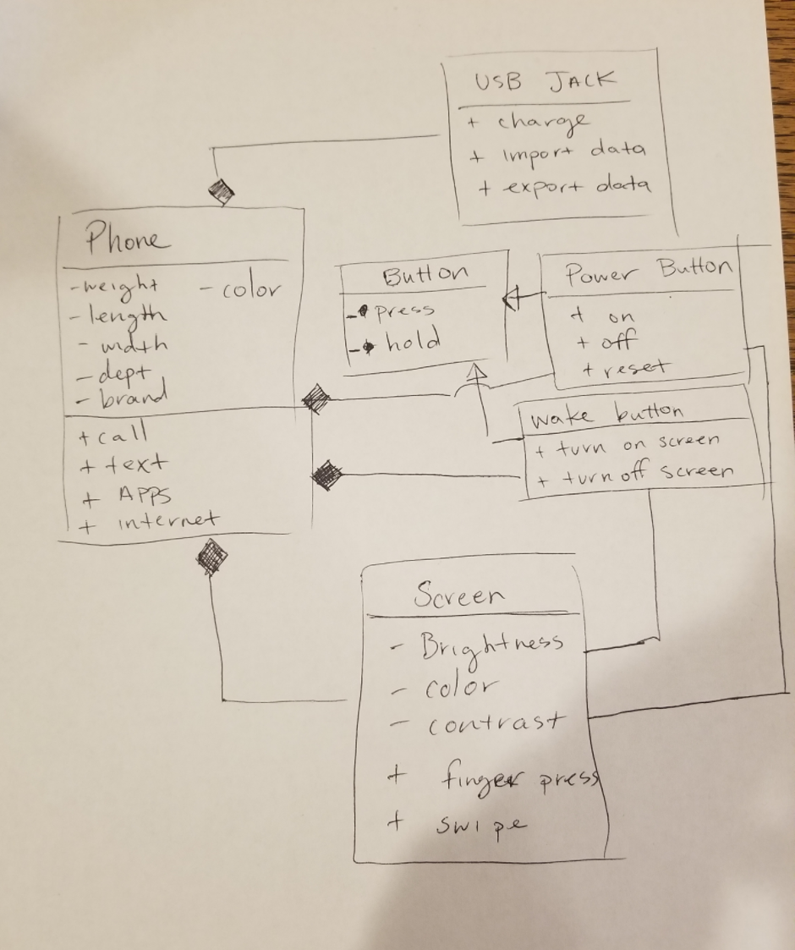
UML Phone Example

Slide 19
End of Session

