Slide 1
Object-Oriented Programming Principles
Eric Pogue

Slide 2
Topics
Review Concepts, Practices, Patterns, and Principles
Defined Design Principles
Agile Design Principles
Agile Development Methodology
Object-Oriented Design Principles
Recap

Slide 3
Object-Oriented Programming [link]
Concepts – powerful features that are indispensable to modern software development
Practices – everyday activities that software developers perform in order to delivery quality products utilizing key Concepts
Patterns – tried-and-true templates for forging powerful relationships between classes
Principles – guidelines that help you determine what classes are needed and how they should work together
Notes:
Concepts/Patterns/Principles… Hours/Days/Months

Slide 4

Agile Design Principles
Software design principles represent a set of guidelines that allow us to create high quality object-oriented designs. The design principles are attributed to Robert Martin who gathered them in the book "Agile Software Development: Principles, Patterns, and Practices".
According to Robert Martin there are 3 important characteristics of a bad design that should be avoided:
Rigidity – The system is hard to change, even to implement what seems like simple changes.
Fragility – The system tends to break in many places when a single change is made. And fixing the problems tend to lead to more creates more issues.
Immobility – The system is hard to reuse in another application because it cannot be disentangled from the current application.
Plus Viscosity, Needless Complexity, Needless Repetition, and Opacity.
Notes:
Our procedural (C) implementation of BMI would be a great example of Immobility… maybe a good example of all three of these.

Slide 5
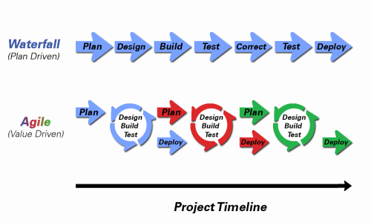
Development Methodologies
Notes:
Development Methodology and Software Development Lifecycle (SDLC) are often used interchangeably.
The Iterative development methodology is not depicted here as even the mainstays and inventors of the Iterative development methodology seem to be moving toward agile. Plus as Waterfall “holdouts” move, they seem to be moving directly toward Agile. Can you start to see my biases?
Object oriented-programming concepts/practices evolve and reprioritize depending on the development methodology.
For example, in Waterfall (as well as in Iterative) object-oriented design often play a critical role in the (big upfront) design activities. UML diagrams and project artifacts are often important to the overall project success. (opinion) Practical reality has been that these design artifacts often do not reflect the actual implementation and are rarely maintained or updated.
The Agile practitioners do not reject these design artifacts. However, the focus on shorter time horizons, evolving architecture, and working code changes the value proposition for object-oriented practices to more focus on the build, test, enhance activities.

Slide 6
Object-Oriented Design Principles
Single-Responsibility Principle
Open-Closed Principle
Liskov's Substitution Principle
Dependency-Inversion Principle
Interface-Segregation Principle

Slide 7
Single-Responsibility Principle
A class should have only one reason to change.
An example would be a Class that maintains the dimensions of a Oval, calculates its area, and draws itself to the screen. This implementation would likely violate the Single-Responsibility Principle.
Consider instead a base Class (Oval) that maintains the dimensions and calculates area, and a separate Class (OvalDraw) that inherits from the base Class (Oval) and implements drawing itself to the screen. This would not violate the Single-Responsibility Principle.

Slide 8


Open-Closed Principle
Classes should be open for extension but closed for modifications.
Notes:
Our example of BMI is C was a great example of NOT implementing this principle. We had to modify the core functionality in order to extend it. It take a long time to know if a class exhibits this principle. You only know after a class has been used by multiple other classes (preferably “owned” by other developers), the class has need to be extended (preferably multiple times), and the dependent classes have not had to change (and the dependent developers have not complained).

Slide 9
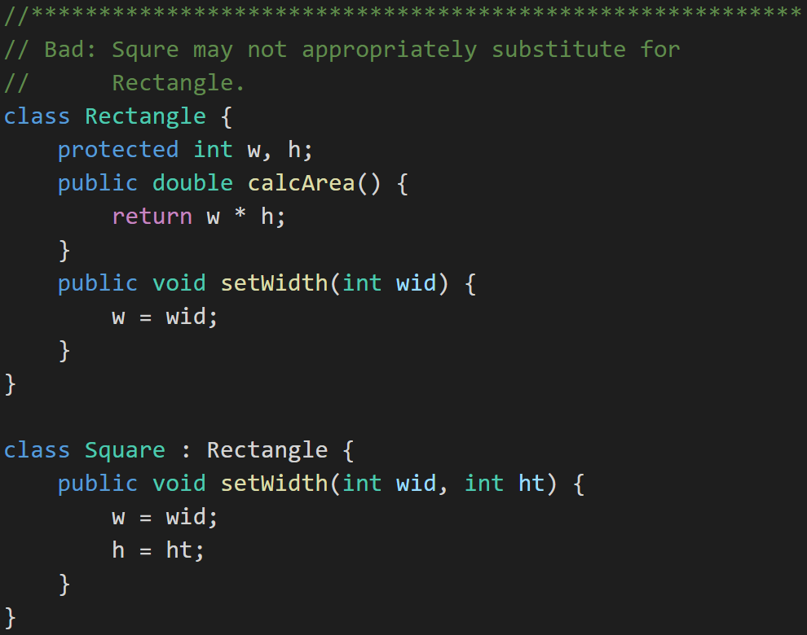

Liskov’s Substitution Principle
Derived classes (subclasses) must be completely substitutable for their base types.
And similarly Subclasses should not break core functionality introduced by their parent.

Slide 10
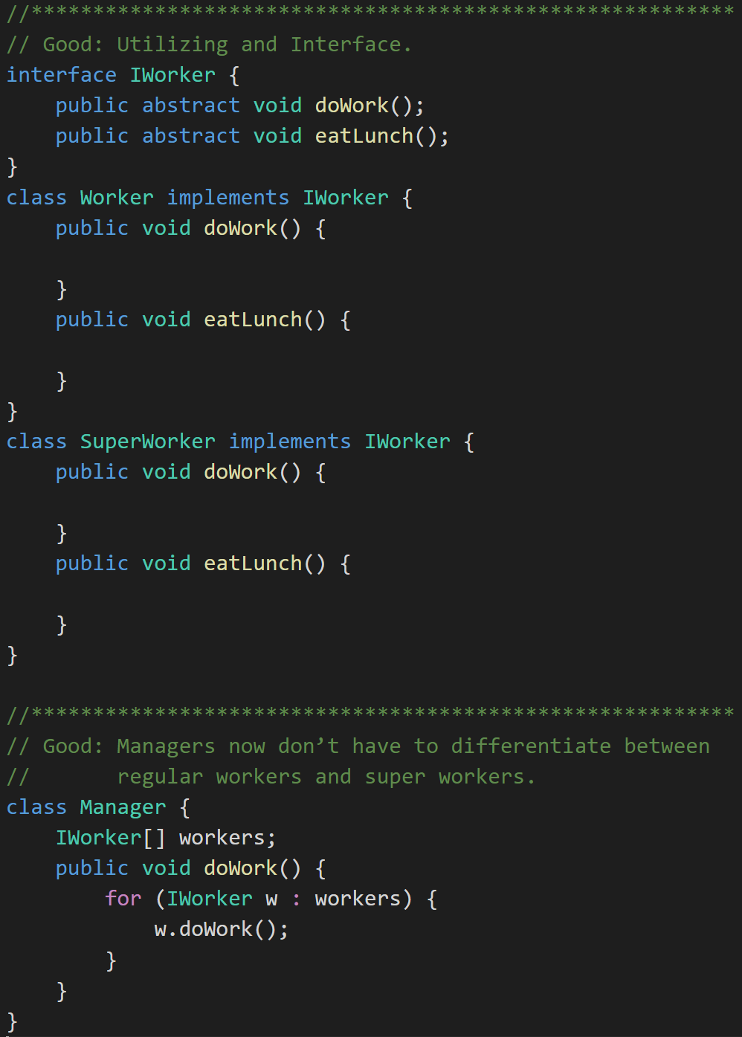
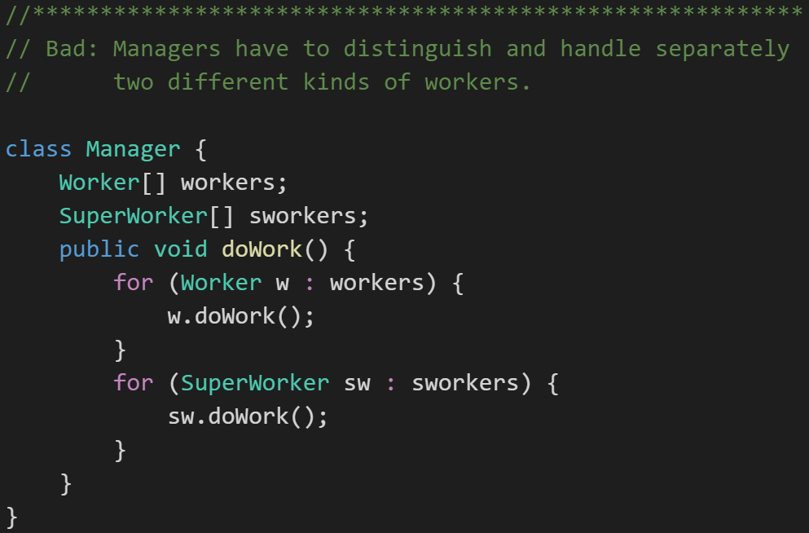
Dependency-Inversion Principle
Don't let owners depend on the implementation of the things it owns.
Notes:
For example a Manager class should not have to behave differently depending on if a what type of workers.
One way to comply with Dependency Inversion Principle is to use an interface. An interface is a class-like data type that prescribes behaviors rather than data.

Slide 11
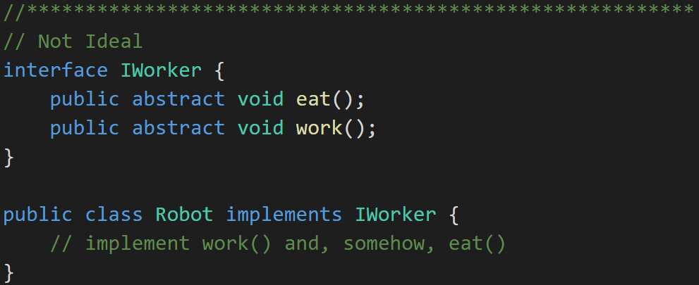
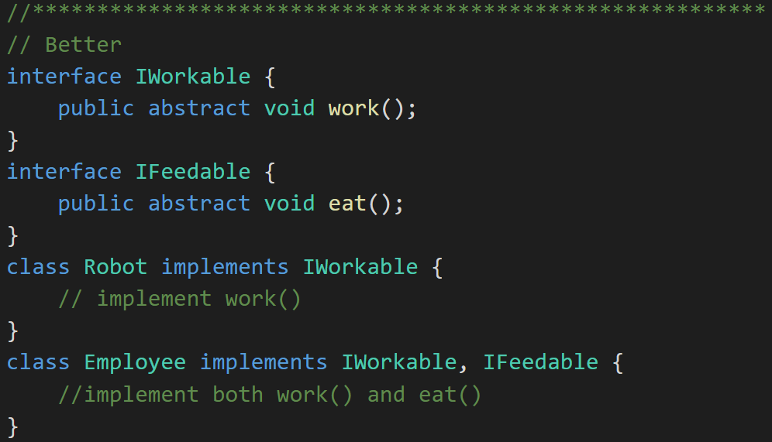
Interface-Segregation Principle
Clients should not be forced to depend upon interfaces that they don't use.
Notes:
The previous example has a minor flaw. Consider the IWorker interface. It specifies that workers both eat lunch and do work. What if we end up building and using robotic workers? They don’t have to eat. So, our definition of Worker includes too much and therefore can only be clumsily applied to situations where our understanding of what a worker is might change.

Slide 12
Recap
Principles – Software design principles represent a set of guidelines that allow us to create high quality object-oriented designs
Design characteristics to avoid include Rigidity, Fragility, and Immobility
The prevalence of Agile development has made design Principles even more important
Key design Principles include:
Single-Responsibility Principle
Open-Closed Principle
Liskov's Substitution Principle
Dependency-Inversion Principle
Interface-Segregation Principle

Slide 13
Topics
Review Concepts, Practices, Patterns, and Principles
Defined Design Principles
Agile Design Principles
Agile Development Methodology
Object-Oriented Design Principles
Recap

Slide 14
Object-Oriented Programming Principles
Eric Pogue

