Slide 1
Object-Oriented Programming Concepts & Practices
Eric Pogue

Slide 2
Topics
Define object-oriented programming (OOP)
Review object-oriented languages, history, and adoption
Demonstrate object-oriented programming concepts
Distinguish between a class and an object
Identify the three primary (and several related) object-oriented concepts
Identify the superclass and the subclass in an inheritance relationship
Demonstrate inheritance, ownership, and abstraction with Java code
Distinguish between aggregation and composition
Recap

Slide 3
Object-Oriented Programming [link]
Object-oriented programming (OOP) is a programming model based on the concept of Objects, which contain both Properties (member variables) and Methods (member functions) that operate on that those Properties.
Most popular OOP languages are class-based, meaning that Objects are instances of Classes.
Animal
Dog
Cat
Bigcat
Notes:
I will often start with definitions from Wikipedia and other sources. If you are struggling with a topic and/or would like more information, it can often be valuable to review the references. You should be able to click on the [link] tag (possibly while holding the shift key down) in order open the reference in a browser.
Properties are the same as Attributes or member variables
Methods are the same a member functions

Slide 4
Object-Oriented Programming [link]
Concepts – powerful features that are indispensable to modern software development
Practices – everyday activities that software developers perform in order to delivery quality products
Patterns – tried-and-true templates for forging powerful relationships between classes
Principles – guidelines that help you determine what classes are needed and how they should divide up the work
Notes:
Concepts/Patterns/Principles… Hours/Days/Months

Slide 5
Object-Oriented Programming Language History
Simula late 1960s
Smalltalk early 1970s
Object Lisp late 1970s
Object Pascal mid 1980s
C++ and Eiffel late 1980s
Java and Python 1990s
C# 2000s

Slide 6
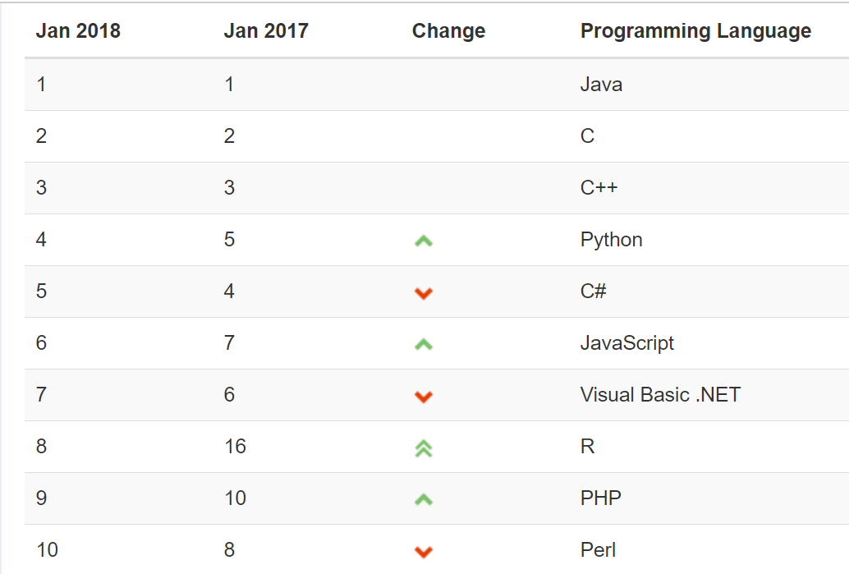
Object-Oriented Languages and Tools Today
The TIOBE index identifies which programming languages are most prevalent.
Non-OOP Examples
Notes:
We will utilize mostly Java and C# for our object-oriented programming examples. We may (or may not) do any Python work. Since it is often ‘unnatural’ to show procedural programming examples in Java, C#, or Python, we will implement programs in C to demonstrate procedure programming examples. Let me know if you have a desire to do some Python work… or work in another OOP language. If so, we can likely work something out.
Note that our reluctance to utilize C++ as a OOP learning tool is does not diminish the value of the C++ toolset. However, C++ is generally considered a very powerful set of tools with a steep learning curve. It’s a very sharp knife… use it carefully.

Slide 7
Why Object-Oriented Programming
Two events greatly accelerated the adoption of object-oriented programming:
The adoption of graphical user interface (GUI) applications (Windows, Macintosh, X Windows, etc.) in the 1990s
The adoption of Iterative and Agile development methodologies in the 2000s

Slide 8
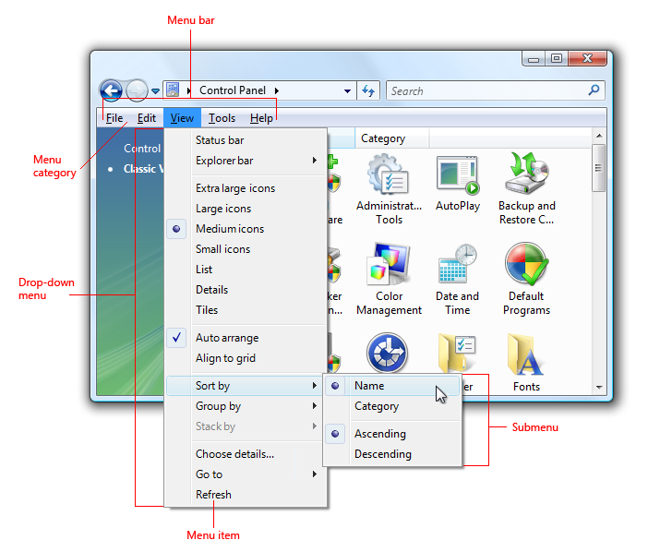
Graphic User Interfaces (GUIs)

Slide 9
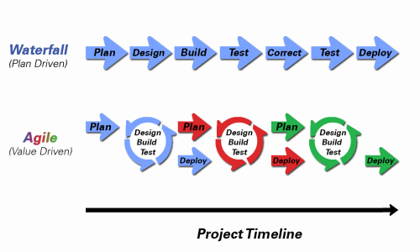
Development Methodologies
Notes:
Development Methodology and Software Development Lifecycle (SDLC) are often used interchangeably.
The Iterative development methodology is not depicted here as even the mainstays and inventors of the Iterative development methodology seem to be moving toward agile. Plus as Waterfall “holdouts” move, they seem to be moving directly toward Agile. Can you start to see my biases?
Object oriented-programming concepts/practices evolve and reprioritize depending on the development methodology.
For example, in Waterfall (as well as in Iterative) object-oriented design often play a critical role in the (big upfront) design activities. UML diagrams and project artifacts are often important to the overall project success. (opinion) Practical reality has been that these design artifacts often do not reflect the actual implementation and are rarely maintained or updated.
The Agile practitioners do not reject these design artifacts. However, the focus on shorter time horizons, evolving architecture, and working code changes the value proposition for object-oriented practices to more focus on the build, test, enhance activities.

Slide 10
Object-Oriented Concepts Example
Implementing the body mass index (BMI) calculation in Java and C should allow us to effectively demonstrate some object-oriented design and programming concepts (Java). We will also compare that to how we would have implemented the same calculation using procedural programming techniques.
Background: BMI is a statistic developed by Adolphe Quetelet in the 1900’s for evaluating body mass. It is not related to gender and age. It uses the same formula for men as for women and children.
The body mass index is calculated based on the following formula:
BMI = weight [kg] / (height [m] * height [m])
Procedural BMI (body mass index):
Variables:
Height
Weight
Functions (or Procedures):
CalcBMI
Object-Oriented BMI:
Class BMI
Properties
Height
Weight
Methods
CalcBMI
Notes:
Well let’s get started on a real-world example that will allow us to see how OOP is used, and to learn some of the basic concepts like classes and objects. I’ve picked a body mass index (BMI) calculator as our first example. If retrospect, I wish I would have used something with shapes or animals. However, I assure you that there will be no shortage of shape and animal examples in the coming weeks.
Can you see how data and procedures/functions map directly to call attributes and methods? Even though it is a directly mapping, it is still good to get our terminology correct.

Slide 11
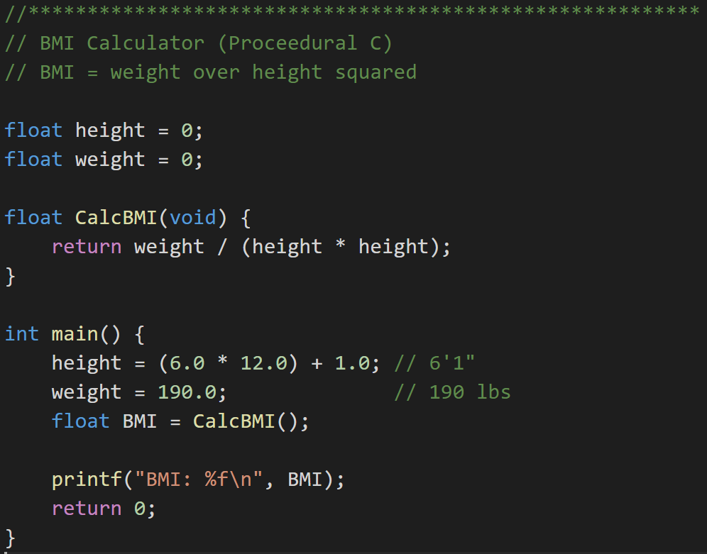
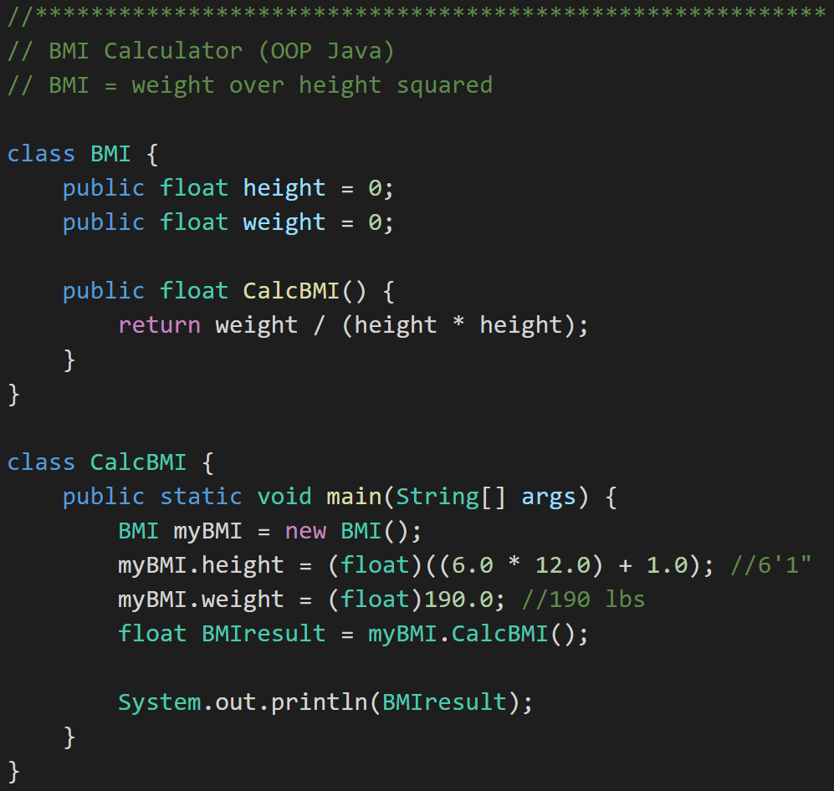
Example: Procedural vs. Object Oriented Programming
Procedural BMI (C):
“Object-Oriented” BMI (Java):
Notes:
Now let’s look at some real code examples. You will quickly notice that I like to use real code examples over philosophical discussion topics. I will try to make the more important coding examples available to you on my GitHub account. Let me know if you see something and would like a copy.
We have quite a lot of code to look at here. Let’s start with the procedural C code. We have data (height & weight) and procedures (CalcBMI)…
We have a pretty simple formula…
When I coded this the first time I used ‘int’ instead of ‘float’ for all my variables. That didn’t work very well.
If you look carefully you will see that we still have a logic problem in both of our implantations. Don’t worry we are going to get back to fix that using some of our OOP concepts.
For now let’s focus on looking through our first OOP Java implantation. We have our first class. Very nice, we will see many more of those.
Let’s go to the next slide to take a closer look at our class.

Slide 12
Distinguish Between a Class and an Object
Procedural BMI (C):
“Object Oriented” BMI (Java):
Notes:
There we have it, a class. It has attributes (height & weight) and a method (CalcBMI). Still has the same logic problem… but let’s wait on that.
Now we need to be able to use our class to do something. For that we need to create an instance of our class.

Slide 13
Distinguish Between a Class and an Object
Procedural BMI (C):
Object Oriented BMI (Java):
Notes:
Ahhhh… and we have an object “myBMI’ which is an instance off the class “BMI”.
We use or myBMI object to set some properties and then we have it calculate BMI by calling “my.BMI.CalcBMI()”
… and of course when we compile and run it, we get… the wrong answer. But it compiled and ran successfully. That’s something, right?
I know you can’t wait to see how this BMI story ends, so that will be our starting point for Section 2. How to fix BMI using object-oriented concepts/techniques.

Slide 14
Topics
Define object-oriented programming (OOP)
Review object-oriented languages and tools
Demonstrate object-oriented programming concepts
Distinguish between a class and an object
Identify the three primary (and several related) object-oriented concepts
Identify the superclass and the subclass in an inheritance relationship
Demonstrate inheritance, ownership, and abstraction with Java code
Distinguish between aggregation and composition
Recap
Notes:
We have a lot of solid topics for our first week. You will quickly notice that three words are underlined. You will see references to object-oriented concepts, patterns, and principles throughout the week and throughout the class.
Concepts: Practices, standards, and tools the effectively support object-oriented design and programming… I need to do enhance the BMI class to provide better Encapsulation and hide the height and weight properties (hours).
Patterns: Well established templates for forging relationships between classes… I would like to generate the random Animal generator using a Factory pattern so it is more supportable (days)
Principles: Proven industry guidelines… Using a Factory Pattern is a good start; however, I think we should focus more on making sure that we follow the Open Close Principle throughout our product (weeks+)
If you take a look through the topics you will hopefully see a few that are familiar; however, I suspect that many will be new. Don’t be concern, by the end of the week you will have some familiarity with all of them. You should also have resources that will let you go back and refresh you memory when you need to do that.
I am going to divide the topics up into three or four sections so that we can focus and keep our energy.

Slide 15
Identify the “Big Three” Object-Oriented Concepts
Encapsulation… and Information Hiding
Inheritance… and Abstraction
Polymorphism
Plus… Composition & Aggregation
Notes:
Helpful Interview Hint: Whenever you are asked a conceptual question about object-programming in an software development interview (and you will be), answer confidently “Encapsulation”, “Inheritance”, and “Polymorphism”.
When asked what is Encapsulation (or how would you implement it), say, “I would limit or minimize variable scope and keep data attributes private as often as possible.”
Now as we are going through our object-oriented examples, be thinking about how you would answer the “What is Inheritance?” and “What is Polymorphism?” interview questions. Note that answering them both with very brief examples can be very effective… and it is always best to use animals in you OOP interview examples.
Now we just need to make sure that we are able to effectively utilize these concepts after we get the job. Let’s start by walking through an example.

Slide 16
Encapsulation & Information Hiding
Encapsulation: Restricting access and visibility of Properties and Methods of a Class in order to make the Class easier to utilize, extend, and maintain. [link]
Information Hiding: The Information Hiding term is often used interchangeably with Encapsulation. Information Hiding does not connection with Object-Oriented Programming and can be used to describe practices utilized in non-OOP languages as well. [link]

Slide 17
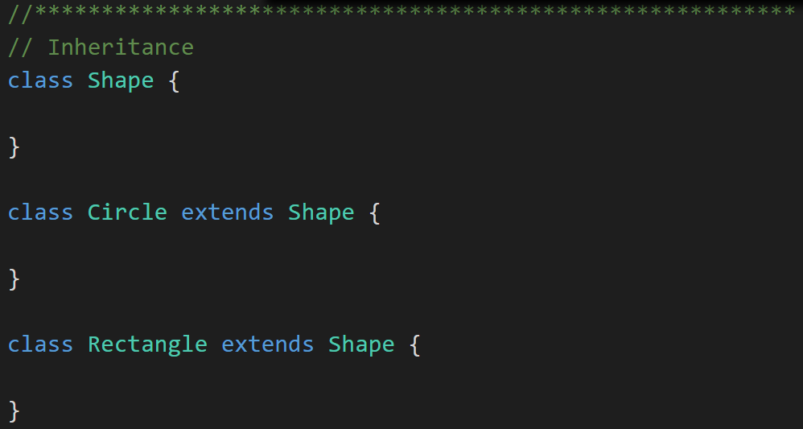
Inheritance & Abstraction
Inheritance: When one Class acquires the Properties and Methods of another Class it is called Inheritance. [link]
Abstraction: Something is abstract when it is a concept but is not concrete or defined enough to actually be built. Generally, in OO design, we start with abstract things, and then we build on them through Inheritance. [link]
Notes:
The first of many “Shape” examples. We will get to a Abstraction example in a few minutes.

Slide 18
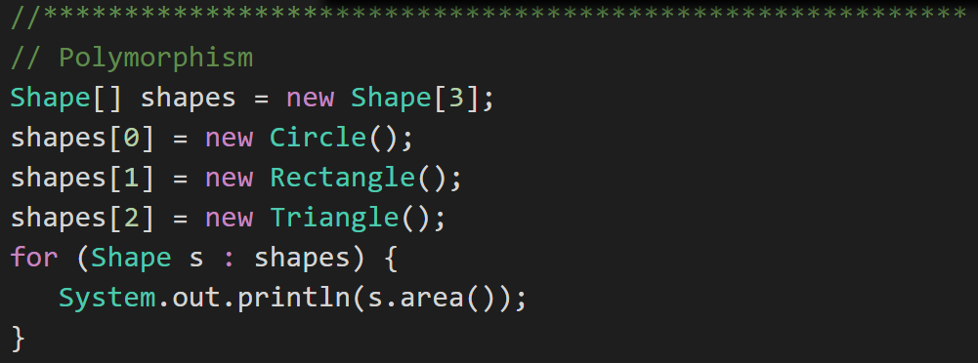
Polymorphism
Polymorphism: Polymorphism enables you to process collections of related things generically. This is particularly useful when you want to use a loop to march through a collection of items. [link]
Notes:
Example of polymorphism: a for loop that moves through the entries of a list. The list might be of a collection of related kinds of object. We can refer to each of the objects in the list through a generic variable (whose data type matches the one that all are ultimately related to). But, when we invoke a particular function that all members of the family share, each will respond by performing that function in their own specific way. For example, we could have a collection of Shape objects. We could refer to each entry in the Shape list through a generic Shape variable, even though the actual entries in the list are specific kinds of shapes – Circle, Rectangle, etc. All Shape objects might have the ability to calculate their own area. When we refer to an object in the list through a generic Shape variable and tell it to calculate its area, thanks to polymorphism, the circle version of the area() function will be called when we’re dealing with a circle, and the Rectangle version of area() will be called when we’re dealing with a rectangle, etc.
The first time through the for loop, we’ll call the Circle.area() function – actually, we won’t; it will happen automatically. The next time through, we’ll call the Rectangle version, and then we’ll call the Triangle version.
Polymorphism is implemented behind the scenes using a Virtual Method Table (VMT). The VMT keeps track of where various related classes’ same-named functions are located in memory. Using the VMT, the operating system is able to figure out which code to implement when we tell each shape to fire its area() function.

Slide 19
The Problem?
BMI formula assumes M (height) and KG (weight)
Procedural BMI (C):
Object-Oriented BMI (Java):
Notes:
Let’s go back to where we left off in our BMI example. We had both Procedural (C) code and Object-Oriented Java code. Both compiled. Both ran. Neither produce the expected result because…
The function / method only worked if we used metric units where we were using English units. Specifically, our BMI formula assumes metric inputs of kg & m while our interactions with the BMI procedures and methods are using English units if inches & lbs. So our implementations do work; however, they only work for metric.
Let fix our BMI (C) implementation in our normal procedural way.
After that we will enhance our Java implementation using Encapsulation and Inheritance concepts.
Polymorphism will need a different example… definitely one with animals.

Slide 20
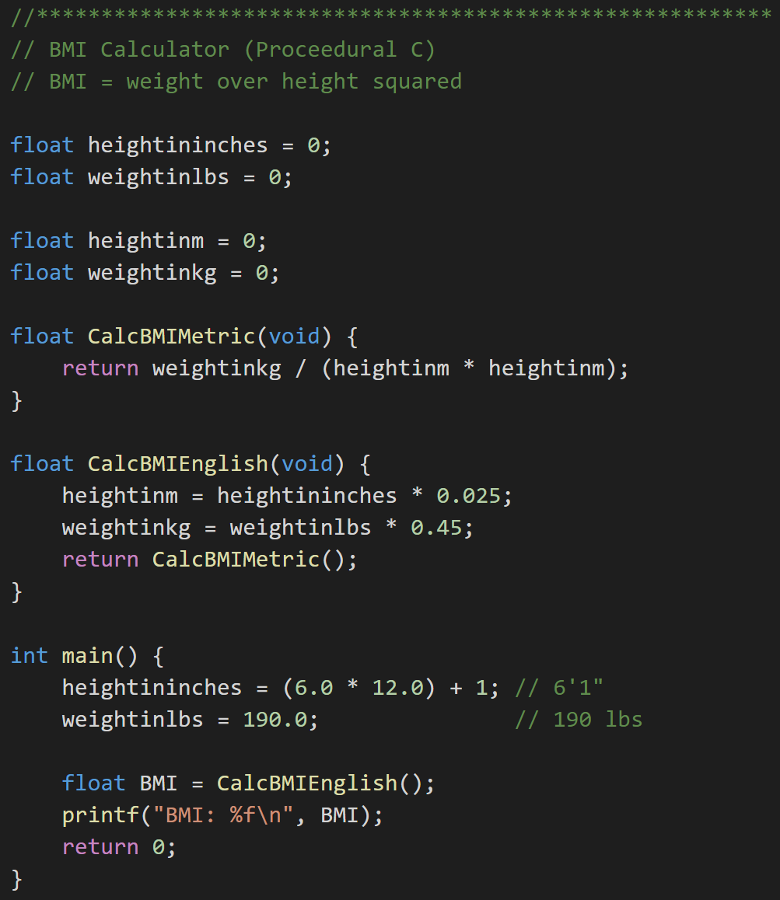
Revising Procedural (C) BMI Implementation
Procedural BMI (C):
Procedural BMI (C) - revised:
Notes:
First let’s spend a couple minutes revising our procedural C implementation the “old fashioned” way.
Since our current implementation actually works for metric units, lets not lose that. We will rename are variables to reflect that they are metric only units (hightinm and weightinkg). Note that since our variables were global, this change alone will break anyone else who was reusing our code (ouch!)
We will also rename our C function to reflect its Metric requirement.

Slide 21
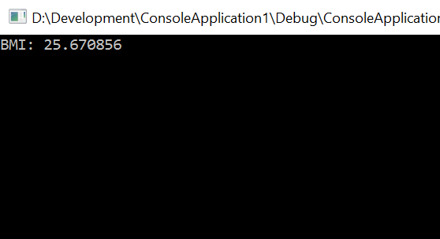
Revising Procedural (C) BMI Implementation
Procedural BMI (C):
Procedural BMI (C) - revised:
Notes:
Now we will add in English variables and functions. Finally, we will call the new English function… and voilà! It works as expected. Hmmmm, 25.6? I thought it would be lower than that.
Not bad. However, when we do these examples, always imagine thousands or tens-of-thousands of lines of code. And recognize that as the size of the code grows and the number of developers grows that the complexity grows exponentially.
Now think about the opportunity to reuse this type of code. If this was a complex ten thousand line implementation, would you want your livelihood dependent on this code and it’s owner? I would not want to be on call the Sunday night that he or she decided to make a last minute change and update the global variable name… and, of course, it would be my code that actually broke because my implementation would be dependent on the variable name remaining the same. This is one reason that the (very bad) practice of “copy-paste” code sharing has become so prevalent.
This is one of the many reasons that OOP has remained so prevalent over the years. It is not necessarily easier to write OOP code the fist time (vs. procedural development); however, the opportunity for well written OOP code to be reused, extended, maintained, and efficiently tested has made it indispensable in modern software development.

Slide 22
Golden Rule of Encapsulation
Minimize Class Property and Method scope and visibility. The Encapsulation hierarchy:
None (can we eliminate the Property or Method)
Local variable
Method parameters,
Private Property
Protected Property
Public Property
global variable
Notes:
Helpful Interview Hint: Whenever you are asked a conceptual question about object-programming in an software development interview (and you will be), answer confidently “Encapsulation”, “Inheritance”, and “Polymorphism”.
When asked what is Encapsulation (or how would you implement it), say, “I would limit or minimize variable scope and keep data attributes private as often as possible.”
Now as we are going through our object-oriented examples, be thinking about how you would answer the “What is Inheritance?” and “What is Polymorphism?” interview questions. Note that answering them both with very brief examples can be very effective… and it is always best to use animals in you OOP interview examples.
Now we just need to make sure that we are able to effectively utilize these concepts after we get the job. Let’s start by walking through an example.

Slide 23
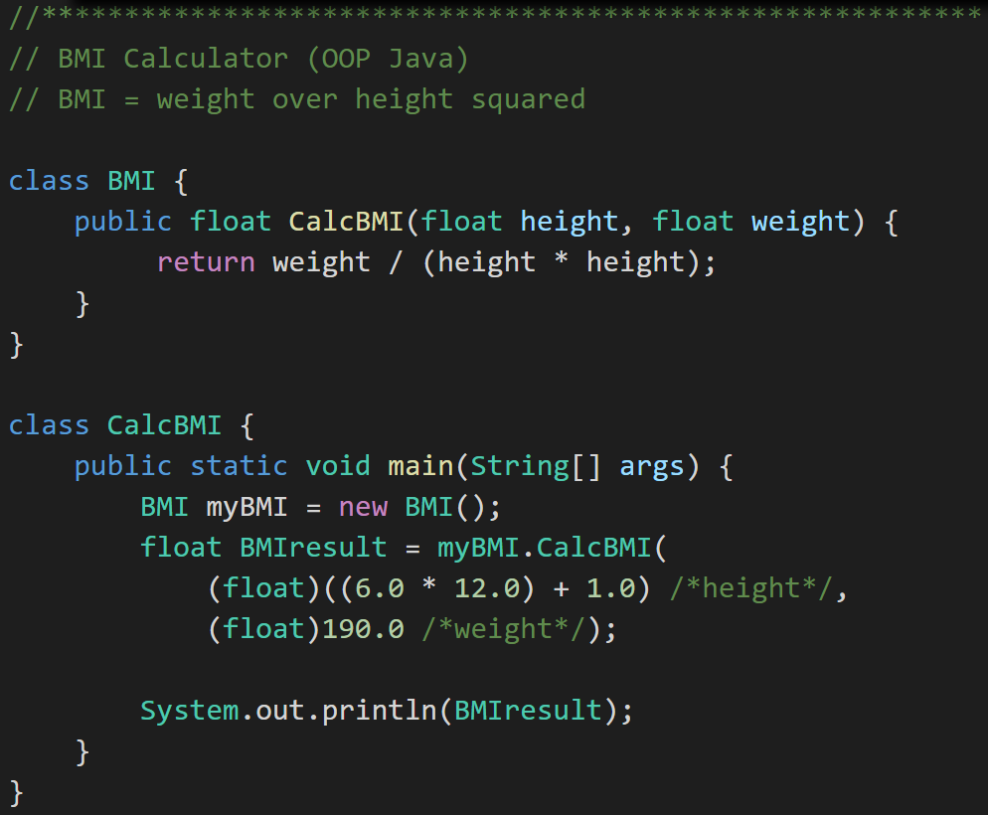
Encapsulation
Object -Oriented BMI:
Encapsulated Object-Oriented BMI:
Notes:
First, let’s Encapsulate our code.
#1 Rule for Encapsulation: Minimize class property and method scope and visibility: (1)none, (2)local, (3)method parameters, (4)private attribute, (5)protected attribute, and (6)public
In this case we can’t eliminate our height and width properties, and we can’t make them local to our method. However, we can make them parameters to our CalcBMI method. That’s a nice simplification. It also makes it very unlikely that future changes will impact users of our BMI class.
Consider: How would you add protective code around setting height to 0 in the initial code (height > 2ft & <9ft)? … How about in our second encapsulated example? Once again consider reuse, testing, and additional modification if this were thousands of lines off code.
This type of Encapsulation & Information Hiding is a feature of nearly all modern development languages… not just object-oriented languages.

Slide 24
Inheritance… Options to Implement English Units
Option #1:
Option #2:
BMI (metric)
BMI
BMI English
BMI Metric
BMI English
Notes:
Now let’s use Inheritance to implement English unit support in BMI. There are really two Inheritance class hierarchy options in this case. Option #1 is very practical and safe… and very unlikely to break anyone’s code who is currently using our class. Option #2 is more pure and elegant.
In the real world where not breaking existing code (causing a retest or potentially a defect) is a VERY high priority, we would have chosen Option #1. It is simpler, less risky, more practical, and can be done with less code. Profession developer rule #1: Don’t break what is working.
For our Learning exercise we will implement Option #2. It is a more pure and elegant implementation where BMI Metric and BMI English are at the same level in the class hierarchy… which satisfies my artistic needs. It also will allow us to demonstrate Abstraction, Superclass, and Subclass at the same time we are demonstrating Inheritance.

Slide 25
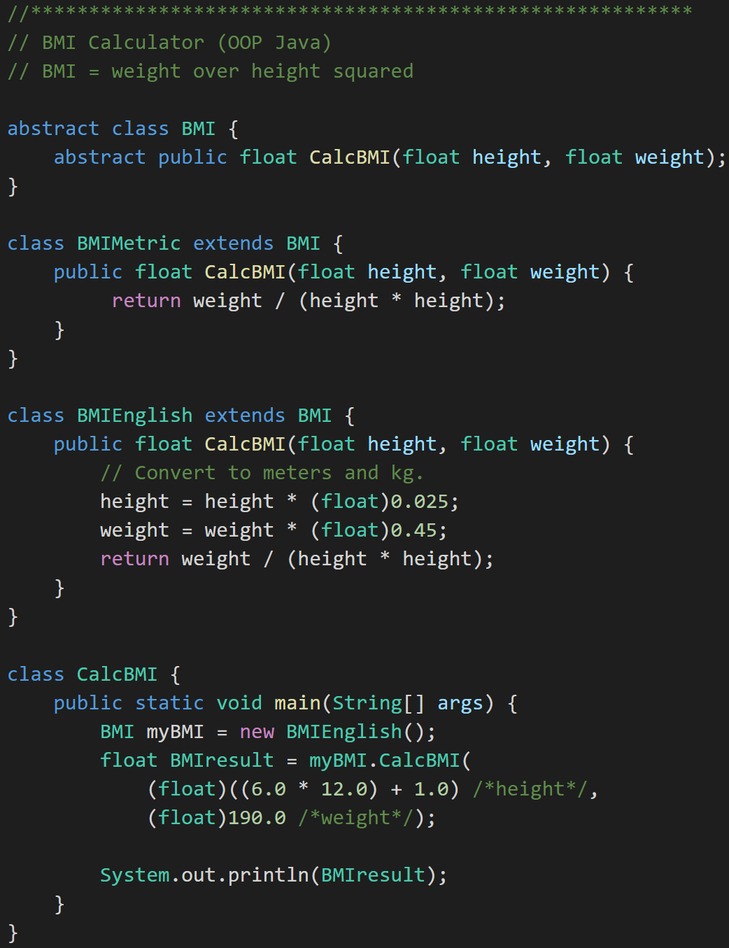
Inheritance to implement English units… And Abstraction
BMI
BMI Metric
BMI English
Notes:
Let’s look at how we enhanced our class hierarchy. We created a new Abstract base class call BMI. Yes, the fact that we did this likely broke others that were using our class. We will need to call them and apologize. Note that implementing Option #1 on the proceeding slide should have avoided this. Notice the Abstract CalcBMI method in BMI. We have not learned the difference between Abstract and Virtual yet. Virtual means a Method can be overridden where Abstract means it must be overridden.
We also implemented two classes that extend BMI. Our original class was renamed to “BMIMetric” and we added a new class “BMIEnglish”… seem elegant and simple.
Now we create a new BMI that is actually a BMIEnglish. If that doesn’t mess with you mind just a little, think about it some more. Note that we could have made the line:
“BMI myBMI = new BMIEnglish();” read
“BMIEnglish myBMIEnglish = new BMIEnglish();”
And have gotten the same results. I actually think the second line is cleaner and simpler. It avoids Polymorphism… which really isn’t need here.
If you understand why these two line produce the same results in this example? If so you are well on your way to understanding Abstraction and Polymorphism. Or you might want to come back to this after our Polymorphism example and see if it makes more sense.

Slide 26
Superclass and Subclass
BMI
BMI Metric
BMI English
Superclass
Notes:
Let’s backtrack and cover a couple required (and valuable) items.
We now have an example of a Superclass in BMI

Slide 27
Superclass and Subclass
BMI
BMI Metric
BMI English
Subclass
Notes:
And we have two examples of Subclasses. That was easy.

Slide 28
Abstraction
BMI
BMI Metric
BMI English
Abstraction
Notes:
And we have and example of Abstraction.
Abstraction
Abstraction is another key concept. Something is abstract when it is a concept but is not concrete or defined enough to actually be built. Generally, in OO design, we start with abstract things, and then we build on them through inheritance.
An abstract class is one that has one or more abstract methods.
An abstract method is a method / function that has no body – just a name, return type, and parameters.
An interface is the strictest interpretation of an abstract class – it is a data structure that consists entirely of abstract methods. In other words, none of its methods/functions have a body.
Abstraction is related to inheritance. Often, when we construct families of related objects, we start the family with an abstract class that represents the least common denominator for everyone in that family. In other words, what do all classes that are part of that family have in common? We often (not always, but often) put that in an abstract class.

Slide 29
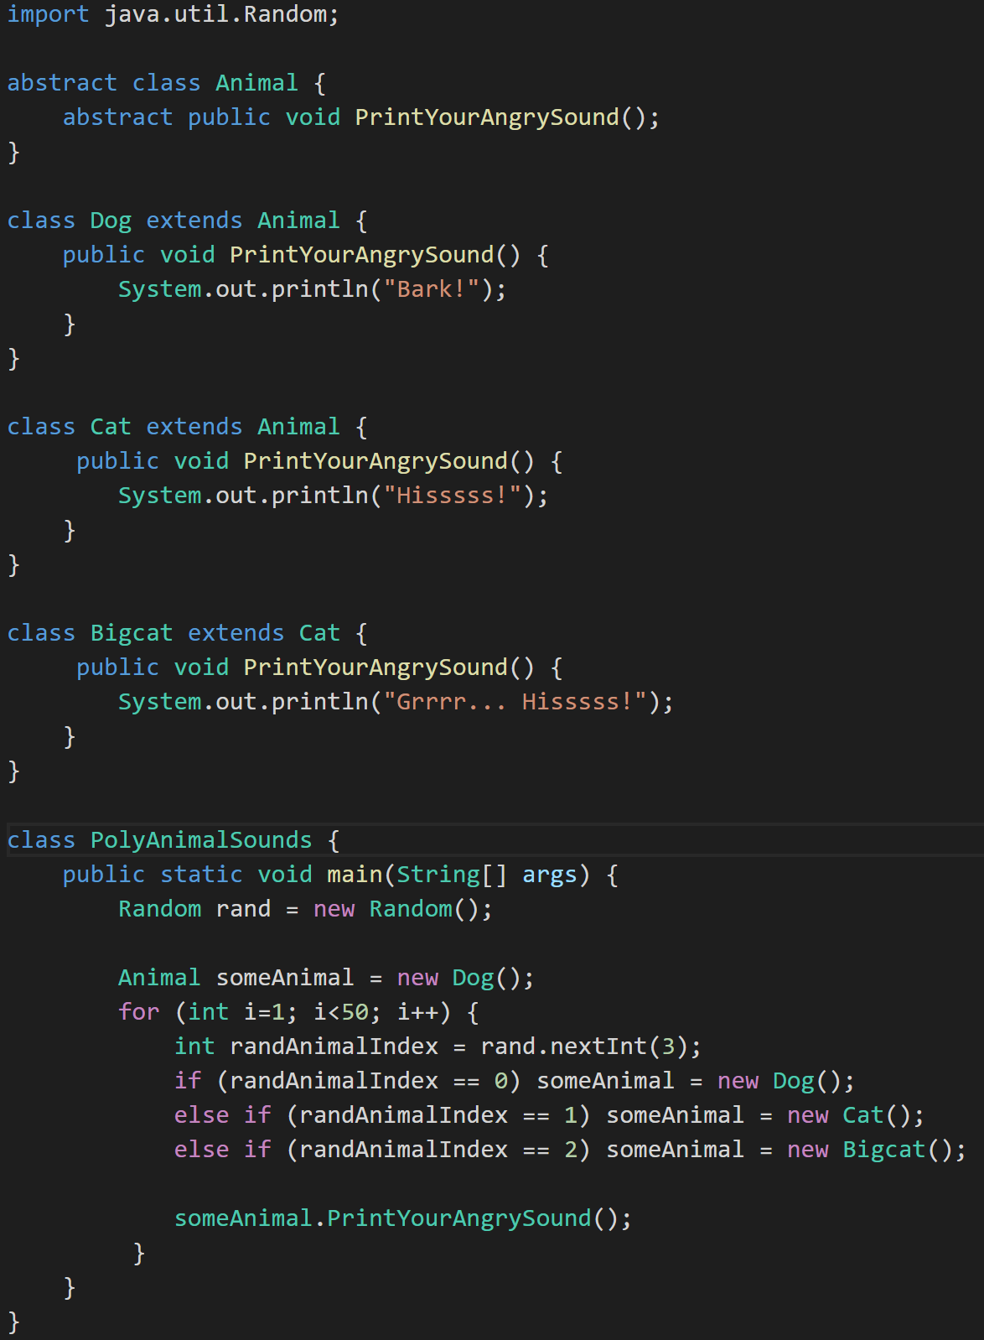
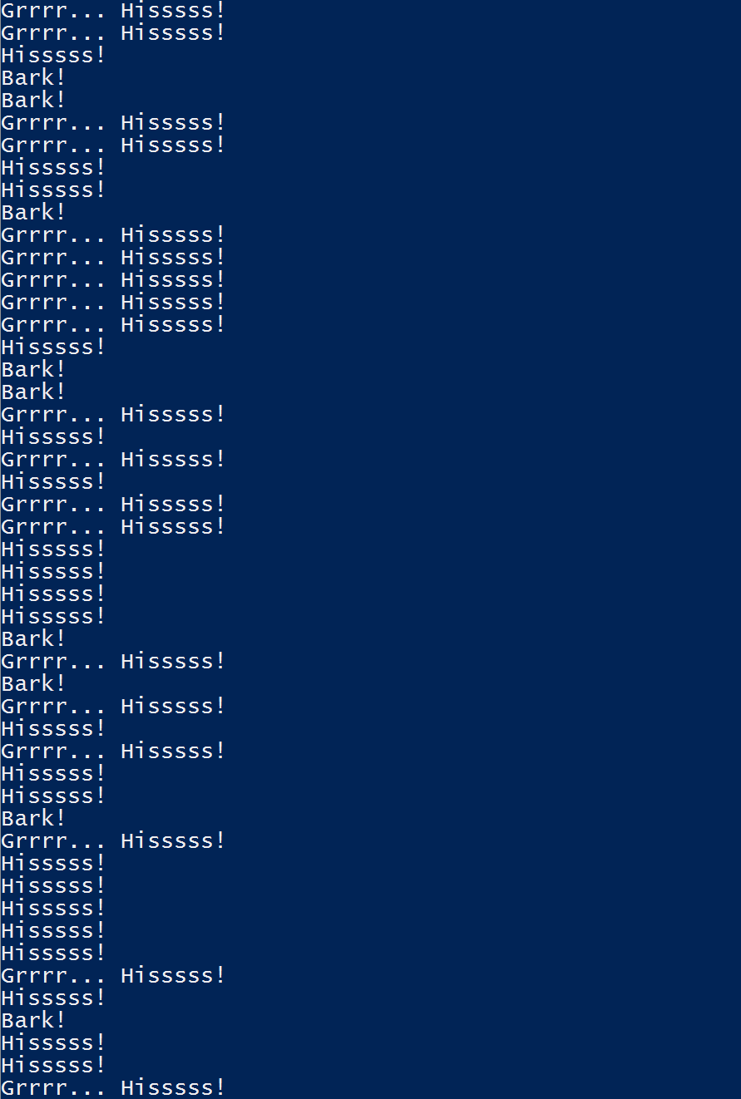
Polymorphism
Animal
Dog
Cat
Bigcat
Polymorphic
Notes:
Polymorphism? Let’s do something new. Let’s do something with Animals, Abstraction, Superclasses, and Subclasses. Take a look at the class hierarchy on the left. Can you track it to the code on the right?
We have and Abstract class Animal that provides the template for an Abstract method “PrintYourAngrySound()”. We have Subclasses Dog and Cat who both Override “PrintYour AngreeSound()” as required. Then we have a Bigcat class that Extends Cat. We have seen all of these things before.
Now we have added the idea of Random numbers. Let’s ignore that for now. It’s enough to know that the Random class that came from “java.util.Random” generates random numbers. Who would have guessed…
Now for the finalize… Notice how “someAnimal” can behave like “Dog”, “Cat”, or “Bigcat” depending the random number generated. This is Polymorphism.
Now can you come up with that brief animal based interview response for Polymorphism. Be sure to throw in “oh yes, Polymorphism is usually implemented with virtual methods and a virtual method table” to get full credit at the interview.
It may also be good to know what that actually means just in case one of the interviewers really know what a virtual method table is and has a follow up question.

Slide 30
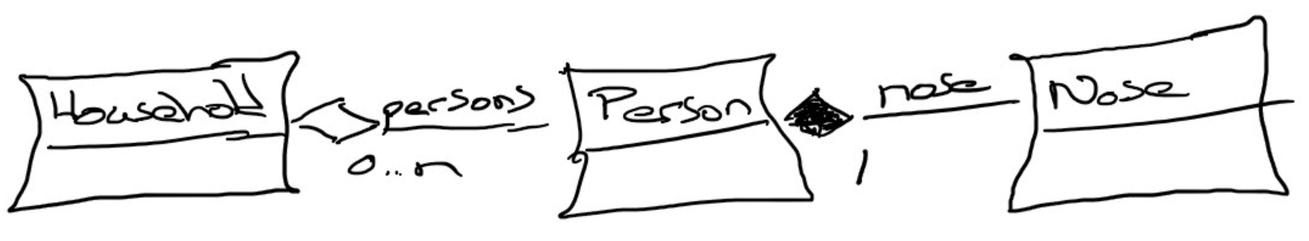
Composition & Aggregation
Composition: A relationship where an object will not exist without the parent object. For example, it is unlikely that the “Nose” object will exist after the “Person” object is gone.
Aggregation: A relationship where multiple objects will likely continue to exist independent of each other. For example, we might have a “Household” object and a “Person” object. It would be very reasonable to expect our “Person” object to continue to exist even if our “Household” object was deleted.
Our First UML:
Notes:
Composition: An example of composition: the relationship between Face and Nose, Mouth, and Eye
class Face {
Nose n;
Mouth m;
Eye le;
Eye re;
}
We probably wouldn’t let the Nose, Mouth, or Eye objects live beyond the Face. They are owned exclusively by the Face. That’s what composition is: exclusive ownership.
One clear sign that we are dealing with composition is if the owner (Face, for example) is responsible for actually creating the objects it owns. Then, clearly, the things that are owned – the Nose, Mouth, etc. – could not have existed on their own and are therefore exclusively owned by the owner object.
Aggregation: Aggregation is also a form of ownership, but it’s non-exclusive ownership. The owned objects can live on and perhaps existed prior to the owned object.
An example of aggregation: A library patron borrows a book. That’s not exclusive ownership, since several people can borrow a book over its lifetime.
The easy way to tell if something is composition or aggregation is to ask if the owner is responsible for creating and destroying the thing that is owned. If so, it’s a composition relationship.

Slide 31
Topics
Define object-oriented programming (OOP)
Review object-oriented languages and tools
Demonstrate object-oriented programming concepts
Distinguish between a class and an object
Identify and define “six” object-oriented concepts
Identify the superclass and the subclass in an inheritance relationship
Demonstrate inheritance, ownership, and abstraction with Java code
Distinguish between aggregation and composition
Recap

Slide 32
Recap: Object-Oriented Programming
Associates Properties and Methods with Objects and Classes
Rich in practice and theory with well accepted concepts
Consistent support for powerful features including:
Encapsulation… and Information Hiding
Inheritance… and Abstraction
Polymorphism
Strong support for delivering reusable, extensible, maintainable, and supportable solutions
Encompasses both design and programming activities

Slide 33
Recap: Why Object-Oriented Programming
#1 – It is the best way we know to consistently deliver high quality software products… particularly sophisticated GUI based application within Iterative or Agile delivery teams
#2 – It is the approach demanded by the industry
#3 – It’s an enjoyable way to build, enhance, and support software solutions
Notes:
You may have different reasons why you think it is important to learn object-oriented design and programming. That’s okay.

Slide 34
Topics
Define object-oriented programming (OOP)
Review object-oriented languages and tools
Demonstrate object-oriented programming concepts
Distinguish between a class and an object
Identify and define “six” object-oriented concepts
Identify the superclass and the subclass in an inheritance relationship
Demonstrate inheritance, ownership, and abstraction with Java code
Distinguish between aggregation and composition
Recap: How is object-oriented programming different
Notes:
We have a lot of solid topics for our first week. You will quickly notice that three words are underlined. You will see references to object-oriented concepts, patterns, and principles throughout the week and throughout the class.
Concepts: Practices, standards, and tools the effectively support object-oriented design and programming… I need to do enhance the BMI class to provide better Encapsulation and hide the height and weight properties (hours).
Patterns: Well established templates for forging relationships between classes… I would like to generate the random Animal generator using a Factory pattern so it is more supportable (days)
Principles: Proven industry guidelines… Using a Factory Pattern is a good start; however, I think we should focus more on making sure that we follow the Open Close Principle throughout our product (weeks+)
If you take a look through the topics you will hopefully see a few that are familiar; however, I suspect that many will be new. Don’t be concern, by the end of the week you will have some familiarity with all of them. You should also have resources that will let you go back and refresh you memory when you need to do that.
I am going to divide the topics up into three or four sections so that we can focus and keep our energy.

Slide 35
Object-Oriented Programming Concepts & Practices
Eric Pogue

