Slide 1
Object-Oriented Programming Patterns
Eric Pogue

Slide 2
Topics
Review Concepts, Practices, Patterns, and Principles
Defined Design Patterns
Identify Singleton Pattern
Identify Factory Pattern
Identify Delegation Pattern
Identify Model-View-Controller Pattern
Recap

Slide 3
Object-Oriented Programming [link]
Concepts – powerful features that are indispensable to modern software development
Practices – everyday activities that software developers perform in order to delivery quality products utilizing key Concepts
Patterns – tried-and-true templates for forging powerful relationships between classes
Principles – guidelines that help you determine what classes are needed and how they should work together
Notes:
Concepts/Patterns/Principles… Hours/Days/Months

Slide 4
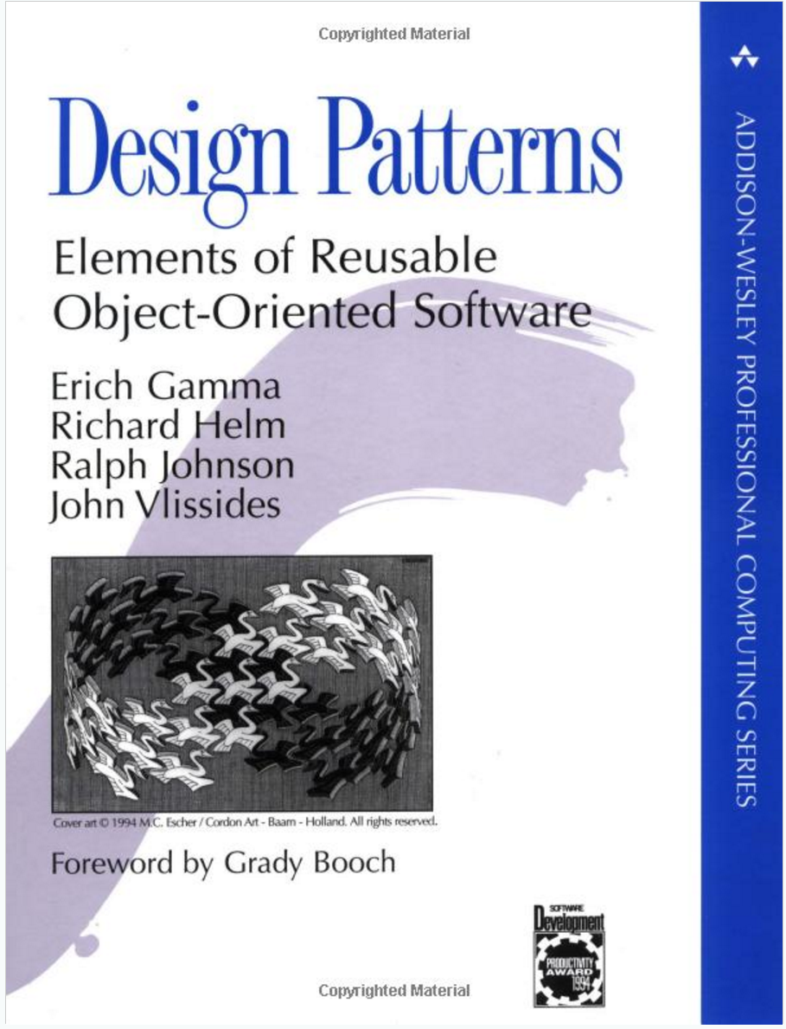
Object-Oriented Design Patterns
Definition: A software design pattern is a commonly repeated approach to constructing software. These approaches are commonly repeated because they consistently produce quality results.
Common Patterns Include:
Singleton
Factory
Delegation
Model-View-Controller
Others… 20+ total in “Design Patterns” book
Notes:
“Design Patterns: Elements of Reusable Object-Oriented Software” has been influential in defining software engineering patterns and is regarded as an important source for object-oriented design theory and practice. The authors are often referred to the “Gang of Four (GoF)”
Interview tip: The answer to any question that references design patterns should include “Gang of Four”, “Reusable Object-Oriented Software”, and “Model-View-Controller”. Now let’s learn what those are.
Why Use Patterns?
Using patterns helps us write good software more regularly, because they are tried-and-true approaches to writing it.

Slide 5
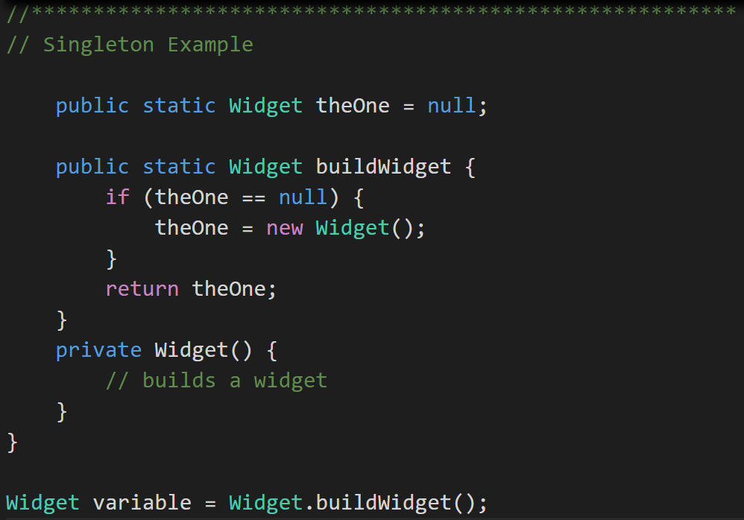
Singleton Design Pattern
Singleton Pattern: Utilized to make sure that only one instance of a class is in existence.
An example would include an application log files that needs to be synchronized across threads. [link]
Notes:
Singleton are pretty easy to understand and come in very handy. A application Logfile class or Configuration file manager are common examples of singletons.
Singleton (making sure there is just one instance of something to avoid conflicts - http://www.oodesign.com/singleton-pattern.html) These are great for coordinating activity across multiple threads of execution or making sure there is a single point of control for a limited resource like a file or printer.
A singleton can be written in Java by making the constructor for the class private and equipping the class with a static function that ensures that the constructor is called only if no other objects of that class already exist.

Slide 6
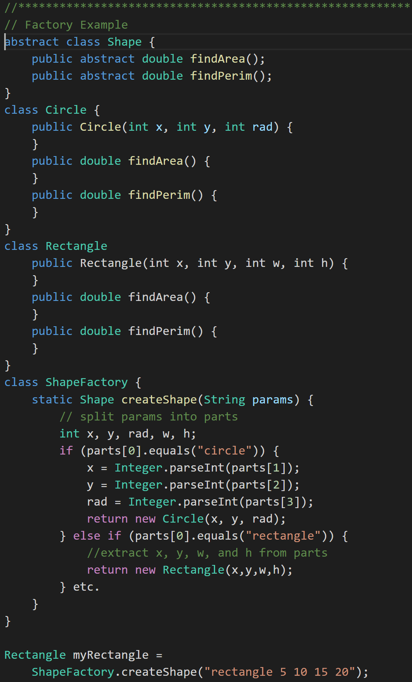
Factory Design Pattern
Factory Pattern: Utilized to create an object without exposing how it is created. [link]
Notes:
An example would have been in our Polymorphic Animal. We could have made an Animal Factory that his the fact that we were just creating random Dogs, Cats, and Bigcats. Then if we wanted to change the ratios or add Animals, we could do it without forcing code changes outside of the Animal Factory.
Another example would be a Shape Factory that return shapes based on input, but does not expose how the shapes are created. See coding example.

Slide 7
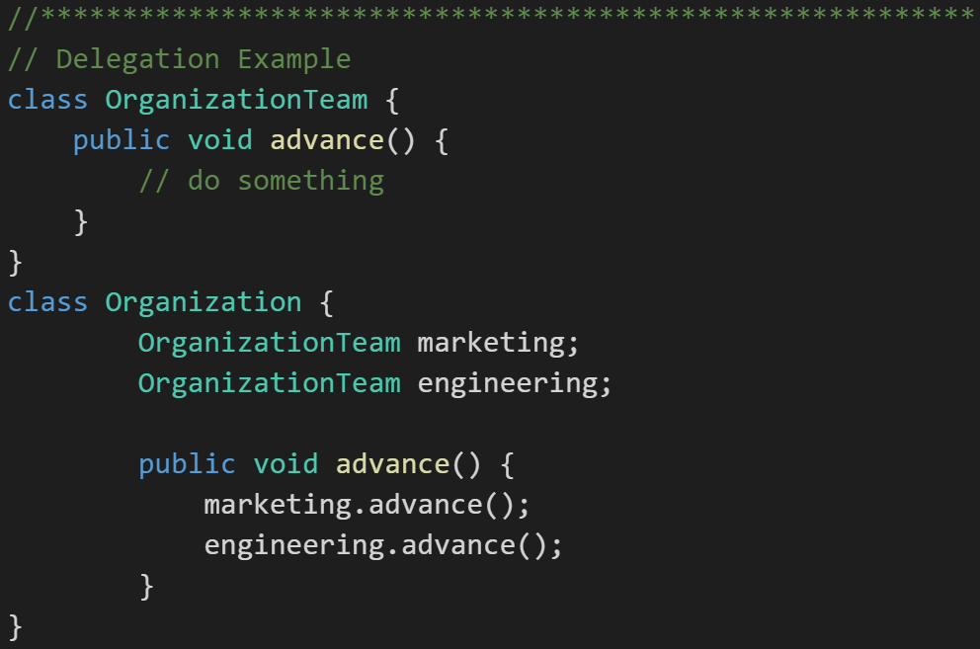
Delegation Design Pattern
Delegation Pattern: In delegation, an object handles a request by delegating to a second object (the delegate). [link]
“Delegation is a way to make composition as powerful for reuse as inheritance” - Grady Booch
Notes:
An example would be an financial application that displays streaming stock prices at the bottom of its windows. We may decide to license an “object” (likely associated with an external service) that we then Delegate the responsibility for displaying on that portion of the screen. Since it may not be technically possible to directly Inherit the functionality from the purchased product, the Delegation pattern allows us to achieve much of the same reuse through an object composition relationship.
Delegation (chain of command; ask an object to do something, which tells something else to do that thing)
Example of the Delegation pattern
In this example, we have software for managing inventory for a manufacturer who makes classroom furniture. We have a variety of writing surfaces that consist of parts. We want to print out our inventory of parts.
class Part {
}
class WritingSurface {
private Part[] parts;
public Part[] listParts() {
}
}
[[Left up to interested reader to complete… or ask for the code.]]

Slide 8
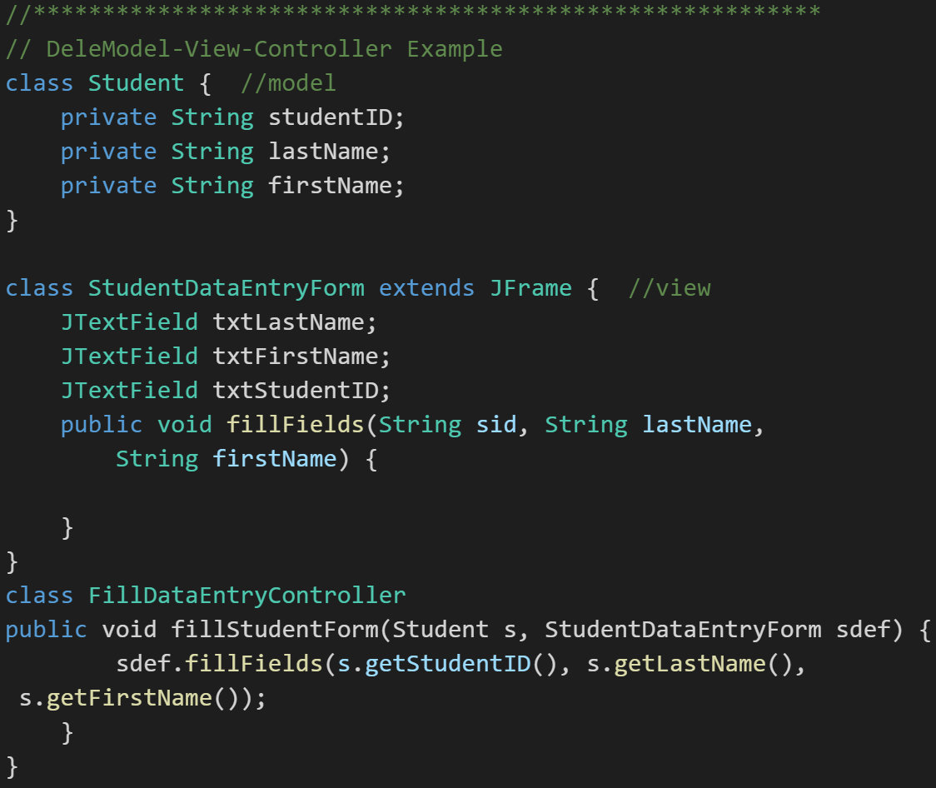
Model-View-Controller
Model-View-Controller (MVC): MVC is an important pattern, will be a primary focus of this course, and will be an important pattern for you to master in your career.
Segregation of our Model (data) from our View (user interface) is necessary to effectively develop, enhance, and maintain modern software.
Notes:
An example would be a system that manages student data. We would want to segregate the Model (data) from the View (UI) for several reasons including that there will likely be many different Views that access the same dataincluding:
student view
faculty view
administrator view,
Web student view,
mobile student view, etc.
Evolution of UI and Data segregation
Document-View (View was responsible for View-Controller functionality)
Model-View-Controller
Model–View–Viewmodel
Learn this Pattern!

Slide 9
Recap
“Each Pattern describes a problem which occurs over and over in our environment, and then describes the core of the solution to that problem, in such a way that you can used the solution a million times over, without ever doing it the same way twice.” –Christopher Alexander (Architect)
“Design Patterns: Elements of Reusable Object-Oriented Software” – THE Book
Common Patterns Include:
Singleton
Factory
Delegation
Model-View-Controller
Others

Slide 10
Topics
Review Concepts, Practices, Patterns, and Principles
Defined Design Patterns
Identify Singleton Pattern
Identify Factory Pattern
Identify Delegation Pattern
Identify Model-View-Controller Pattern
Recap

Slide 11
Object-Oriented Programming Patterns
Eric Pogue

