Slide 1
More Object-Oriented Programming
Eric Pogue

Slide 2
Topics
Recall Encapsulation, Inheritance, and Polymorphism
Reinforce Private, Protected, and Public modifiers
Reinforce Method Overriding and Overloading
Explain Constructors
Explain Getters & Setters
Explain the Java Root Class
Recap

Slide 3
Encapsulation & Information Hiding
Encapsulation: Restricting access and visibility of Properties and Methods of a Class in order to make the Class easier to utilize, extend, and maintain. [link]
Information Hiding: The Information Hiding term is often used interchangeably with Encapsulation. Information Hiding does not connection with Object-Oriented Programming and can be used to describe practices utilized in non-OOP languages as well. [link]

Slide 4
Golden Rule of Encapsulation
Minimize Class Property and Method scope and visibility. The Encapsulation hierarchy:
None (can we eliminate the Property or Method)
Local variable
Method parameters,
Private Property
Protected Property
Public Property
global variable
Notes:
Helpful Interview Hint: Whenever you are asked a conceptual question about object-programming in an software development interview (and you will be), answer confidently “Encapsulation”, “Inheritance”, and “Polymorphism”.
When asked what is Encapsulation (or how would you implement it), say, “I would limit or minimize variable scope and keep data attributes private as often as possible.”
Now as we are going through our object-oriented examples, be thinking about how you would answer the “What is Inheritance?” and “What is Polymorphism?” interview questions. Note that answering them both with very brief examples can be very effective… and it is always best to use animals in you OOP interview examples.
Now we just need to make sure that we are able to effectively utilize these concepts after we get the job. Let’s start by walking through an example.

Slide 5
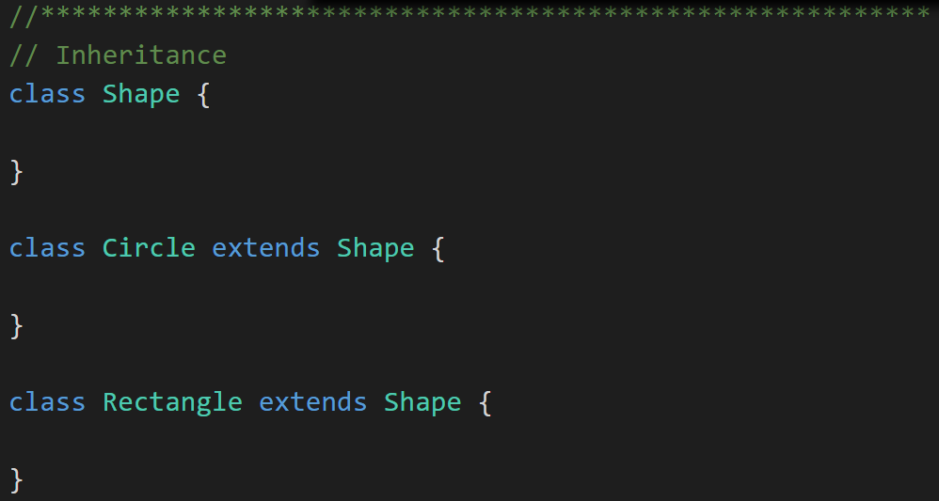
Inheritance & Abstraction
Inheritance: When one Class acquires the Properties and Methods of another Class it is called Inheritance. [link]
Abstraction: Something is abstract when it is a concept but is not concrete or defined enough to actually be built. Generally, in OO design, we start with abstract things, and then we build on them through Inheritance. [link]
Notes:
The first of many “Shape” examples. We will get to a Abstraction example in a few minutes.

Slide 6
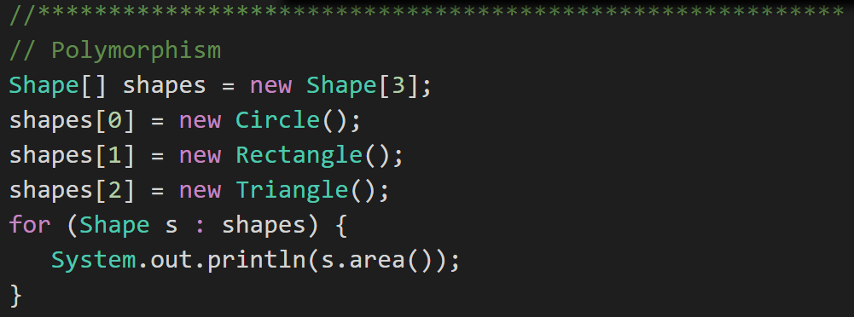
Polymorphism
Polymorphism: Polymorphism enables you to process collections of related things generically. This is particularly useful when you want to use a loop to march through a collection of items. [link]
Notes:
Example of polymorphism: a for loop that moves through the entries of a list. The list might be of a collection of related kinds of object. We can refer to each of the objects in the list through a generic variable (whose data type matches the one that all are ultimately related to). But, when we invoke a particular function that all members of the family share, each will respond by performing that function in their own specific way. For example, we could have a collection of Shape objects. We could refer to each entry in the Shape list through a generic Shape variable, even though the actual entries in the list are specific kinds of shapes – Circle, Rectangle, etc. All Shape objects might have the ability to calculate their own area. When we refer to an object in the list through a generic Shape variable and tell it to calculate its area, thanks to polymorphism, the circle version of the area() function will be called when we’re dealing with a circle, and the Rectangle version of area() will be called when we’re dealing with a rectangle, etc.
The first time through the for loop, we’ll call the Circle.area() function – actually, we won’t; it will happen automatically. The next time through, we’ll call the Rectangle version, and then we’ll call the Triangle version.
Polymorphism is implemented behind the scenes using a Virtual Method Table (VMT). The VMT keeps track of where various related classes’ same-named functions are located in memory. Using the VMT, the operating system is able to figure out which code to implement when we tell each shape to fire its area() function.

Slide 7
Private, Protected, and Public modifiers
Access Modifiers allow us to enforce Encapsulation be describing the level of access defined for Properties, Methods, and Classes. Common Modifiers include:
Better Encapsulation
Modifier | Class | Subclass | Global
Public | Yes | Yes | Yes
Protected | Yes | Yes | No
Private | Yes | No | No
Modifier | Class | Package | Subclass | Global
Public | Yes | Yes | Yes | Yes
Protected | Yes | Yes | Yes | No
Default | Yes | Yes | No | No
Private | Yes | No | No | No

Slide 8
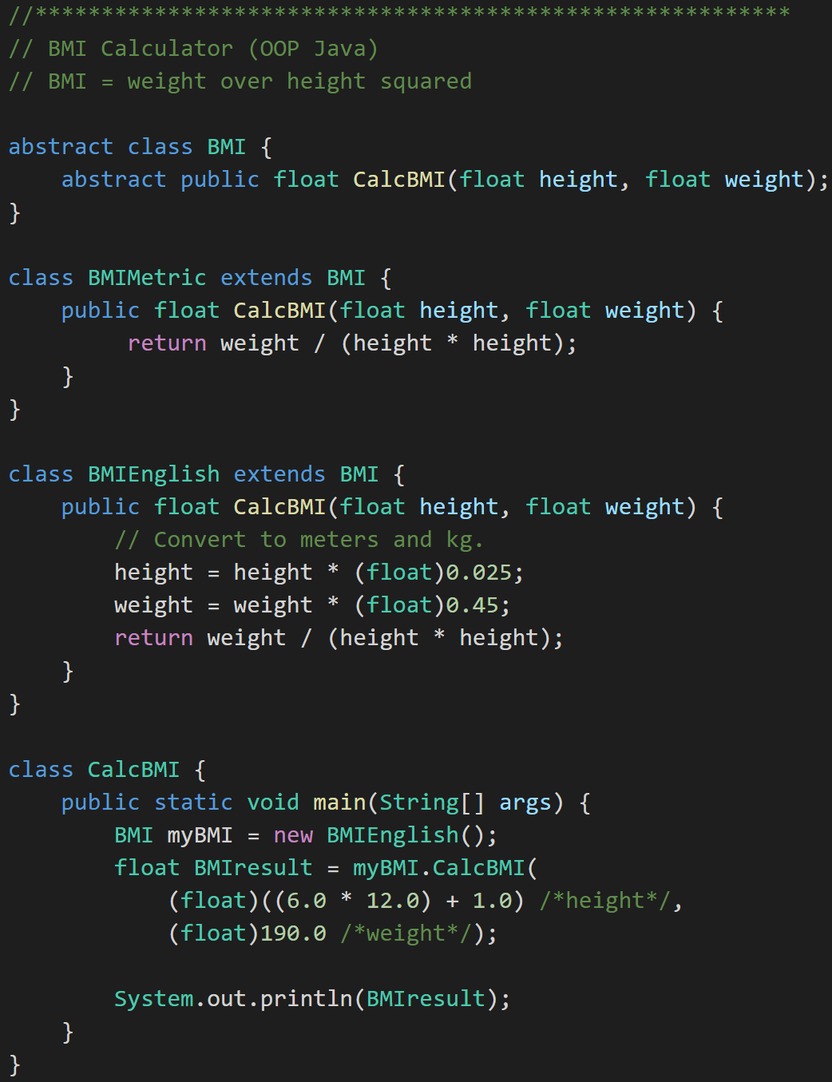
Overriding and Overloading
Overriding Method: Subclass implementing same method name and same parameters
Overloading Method: Same function name with different number of parameters. Only use this in specific situations like Constructors.
Overriding
Notes:
It’s regrettable that the naming is so close on these two concepts.
Method Overriding is what we have been doing as we create supperclasses and subclasses. We Override methods in the parent class to add functionality. For example, we overrode (override, overriding, overrode) the CalcBMI method of BMI when we implemented CalcBMI in BMIEnglish.
We will be Overriding methods constantly in this class. Overloading will be less common and less important, but we do need to understand what it is.
Overriding MUST have exactly the SAME parameters and return types.
Overriding MUST have at least one parameter or return type that is different.

Slide 9
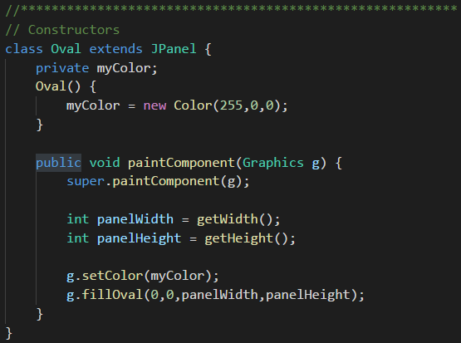
Constructors
A Constructor is a special method that initializes the Object Properties.
In Java a constructor has the same name as the Class, is called when the object is initialized, and generally utilizes the default (package friendly) modifier.
Constructor
Notes:
This is an example of an Overridden method.

Slide 10
Constructor Writing Guidelines
Constructors are unique in that they cannot return a value and the associated object may not be fully initialize as the constructor is executing. Therefore, when writing Constructors it is good practice to:
Be careful about which methods are called from a constructor… to be completely safe we should only call private, final, or static methods
Ovoid calling methods that take a long time, create separate threads, or are likely to fail
Consider creating separate methods to initialize objects for long running or “risky” activities like opening a file, database, or socket connection for example
Notes:
Below are some conversation that I took from various Internet sources related to calling methods from Constructors. Many organizations shy away from doing “complex” or “dangerous” things in Constructors. Consider how we would recover from a failed command in a constructor… recall that by definition it has not return value.
Below are some quote from various Internet sources:
You should not call instance methods in constructor is dangerous as the object is not yet fully initialized (this applies mainly to methods than can be overriden). Also complex processing in constructor is known to have a negative impact on testability.
Constructors should not call an overridable method - that is, they should only call methods that are private, static, or final.
Constructors (of non-final classes) should call only final or private methods. If you decide to ignore this rule and let the constructor call non-final/non-private methods, then those methods and any methods they may call must be careful not to assume the instance is fully initialized, and the subclasses that override those methods (subclasses that may not even be aware that the superclass constructor is calls those methods) must not assume that the subclass constructor and superclasses' constructors have been fully executed. This problem gets worse the deeper down the inheritance hierarchy the superclass with the "evil" constructor is.
Is all that extra cognitive baggage worth it? You could allow an exception for simple mutators that only assign a value to an instance variable, since there's little benefit, even that doesn't seem worth it.
Setters can be useful for standard range checks and so on, thus no extra code to verify the input is needed. Again using setters is slightly dirtier approach.

Slide 11
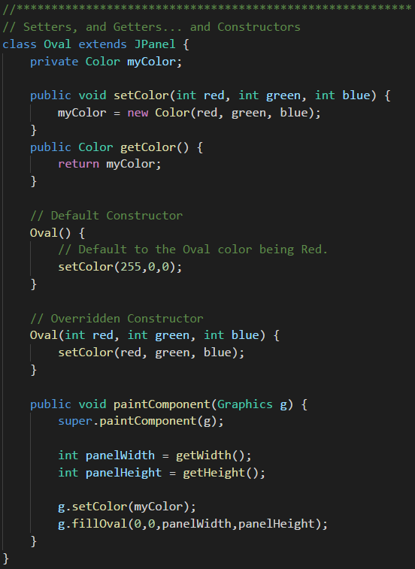
Setters & Getters
Setters and Getters are a practice where Encapsulation is improved by implementing Public or Protected methods to control how private Attributes are updated.
They can be beneficial in:
Validation
Optimization
Converting types (English to metric)
Debugging breakpoints
Some libraries expect setters and getters
Setter & Getter
Notes:
Setters… and Getters… and Constructors…. Oh my!
Why use Setters & Getters? Because 2 weeks (months, years) from now when you realize that your setter needs to do more than just set the value, you'll also realize that the property has been used directly in 238 other classes. (Internet quote)
Our rules:
1 – All class properties/attributes will be private
2 – Getters & Setters will be utilized and be defined as protected or private when they are needed
Notice the Overridden and Overloaded Constructors

Slide 12
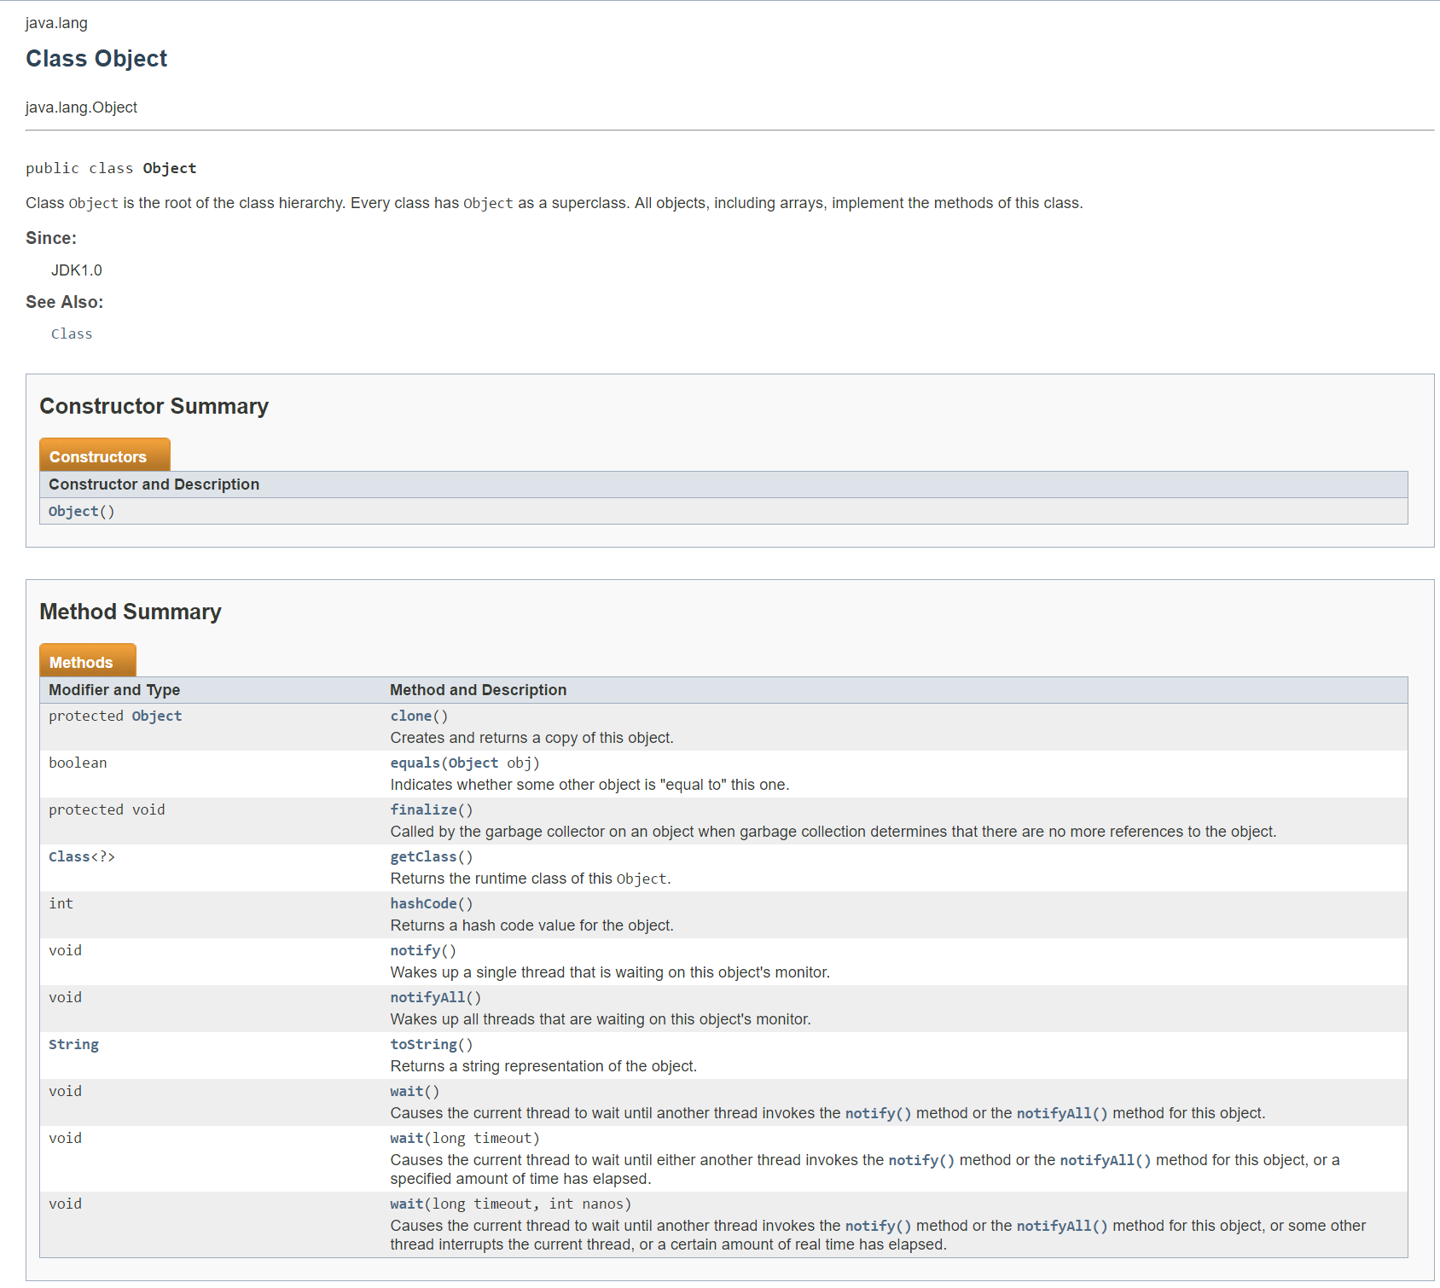
Inheritance… and Java Root Class
java.lang.Object:
The Class named Object is the base class for ALL classes
It contains numerous methods including toString()
A little foreshadowing… the screen to the right was automatically generated using JavaDoc
Notes:
A package is a logical grouping of Java library classes. The java.lang package comes “for free” for all Java applications.
All java classes inherit from Object.
Note: Yes, I know, the terminology of having a base class called “Object” can be challenging. For our purposes objects are instances of classes. However we also recognize that the base Java class is also regrettably called “Object”. I will generally call it “the base java class” and not refer to it as “Object”.
Take note of the “toString()” method and recognize that EVERY java class can be expected to have a “toString” method. We will be overriding this method regularly in this week’s examples.

Slide 13
Recap
Recall Encapsulation, Inheritance, and Polymorphism
Reinforce Private, Protected, and Public modifiers
Reinforce Method Overriding and Overloading
Explain Constructors
Explain Getters & Setters
Explain the Java Root Class

Slide 14
End of Session

