Slide 1

Object-Oriented Programming Discussion, Lecture, & Lab Eric Pogue
Agenda for Sprint 2 Live Lecture/Lab Session:
Friendly Conversation Topic – Software Engineering Models and the Virtuous Triangle
Configuration Management (Git/GitHub)
Sprint Planning for Sprint 2
Foreshadowing Sprint 3 FaceDraw Assignment
Discuss UML Phone Example
Discuss Shapes Tutorial Expectations
Review Select Topics from More Object-Oriented Programming
Lab
Wrap-up and Final Questions/Comments
Discussion & Questions welcome at any time… please be present with no phones or email during our time together

Slide 2
- Verify Screen Resolution 1920x1080 - Verify Chat Session Open & Working - Mute Lines - Start Recording

Slide 3
Object-Oriented Programming Discussion, Lecture, & Lab Eric Pogue
Agenda for Sprint 2 Live Lecture/Lab Session:
Friendly Conversation Topic – Software Engineering Models and the Virtuous Triangle
Configuration Management (Git/GitHub)
Sprint Planning for Sprint 2
Foreshadowing Sprint 3 FaceDraw Assignment
Discuss UML Phone Example
Discuss Shapes Tutorial Expectations
Review Select Topics from More Object-Oriented Programming
Lab
Wrap-up and Final Questions/Comments
Discussion & Questions welcome at any time… please be present with no phones or email during our time together

Slide 4
Today’s “Friendly Conversation” topic
Software Engineering Models
“Essentially, all models are wrong, but some are useful.”
– George Box

Slide 5
People, Process, and Technology
Software Engineering:
People: Teams, Optimism, Engagement, Ambition, Dedication, Leadership, Skills, Experience, Domain Knowledge…
Process: Waterfall/Iterative/Agile, Portfolio Management, Project Management, Funding, Prioritization, Metrics…
Technology: Development Environments & Languages, Object-Oriented Programming, Configuration Management, Cloud Hosting, Scriptable Infrastructure, Source Code Management, Automated Testing…
Notes:
Eric’s View

Slide 6
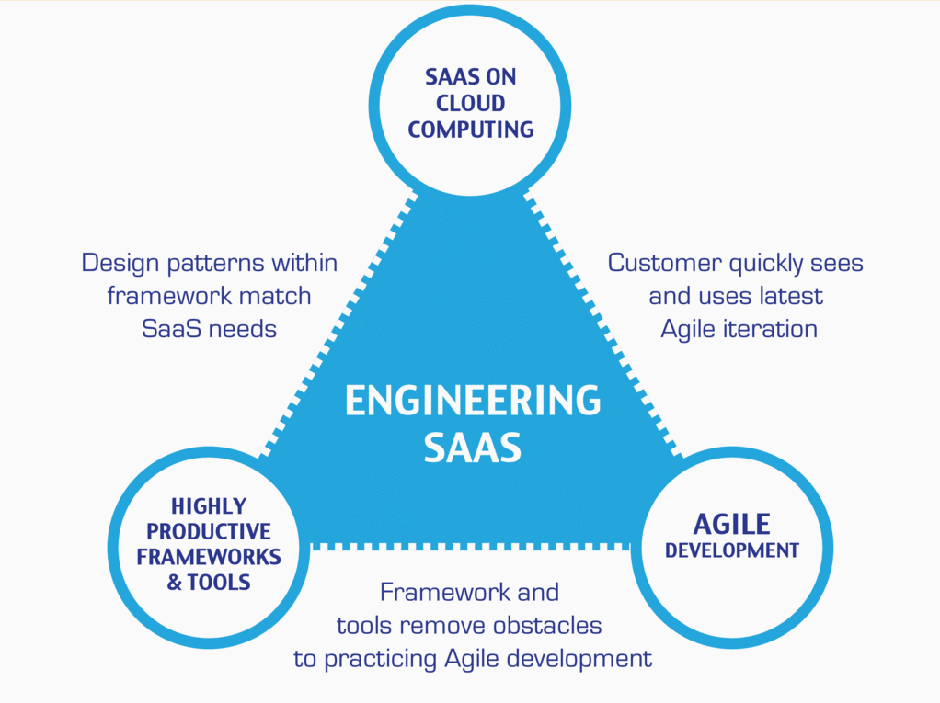
…And the Virtuous Triangle
Hosting Technology: Cloud, Scriptable Infrastructure, Software as a Service (SaaS)…
People: Teams, Optimism, Engagement, Ambition, Dedication, Leadership, Skills, Experience, Domain Knowledge…
Process: Agile, Portfolio Management, Project Management, Funding, Prioritization, Metrics…
Productivity Technology: Development Environments & Languages, Object-Oriented Programming, Source Code Management…
By Armondo Fox and David Paterson
“Engineering Software as a Service

Slide 7
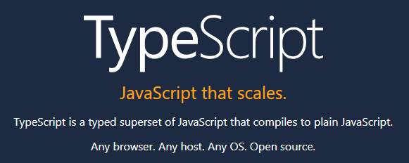

Slide 8
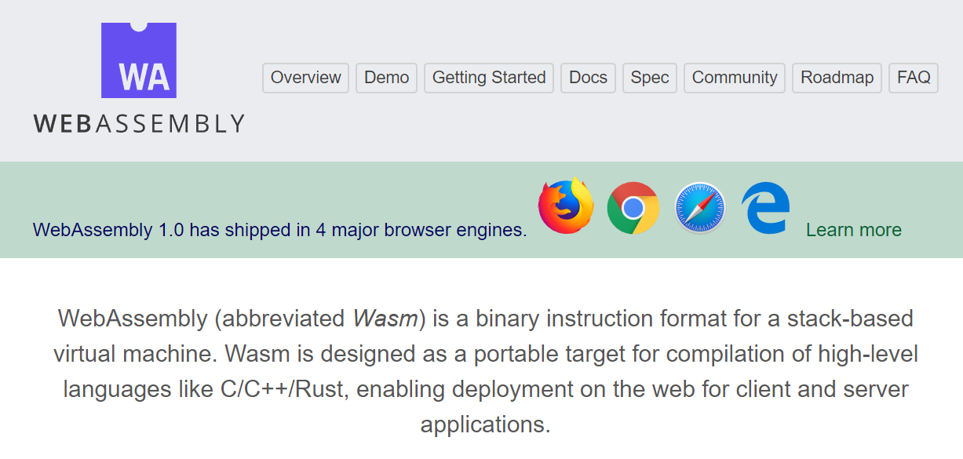

Slide 9
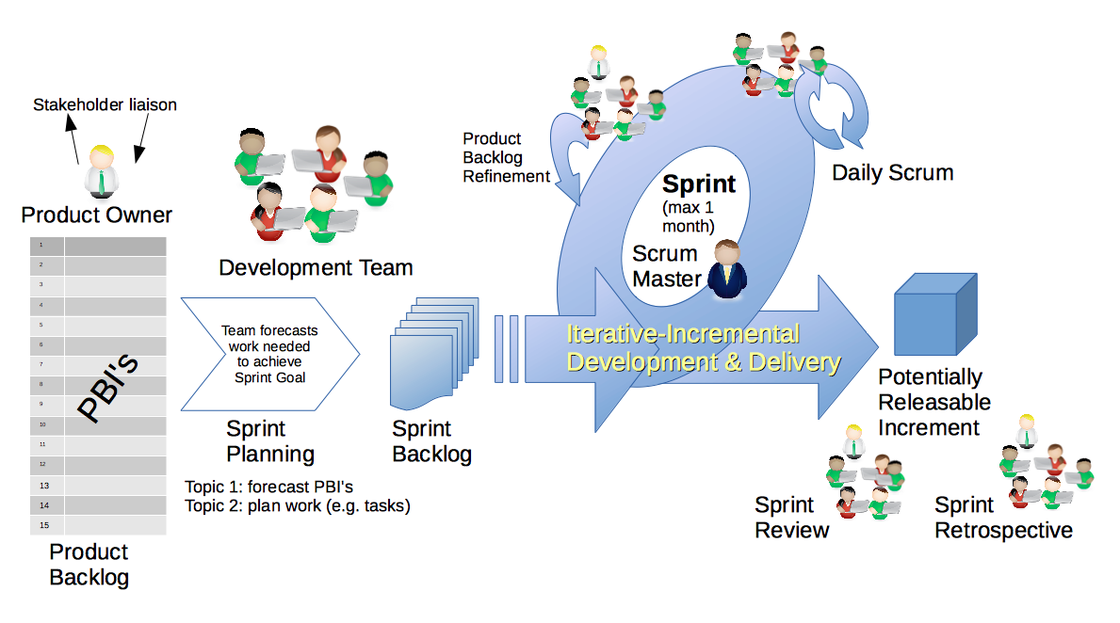
Scrum Process & Roles – Sprint Planning
By Dr ian mitchell - Own work, CC BY-SA 4.0, Link

Slide 10
Review Sprint 2 Activities List, Programming Assignment, and Quiz
Notes:
Optimism, good natured humor, and effectively working together is immensely important to delivering good software… and likely equally important to delivering just about any quality product
Even if you don’t intend to be a professional software developer, many of the things that we learn will be valuable in related areas.
Soooo… We have 16 weeks to learn something valuable and interesting. Let’s enjoy our time together and make the most out of it.

Slide 11
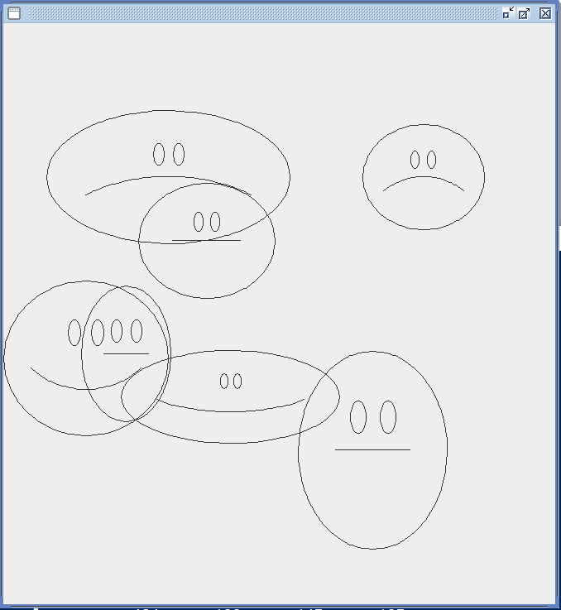
Foreshadowing FaceDraw
In the sprint 3 FaceDraw assignment, you will need to:
Create an graphical Java application
Draw 3 to 10 random faces on a window
Make each face a random width and height
Give each face a random emotion
Make it all visually appealing
And more
It will be challenging!

Slide 12
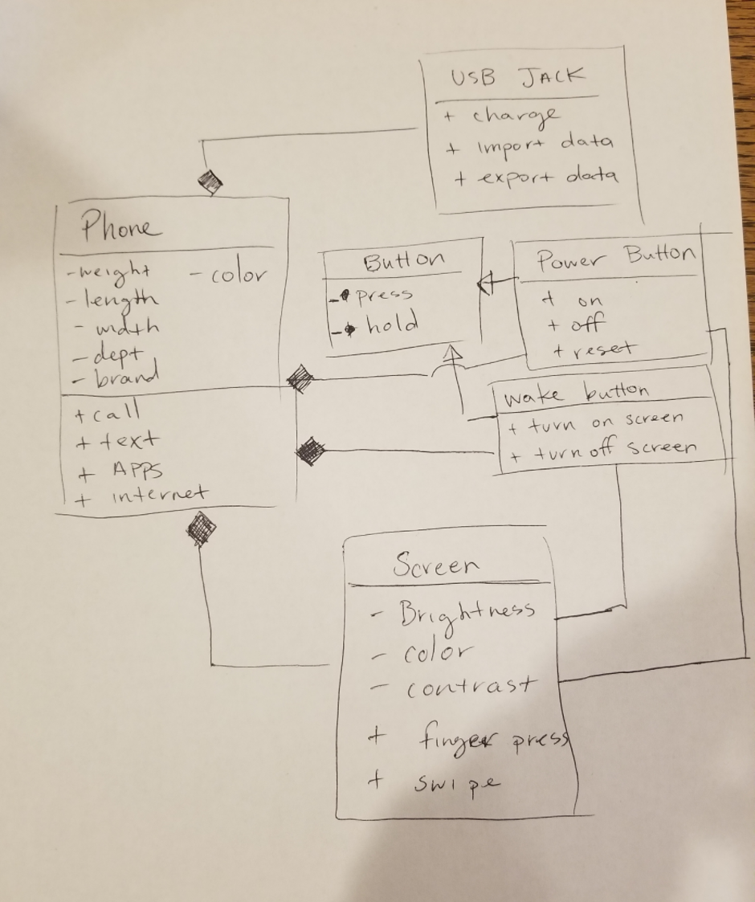
UML Phone Example

Slide 13
Shapes Tutorial Expectations
After you complete the Shapes Step 1 and Shapes Step 2 Tutorials you should be able to:
Declare an abstract class and explain why it is useful
Use Inheritance to build classes and objects that extend base class functionality
Implement Encapsulation and Data Hiding by using setters and getters
Write default and non-default constructors
Override the toString function
Store multiple objects in an ArrayList using generic data types
Distinguish between using an array and an ArrayList
Work with a collection of related objects polymorphically
Explain how Polymorphism is implemented behind the scenes

Slide 14
Review Select Topics: More Object-Oriented Programming

Slide 15
Sprint 2 Lab
Note that these lab items utilize topics that we will cover in the sprints 1-3. Many of the topics may be unfamiliar and may make you uncomfortable. My hope is that by giving you an early preview to them, our week 3 FaceDraw assignment will be more enjoyable.
Review of hierarchical file systems and where to store material for this class
Clone & Pull the current course materials… you should do this regularly
Compile, run, and review the ShapeDraw application in the source-lite folder
Note: You still need to complete the “Shapes Step 1” and “Shapes Step 2” tutorials!
Review pre-OOP Graphical Hello World Windows C code
Code HelloWorldPlus together
Complete OvalDraw Tutorial Using GitHub and Git together (next slide)

Slide 16
Sprint 2 Lab (continued)
OvalDraw Tutorial Using GitHub and Git:
Discuss Configuration Management
Review Common Git/GitHub Command Branching Pattern
Create a GitHub project
Clone project
Step 1: Implement “Hello World” type application
Step 2: Implement JFrame
Step 3: Implement JPanel
Step 4: Implement Oval that draws itself

Slide 17
Configuration Management (Git/GitHub)
Source code control is Part of Configuration Management that many professional organizations feel new software developers do not get enough experience with in college. Git & GitHub can play a central role in:
Managing your source code
Providing a “safety net” while you are programming… allowing you to be more bold in your programming
Submitting project code for class
Allowing a team to collectively share and manage code
Deploying code to test or production environments

Slide 18
Git Commands
Git is a rich and powerful tool. Today we are going to be focused on utilizing some of the basic Git commands as well as branching commands. These commands include:
git clone
git add
git commit [-a -m “Update file.”]
git branch
git checkout
git merge
git push
Pattern:
git branch v0-0x
git checkout v-0x
git commit -a -m “Implement v-0x
git checkout master
git merge v0-0x
git push

Slide 19
Wrap-up and Final Questions/Comments

Slide 20
End of Session

