Slide 1
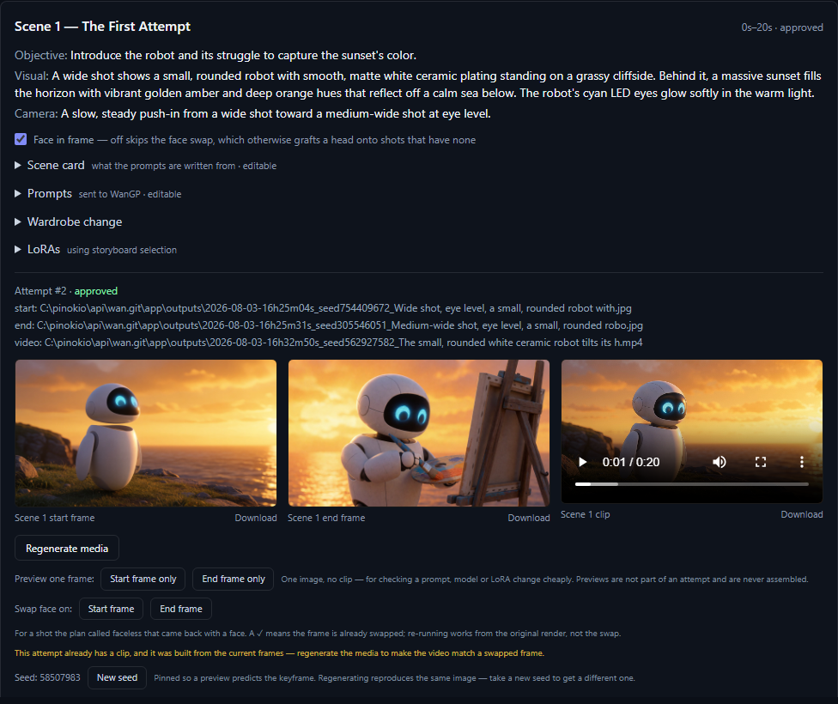
STORYFORGEAI
From one idea to an approved AI media package
A local-first production workspace where specialized agents plan the story, write scene-level keyframe and video prompts, and orchestrate Wan2GP through MCP.
AGENTIC PLANNING
SCENE CONTRACTS
WAN2GP MCP
Business and solution engineering overview
Editable PowerPoint + audience-specific infographics
SCENE-LEVEL OUTPUT
Objective + camera + prompts + start/end keyframes + clip + approval
StoryForgeAI integrates with WanGP/Wan2GP as an independent media backend. Model licenses and commercial-use terms vary.

Slide 2
STORYFORGEAI
PRODUCT STORY
OPERATING MODEL
A production system, not a one-shot prompt
Creative intent becomes a chain of explicit, editable artifacts before GPU generation begins.
1
Intent
2
Creative plans
3
Storyboard
4
Media prompts
5
Approved cut
Concept, duration, style, tone, audience
World, direction, camera, art and variants
Timed scene cards with continuity decisions
Start/end keyframes plus motion-first video text
Wan2GP attempts, QC, approval and assembly
WHAT CHANGES
Before rendering
During rendering
After rendering
Leaders and creators can review the creative logic while revisions are still inexpensive.
Each attempt stays attached to its scene, prompts, seed, model choice and approval state.
Only approved clips reach assembly; exports preserve the storyboard and generation manifest.
Core idea
Make the production decisions visible, editable and reusable before asking image and video models to execute them.
Local-first agentic creative studio
02

Slide 3
STORYFORGEAI
BUSINESS INFOGRAPHIC
FOR BUSINESS LEADERS
Creative scale with control points built in
StoryForgeAI coordinates specialized AI work around a shared storyboard, keeping human choice visible from direction to final cut.
BUSINESS INTENT
AI CREATIVE CREW
STORYBOARD
WAN2GP
APPROVED PACKAGE
Concept + audience
Plans + variants
Timed scene decisions
Keyframes + clips
Cut + manifests
BUSINESS VALUE
Align earlier
Reduce rework
Protect consistency
Keep accountability
Select a creative direction and inspect the plan before committing render time.
Edit one scene or rewrite one prompt pass without rebuilding the whole project.
World, camera, cast, wardrobe and continuity decisions follow the scene.
Attempts, QC findings and approvals remain attached to the production record.
HUMAN CHECKPOINTS
Select direction
Edit scene
Review attempts
Approve clip
Assemble
LOCAL-FIRST OPTION | DEMO WITHOUT EXTERNAL SERVICES | MODEL BACKENDS REMAIN SWAPPABLE
Local-first agentic creative studio
03

Slide 4
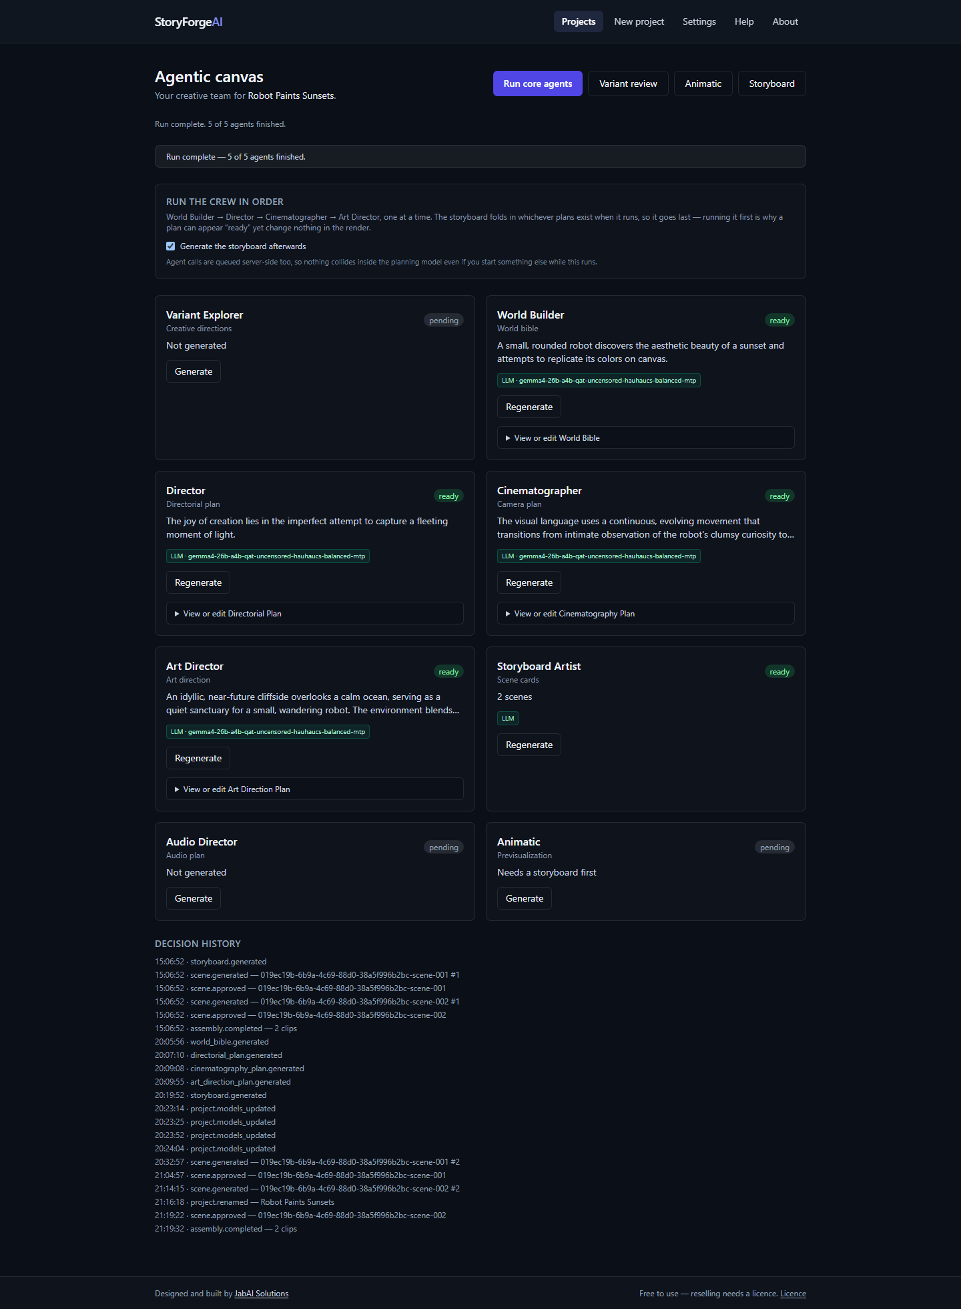
STORYFORGEAI
AGENTIC CANVAS
CREATIVE INTELLIGENCE
A visible crew, each accountable for one artifact
Agents do not blend into one opaque answer. Their plans are stored, reviewed and applied when the storyboard is generated.
PLANNING CREW
PRODUCTION HANDOFF
THE APP MAKES THE CREW LEGIBLE
VE
Variant Explorer
1
Intake Producer
Three creative directions
normalizes the brief
WB
World Builder
2
Story Architect
Rules, locations, motifs, contradictions
creates one beat per segment
Director
3
Visual Bible
DR
consolidates continuity rules
Thesis, pacing, performance, scene intent
4
Storyboard Artist
CI
Cinematographer
writes timed scene cards
Shot language, lens, movement, lighting
5
Prompt Engineers
Art Director
write image + video prompts per scene
AD
Production design, props, color, wardrobe
Plan influence is bound when the storyboard runs; later plan changes require storyboard regeneration.
Local-first agentic creative studio
04

Slide 5
STORYFORGEAI
STORYBOARD + PROMPTS
GENERATION CONTRACT
Every scene becomes a controllable media instruction
The storyboard connects creative intent to two keyframes, a motion-focused video prompt, model settings and an approval decision.
SCENE CARD
KEYFRAME PROMPTS
VIDEO PROMPT
The creative source of truth
Start state
Motion between the frames
Establish framing, subject, set, wardrobe and lighting.
Objective + story beat
Action progression
PREVIOUS END FRAME CAN CARRY FORWARD
Visual + action description
Camera motion + pacing
End state
Identity + continuity constraints
Camera movement + timing
Describe where the scene must land; optionally condition on the opening frame.
Duration + native audio direction
Cast present + wardrobe state
Continuity into the next scene
Model-aware rules
WAN2GP-READY
Cast scope + wardrobe + LoRAs + family directive + exclusions
Prompt + schema-valid settings + media references
Editable before render
The scene card remains editable; image and video prompt passes can be rewritten independently.
Local-first agentic creative studio
05

Slide 6
STORYFORGEAI
TECHNICAL INFOGRAPHIC
FOR SOLUTION ENGINEERS
Artifact-driven orchestration across local AI services
A TypeScript control plane stores creative state, resolves per-scene context, and sends schema-valid generation jobs to Wan2GP over MCP.
EXPERIENCE
CONTROL PLANE
CREATIVE ARTIFACTS
MCP ADAPTER
MEDIA ENGINE
Next.js UI Projects | Canvas | Storyboard | Console | Assembly
API routes + services Orchestrators | queues | approvals | exports
Zod-validated records Brief | plans | scenes | prompts | attempts
Wan2GP client Discover | schema | submit | poll | cancel
Installed model families Image | video | audio | postprocess
PER-SCENE RESOLUTION BEFORE THE PROMPT CALL
Cast scope
Wardrobe timeline
Model family
Continuity
2 calls / scene
Who is in this shot?
What are they wearing now?
Which prompt grammar applies?
Cut, carried frame or clip continuation?
image pass + video pass
OPTIONAL LOCAL SIDECARS
OpenAI-compatible planning LLM
JSON file project store
ffmpeg assembly
Deepy assist
Deterministic mocks for demo/test
External systems are feature-gated behind swappable interfaces; live media generation requires a reachable Wan2GP MCP server.
Local-first agentic creative studio
06

Slide 7
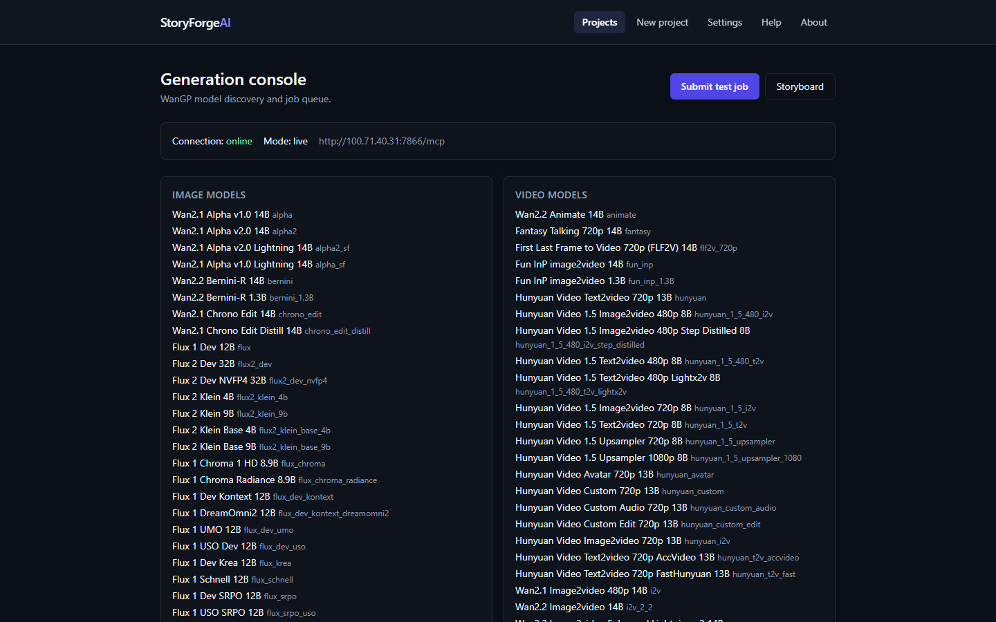
STORYFORGEAI
WAN2GP MCP
EXECUTION PATH
Prompts become model-valid jobs, not raw guesses
StoryForge queries the backend that is actually installed, composes settings from its schema, and tracks every job through completion.
01
Discover
02
Resolve
03
Compose
04
Execute
05
Record
List installed image, video and audio models
Honor pins or route by capability and family
Merge schema defaults, prompts, LoRAs and refs
Submit, poll and cancel through MCP
Store outputs as a scene attempt for review
MODEL-ORDERED MEDIA PIPELINE
KEYFRAMES
FACE SWAP
VIDEO
QC
Why phase by model?
Wan2GP holds one large model at a time. Grouping work avoids repeated image -> edit -> video reloads across scenes.
NETWORK FAULT RETRIES
NO DOUBLE-SUBMIT ON GENERATE
Local-first agentic creative studio
07

Slide 8
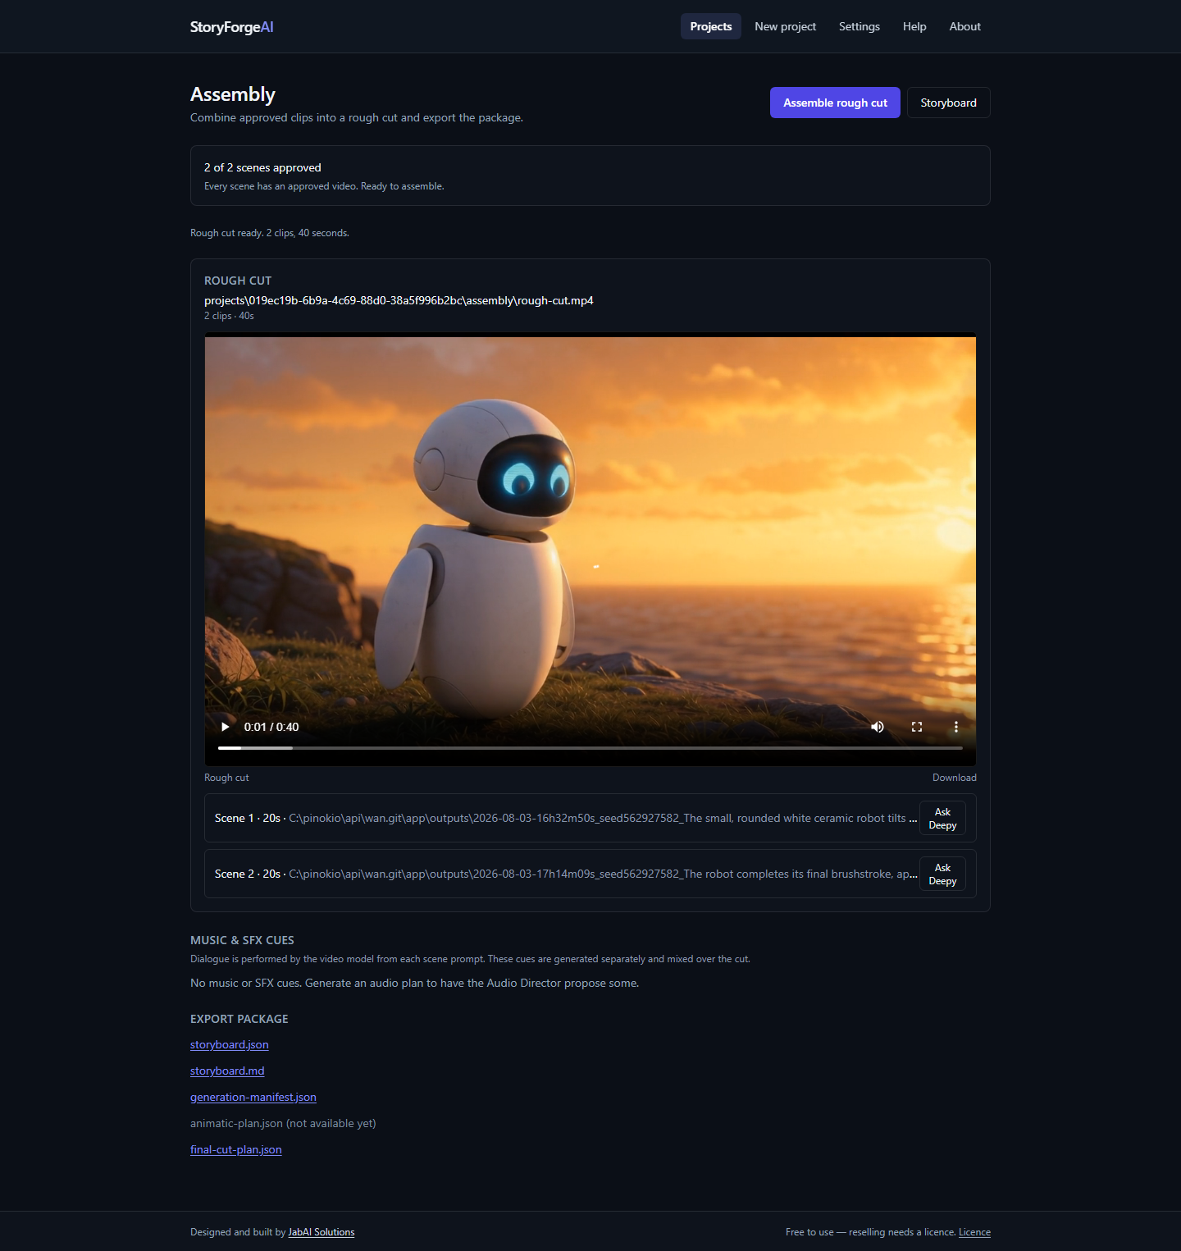
STORYFORGEAI
CONTROL + GOVERNANCE
OPERATIONAL CONFIDENCE
Consistency controls and human approval surround generation
StoryForgeAI keeps creative context attached to the scene while preserving the operator's authority over what proceeds.
CONSISTENCY
CONTROL POINTS
EVIDENCE IN THE WORKSPACE
Cast identity
1
Choose
Scene-scoped descriptions, references and optional face swap.
Select a variant, model pins and LoRA stack.
2
Inspect
Wardrobe timeline
Open agent artifacts, scene cards and exact prompts.
Changes carry forward across scenes instead of becoming a global lock.
3
Intervene
Frame continuity
Edit a card, import a keyframe or rerun one pass.
Reuse an end frame, withhold its reference, cut, or continue a compatible clip.
4
Approve
Only an approved attempt can enter final assembly.
Model-aware prompting
Family-specific instructions and exclusion routing survive backend differences.
APPROVAL GATES ASSEMBLY
Approved clips -> rough cut -> export package
Local-first agentic creative studio
08

