Slide 1
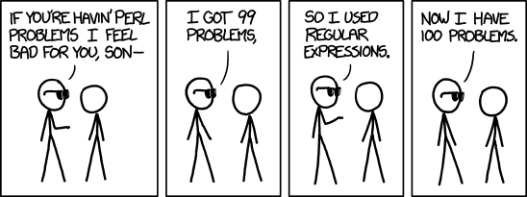
Bash Scripting – Intro to Regular Expressions

Slide 2
Grabbing a copy of the example files:
Slides:
Browse to https://github.com/jamesberger/Teaching and open the directory Class_7_Bash_scripting_3_Intro_to_regular_expressions
Click on the .pptx files and select ‘download’ to get a copy of the slides.
Example script:
You can click on text files and select “raw” to get the path. Then use wget to grab them in the following fashion:
wget https://raw.githubusercontent.com/jamesberger/Teaching/master/Class_7_intro_to_regular_expressions/example-regex.sh
wget https://raw.githubusercontent.com/jamesberger/Teaching/master/Class_7_intro_to_regular_expressions/new-student.sh

Slide 3
Grabbing a copy of the example files:
Most of the material for today is contained in the example-regex.sh and new-student.sh scripts.

Slide 4
When to use regular expressions
When you have to search through a vast amount of data and the thought of doing it by hand brings you to tears.
When a simple grep or find and replace won’t cut it.
When you have time to do it the right way.

Slide 5
When not to use regular expressions
When it would be faster to just go through and edit it by hand
When there isn’t enough time to construct a proper regex and test it.
When the amount of data you’re looking through isn’t far more than any normal human being could cope with.

Slide 6
What are regular expressions?
In short, nothing more than fancy pattern matching.
Often mystified and treated as being overly difficult
They aren’t always simple and they can grow to be large and complicated, but this is no different from anything that does a complex job.
Traditional search and replace is usually limited to globbing (*) or searching for an exact term and replacing it.
What if your search needs to select things that have the same pattern, but not the same text?
REGEX TO THE RESCUE!

Slide 7

Sanitizing your inputs:

Slide 8
What is privilege escalation?
A hacker
Your web form that doesn’t sanitize inputs
Your database that runs under the root user
Your server that has access to your AWS account

Slide 9
A story about what happens when you don’t sanitize your inputs:
$STORY

Slide 10
Adding features to the example script:
Add and validate the following fields:
First name
Last name
Address number
Address street name
Address city name
Address state name
Address zip code (five digits only)
Prospective student email address (validate this as best you can)
Generate a student information file every time the script runs successfully, append the output on every run.
If you have time, see if you can re-write the script to allow the user to edit the data when it’s given to them for review if anything is mis-typed.

Slide 11
The end!
Questions?

