Slide 1
Linux Memory Management

Slide 2
What is memory?
Fundamentally, memory is just a form of storage
Computers have many layers of memory – CPU registers, CPU cache, RAM, Disk
The higher up you go, the longer things take:
CPU registers? 1 CPU cycle
L1 cache? 3 CPU cycles
L2 cache? 9 CPU cycles
L3 cache? 36 CPU cycles
RAM (main memory)? 150-400 CPU cycles
Disk? 40 million CPU cycles

Slide 3
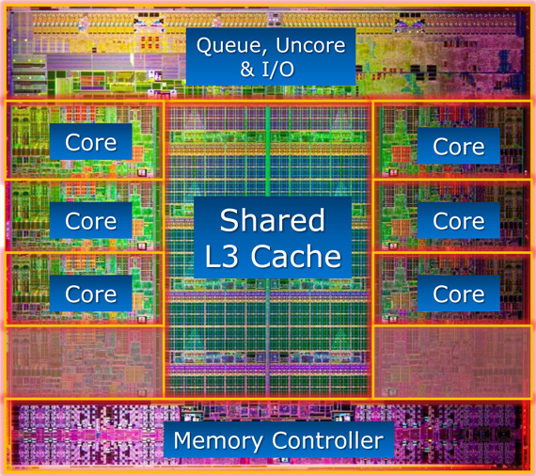
What does “on CPU” memory look like?
Intel Core i7 CPU die map

Slide 4
What is memory?
Modern (post 1970) memory can be grouped into two types:
SRAM, Static Random Access Memory
More expensive than DRAM due to smaller size and required precision
Uses 6 transistors to store data
Used for registers, L1/L2/L3 cache
DRAM, Dynamic Random Access Memory
Less expensive than SRAM
Uses one capacitor and one transistor
Transistor allows memory controller to read the state of the capacitor
0 = low charge
1 = high charge
Used for main memory (RAM)

Slide 5
What is memory?
Memory is found in 5 basic locations
Registers
Very small, very fast. On x64 chips, they hold 64 bits. 32 bits on a x32 chip, 8 bits on an 8 bit chip, etc. This is where data is stored while the CPU is working on it – adding, subtracting, etc.
L1 cache:
It’s very small and very tightly bound to the actual processing units of the CPU, it can typically fulfill data requests within 3 CPU cycles. L1 cache tends to be around 4-32KB depending on CPU architecture and is split between instruction and data caches.
L2 cache:
larger than the L1 cache, but slower and is generally tied to a CPU core. Recent processors tend to have 512KB of cache per core and this cache has no distinction between instruction and data caches, it is a unified cache. The response time for in-cache data is typically under 10 CPU cycles.

Slide 6
What is memory?
Memory is found in 5 basic locations
L3 cache:
Tends to be shared by all the cores present on the CPU and is much larger and slower again, but it is still a lot faster than going to main memory as it’s still on the CPU chip. L3 cache size on an i7 CPU is 8 MB. It takes around 36 CPU cycles to access data stored here.
Main memory aka RAM:
No longer on the CPU, sits on a separate chip, and it’s accessed over the memory bus. The memory bus is a long, long way from the CPU compared to the distance of the L3 cache, so we go from 36 clock cycles to grab some data to around 150-400 clock cycles. Ouch!

Slide 7
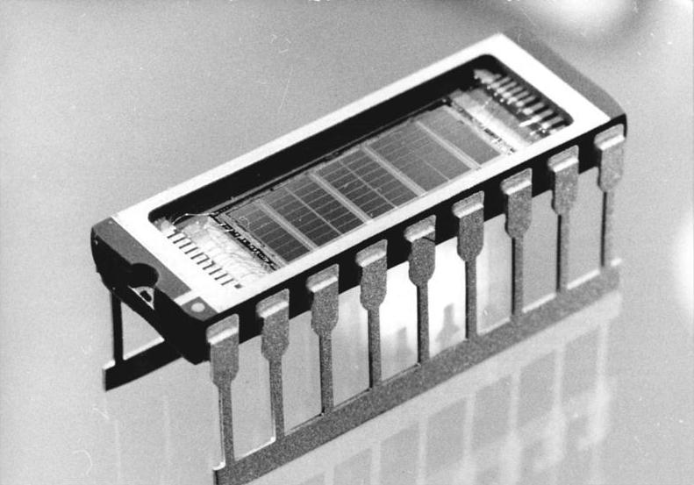
History
1 megabit of RAM, circa 1989

Slide 8
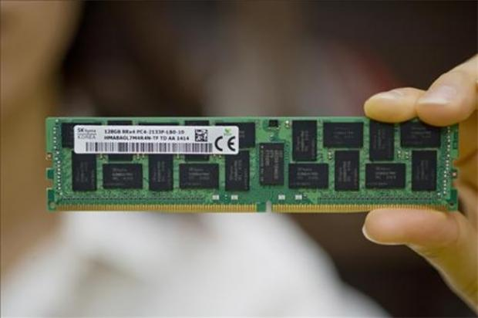
History
128 gigabytes of RAM, circa 2014
(around 128 million times more memory)

Slide 9
Physical Memory vs. Virtual Memory
Physical (main) memory is provided as a map to the OS
This map is divided into page frames of 4KB each
Each GB of memory is ~250k pages
Main memory is never allocated directly – only the virtual memory that is mapped to the main memory
Virtual memory is allocated to processes – these processes think they are the only thing on the system
The virtual memory they use is mapped back to real memory via page tables

Slide 10
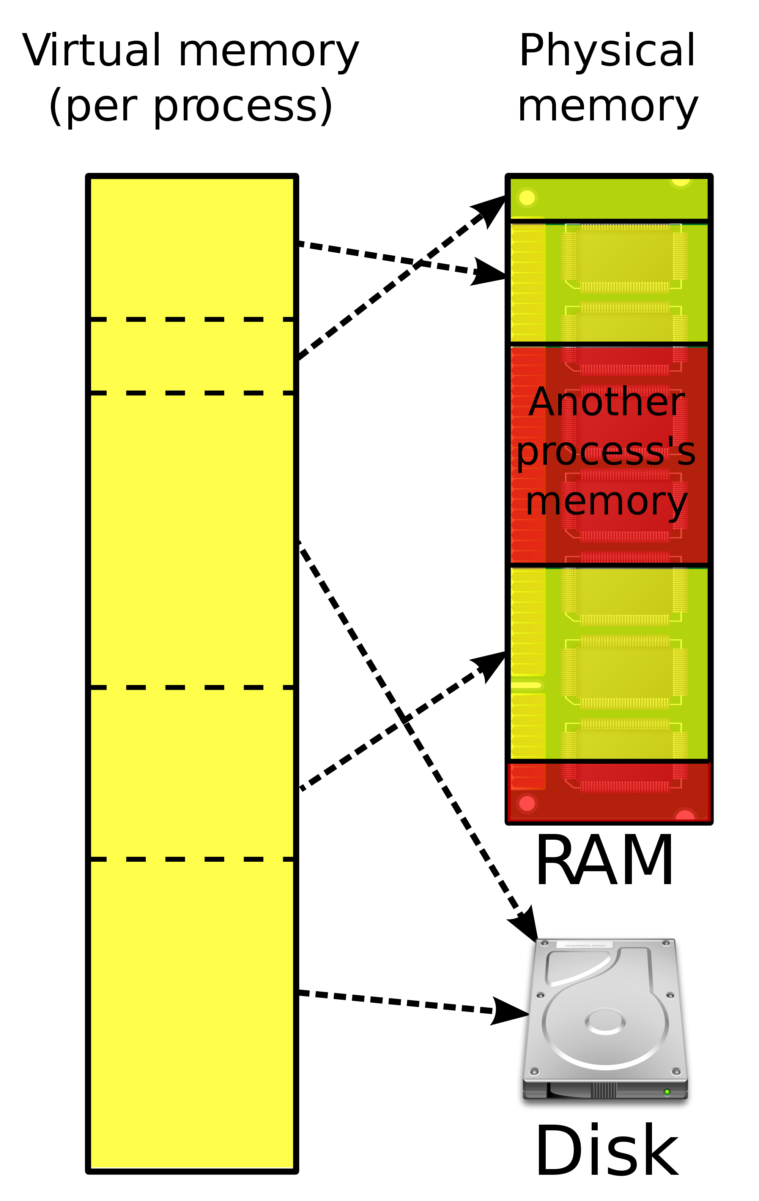
Physical Memory vs. Virtual Memory

Slide 11
Paging
Paging is the movement of pages into and out of the main memory
Allows partially loaded programs to execute
Allows programs larger than main memory to execute
Efficient movement of programs between main memory and storage
Fine grained, unlike swapping – swapping moves entire programs in/out, paging only moves pages, which can be relatively small, e.g. 4KB
Multiple types of paging – File System Paging and Anonymous Paging

Slide 12
File System Paging
Reading/writing of pages in memory mapped files (mmap()) and on file systems that use page cache
“Good” Paging
Kernel can free memory by paging
If file system page has been modified in main memory, is a “dirty” page, and requires write to disk
If not modified, or “clean” page, the page out just frees the memory immediately
Therefore, term “Page Out” just means that the page has been moved out of memory, but this operation could have also included writing the page to a storage device

Slide 13
Anonymous Paging
Anonymous pages are private to processes – process heaps and stacks
Called anonymous due to lack of a named location in the operating system, such as a file system path
Anonymous page outs require the data be moved to physical swap devices or swap files – ‘swapping’
Anonymous paging, or swapping, hurts performance, and is thus “bad” paging
Applications requiring access to anonymous pages that have been paged out require anonymous page in, which is a blocking I/O call to the disk.
Page outs themselves may not negatively affect performance as they can be done asynchronously, while page ins are synchronous

Slide 14
On Demand Paging
On demand paging is the act of mapping pages of virtual memory to main memory on demand. Defers CPU overhead of creating mapping until they are needed and accessed, instead of when memory is first allocated
A page fault occurs when a page is accessed that has no page mapping from virtual memory to main memory
If the mapping can be satisfied from another page in memory, it is called a minor fault – may occur for mapping a new page from available memory. Can also occur when mapping to an existing page, such as reading a page from a shared library

Slide 15
On Demand Paging, contd.
The UNIX virtual memory model has 4 states for a page
1. Unallocated
2. Allocated, unmapped (Unpopulated and not yet faulted)
3. Allocated, mapped to main memory
4. Allocated, mapped to swap device
2 is the default state we initially care about – transition to 3 is a page fault. If it requires disk IO, is a major page fault, otherwise minor
4 is reached if the page is paged out due to system memory pressure
Can define two memory sets from these states:
Resident Set Size, or RSS – size of allocated main memory pages (3)
Virtual Memory Size – size of all allocated pages (2+3+4)

Slide 16
Overcommit
Allows more memory to be allocated than physical exists – more than the main memory + swap. Dependent on on-demand paging and applications not using more than a minority of allocated memory
Allows for malloc() requests to succeed instead of failing – system will rarely decline requests for virtual memory
Consequences of overcommit depend on tunables and how kernel manages memory pressure – most frequently you see OOM Killer (Out of Memory Killer) – further details later on.

Slide 17
Swapping
As previously noted, swapping is act of moving entire process between main memory and the swap device or file
Thread structures, heap, stack, must be swapped. Data from file systems that is unmodified can be dropped
Processes that are swapped out are still known by the kernel – metadata is still resident in kernel memory
Kernel prioritizes swapping in based on various factors – thread priority, wait time, size of process. The longer it has been waiting and the smaller it is, the higher in the queue
Modern Linux does not perform traditional swapping at all – uses paging operation on a swap device or file instead. Some UNIX systems still perform actual swapping

Slide 18
File System Cache
Often the cause of people thinking they are low on memory when they really are not – truly free memory is not useful and does nothing, so the OS will attempt to utilize spare memory to cache file system
Kernel is able to quickly free memory from file system cache
Transparent for applications – logical I/O latency is much lower, as requests are being served from main memory
Cache grows over time – “free” memory shrinks.
Regular caching used to improve read performance
Buffering inside the cache for improving write performance

Slide 19
Page Cache
Buffer cache is stored in the page cache in modern Linux – used for disk I/O to buffer writes
Dynamic – current size can be checked in /proc/meminfo
Page cache is used to increase directory and file I/O – virtual memory pages and file system pages are stored in it.
Dirty file system pages are flushed by flusher threads (flush), per device processes. Happens after:
An interval (default 30s)
Sync(), fsync(), msync() system calls
Too many dirty pages (dirty_ratio)
No available page cache pages
If there is a system memory deficit, kswapd will look for dirty pages to be written to disk

Slide 20
Page Cache
All I/O goes through the page cache unless explicitly set not to do so – Direct I/O
This can result in all writes being blocked if the page cache has completely filled.
There is a certain amount of page cache available, and will begin writing to disk at a certain background ratio. If it continues to fill, there is eventually a point where it will prevent all other writes from occurring.
When all writes are blocked, operating systems have a tendancy to stop

Slide 21
File System Cache
Dentry cache remembers mappings from a directory entry to the VFS inode. This increase path name lookup performance
Allows you to get the exact inode, rather than stepping through directory contents
Also performs negative caching, remembering lookups for non existent entries
As with other caches, grows dynamically, with data on size exposed by /proc
Inode cache contains VFS inodes, with the properties of file system objects, such as described by stat()
VFS = Virtual File System, abstraction that allows OS to interact uniformly with different actual file systems
Inode cache will always include at the very least the inodes mapped by the dentry cache
Size shrinks under memory pressure, size details once again exposed by /proc

Slide 22
OOM Killer:
As we’ve discussed, the system has quite a few methods to manage memory – paging, shrinking caches, removing things from caches, and so on
Sometimes this isn’t enough – enter OOM Killer
OOM Killer will sacrifice processes to keep the system online – this also kills any processes that share the mm_struct as the selected process
Can make things immune by adjusting /proc/<pid>/oom_score_adj to -1000 (+1000 puts a target on the processes’ head)
Process with the highest OOM score (/proc/<pid>/oom_score) is sacrificed
OOM score calculation is basically ‘How much of the available memory to the process is actually in use?’ – 100% would result in a score of 1000
Root owned processes get a slight handicap – 30 is subtracted from the OOM score
Only triggers for low order allocations, e.g. 2^3 or less
Pages are allocated in powers of 2 – so a 3rd order allocation would be 2^3 (8) pages, with the total size being determined by your page size

Slide 23
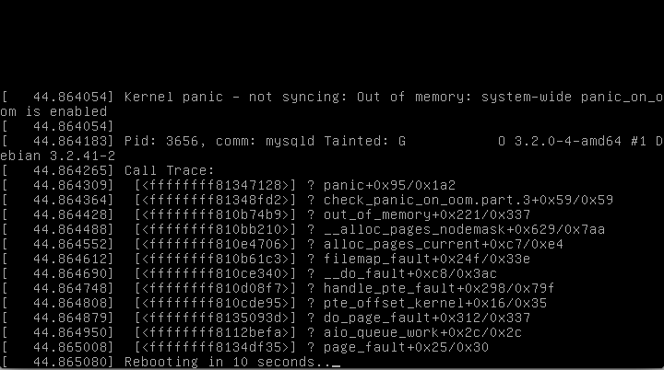
OOM Killer:

Slide 24
OOM Killer
What causes this? Most often, the system really is out of memory. If /proc/meminfo is showing SwapFree and MemFree to be ~1% or lower, this is likely the case
(Much!) More rarely, kernel data structure or memory leak can be the culprit – check /proc/meminfo for SwapFree and MemFree, and then /proc/slabinfo – telltale signs can be task_struct objects being high could indicate the system forking so many processes it ran out of kernel memory. You can also see the object utilizing most of the memory
SwapFree can be misleading when a program uses mlock() or HugeTLB – it cannot be swapped if these are in use
SwapFree will not be relevant on most instances with default setups – very few have swap enabled
Again, most cases are the system actually running out of memory. Tracking process memory usage and finding the offender is important (more on tools later)

Slide 25
Segmentation Fault (segfault)
Segfaults are access violations. Hardware with memory protection will notify the OS that a memory access violation has occurred. This might be caused by trying to read a part of memory that the application is not allowed to access, or trying to use a section of memory in a way that is not allowed, such as trying to write to read-only memory
Ultimately caused by software errors, most often seen in C programs where pointers reference a portion of virtual memory they are not allowed to access
Some programs have exception handling built in for segfaults, but more frequently do not, and a segfault will result in the process crashing and potentially generating a core dump
Core dumps are files containing a process's memory address space at a specific time - in this case, the time of the crash. In practice, you often see other pieces of the program state also dumped, such as processor registers, which often include the program counter and stack pointer, general memory management information, and other processor and operating system flags.

Slide 26
Page Allocation Failure
Name is fairly self explanatory – system failed to allocate a page
Can be caused by memory segmentation – the available memory is so fragmented that there is not enough contiguous space to allocate pages that require contiguous space
Can also be caused by a general lack of memory – as we discussed earlier, OOM Killer doesn’t trigger on high order allocations. In such a case that you are trying to allocate a larger set of pages than would trigger OOM Killer when low on memory, you might see this instead

Slide 27
Null Pointer Reference
For background, a pointer is a variable that contains another variable as the value - such as a memory address
Occurs when a pointer is used pointing at a NULL value, when the assumption is made that it is pointing at a valid memory address
Almost always results in the process crashing, unless exception handling is built in, similar to with segfaults.

Slide 28
Machine Check Exceptions
MCEs are a hardware error, thrown when the CPU detects a hardware problem
Main potential causes are errors with the system bus, memory, and CPU cache
Example:
CPU 0: Machine Check Exception: 0000000000000004
Bank 2: f200200000000863
Kernel panic: CPU context corrupt
In OS, you will need tools to decode the error, such as mcelog – this will take the error and give you more useful information

Slide 29
Huge Pages & Transparent Huge Pages
As discussed earlier, pages are generally 4KB in size, however, you can change this
Huge Pages allow for pages that are 2MB and 1GB in size
Performance win, as modern processors contain a limited set of page table entries – when you use larger pages, the processor can work with more memory, without falling back to the slower software memory management
Requires applications to be aware and coded to take advantage of them
Transparent Huge Pages are an attempt to abstract this so that everything can take advantage of Huge Pages – however, this can cause oddities in behavior on some applications, and some vendors such as Red Hat explicitly state that they are problematic in certain workloads such as databases
Setting /sys/kernel/mm/transparent_hugepage/enabled to never will disable them

Slide 30
Dropping Cache
It is possible to drop the page, dentry, and inode caches in Linux, either to forcefully free up memory, or to test filesystem performance prior to anything being cached
To drop the page cache
echo 1 > /proc/sys/vm/drop_caches
To drop dentry and inode caches:
echo 2 > /proc/sys/vm/drop_caches
To drop both:
echo 3 > /proc/sys/vm/drop_caches

Slide 31
Changing Overcommit Settings
You generally do not want to do this, but you can modify the system overcommit behavior by modifying /proc/sys/vm/overcommit_memory
0: Heuristic overcommitting. Ensures "crazy" allocations fail while allowing more normal over allocation. Default.
1: Always allow overcommitting
2: Never allow overcommitting. Total address space is limited to swap + configurable percentage of physical ram. Percentage defaults to 50%, is set at /proc/sys/vm/overcommit_ratio

Slide 32
File System Repair and Memory Requirements
When checking/repairing a file system, you can see fairly extreme requirements on memory, particularly when a large file system is involved.
Specifics vary, but XFS for example is particularly onerous – SGI recommends 2GB of RAM per TB of space, and 200MB of RAM per million inodes
Can be worked around with using a large swap partition, or with fsck, a scratch file (Setting a scratch file can be done in /etc/e2fsck.conf)
When in doubt, it is safer to side with more RAM and swap – repairs failing due to a lack of memory can be damaging to the data you are trying to save.

Slide 33
vmstat
Part of the sysstat package
[root@ip-172-16-0-192 ~]# vmstat -Sm 1
procs -----------memory---------- ---swap-- -----io---- --system-- -----cpu-----
r b swpd free buff cache si so bi bo in cs us sy id wa st
0 0 0 765 60 148 0 0 2 3 13 27 0 0 100 0 0
0 0 0 765 60 148 0 0 0 0 16 15 0 0 100 0 0
0 0 0 765 60 148 0 0 0 0 12 15 0 0 100 0 0
0 0 0 765 60 148 0 0 0 0 7 10 0 0 100 0 0
Swpd: Amount of “swapped”-out memory
Free: Free available memory
Buff: Memory in the buffer cache
Cache: Memory in the page cache
Si: Memory “swapped” in
So: Memory “swapped out”
(Remember: Linux swapping is actually paging, just to a swap device or file)
-Sm puts output in megabytes
1 is used for timer

Slide 34
ps
Built in to the system
[root@ip-172-16-0-192 ~]# ps aux | head -n 5
USER PID %CPU %MEM VSZ RSS TTY STAT START TIME COMMAND
root 1 0.0 0.1 19480 1596 ? Ss Feb25 0:01 /sbin/init
root 2 0.0 0.0 0 0 ? S Feb25 0:00 [kthreadd]
root 3 0.0 0.0 0 0 ? S Feb25 0:00 [ksoftirqd/0]
root 5 0.0 0.0 0 0 ? S< Feb25 0:00 [kworker/0:0H]
%MEM: Main memory usage as a percentage of the total in the system
RSS: Resident set size in KB
VSZ: Virtual set size in KB
RSS includes shared segments such as libraries which might be mapped by multiple processes – this means you cannot add up RSS and expect it to match the total amount of memory in a system, or the real amount memory used.

Slide 35
top
Built into the system
top - 09:08:40 up 20:18, 4 users, load average: 0.00, 0.01, 0.05
Tasks: 78 total, 1 running, 77 sleeping, 0 stopped, 0 zombie
Cpu(s): 0.3%us, 0.0%sy, 0.0%ni, 99.3%id, 0.0%wa, 0.0%hi, 0.0%si, 0.3%st
Mem: 1020196k total, 273808k used, 746388k free, 58752k buffers
Swap: 0k total, 0k used, 0k free, 145348k cached
PID USER PR NI VIRT RES SHR S %CPU %MEM TIME+ COMMAND
1 root 20 0 19480 1596 1284 S 0.0 0.2 0:01.05 init
Output per process is very similar to what is shown as PS. VIRT = VSZ, RES = RSS
Other overall system levels, including free memory, used memory, buffer size, cache size, and swap details.

Slide 36
Other tools
Atop – historical logging of memory usage on a per process basis, as well as CPU, network, etc, usage – very powerful
Sar – part of sysstat, includes overall system details, including memory, CPU, interrupts, I/O, etc.
Slabtop – Detailed memory slab information presented in a top style format
There are specific tools available for some languages – the JVM has many, such as jstack/jhat, PHP has the debug_backtrace function, nodejs has console.trace(), and so on

Slide 37
The End

