Slide 1
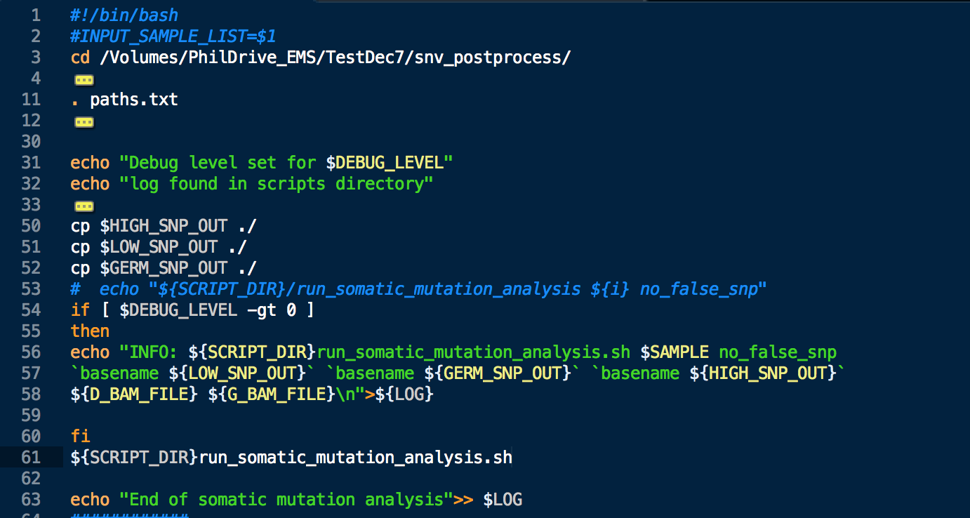
Bash Scripting Basics

Slide 2

The bell:

Slide 3
There’s more than one shell?
Bash: Default shell in most Linux distributions.
Released in 1989.
Does everything you really need.

Slide 4
There’s more than one shell?
ksh or KornShell: Better loop syntax, easier to repeat commands, acts like Vi or Emacs in some regards, combines C shell and Bourne shell features.
Created in 1982, used heavily by AT&T, proprietary software until 2000/2005.
Does everything you really need.

Slide 5
There’s more than one shell?
Tcsh aka “tee shell”: Also derived from C Shell, added command completion, command line editing and a few more things
Released in 1983
Uses the tsch scripting language. Some people really, really like it.
Does everything you really need, but a little strangely.

Slide 6
There’s more than one shell?
zsh aka “zee shell”: Derived from Bourne Shell, mugged other shells in a dark alley and took features from them – bash, ksh and tsch.
Released in 1990
Has better command completion, better implementation of “globbing” (matching filenames with a wildcard, like *.txt), nicer handling for arrays and variables. Implements spelling correction.
Lots of extensions for it maintained on the “Oh My Zsh” website.
Somewhat confusing to use if you’re coming from bash.
Favorite choice of zealots.

Slide 7
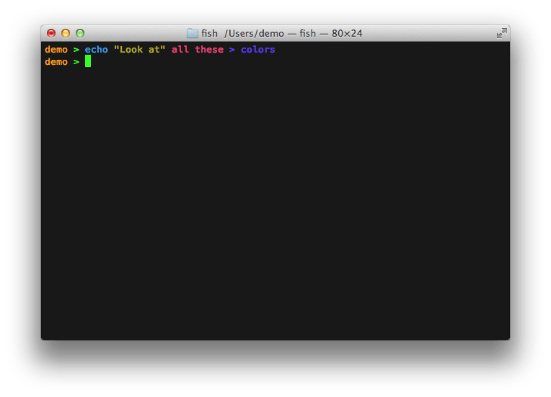
There’s more than one shell?
fish:

Slide 8
There’s more than one shell?
fish: The new and trendy shell, has the tagline “Finally, a shell for the 90s”
Released in 2005
Adds lots of fancy command completion features, supports glorious VGA color – all 256 of them!
Many people like that it completes commands as you type based on the history of previous commands you’ve run, similar to how Google auto-completes your searches based on past searches you’ve made.
All the cool kids are using it.
Does everything you really need, but more colorfully than everyone else.

Slide 9
Which should I use?
Bash*.

Slide 10
Which should I use?
*(until you get bored with it)

Slide 11
Which should I use?
See http://hyperpolyglot.org/unix-shells for extensive list of feature differences.

Slide 12
Bash scripting topics:
Script formatting, comments and other initial things to know
Variables and built in variables
Conditional logic
Conditional statements (if and case)
Loops (for, while and until)
Built in commands
File handling
Debugging
Arithmetic
Making a script interactive and passing in command line arguments
Functions
Arrays
Lists
Regular expressions
I/O redirection
Forking

Slide 13
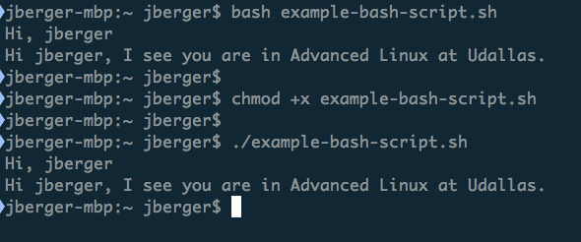
How to run a script:

Slide 14
Example script formatting:
#!/bin/bash
# The first line tells it what interpreter to use
# This will print your user name on the command line by referencing the# built in variable $USER. Variables are prefaced by the $ sign.
echo "Hi, $USER.”
# But we didn't set the value for user in our script?
# Where is it pulling the value from?
# To find out, run the command "printenv | grep USER" (case sensitive).
# This displays the global variables for the current user, which are applied# when a user logs in.
# This is how you set a variable:
UNIVERSITY="Udallas”
CLASS="Advanced Linux”
#This is how you use variables you’ve set:
echo "Hi $USER, I see you are in $CLASS at $UNIVERSITY."

Slide 15
Grabbing a copy of the example script:
wget https://raw.githubusercontent.com/jamesberger/python-projects/master/teaching/example-bash-script.sh

Slide 16
Reviewing the script:
$REVIEW_SCRIPT

Slide 17
Build your own version before the end of this class:
Implement the following:
Set a variable.
Print the variable to the command line.
Create an if statement that prints out different output depending on the condition it is testing.
Create a loop – for, while or until – pick one of your choice – that prints the output to the command line.

Slide 18
Extend your script:
Before next class:
Tinker with your script and elaborate on it.
Add as many features as you like, as long as the script can run successfully.
Iterate and save working copies of your extended script, so if you break something, you have a known working version you can fall back on.
Have fun with building it! Be silly, test things, see how things work.
Answer the extra credit questions in the initial example script if you want some free extra credit. The answers can be added as comments in your extended script.

Slide 19
The end!
(return the bell)
Questions?

