Slide 1
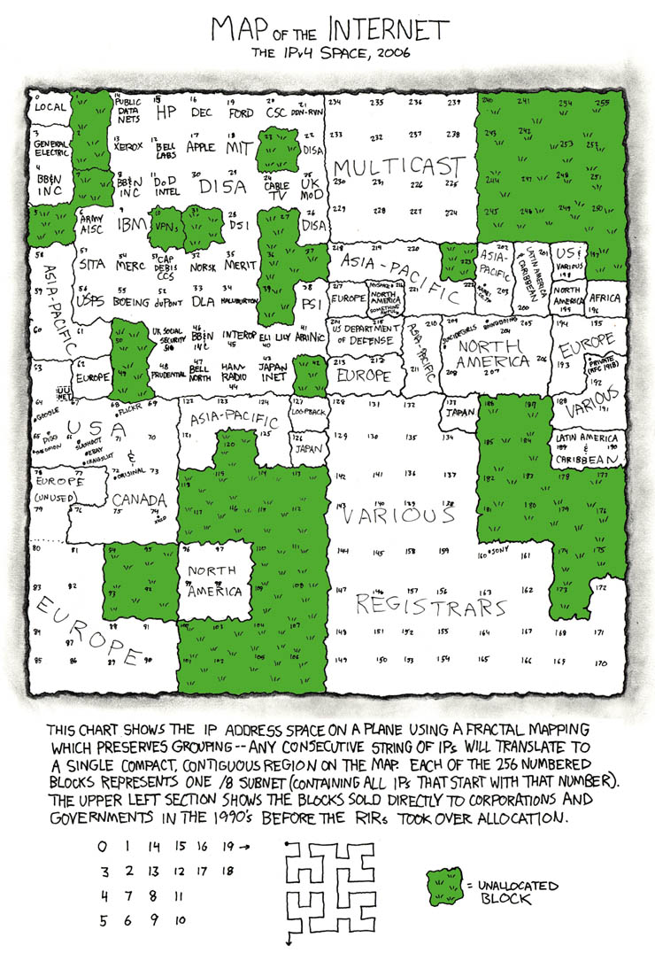
Networking In a Nutshell

Slide 2
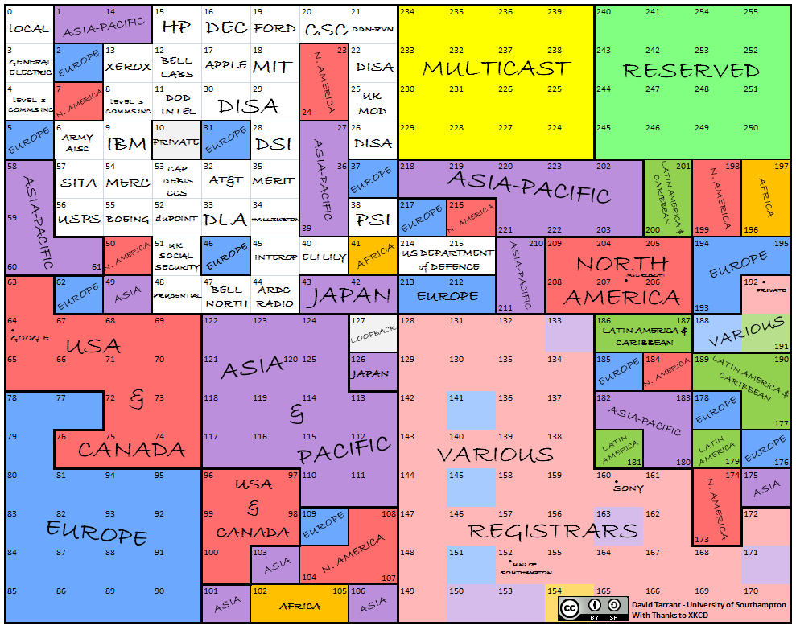
Map of the Internet

Slide 3
IPv4 vs IPv6 – Why IP addres space exhaustion matters:
Notes:
4.3 billion addresses should be enough for anyone, right? IPv6 and its 3.4×10³⁸ (340 undecillion) addresses.

Slide 4
The British Postal Service as a Metaphor for Networking
My apartment – 221B aka 192.168.0.8 (PC)
My apartment complex – 239 North Baker Street – aka 76.183.148.24 (ISP)
My city – London – aka “The Internet”

Slide 5
The British Postal Service as a Metaphor for Networking
My apartment – 221B aka 192.168.0.8 (PC)
My apartment complex – 239 North Baker Street – aka 76.183.148.24 (ISP)
My city – London – aka “The Internet”

Slide 6
The British Postal Service as a Metaphor for Networking
How does mail get to my apartment?
“Send this letter to the funny looking bloke in the red house near the book shop.”
Somehow, mail never gets to my apartment :(

Slide 7
The British Postal Service as a Metaphor for Networking
Send this letter to London (the entire internet)?
Still no mail at my house, or worse - every house in London now has a copy of “Brony Monthly” with my name on it :(

Slide 8
The British Postal Service as a Metaphor for Networking
Send this letter to my apartment complex in London at 239 North Baker Street (everyone that uses my ISP)?
Now every apartment in my complex has a copy of “Brony Monthly” with my name on it. This is really just as bad.

Slide 9
The British Postal Service as a Metaphor for Networking
Send this letter to my apartment 229B (my PC) in my apartment complex at 239 North Baker Street (my ISP) in London (the internet)?
Much better. Now none of my neighbors will give me a hard time for being a brony.

Slide 10
The British Postal Service as a Metaphor for Networking
So if the internet isn’t much different, how do I tell Google’s servers to send me back the results of my search for “Latest My Little Pony episode recap”, instead of sending it to anyone on the internet? Or anyone using my ISP?

Slide 11
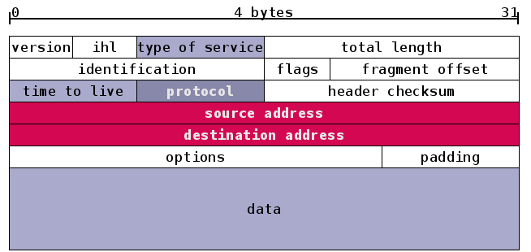
The British Postal Service as a Metaphor for Networking
As it turns out, it’s quite similar to putting an address on an envelope. The data – the contents of the Google search results for “Latest My Little Pony episode recap” – has a header added to it with the return address.

Slide 12
The British Postal Service as a Metaphor for Networking
A packet has multiple layers – the contents, which are encapsulated with a TCP header with TCP routing information.
In turn, the TCP header and data are encapsulated with an IP header, which contains routing information.
The IP header contains the source address – our Google server, and the destination address, our apartment in London. Well, the computer in our apartment in London.
If you look at the next slide, you’ll notice that the TCP header doesn’t contain our address, just the port that the data should be sent to (80, for HTTP traffic).

Slide 13
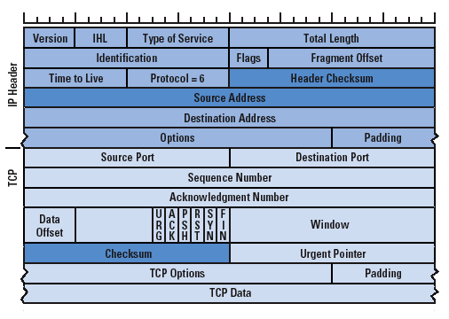
The British Postal Service as a Metaphor for Networking

Slide 14
The British Postal Service as a Metaphor for Networking
Bandwidth – How many copies of “Brony Monthly” can the British Postal Service deliver on a given day? Let’s say the 150,000 postal workers can unpack, sort and deliver 50 catalogs in a day. So 7.5 million copies could theoretically be delivered in a single day in the UK.
Throughput – How many copies actually get delivered. 45% of the 150,000 employees are off on the weekends. 2.5% have called in sick. Another 2.5% are stuck in traffic. So in reality, even though at peak efficiency, the British Postal Service *could* deliver 7.5 million copies of “Brony Monthly”, only 3.7 million get delivered on a Sunday.

Slide 15

The British Postal Service as a Metaphor for Networking
Congestion – The local post office with 10 employees can send out 500 catalogs in a given day. However, the number of employees actually loading mail on the dock is fairly small – let’s say two – and they can only unload and load any two given mail trucks at a time.
If you have six mail trucks lined up to drop off and pick up mail, and only two can be loaded or unloaded at once, you have congestion. Mail is queuing up faster than it can be processed.
Let’s say our British mail service has the same level of dedication to the mail that the US postal service has…
So the mailmen don’t wait in line patiently for the other trucks to finish, they just drop their mail off in the parking lot and take off. These dropped letters are equivalent to dropped packets. They never get sorted, and so they just sit undelivered, get soggy in the rain and are eventually tossed in a dumpster.

Slide 16
The British Postal Service as a Metaphor for Networking
NAT – Network Address Translation. So London is nicely laid out and every house has its own standardized address (public IP).
However in the small village of Framlingham (seriously, it’s a real place!), no one uses standard addresses, they have a system that’s only used by the villagers (private IPs).
So the local village post office performs the equivalent of NAT – “Letter for John Gummer, Framlingham village”. The London mailman asks “What number is John Gummer at?”
The local cow herder says “Well, go over the ridge there, turn right at the oak tree and it’s the third red barn near the stream. The London mailman lives in a city and has no idea that oak trees and maple trees are different things, and turns right at the maple tree and promptly gets lost.

Slide 17
The British Postal Service as a Metaphor for Networking
NAT – (continued). So the mailman from London admits defeat and goes to the local post office. The local postmaster knows exactly where the letter goes and Clive Aslet, the local mail delivery man, gets it to John Gummer that same afternoon.
PAT – (port address translation) – There’s less of a real life equivalent for this, but let’s say that John Gummer actually lives in his barn, and never checks the mail slot in his cottage (TCP port 25).
So mail delivered to TCP port 80 – the mail slot, never gets read. But the local postmaster knows this, and so he has it delivered to John’s barn – TCP port 8080.

Slide 18
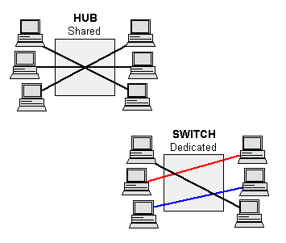
Hubs vs Switches vs Routers
Hubs – One to many, all clients get traffic being sent from one client.
Switches - A switch records the MAC address of all the clients and can send traffic from client A to client B. Switches are layer 2 devices

Slide 19
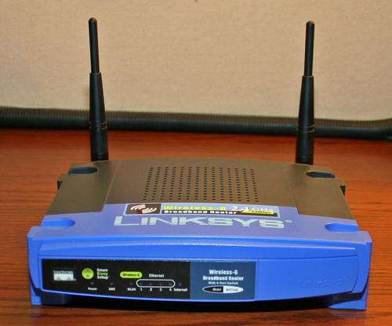
Hubs vs Switches vs Routers
Routers – Routers can handle multiple address spaces – sending traffic from private 10.x.x.x address space to public 54.x.x.x address space, for example.

Slide 20
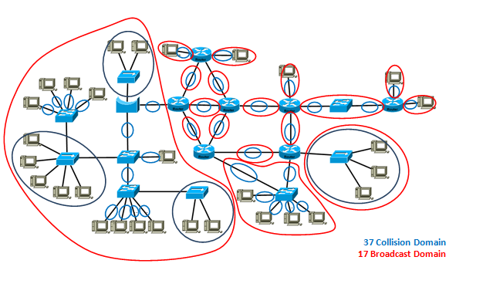
Collision Domains:
What happens when two devices transmit at the same time? Collisions!
Retransmits suck :(

Slide 21
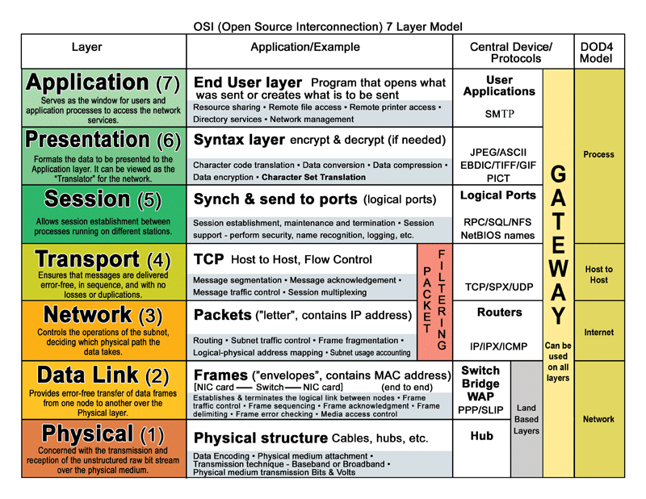
OSI Layers:

Slide 22
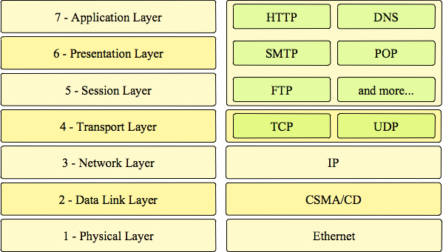
Ethernet? IP? TCP?

Slide 23
Anatomy of a Subnet
192.168.1.0 /24 – The very first address in the subnet, known as the network address. The range - /24 tells us how large the subnet is in bits.
192.168.1.1 – The first usable IP address. We can assign this to our computer.
192.168.1.254 – The last usable IP address that can be assigned to a computer.
192.168.1.255 – The broadcast address for the subnet. Any traffic sent to this address goes to every single usable IP address in the subnet.

Slide 24
CIDR vs Classful Networking
In the beginning (1981 to 1993 to be specific), there was classful networking.
IPv4 public addresses were divided into five classes of addresses – A,B,C,D and E.
A, B and C were different sizes of networks.
D was used for multicast.
E was reserved for experimental use and never really saw use.

Slide 25
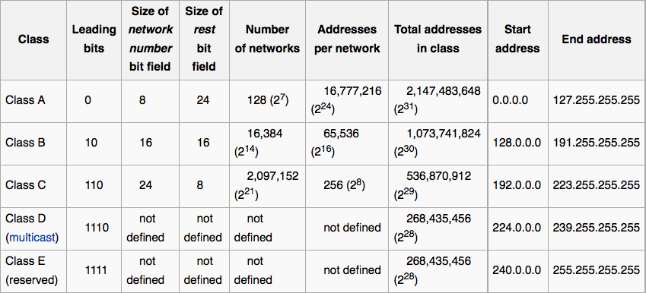
CIDR vs Classful Networking

Slide 26
CIDR vs Classful Networking
The trouble with chopping up addresses into just three different sizes:
“I need just a few more IP addresses than a class C network provides.”
“OK, have a class B.”
“This has far more IP addresses than I need.”
“Hey, we are amazingly low on unassigned class B networks for some weird reason.”

Slide 27
CIDR vs Classful Networking
No one likes IPv4 exhaustion, and seeing that coming up in the near future, and how three sizes of networks for some weird reason didn’t fit all use cases, they decided to go a little more fine-grained.
With CIDR (classless inter-domain routing), you have 33 delightful sizes to choose from.
The vast /0 with 4.2 billion addresses to the surgical /29 with 8 addresses.

Slide 28
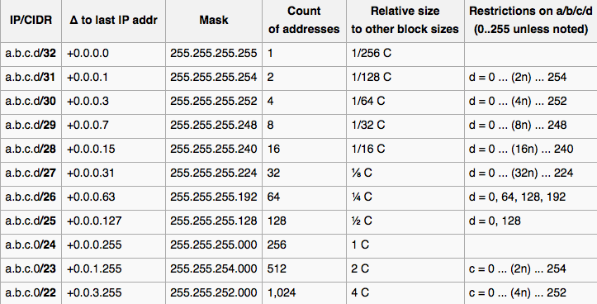
CIDR vs Classful Networking

Slide 29
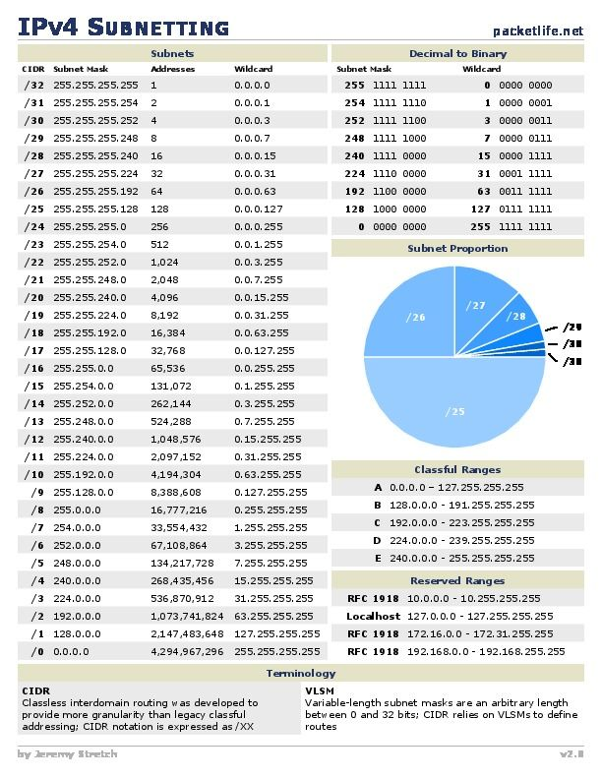
CIDR vs Classful Networking

Slide 30
CIDR vs Classful Networking
Calculating subnets sizes with CIDR is easy enough to do in your head.
The only thing to remember? /32, the smallest size.
A /32 is one address.
A /31 is two addresses.
A /30 is four addresses.
A /29 is eight addresses.
And so on until you get to /0.
Just remember, there’s always two IP addresses in a subnet that are reserved (network and broadcast), so the actual usable number of addresses is always two less than the size of the subnet.

Slide 31
DHCP
Imagine your ISP said “Hey Bob, you have 72.48.230.12 to use for your home computer.”
Ok, sure, no problem.
You start a small business, and you have a few employees. Your ISP gives you 32 IPs. Ok, sure, no problem.
John quits your business, so his IP address is unused. Then Sally needs a second computer to run data analysis on, so you give her John’s IP. And then a few other employees move around, you get a lab full of computers that need their own addresses.
Pretty soon, the small bit of paper you have with who has what IP address gets very messy. Mistakes are made. People get cranky when they’re both assigned the same IP address and can’t read Facebook at work when they get in first thing in the morning.
Or you’re an ISP. You have this same problem, only thousands of times worse.

Slide 32
DHCP
So you need some sort of way to automate who gets which address. There have been a few different methods of doing this – RARP (reverse address resolution protocol), BOOTP (Bootstrap Protocol), but each of those had their own shortcomings.
So in the fall of 1993, in comes DHCP (Dynamic Host Configuration Protocol).
Your computer starts up, and sends a broadcast out “Hey, can I have an IP address?”
Your DHCP server (often combined with your router) looks at the pool of addresses available and assigns one to you.

Slide 33
DHCP
How does this work at a lower level?
DHCP works over UDP, rather than TCP (important to know when updating your firewalls!). UDP port 67 is used by the server, and UDP port 68 is used by the client. So what port do you want to make sure is open on your computer?
So networking starts and it sends out message to the broadcast IP for the subnet it’s in – say, 192.168.1.255.
This UDP packet gets sent to every single address in that subnet. So your computer doesn’t need any prior knowledge of which IP is being used by your DHCP server and doesn’t have to play the “Query 254 IPs to find it!” game.

Slide 34
DHCP
So your computer sends out its DHCP discovery request to 192.168.1.255.
Your DHCP server, sitting at 192.168.1.2 (because we’re a fancy shop and we have our own standalone DHCP server rather than having it combined with our router), sends back a DHCP offer to your computer. “Hey, 192.168.1.43 is free, you can use that.”
Your computer responds with a DHCP request “Ok, 192.168.1.43 it is, sounds good.”
The DHCP server then replies back a final time with the DHCP acknowledgement;
“Ok, I have you down for 192.168.1.43, here’s where the gateway is so you can send traffic out to the internet – 192.168.1.0.
And here’s where the DNS server is so you know where www.google.com is.
You can have your IP for the next 12 hours, after that, please send out another discovery request.”

Slide 35
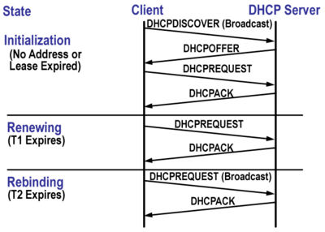
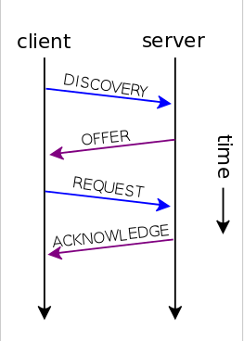
DHCP

Slide 36
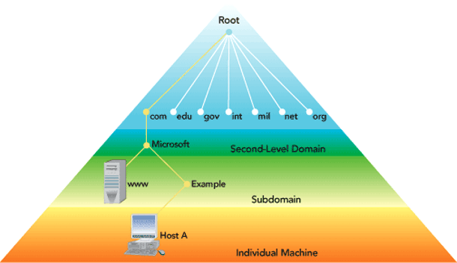
DNS

Slide 37
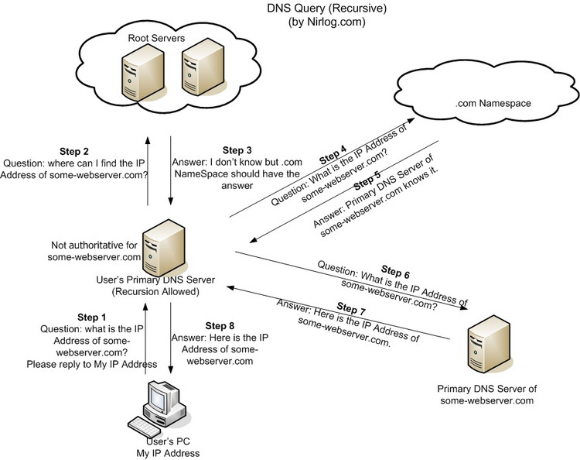
DNS

Slide 38
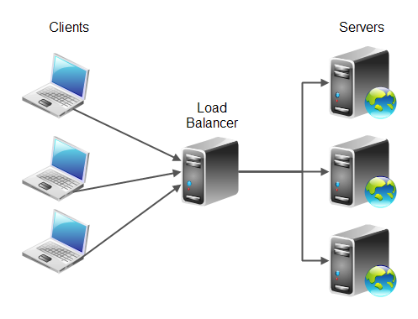
Load Balancers:

Slide 39
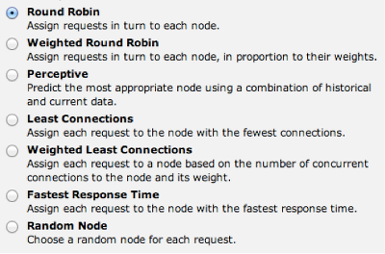
Load Balancers:

Slide 40
Equal Cost Multi-Pathing (ECMP):

Slide 41
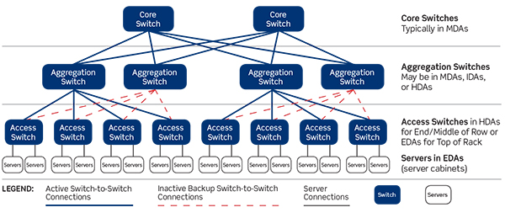
Spine and Leaf Network Architecture:

Slide 42
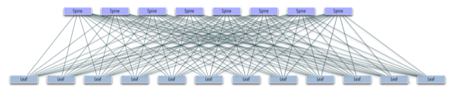
Spine and Leaf Network Architecture:

Slide 43
RIP vs OSPF vs BGP vs EIGRP: the Gateway Protocol showdown
RIP:
Good for up to 16 hops, you get network unreachable after that. An internet with less than 15 hops? Hah!Broadcasts its route table every 30 seconds, this is a bit bandwidth intensiveRIP only cares about node to node path cost, not entire path cost
OSPF:
Considers the shortest path to destination through *all* nodesMore intensive than RIP – requires more memory and CPU, plus it uses a large amount of bandwidth for the initial link state transmission.No limit on the number of hops.
Notes:
RIP (routing information protocol) vs OSPF (Open Shortest Path First)

Slide 44
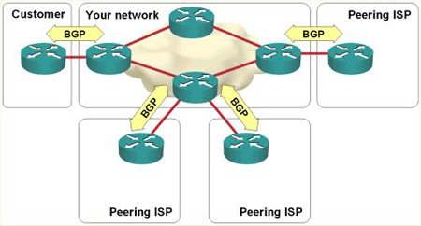
BGP and EIGRP
BGP:
Ye olde standby. Common use (v4) started in 1994.
No auto-discovery, peers configured manually(!!).
Bad peer configurations can propagate (see 2008 Youtube outage due to Pakistan trying to block it in their country).
EIGRP:
Shares routes with other routers, but only sends incremental updates to reduce router workload.
Stores a neighbor table (what other routers am I physically connected to?) and a topology table (what routes exist to what servers?)
Uses distance vector routing when calculating what route to send traffic down.
Initially a proprietary Cisco protocol, open sourced in 2013 and 2016
Notes:
BGP (border gateway protocol) and EIGRP (enhanced interior gateway routing protocol)

Slide 45
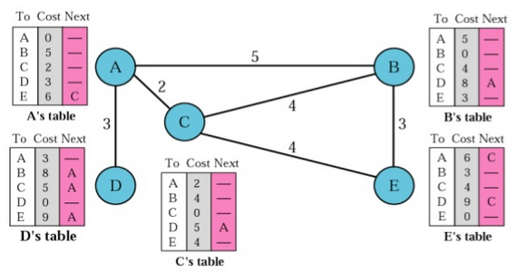
Distance Vector Routing
How do you know where to send your traffic if there’s more than one route to your destination?
Let’s make a table that shows the shortest paths between any given set of of servers:

Slide 46
How do VPNs work?
Let’s say you are sending your spreadsheet of sensitive financial info, along with a list of all of your competitors and how much you plan to undersell them by. This information is critical, and if your competitors got ahold of it, they could easily end your business.
To send it from your branch office to your main office in NYC, you need to send it over the internet. There’s no way you can afford to buy a direct line from Seattle to NYC.
So every single server that passes this traffic on from Seattle to NYC – there could easily be a hundred – has a copy of your critical financial data.
This is not good.

Slide 47
How do VPNs work?
So let’s encrypt that data!
Doing it by file really isn’t great, and there’s the potential that you could miss something and have your encrypted file decrypted if your competitors have it for long enough.
What about encrypting every single packet you send out? How would you even do that?

Slide 48
How do VPNs work?
You have VPN software that allows you to support sending out encrypted traffic.
You know what the IP address is for the VPN server at your main NYC office.
So you pull out your handy RSA fob that generates a unique one time number based on a clock. That clock is synchronized to the one on your VPN server, and they’re both using the same algorithm to generate the number.
You add your password to this number (after all, if you dropped your RSA fob in the parking lot and a competitor stole it, you wouldn’t want them to be able to log into your VPN!).
Your VPN server gets your request, with your one time number and password and authenticates it.
“Hello Dave.”

Slide 49
How do VPNs work?
The VPN server sends a request –
“Ok, do you support AES-256 to encrypt your data?”
“Affirmative.”
“Ok, cool, let’s use RSA 2048 to verify that we are who we say we are.”
“Sounds good.”
“Ok, you send packets encrypted that way, and I’ll decrypt them. VPN tunnel is up.”
“Confirmed on my end, tunnel is up.”

Slide 50
tcpdump For Fun and Profit:
Run the following:
sudo tcpdump -c 2 -i eth0
Extra credit: Capture some packets and view them in Wireshark

Slide 51
The end!
Questions?

