Slide 1
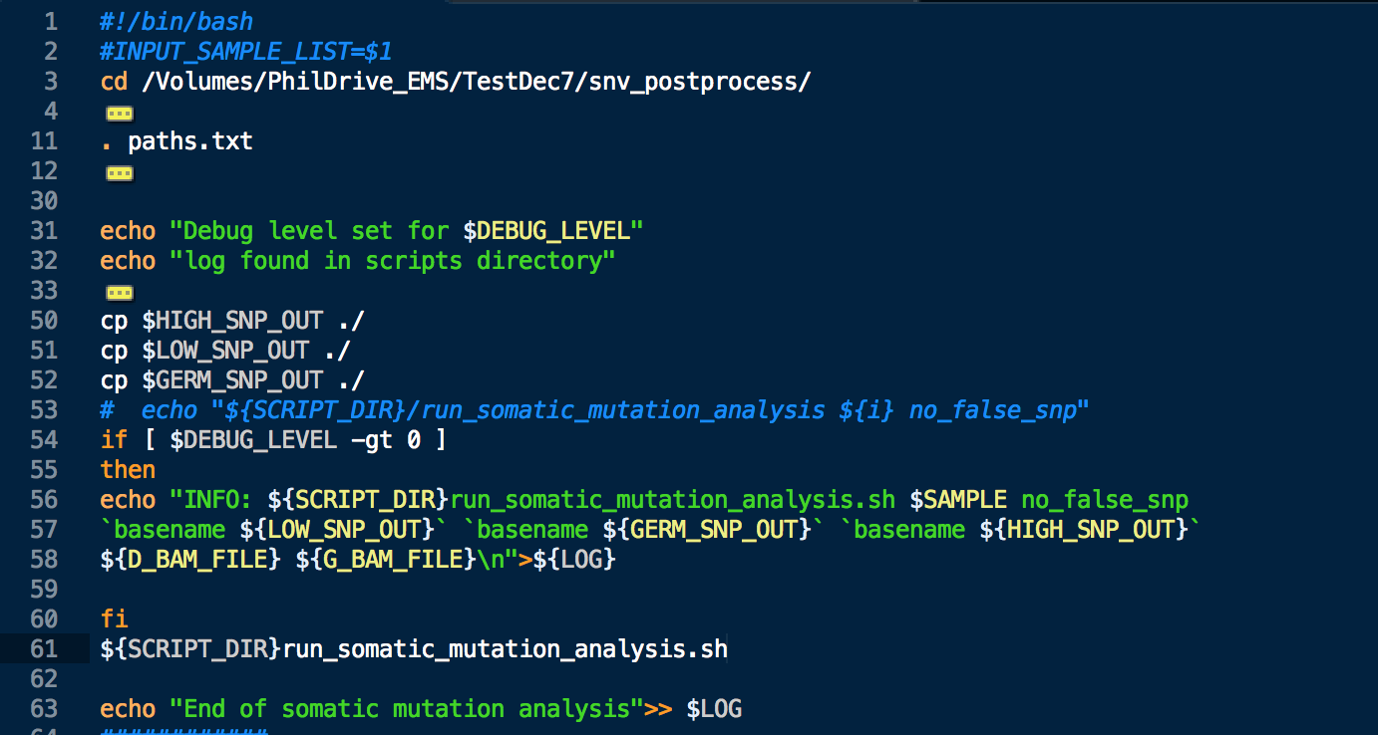
Bash Scripting – Part 2

Slide 2

The bell:

Slide 3
Bash scripting topics:
Script formatting, comments and other initial things to know
Variables and built in variables
Conditional logic
Conditional statements (if and case)
Loops (for, while and until)
Built in commands
File handling
Debugging
Arithmetic
Making a script interactive
Functions
Arrays
Lists
Regular expressions
I/O redirection and passing in command line arguments
Forking

Slide 4
Built in bash commands:
Run ”compgen -c” for a full list of the commands that are available to you on a given *nix system (Macs included).
No need to go over entire list in class, good area to explore yourself.
If you need details on how a given command works, run “man commandName” to view the manual.

Slide 5
Basic Debugging:
When in doubt, echo it out.
bash –n myscript.sh – check for syntax errors, but don’t run script
Bash –v myscript.sh – echoes each command before running it (verbose mode)
Check for syntax errors and run script with verbose output – bash –nv myscript.sh
Break things into smaller chunks to help pinpoint where something is failing. (finding one error in a single 500 line statement vs finding one error in ten 50 line statements). This is covered in more detail when we get into writing functions.

Slide 6
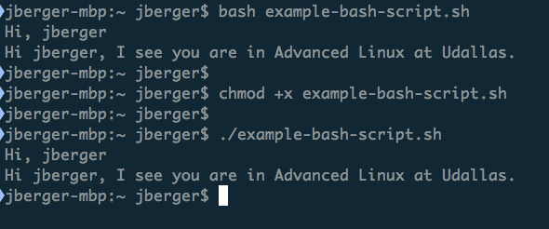
How to run a script:

Slide 7
I want to…
On a given text file, I want to find:
How many words are in the file.
What the most frequently used words are.
For a given word, how many times it occurs in the text.

Slide 8
Expanding a command into a script:
cat the-iliad.txt | tr [:space:] '\n' | grep -v "^\s*$" | sort | uniq -c | sort -bnr | head -10
Implement the following:
Make this an interactive script.
Get the file name from the user.
Generate a word count with wc –l after passing it through tr.
Allow the user to set the number of results (instead of it being hard coded to 10).
Allow the user to specify a word and find the frequency of that word for them.
Results can be stored in a text file to speed up processing – for example, running tr multiple times on a long text file is expensive in terms of CPU time (and you sitting there staring at a terminal time!).
Extra credit if you can find the user’s word and match on it in a non-case sensitive fashion (hint – you can use tr here as well)

Slide 9
Grabbing a copy of the example files:
Browse to https://github.com/jamesberger/Teaching and look at the file names.
For example, click on the .pptx files and select ‘download’ to get a copy of the slides.
You can click on text files and select “raw” to get the path.
Then use wget to grab them in the following fashion:
wget https://raw.githubusercontent.com/jamesberger/Teaching/master/Class_4_Bash_scripting_1/example-bash-script.sh

Slide 10
Extend your script:
Before next class:
Add logging.
Document the user’s choices each time the script is run in a log file.
Each time the script is run, there should be a new line in the log file that shows what choices were made.
Each line should start with the time and date the script was run on.
If the script failed, stderr output should be captured by the log file as well. (experiment with different ways to break your own script!)

Slide 11
The end!
(return the bell)
Questions?

