Slide 1
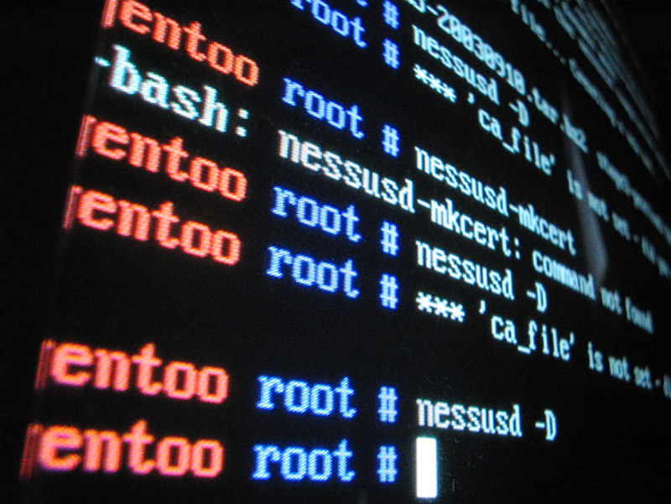
First There Was the Command Line

Slide 2
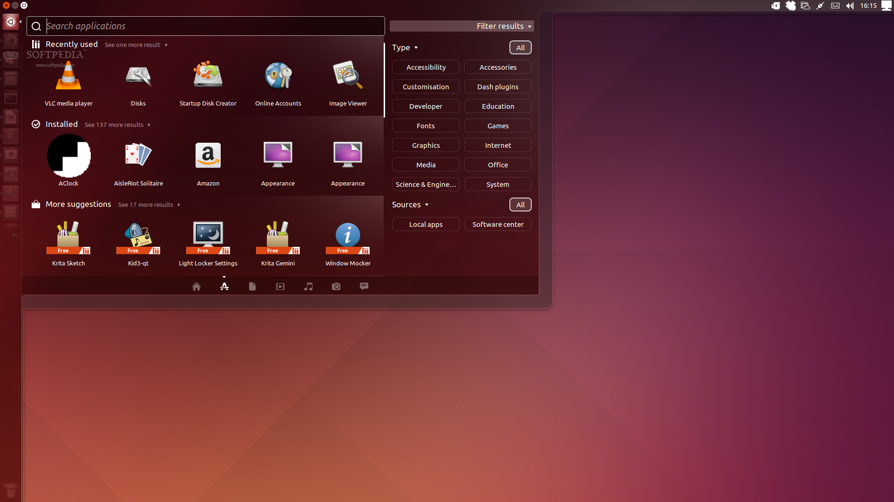
Doesn’t Linux have a GUI?
Notes:
We acknowledge that Linux has a GUI, but in this class, we are going to pretend that it doesn’t exist.

Slide 3
Logging in:
ssh student@x.x.x.x where x.x.x.x is an IP address
A.) 54.83.180.118
B.) 54.164.189.226
C.) 52.90.145.48
D.) 54.88.115.115
E.) 52.91.225.141
F.) 54.85.137.117
Password: udrocks!

Slide 4
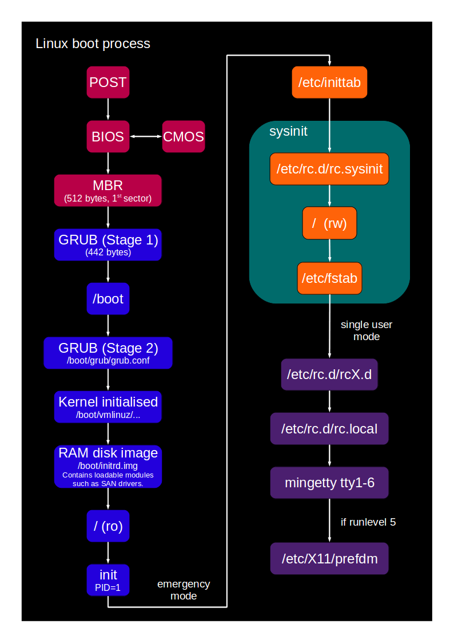
What leads to the command line?

Slide 5
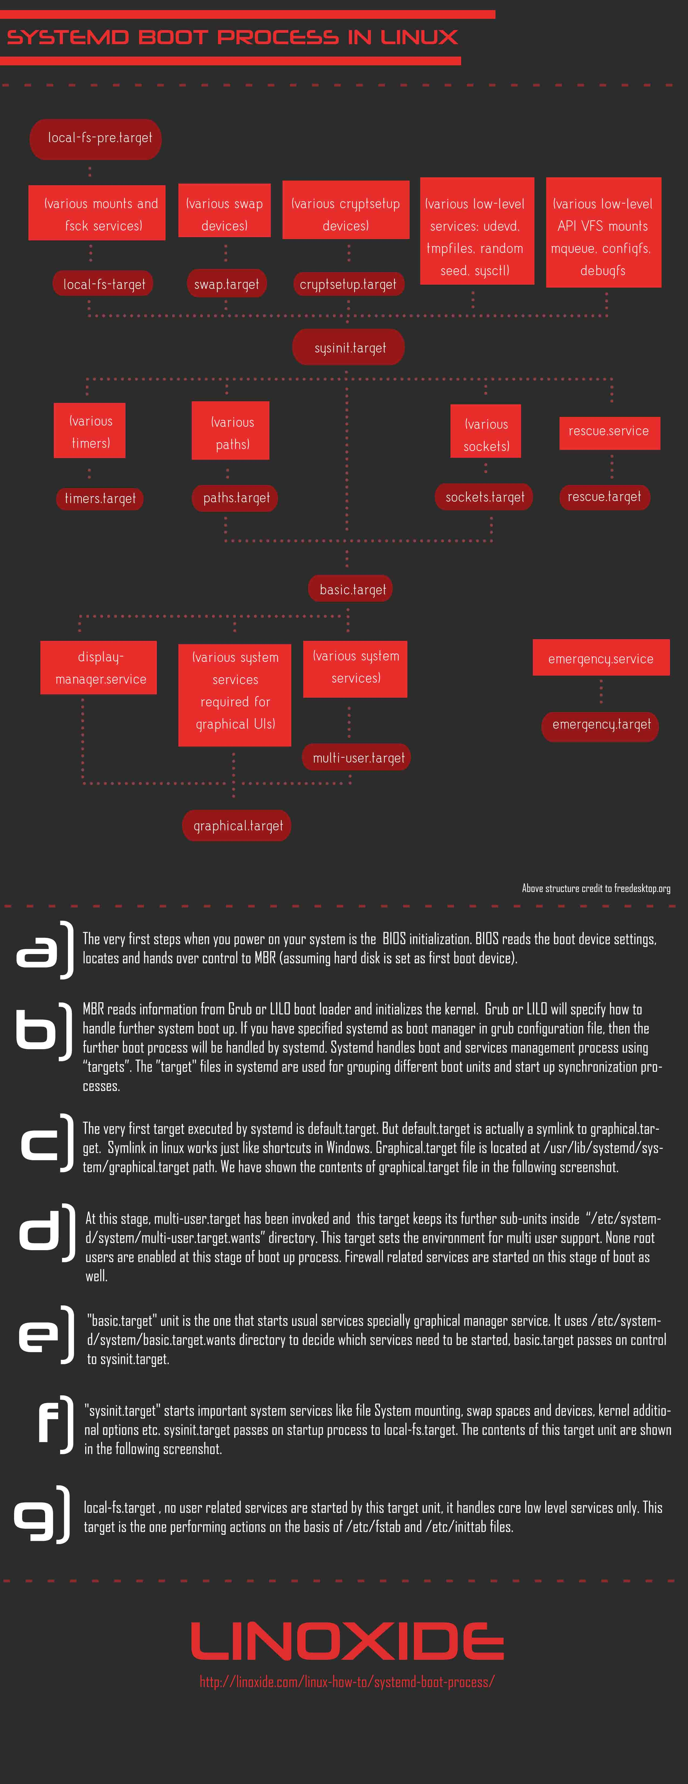
Systemd init vs ye olde SysV init:

Slide 6
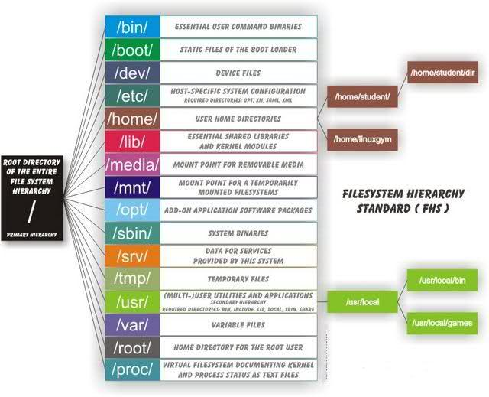
Linux directory structure:

Slide 7
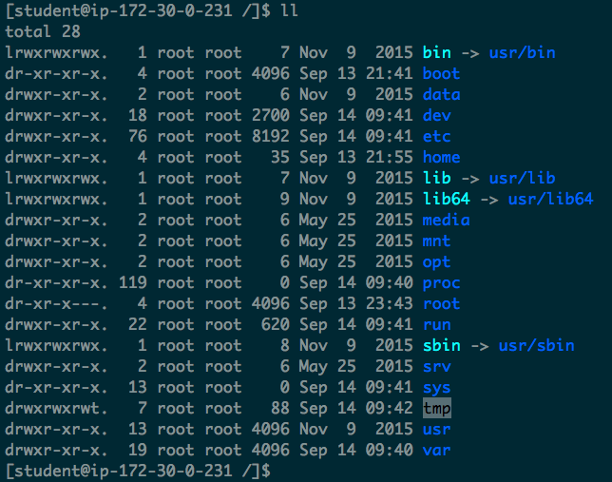
Linux directory structure:

Slide 8
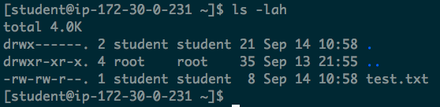
Sooo… What is all of that?

Slide 9
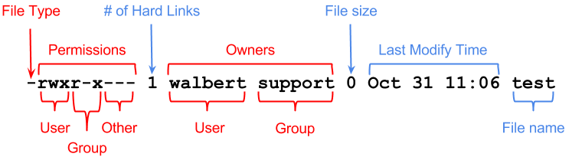
Sooo… What is all of that?

Slide 10
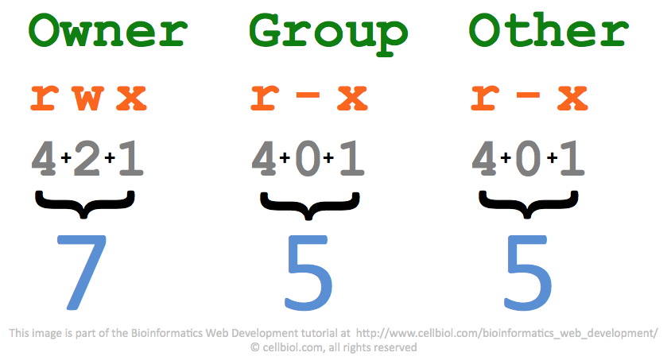

Slide 11
Permissions:
File permissions structure:
owner, group, other
_ _ _, _ _ _, _ _ _
Read, write, execute
rwx, rw_, r_ _
Numeric file permissions and chmod:
Read = 4
Write = 2
Execute = 1
“I want to read, write and execute this file, I want people in my group to read and write to it, and I want anyone else just to read it”
chmod 7?? awesomescript.sh

Slide 12
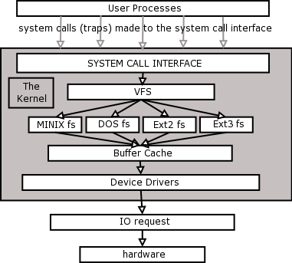
The Linux File System:

Slide 13
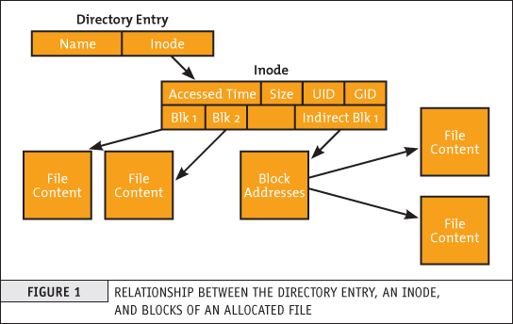
So what is an inode?

Slide 14
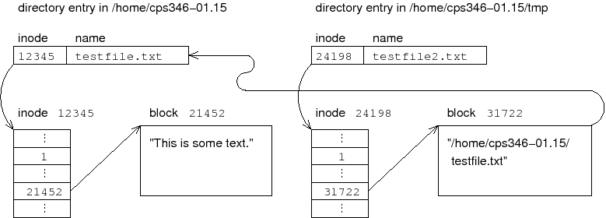
Ok, so what’s a sym link?

Slide 15
Navigating in Bash:
cd, cd .., cd ../..
“cd ~/list-of-banks-to-rob”
vs
“cd /home/bob-who-is-totally-not-a-bank-robber/list-of-banks-to-rob”
What the deuce? Relative paths vs absolute paths
ls and ls –lah or ls -1
pwd
locate
yum install mlocate
sudo updatedb

Slide 16
A few commands:
cd - change directory
ls – list directory contents
pwd – print working directory
mkdir – creates a directory
rmdir - removes a directory
touch – creates a file or updates the last accessed time
cat – concatenate and print files, almost always used to print the file contents to the console
head – grab the first few lines of a file
tail – grab the last few lines of a file
cp – copy a file
rm - removes a file
df – show free disk space, as well as what is mounted where
du - shows what is using up your disk space and where it is
ps – lists processes
kill – kills a process
grep – search for patterns
sort – takes stdin and sorts it, then outputs it to stdout
uniq – removes duplicates

Slide 17
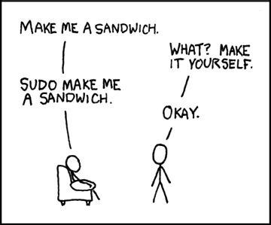
Sudo:

Slide 18
Sudo:
“I want to do something as root, but only for a single command”
Or
“I don’t trust this user not to destroy the server if I let them log in as root”
Or
“I want to be very mindful of commands I run as the root user”
(this doesn’t work well if every command you run starts with sudo though, mind you)
sudo cat /etc/sudoers
“sudo touch /home/student/sudo-yes-example.txt”
Vs
“touch ~/sudo-no-example.txt”

Slide 19
What are these stdin / stderr things I keep hearing about?
Standard input (stdin) – keyboard input, file descriptor 0
Standard output (stdout) – console window, file descriptor 1
Standard error (stderror) – (often the console window but not always), file descriptor 2

Slide 20
Linux operators:
Redirect stdout:
ls > directory_contents.txt
Redirect stdout, but append, don’t overwrite:
ls >> directory_contents.txt
Redirect stdin:
sort –r < directory_contents.txt
Redirect stdout and stderr to the same file:
ls > directory_contents.txt 2>&1
Send errors to their own file:
make bob 2> make_errors.txt

Slide 21
Pipes, appending to a file, cat and less:
Create a file:
ls / > directory_contents.txt
Cat out the file:
cat directory_contents.txt
Append content to a file:
ls /; date > directory_contents_more.txt
Repeat the above 15-20 times
Cat out the file:
cat directory_contents_more.txt
More managable? Pipe it through less:
cat directory_contents_more.txt | less

Slide 22
Who’s here?
Users:
sudo cat /etc/passwd
Groups:
cat /etc/group
Who is logged onto the server:
who
Message others on the server:
wall <<< “Hi there”

Slide 23
One small command:
rm -rf / mnt/bob --no-preserve-root

Slide 24
Recap - Semester One Topics:
Command line basics - cd, mv, cp, touch, chmod, adduser vs useradd, ssh, etc
Command line intermediate - pipes, grep, locate, rm, mount, fdisk, xargs, don't use backtick, etc
Bash scripting part 1 - basic operations, if statements, while and for,
Bash scripting part 2 - writing a function, arrays, handling files, lsof, stat, fork, how not to forkbomb, exec
Bash scripting part 3 - writing your own simple utility
Linux general architecture part 1 - userland architecture, kernel architecture, run levels, bootloaders, initial ram disk
Linux general architecture part 2 - kernel modules and tuning, system calls, more detail on the boot / init process, systemd vs init
Linux disk architecture and RAID - fstab, mount, fdisk, madm, LVS, RAID levels, character devices vs block devices, IO and split IO, NFS shares
Linux memory architecture - swap, virtual memory vs physical memory, page cache and dirty pages, pages vs huge pages, buffer overflow attacks
Linux CPU architecture part 1 - top vs htop, mtop, etc, process IDs, virtual filesystems - /proc and /sys
Linux CPU architecture part 2 - CPU schedulers - CFS vs O(1) scheduler, using 'nice', load vs % cpu utilization
Linux network architecture - network interfaces, tcpdump, netcat server / client mode, dig, nslookup, telnet, netstat
Linux permissions - sudo, users, groups, wheel, files, sticky bit, chattr and immutable
Linux troubleshooting - environment variables, cron, logging, log rotating / compressing, basic troubleshooting - uptime, free, what logs where, dmesg, messages

Slide 25
The end!
Questions?

