Slide 1
Companion 8/8/19
By: The bros

Slide 2
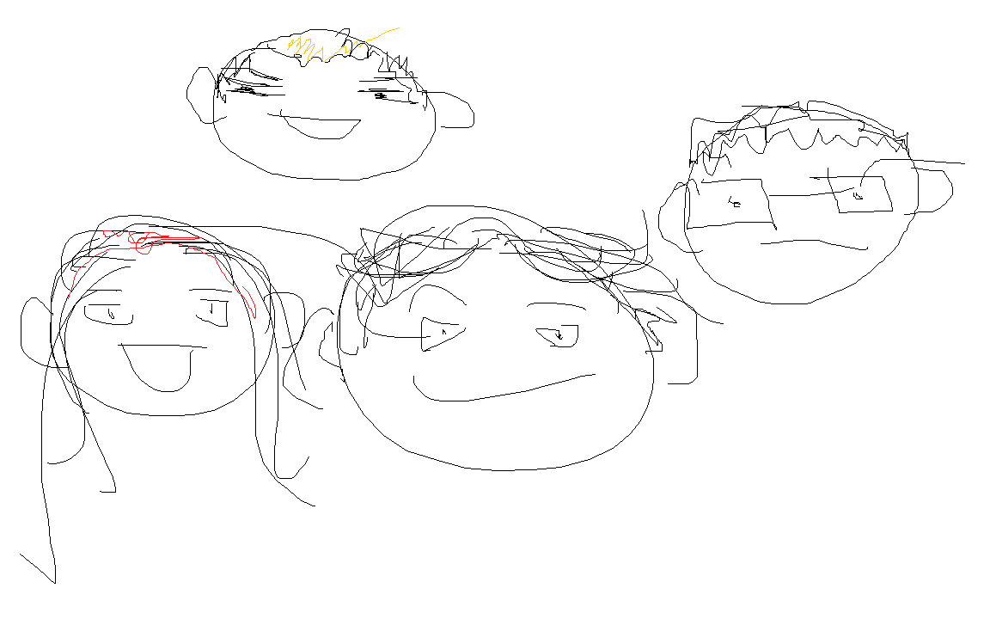
-Story is finished -Everything is currently working -Working on Final presentation -
Nikki: probably gay
We tried thank u enjoy u day :> ☺ :] :} :>
Hunter:boy
with luv ;]
Citlally : idk she cute
Jorge : Big brain

Slide 3
LINK!!!
https://companion-248917.appspot.com

