Slide 1
Companion 8/7/19
By: The bros

Slide 2
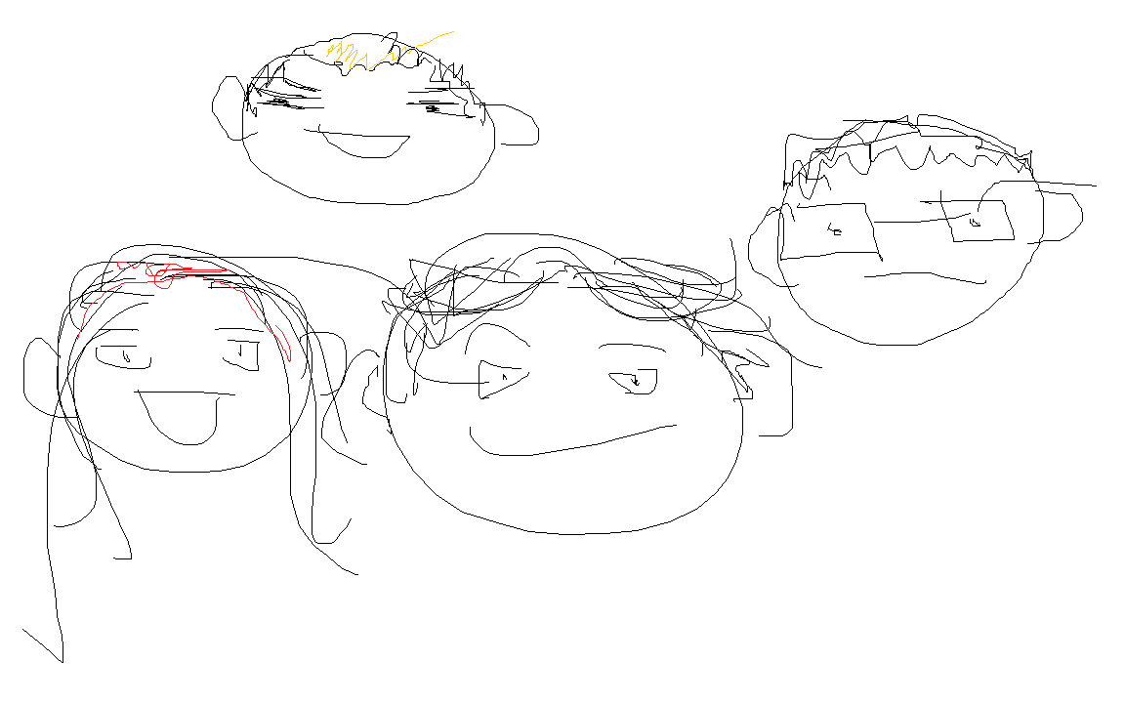
-Story is almost finished - Finished User login page -CSS for webpage and text -On schedule to complete by Friday with possibility of adding extras details for aesthetic
Nikki: probably gay
We tried thank u enjoy u day :>
Hunter:boy
with luv ;]
Citlally : idk she cute
Jorge : Big brain

Slide 3
LINK!!!
https://companion-248917.appspot.com

