Slide 1
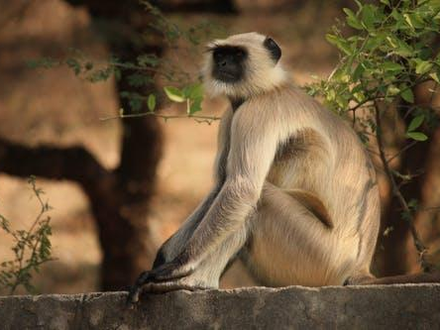
Zoohackathon:
IReport app
16-17 November, 2019
UWEC, Entebbe

Slide 2
IReport
Problem:-
Lack of necessary channels for local communities to report poaching and wildlife destruction related activities

Slide 3
IReport
Solution:- IReport is a whistleblowing app that allows any concerned individual to report suspicious illegal wildlife activities.

Slide 4
IReport
How it works:- Through the IReport app, local community informants tip off the responsible authorities about illegal activities around wildlife zones.

Slide 5
IReport
The informations and tip offs are delivered in real time meaning the concerned authorities can take action immediately.

Slide 6
IReport
It’s easy to use interface allows for every individual to participate in wildlife conservation through collaborating with the authorities

Slide 7
IReport: Target
Communities living around wildlife conservation areas
Wildlife authority officials on ground
Tour operators
Tourists

Slide 8
IReport: Implementation
sensitisation of communities about importance of wildlife
Training communities on how to use IReport to report illegal activities

Slide 9
IReport: The technology
frontend:- HTML5, CSS3, JavaScript, bootstrap 4
backend:- nodejs, mongoDB

Slide 10
IReport: Demo
App reporting interface

Slide 11
IReport: Demo
Admin interface

Slide 12
What we’ve got done
A working prototype
reporting of information
Admins being able to view reported information
Items being stored to database

Slide 13
What we learned
As a team
teamwork
development
contribution
interpersonal skills

Slide 14
Wrap Up
Team members:
James Besigye
Sandra Nanteza
Chandi Mary Gloria
Joshua Ogwang
Atim Joyce Sandra

