Slide 1

Quicklog
A procedures log for healthcare professionals
The Team | Mr Kieran Gutteridge Mr Andrew Vizor Mr Youhana Dev | Dr Conrad Lee Dr Michael George Mr Roy Lines Mr James Bloomer

Slide 2

Logging clinical procedures is a bit of a nightmare ….

Slide 3

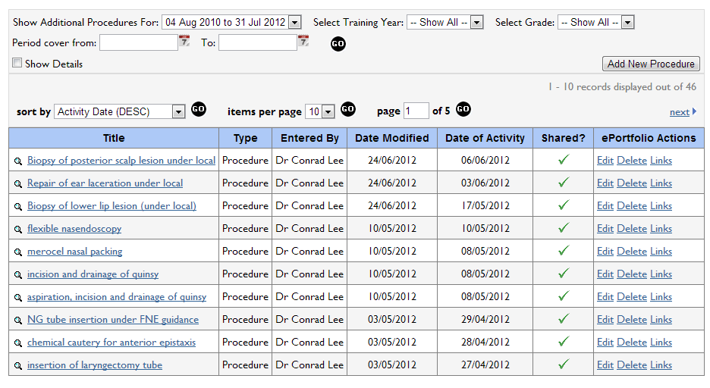

Slide 4

What we need…

Slide 5


Quicklog
Rapid!
Works offline
Statistical analysis
Notes:
http://www.bravr.com/wp-content/uploads/131404860.jpg

Slide 6

http://quicklog.herokuapp.com/
Notes:
http://www.google.co.uk/imgres?um=1&hl=en&safe=off&sa=X&tbo=d&authuser=0&biw=1241&bih=593&tbs=isz:lt,islt:svga&tbm=isch&tbnid=UlQT_H7a1UPrMM:&imgrefurl=http://www.itgenesys.com/&docid=Q8Aa-Qc8lGLLZM&imgurl=http://www.itgenesys.com/images/www.jpg&w=860&h=598&ei=QfgEUYOwJonEsgaLrICAAQ&zoom=1&iact=hc&vpx=734&vpy=296&dur=1823&hovh=188&hovw=270&tx=105&ty=124&sig=115853964841063597103&page=2&tbnh=128&tbnw=190&start=18&ndsp=26&ved=1t:429,r:22,s:0,i:151

Slide 7
