Slide 1
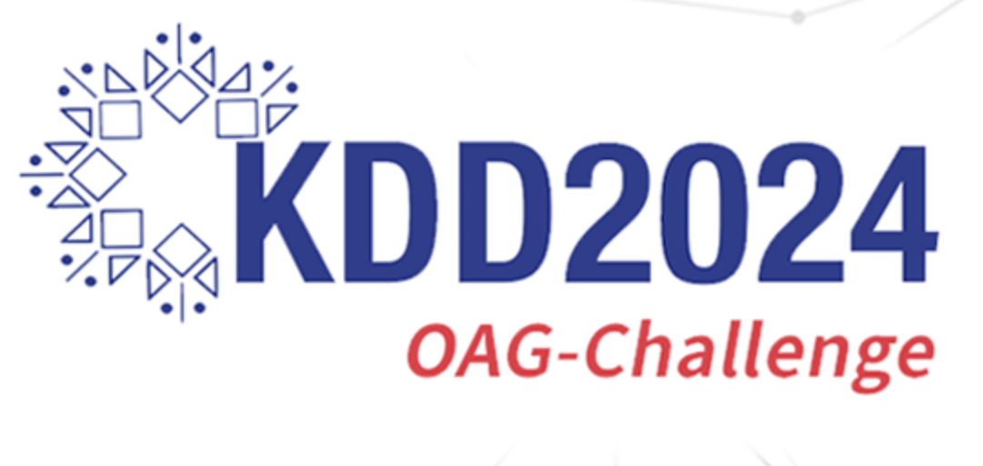
WhoIsWho-IND-KDD-2024
Final Presentation
2024. 06. 11.
Department of Applied Artificial Intelligence
Minsu Kim
Hanyong Kim
SungJun Park

Slide 2
Index
1. Introduction
2. Analysis
(1) Analysis - 1
(2) Analysis - 2
(3) Analysis - 3
3. Result & Conclusion

Slide 3
1. Introduction

Slide 4
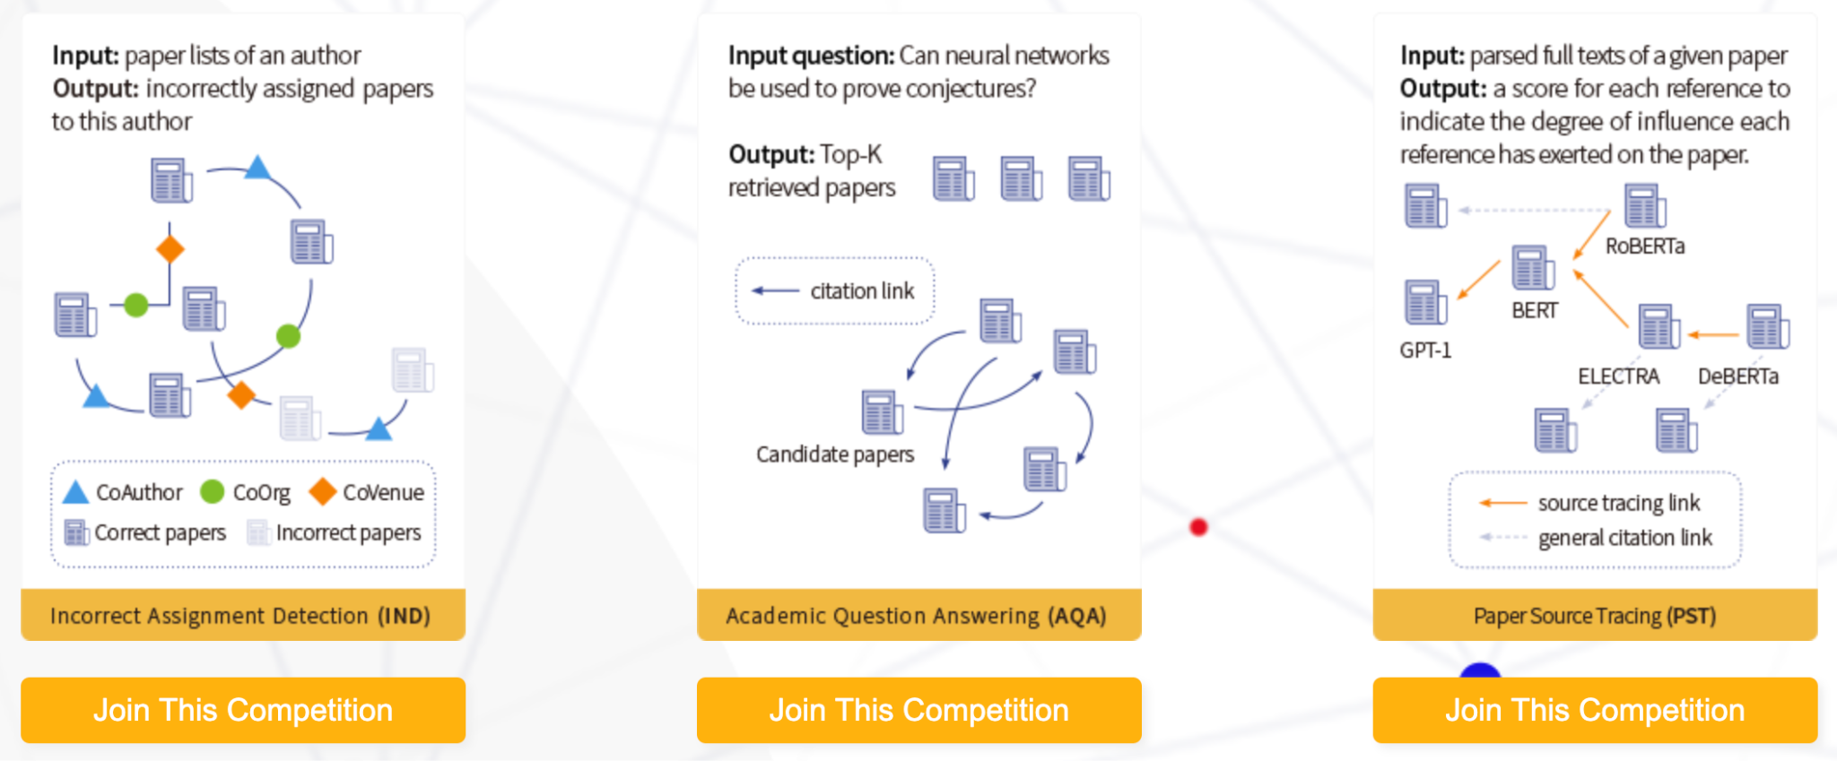
KDD 2024 OAG-Challenge
Motivation
Academic data mining has potential to unlock enormous scientific, technological, and educational values.
However, academic graph mining has been limited by the lack of a suitable public benchmark.
Open Academic Graph Challenge(OAG-Challenge) is open to advance the SOTA in academic graph mining.
WhoIsWho-IND(Incorrect Assignment Detection) Task
Given the paper assignments of each author and paper metadata, the goal is to detect paper assignment errors for each author.
Our Challenge
< Fig 1. Three tasks of KDD 2024 OAG-Challenge >

Slide 5
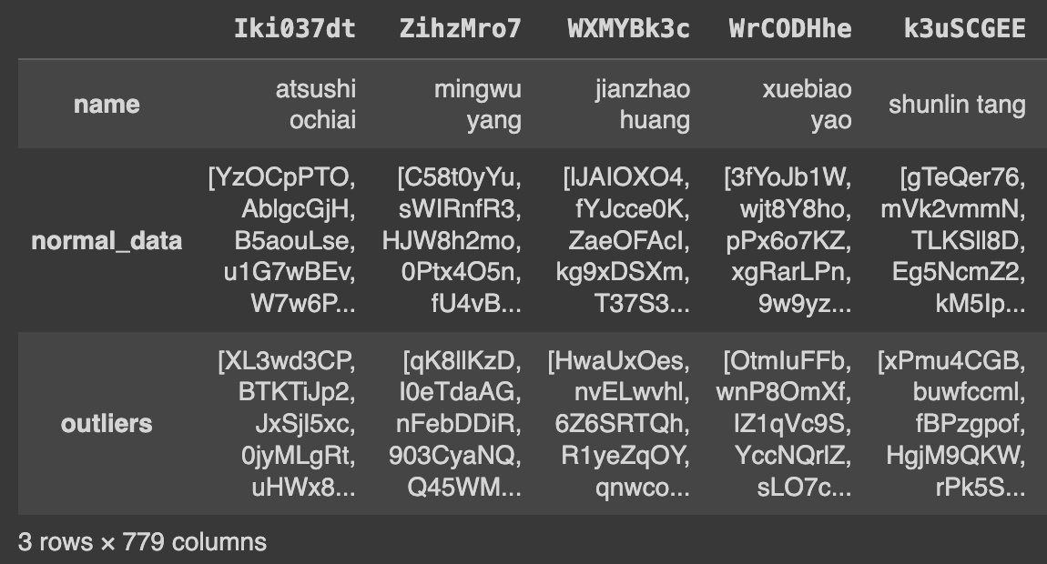
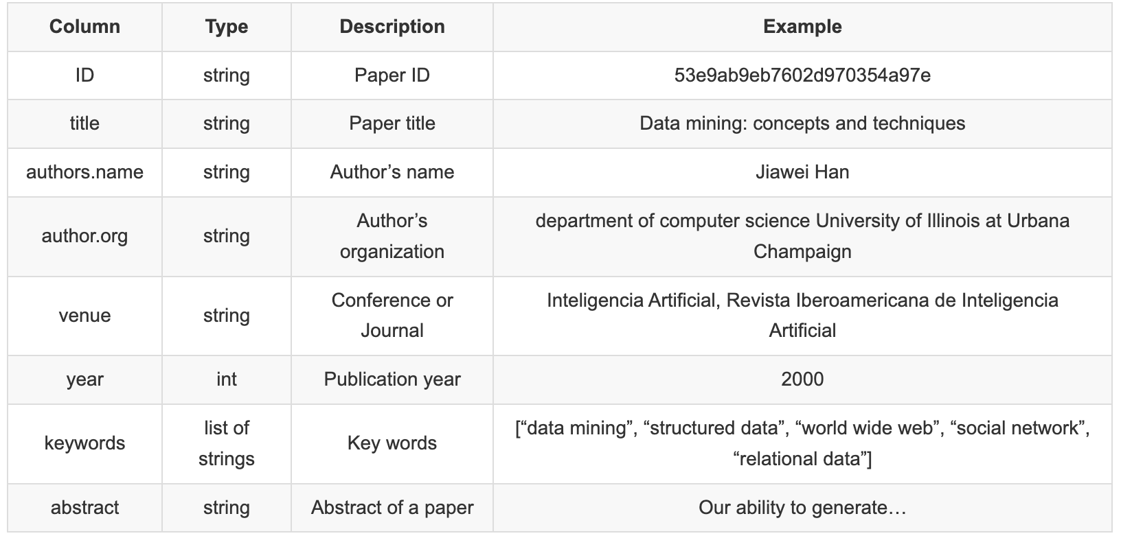
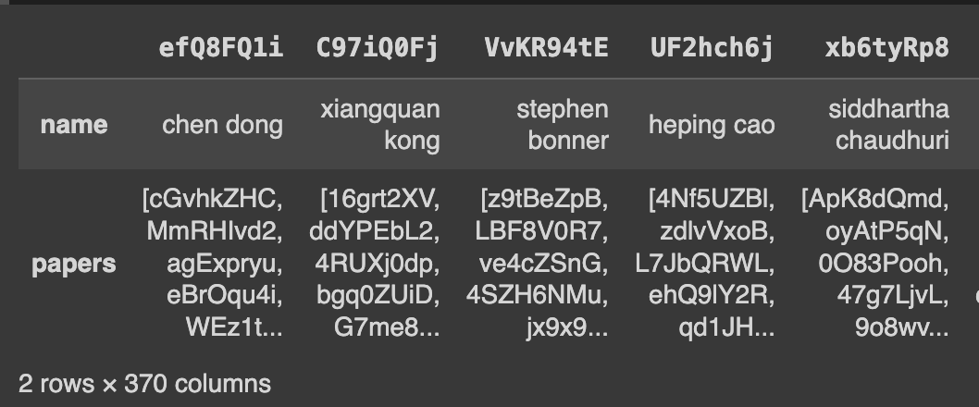
Dataset
train_author.json & ind_valid_author.json
The key is the Author ID and has the ‘name’.
‘normal_data’ for owned papers correctly.
‘outliers’ for incorrectly assigned papers.
779 authors(train) and 370 authors(valid)
pid_to_info_all.json
Paper ID
Author info : name, organization
Paper info : venue, publication year
Text info : paper title, keywords, abstract
< Fig 2. train_author/ind_valid_author data (left), pid_to_info_all data (right) >

Slide 6
2. Analysis

Slide 7
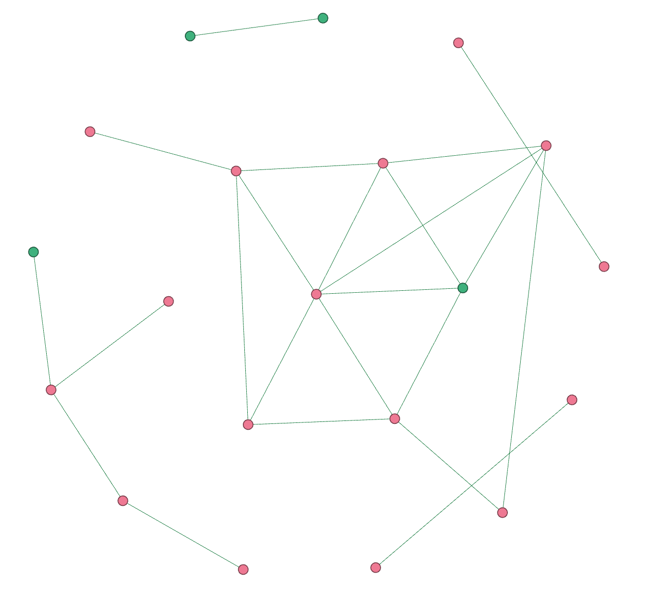
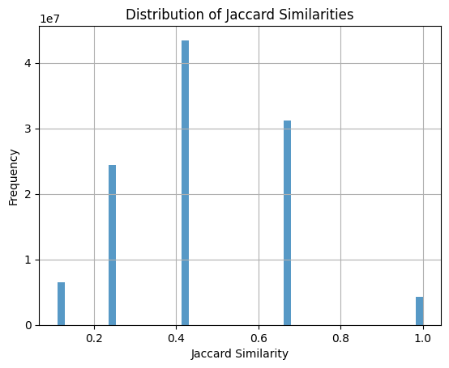
(1) Analysis – 1 : Graph Learning
Constructed the “Paper-Paper Graph” by author
Stopwords elimination from the title of paper & Embedding
Extracted Roberta keywords by using Embedding of title
Calculated Jaccard similarities among keywords
If Jaccard similarities >= 0.6,
→ Construct the “Paper-Paper Graph” by author
Embeddings of title can be used for feature vectors.
< Fig 4. Sample graph of Paper-Paper Graph on KDD Dataset >
< Fig 3. Distribution of Jaccard Similarities among keywords >

Slide 8
(1) Analysis – 1 : Graph Learning
Graph Modeling : GCN (Graph Convolution Network)
Inductive Learning (Dataset split → Train Set : Validation Set = 7 : 3)
Feature Extraction with two of GCN Conv. Layers from the graph
Adam Optimizer & FC Layer for the final output & binary output with Sigmoid activation
Hyper-parameters
Hidden : 768
Epochs : 50
Learning rate : 0.0005
Evaluation metric : AUC
Valid AUC | Public Board
0.592 | 0.583
*Ref. Lecture Slide-05_nc, p.5, Interactive Graph Mining, SKKU, 2024 Spring

Slide 9
(2) Analysis – 2 : Machine Learning
Data Preprocessing
Stopwords elimination from the title and abstract
Text embedding for the title and abstract with RoBERTa
Combining embeddings, features(title, abstract, keywords, authors, venue), and year
Get ready with Training dataset(148,409) and Validation dataset(62,229)
Method
LightGBM learning with stratified K-Fold cross validation
Train:Test = 80:20
Optimizing hyper-parameters by using grid search
Evaluation metrics: ROC-AUC, Accuracy, Precision, Recall, F1-score
Valid AUC | Public Board
0.764 | 0.638

Slide 10
(3) Analysis – 3 : GCCAD Modeling
GCCAD modeling with WhoIsWho-IND Baseline code
Build Graph
Eliminating stopwords from the title
Building Paper-Paper Graph by author → Edge weights with co-author, co-work years and venues
Embeddings of title are used for feature vectors.
GCCAD Modeling (Graph Contrastive Learning for Anomaly Detection)
GraphCAD is a complex graph neural network model aimed at Outlier Detection in graph structures.
Designed to exploit the characteristics of graph data to detect anomalies at node, edge, and system levels
Experiment
epochs : 40 and default value of baseline code
Valid AUC | Public Board
0.693 | 0.682
*Ref. Lecture Slide-05_nc, p.5, Interactive Graph Mining, SKKU, 2024 Spring

Slide 11
3. Result & Conclusion

Slide 12

Result & Conclusion
Result
Ranked 53rd on the Leaderboard with an accuracy 0.68226 (scored by GCCAD)
Conclusion & Limitations
We tried both Machine Learning and Graph Learning.
ML performs well in general.
GNN is huge and heavy. → GNN needs enormous computing power and resources.
There was a difficulty on modeling and running codes due to the lack of computing resources. (Oh, C’mon Colab!)
Proper topic selection and utilization for GNN are very important.
< Fig 5. Screenshot of the competition leaderboard (June 9, 2024) >

Slide 13
References
[1] Ravipati, R. D., & Abualkibash, M. (2019). Intrusion detection system classification using different machine learning algorithms on KDD-99 and NSL-KDD datasets-a review paper. International Journal of Computer Science & Information Technology (IJCSIT) Vol, 11.
[2] Li, Y., Fang, B., Guo, L., & Chen, Y. (2007, March). Network anomaly detection based on TCM-KNN algorithm. In Proceedings of the 2nd ACM symposium on Information, computer and communications security (pp. 13-19).
[3] Aljawarneh, S., Aldwairi, M., & Yassein, M. B. (2018). Anomaly-based intrusion detection system through feature selection analysis and building hybrid efficient model. Journal of Computational Science, 25, 152-160.
[4] Chiang, W. L., Liu, X., Si, S., Li, Y., Bengio, S., & Hsieh, C. J. (2019, July). Cluster-gcn: An efficient algorithm for training deep and large graph convolutional networks. In Proceedings of the 25th ACM SIGKDD international conference on knowledge discovery & data mining (pp. 257-266).
[5] Jiang, J., Chen, J., Gu, T., Choo, K. K. R., Liu, C., Yu, M., ... & Mohapatra, P. (2019, November). Anomaly detection with graph convolutional networks for insider threat and fraud detection. In MILCOM 2019-2019 IEEE Military Communications Conference (MILCOM) (pp. 109-114). IEEE.

Slide 14
Thank you!
Q&A

