Slide 1
KOSS SELECTION TASK
Async ,Await, Promises and Callbacks in Javascript
NAME – ZAID AHMED KHAN
ROLL NO-21CH10079

Slide 2
What is synchronous and Asynchronous JavaScript ?

Slide 3
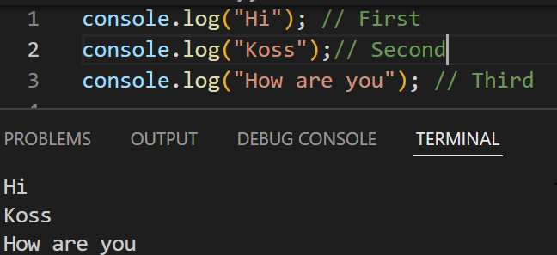
Synchronous JavaScript
As the name suggests synchronous means to be in a sequence, i.e. every statement of the code gets executed one by one.
Let us see a simple example to understand what asynchronous code look like

Slide 4
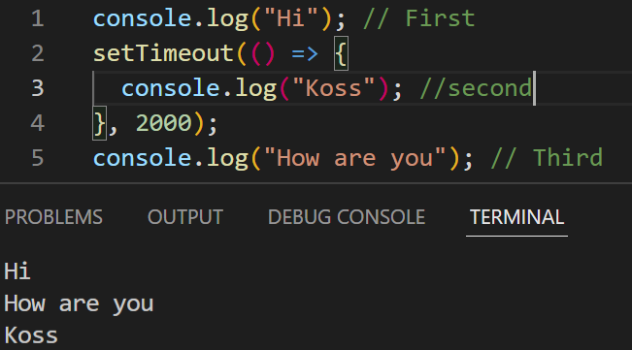
Asynchronous JavaScript
Asynchronous means that things can happen independently of the main program flow.
Let us see a simple example to understand what asynchronous code look like

Slide 5
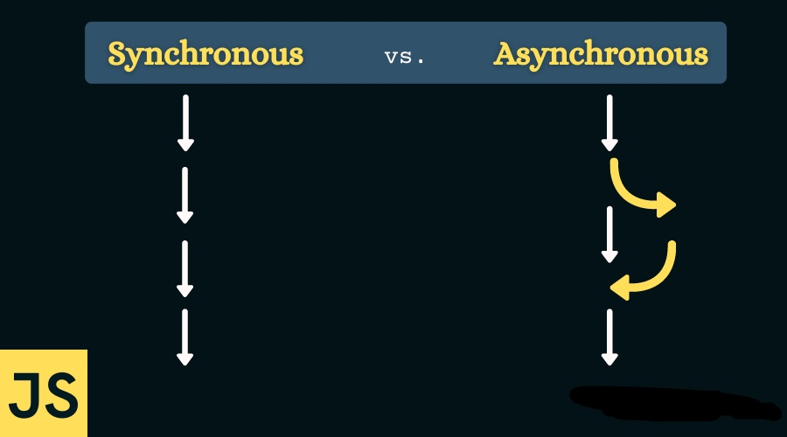
Synchronous vs Asynchronous

Slide 6
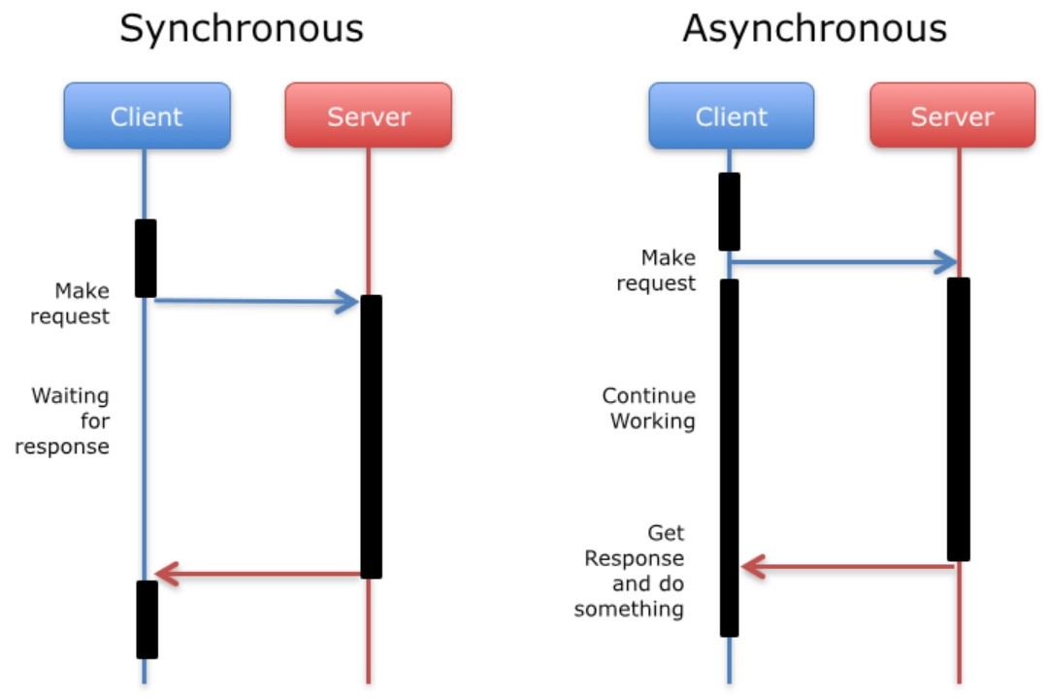
In Synchronous Code, things happen once at a time .
An Asynchronous Code allows multiple things to happen at the same time .
If our program involve
any feature which takes
a long time to execute
then in snynchronous our
client will not be able to use
other feature for some time.

Slide 7
How to make an asynchronous code ? We can make our code asynchronous by using :-
Callbacks
Promises
Async/Await

Slide 8
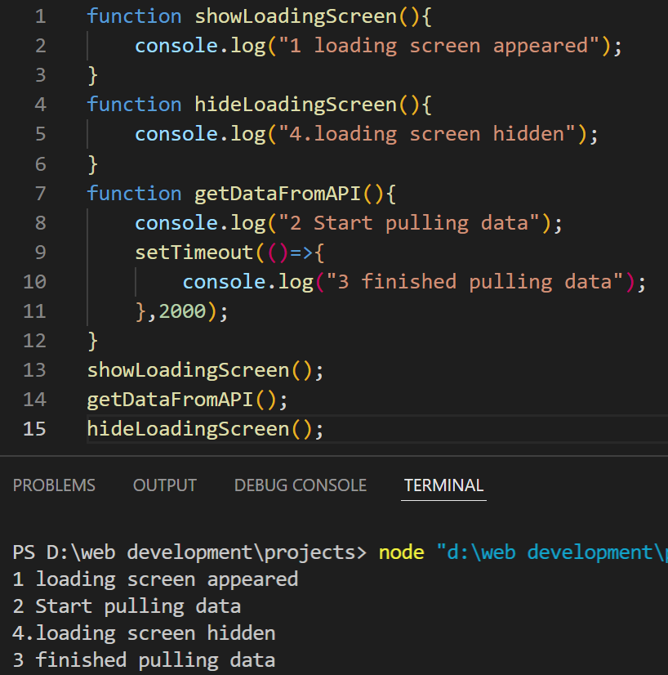
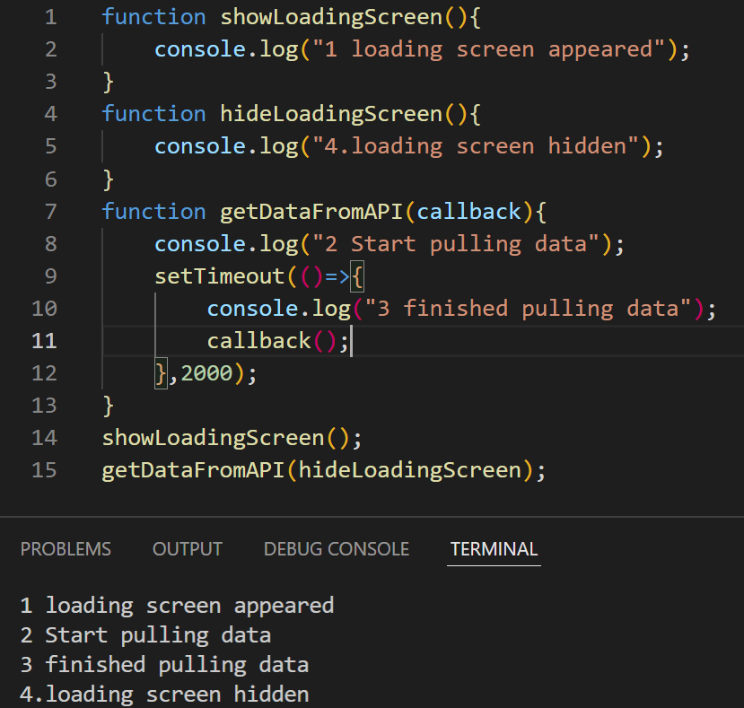
What are callback?
Any function that is passed as an argument to another function so that it can be executed in that other function is called as a callback function. Ex-
After using callback
Before using callback

Slide 9
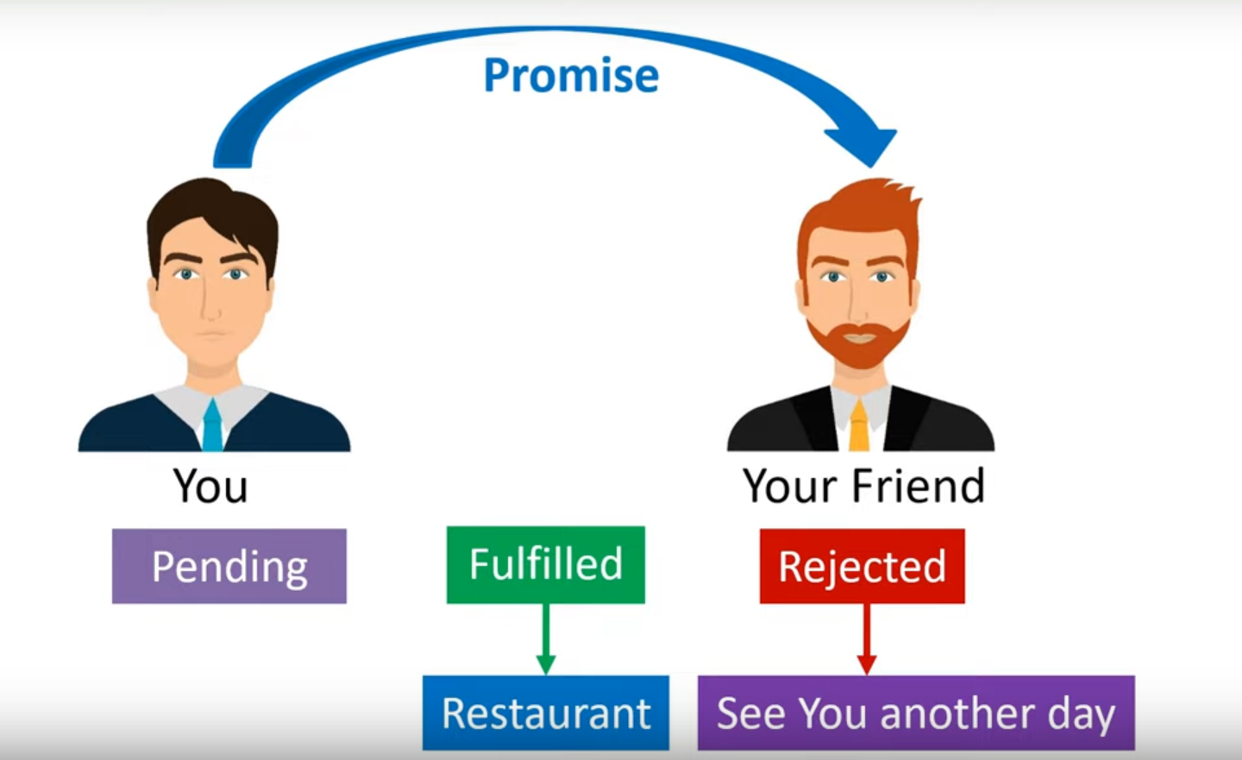
What are promises ?

Slide 10
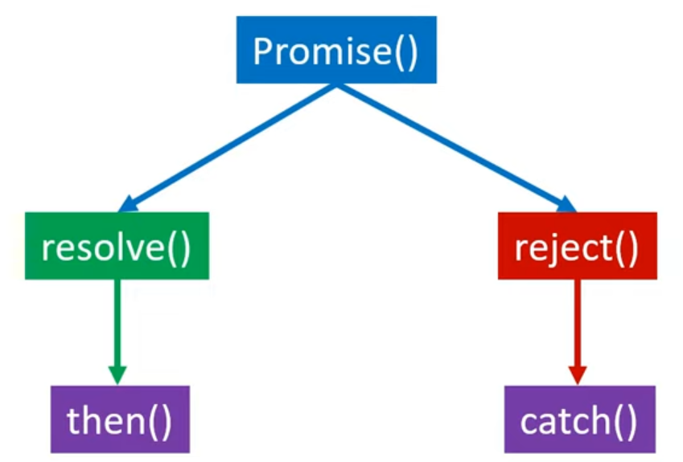
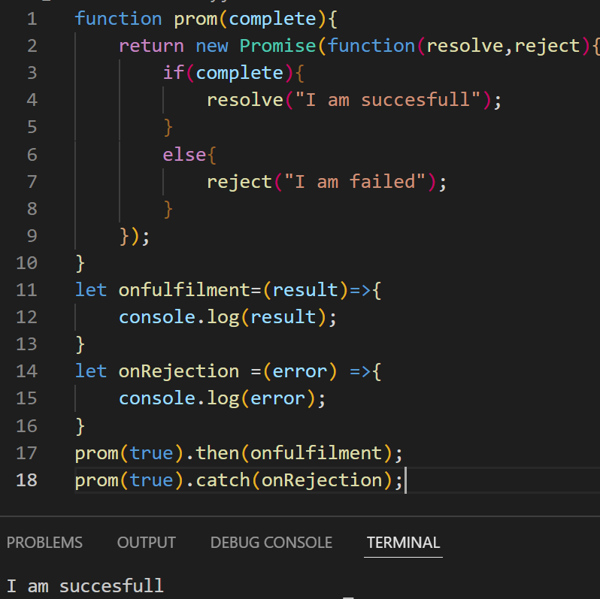
Promises flowchart
Promises syntax

Slide 11
Why are Promises better than Callbacks ?

Slide 12
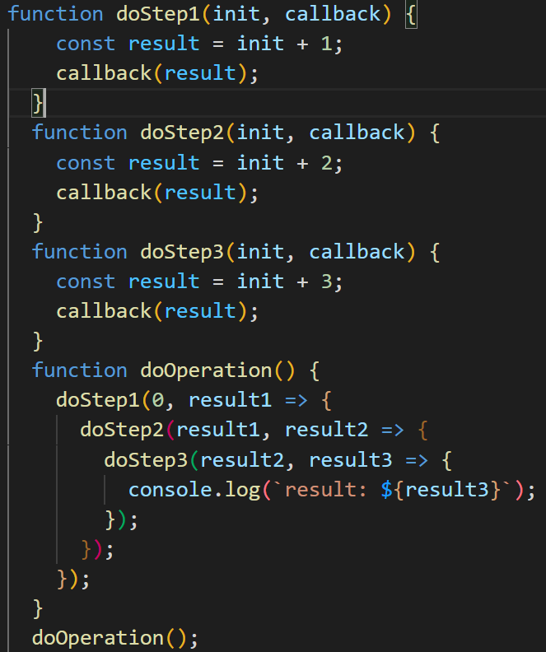
.
In callback we have to call callbacks inside callbacks, So we get a deeply nested doOperation() function, which is much harder to read and debug . This is sometimes called "callback hell" .
When we nest callbacks like this, it can also get very hard to handle errors: often you have to handle errors at each level of the "pyramid", instead of having error handling once at the top level .
On the right is an example of
Callback hell .

Slide 13
What are async and await ?

Slide 14
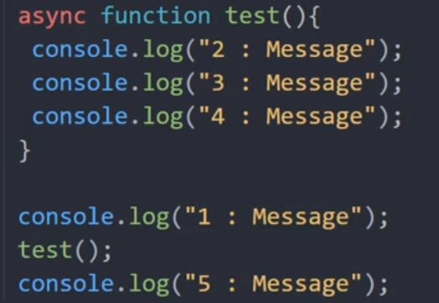
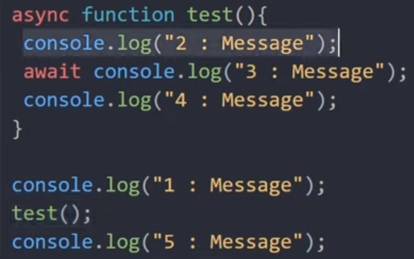
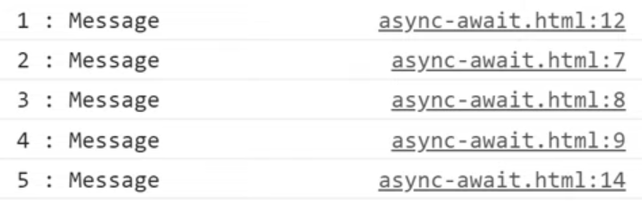
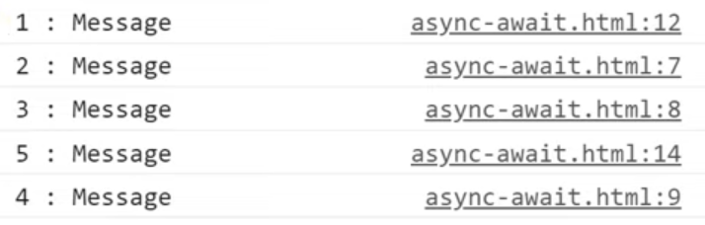
After using await method
Async syntax
Before using await methodyntax

Slide 15
Why we should use async/await over promises ?

Slide 16
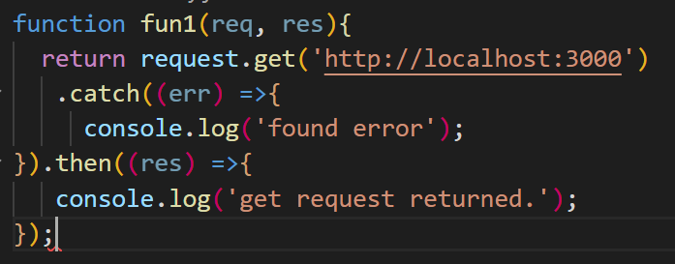
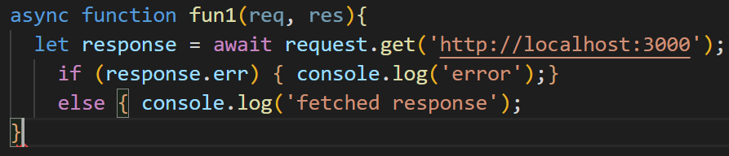
Before using async
async and await syntax is much more easier than promises syntax
Async and await help in dealing function chaining .
See the example below
After using async

Slide 17

THANK YOU

