Slide 1



Introduction to ggplot2:
LASS workshop – day 2
James Brand
james.brand@canterbury.ac.nz

Slide 2
Background
Learning aims:
Explore a dataset in an informative manner
Make informed choices about how best to present data clearly and accurately through visualisations
Use the ggplot2 package to produce visualisations of data
Customise your visualisations so they look awesome to you and your audience
Reap the benefits of using R to quickly modify, update, and reproduce your visualisations

Slide 3
Background
Structure:
Why data exploration and visualisation are important (conceptual)
Key principles regarding the way you explore and visualise data (conceptual)
Exploring data (practical)
Visualising with ggplot2 (practical)

Slide 4
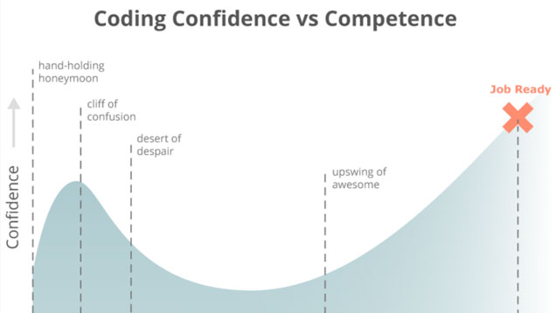
Background

Slide 5
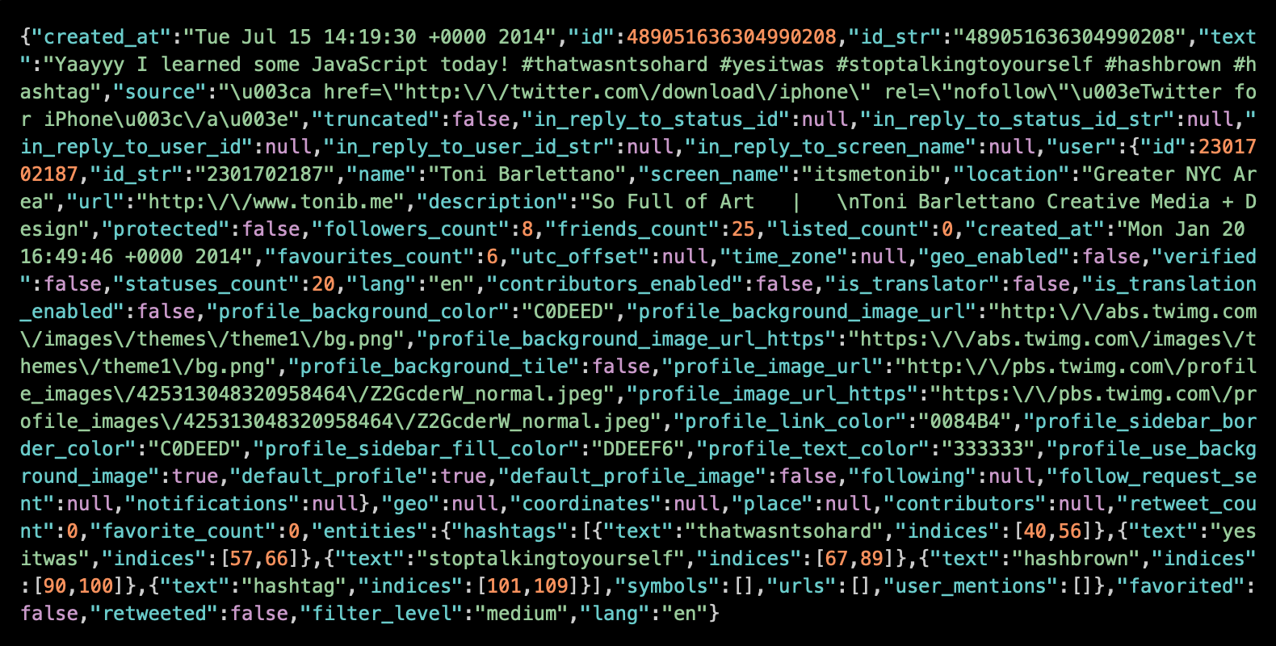
Background

Slide 6

Background

Slide 7
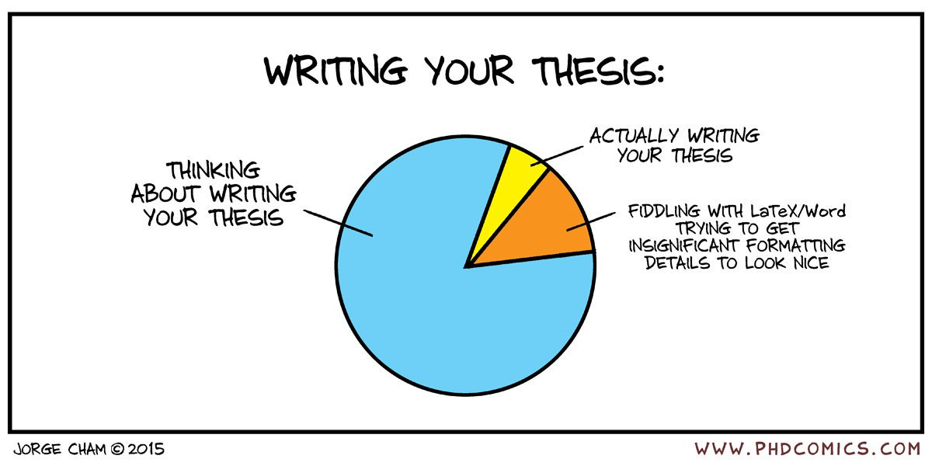
Background

Slide 8
Background
Open RStudio...

Slide 9
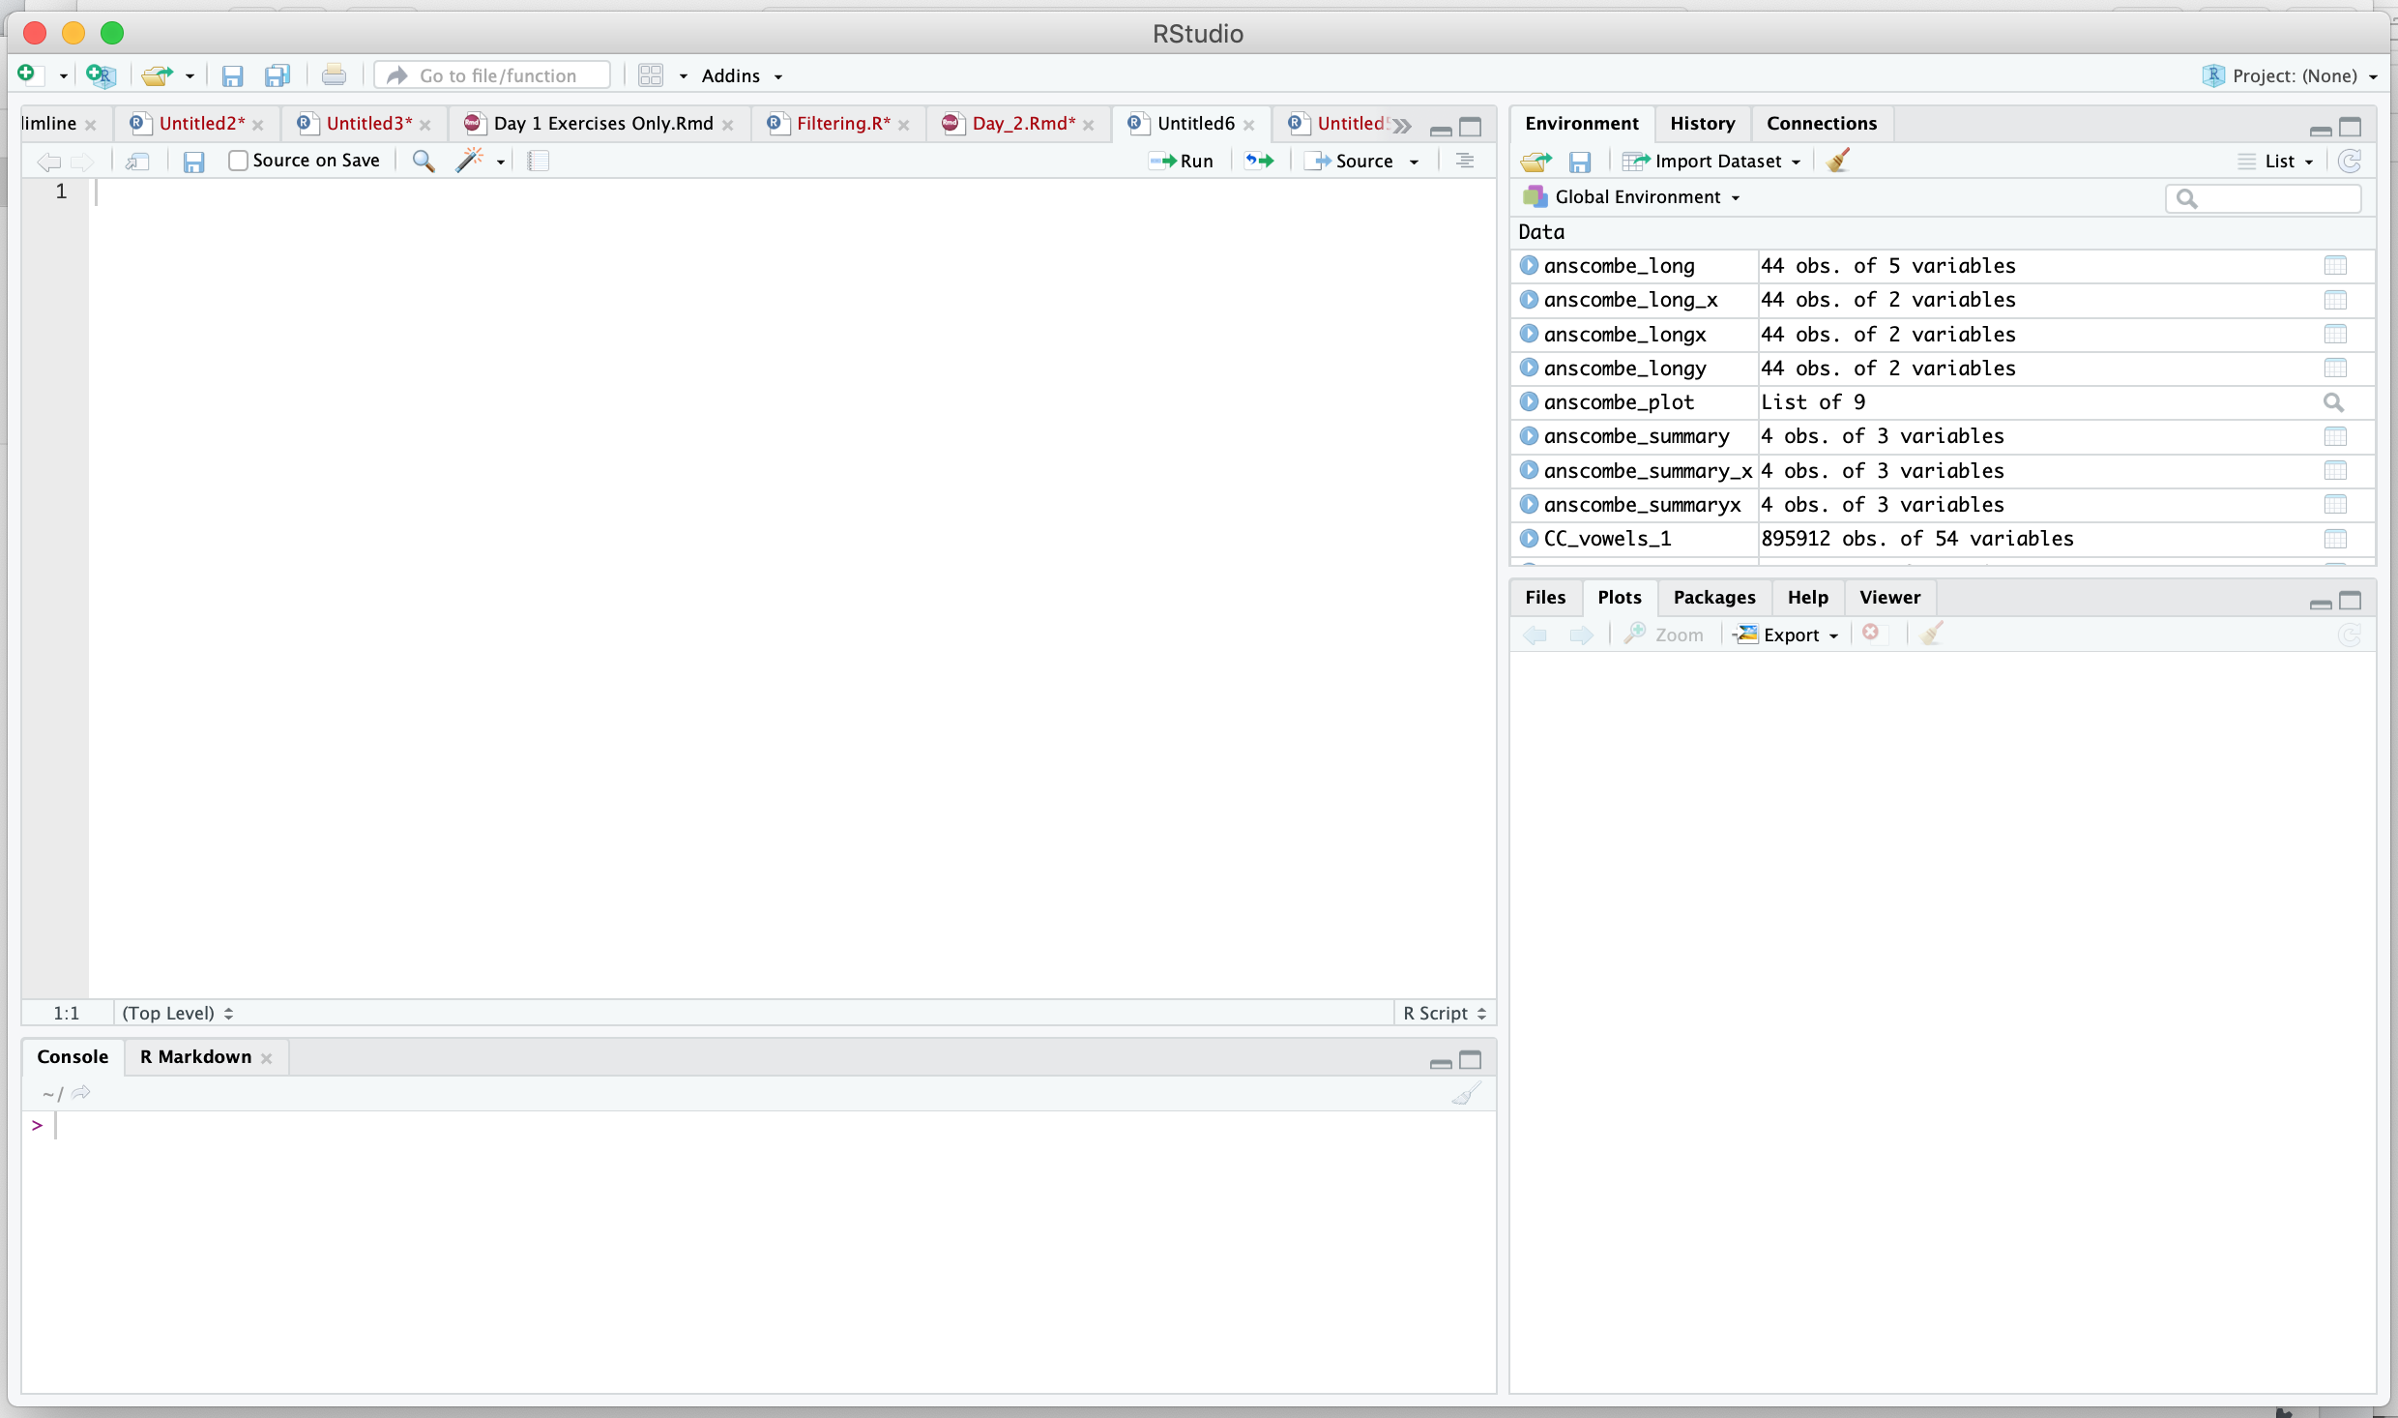
Background
DATA
CODE
PLOTS
OUTPUT

Slide 10
Background
You can view the worksheet online at:
https://bit.ly/2FRDmXW

Slide 11
Background
We will be working between the online worksheet and R Studio together…
So please do not skip forward
and…
Always ask for help if needed

Slide 12
Thanks
Tēnā koutou

