Slide 1
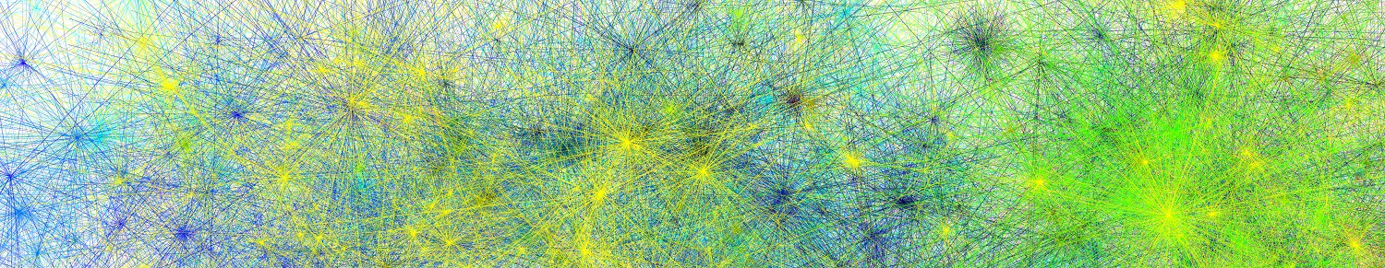


Introduction to online research: JsPsych and Cognition.run
James Brand
Edge Hill University
james.brand.ac@gmail.com
09/07/2024, PsychoSlav - Wrocław

Slide 2
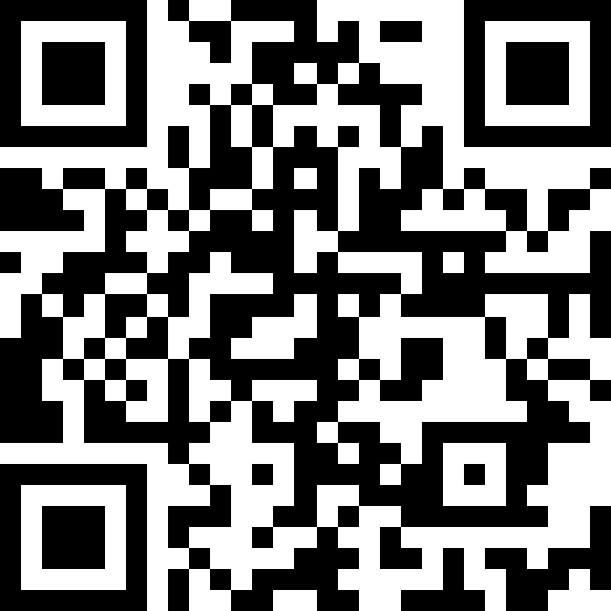
Workshop materials
https://tinyurl.com/psychoslav-jspsych

Slide 3
Examples:
Lexical decision
Audio
Video
Eye-tracking
Mouse-tracking

Slide 4
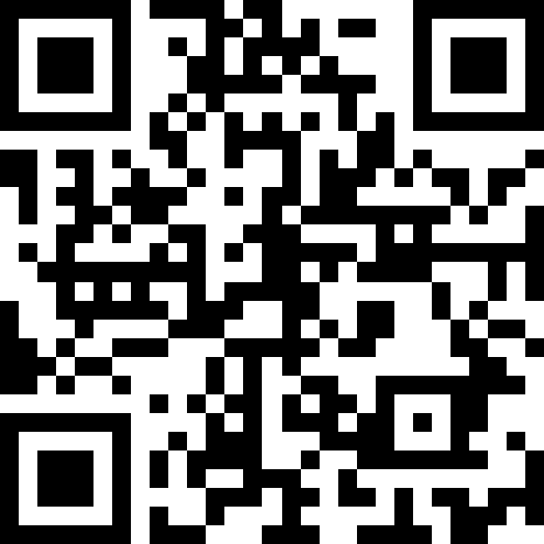
Session 1
https://tinyurl.com/psychoslav-jspsych1

Slide 5
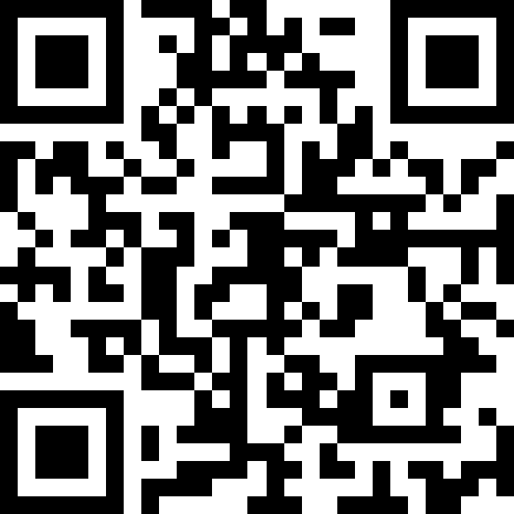
Session 2
https://tinyurl.com/psychoslav-jspsych2

