Slide 1

Artificial language learning workshop: Lecture 4
James Brand
j.brand@lancaster.ac.uk

Slide 2
Overview
Artificial Language Learning
Still to do
Introduction to PsychoPy
Understanding the design and architecture
Interpreting the output and looking at results
Stimulus design
Letting you modify and adapt the experiment

Slide 3
Overview
Artificial Language Learning
PsychoPy
What is it?
An application that allows you to design and run experiments

Slide 4
Overview
Artificial Language Learning
PsychoPy
Why use it?
It is free
It is open source
It can run cross-platform
It is written in Python

Slide 5
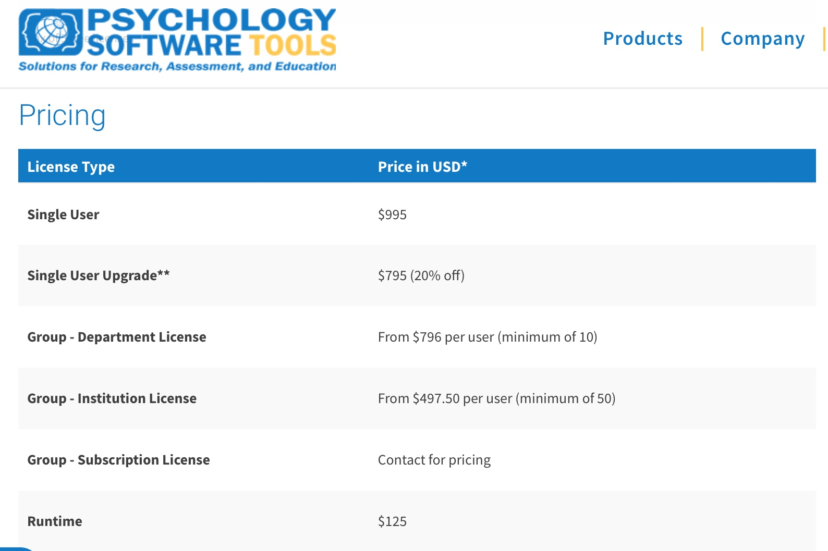
Overview
Artificial Language Learning
PsychoPy
Why use it?

Slide 6
Overview
Artificial Language Learning
PsychoPy
Why use it?
If you share your experiments (and data) more people will be able to understand what you did and reproduce your designs and results

Slide 7
Overview
Artificial Language Learning
PsychoPy
Why use it?
It is developing so you can host your experiments on the internet
https://pavlovia.org/run/demos/stroop/html/

Slide 8
Overview
Artificial Language Learning
PsychoPy
Why use it?
Builder or coder interfaces
Online community to help you
You learn something new

Slide 9
Overview
Artificial Language Learning
PsychoPy
How to use it?

Slide 10
Overview
Artificial Language Learning
PsychoPy
How to understand the data?

Slide 11
Overview
Artificial Language Learning
PsychoPy
How to understand the data?
Levenshtein distance calculator
goo.gl/D3Uhd9

Slide 12
Overview
Artificial Language Learning
PsychoPy
How to understand the data?
Use R
Package ‘stringdist’
Stringdist(“lenoga”,“lenoha”, method=“lv”)
https://cran.r-project.org/web/packages/stringdist/stringdist.pdf

