Slide 1
Binomial Bayes: Hamada launch failure example
Bayesian Reliability, Example 1
Worked with rjags

Slide 2
Set up
Hamada, Bayesian Reliability, page 21 following
Johnson, et al. (2005) present data on estimating the probabilities of failures of launch for vehicles used to put satellites in orbit.
Estimates of failure probabilities play a prominent role in risk assessment, viz.,
Public safety
Ability of aerospace manufacturer to develop and field new systems.
Purpose: estimate failure probability for new rockets fielded by companies with limited experience.

Slide 3
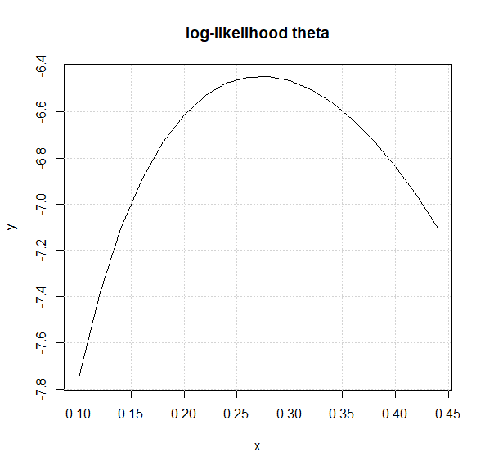

Data
Outcomes for 11 manufacturers with new vehicle launches- 3 successes and 8 failures
MLE estimate of parameter $θ$, probability of success = 3/11 = 0.273
Log likelihood of binomial with $θ$ = 0.273

Slide 4

OK, Bayes…
Choice of a prior
What is our belief about the prior probability of success, $θ$?
Idea-
Not much is known use a vague prior
Some knowledge, use an informative prior
Useful in cases that involve transformations of variables, Jeffreys prior

Slide 5
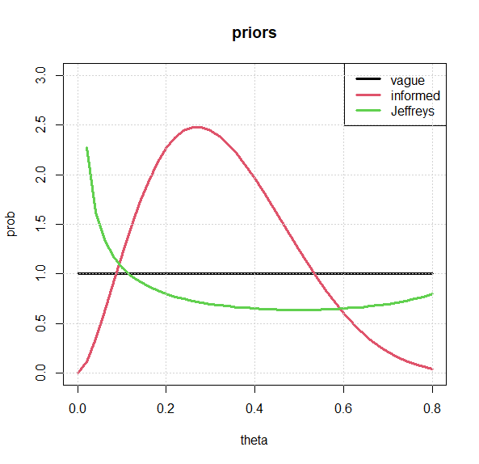
Possible priors
Tell a story about each prior

Slide 6
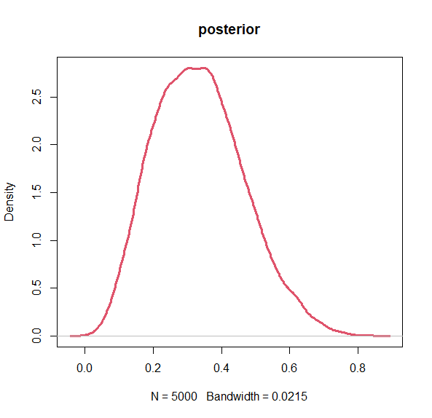
Posterior plots, vague prior

Slide 7

Posterior distribution, Jeffreys prior

Slide 8
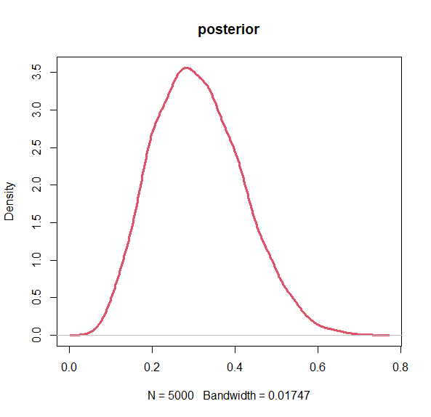
Posterior distribution, informative prior

Slide 9
Credibility intervals for launch success probabilities
Prior | Lower credibility interval | Upper credibility interval
vague | 0.11 | 0.51
informative | 0.14 | 0.47
Jeffreys | 0.10 | 0.52
Predictive posterior distribution for launch success: fit a beta distribution to posterior samples

Slide 10
R code…
Set up rjags stuff
library(rjags)
# Define failure data
observed_successes <- 3 # Replace with the number of observed successes total_trials <- 11 # Replace with the total number of trials
# Specify the number of iterations, burn-in, and thinning
n_iterations <- 10000
n_burnin <- 1000
n_thin <- 2

Slide 11
Set up the jags model
# Define the model
model_code <- "model {
# Likelihood: Binomial distribution
successes ~ dbin(p, trials)
# Prior: Uniform prior for binomial probability
#p ~ dunif(0, 1) # vague prior
#p ~ dbeta(0.5, 0.5) #Jeffreys prior
p ~ dbeta(2.7, 5.8) # informative prior
#x ~ dexp(0.1)
#logit p = x/(x+1) same as p <- ilogit(x)
#logit(p) <- x
#probit p = inverse normal CDF(x)
#probit(p) <- x #loglogistic #p <- ilogit(x) }"
Note: model_code can be inline (with textConnection function) or may be a text file

Slide 12
Create data list, initialize, run the model
# Create data list, jags model
data_list <- list( successes = observed_successes, trials = total_trials)
Initialize JAGS model
jags_model <- jags.model(textConnection(model_code),
data = data_list, n.chains = 3)
# Run the MCMC simulation
jags_samples <- coda.samples(jags_model, variable.names = "p", n.iter = n_iterations, n.burnin = n_burnin, thin = n_thin)
Cut to the code

Slide 13
Posterior analysis
# Load the coda package for posterior analysis
library(coda)
# Extract the posterior samples
posterior_samples <- as.mcmc(jags_samples[[1]])
# Summary statistics of the posterior distribution
summary(posterior_samples)
# Plot the posterior distribution
plot(posterior_samples, main = "Posterior Distribution of p")

Slide 14
Credibility intervals
Use kernal density
kd = density(posterior_samples)
plot(kd, lwd=3)
# find credibility interval
sortedSamples = sort(posterior_samples)
nSorted = length(sortedSamples)
lCred = sortedSamples[round(nSorted*0.05)]
uCred = sortedSamples[round(nSorted*0.95)]
print(paste('90% credibility interval: (',round(lCred,2), ',’ , round(uCred,2),')’)) abline(v = c(lCred, uCred), col='orange')

Slide 15
Posterior predictive distribution
Posterior predictive distribution accounts for uncertainty about p, taken from the posterior distribution of p.
Posterior predictive distribution is based on the posterior distribution of p.
But what value of p from the posterior distribution should be used to predict future performance?
Using the mean or mode value of p from the posterior distribution ignores the uncertainty found in the posterior distribution
Incorporate this uncertainty by using the posterior distribution as a ‘new’ prior distribution

Slide 16
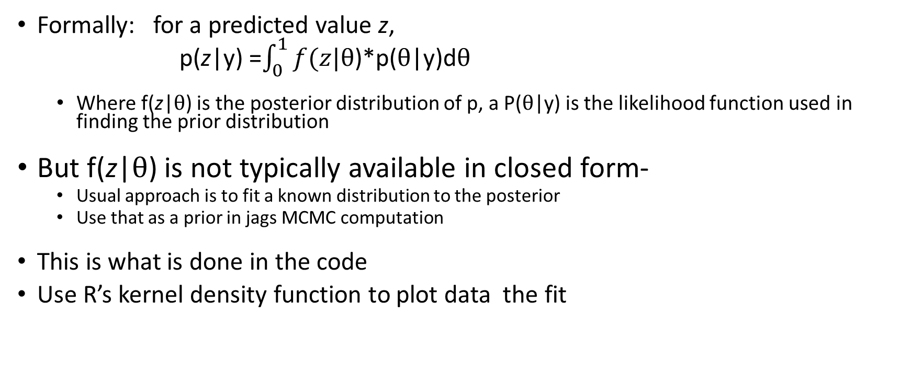
Predictive posterior distribution
Formally: for a predicted value z,
p(z|y) =$\int_{0}^{1}{f(z|θ}$)*p($θ$|y)d$θ$
Where f(z|$θ$) is the posterior distribution of p, a P($θ$|y) is the likelihood function used in finding the prior distribution
But f(z|$θ$) is not typically available in closed form-
Usual approach is to fit a known distribution to the posterior
Use that as a prior in jags MCMC computation
This is what is done in the code
Use R’s kernel density function to plot data the fit

Slide 17
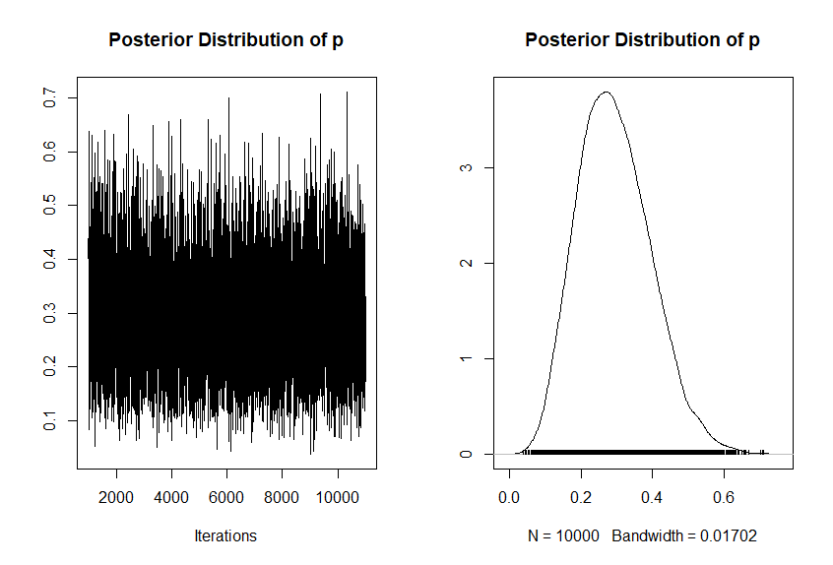
Posterior distribution of p
The posterior is unimodal, approximately symmetric, approximate it with a normal of t-distribution

Slide 18
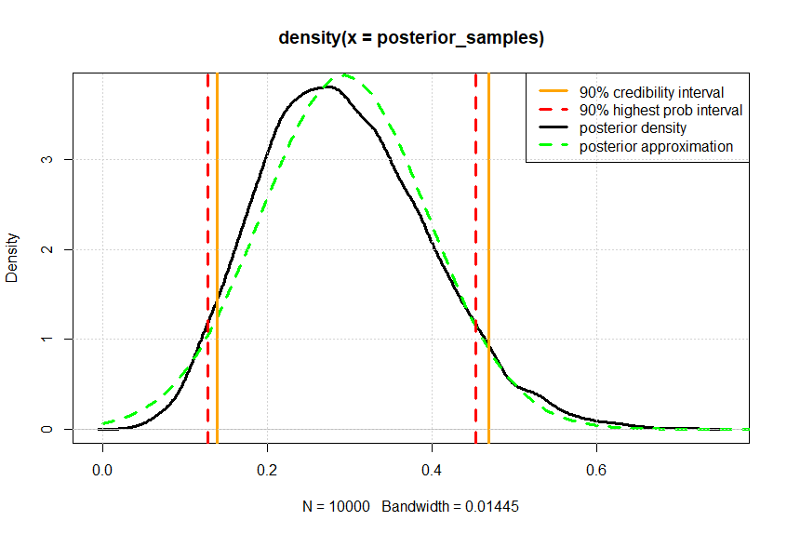
Posterior fit with a normal distribution

Slide 19
Get the posterior predictive distribution
As noted on slide 16, we fit with a normal or t-distribution
Here’s the new rjags model:
postPredModel_code <- “
model {
successes ~ dbin(p, trials) # Likelihood: Binomial distribution
# Prior: normal approximation to posterior
p ~ dnorm(m, 1/s) # the new prior for predicted posterior}
"

Slide 20
Set up rjags for the posterior predictive
# data list
postData_list = list(successes = observed_successes, trials = total_trials, m = meanPost, s = stdPost)
# initialize the modeljags_model_Post <- jags.model(textConnection(postPredModel_code), data = postData_list, n.chains = 3)
# Run the MCMC simulation
jags_samples_Post <- coda.samples(jags_model_Post, variable.names = "p", n.iter = n_iterations, n.burnin = n_burnin, thin = n_thin)

Slide 21
Sample from the posterior predictive distribution
summary(jags_samples_Post)
plot(jags_samples_Post)
# Extract the posterior
samplespost_Pred_samples <- as.mcmc(jags_samples_Post[[1]])

Slide 22
And plot the postrior predictive distribution
kd_PostP = density(post_Pred_samples)
plot(kd, lwd=3, col='red', lty=2)
lines(kd_PostP, lwd=3, xlab='probability of success’, col='black’)
legend('topright',c('predictive posterior','posterior'), col=c('black', 'red'), lty=c(1,2), lwd = c(3,3))grid()

Slide 23
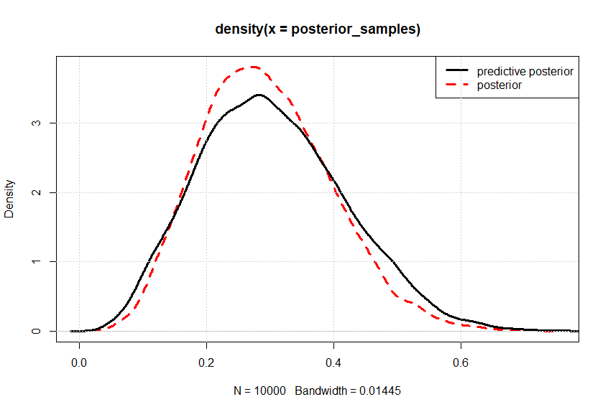
Posterior predictive and the posterior for p

Slide 24
Reference
V. E. Johnson, et al. A hierarchal model for estimating the early reliability of complex systems. IEEE Transactions on Reliability, 54-224-231, 2005

