Slide 1
Binomial Bayes: Hamada launch failure example
Bayesian Reliability, Example 1
Worked with rjags

Slide 2
Set up
Hamada et al., Bayesian Reliability, (2008) page 21, following
Johnson, et al. (2005) present data on estimating the probabilities of failures of launch for vehicles used to put satellites in orbit.
Estimates of failure probabilities play a prominent role in risk assessment, viz.,
Public safety
Ability of aerospace manufacturer to develop and field new systems.
Cost/schedule planning
Purpose: estimate failure probability for new rockets fielded by companies with limited experience.

Slide 3
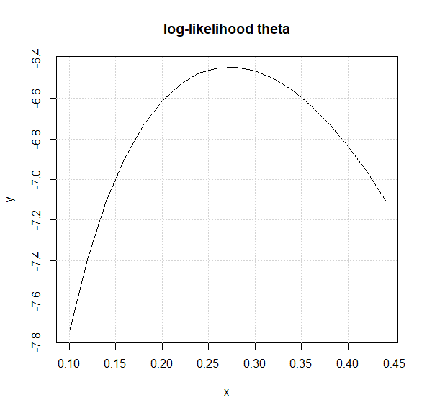

Data
Outcome from Hamada: 11 manufacturers with new vehicle launches- 3 successes and 8 failures
MLE estimate of parameter $θ$, probability of success = 3/11 = 0.273
Log likelihood of binomial with $θ$ = 0.273

Slide 4
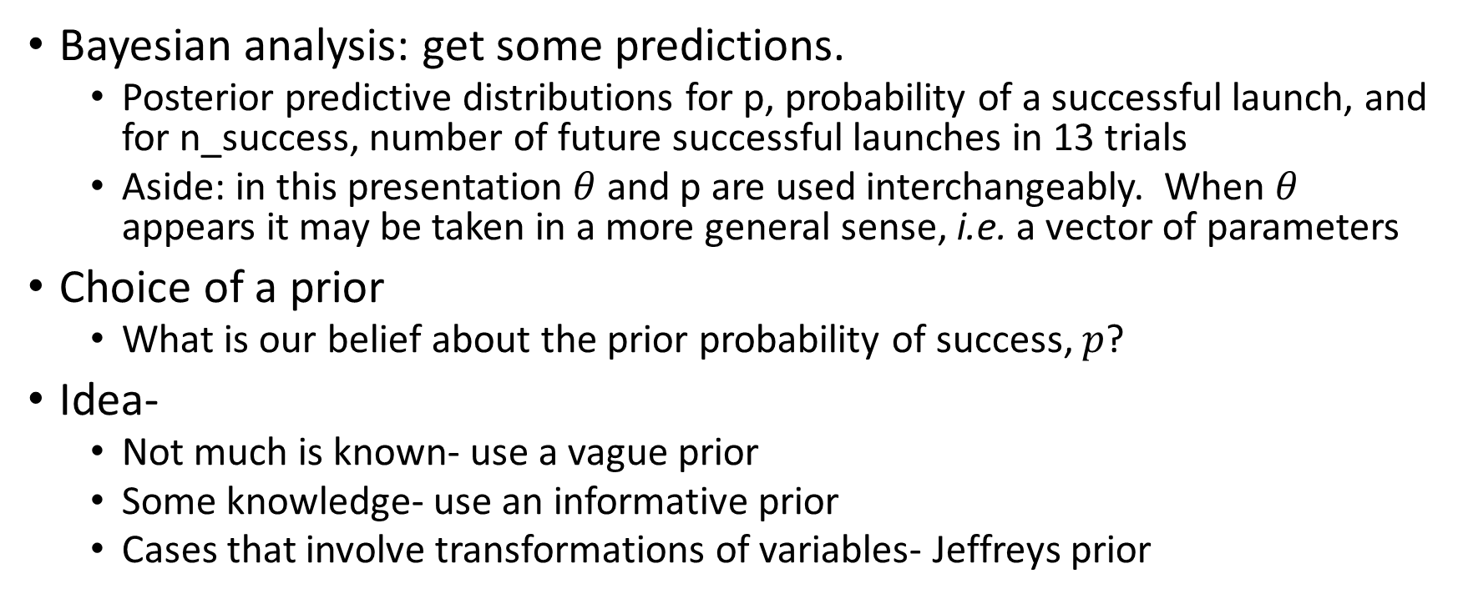
OK, Bayes…
Bayesian analysis: get some predictions.
Posterior predictive distributions for p, probability of a successful launch, and for n_success, number of future successful launches in 13 trials
Aside: in this presentation $θ$and p are used interchangeably. When $θ$ appears it may be taken in a more general sense, i.e. a vector of parameters
Choice of a prior
What is our belief about the prior probability of success, $p$?
Idea-
Not much is known- use a vague prior
Some knowledge- use an informative prior
Cases that involve transformations of variables- Jeffreys prior

Slide 5
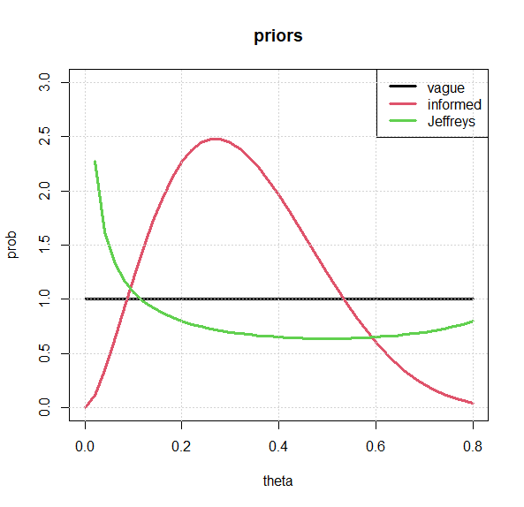
Possible priors
Tell a story about each prior

Slide 6
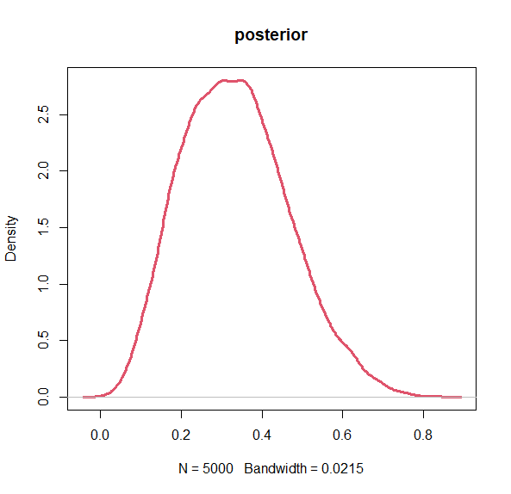
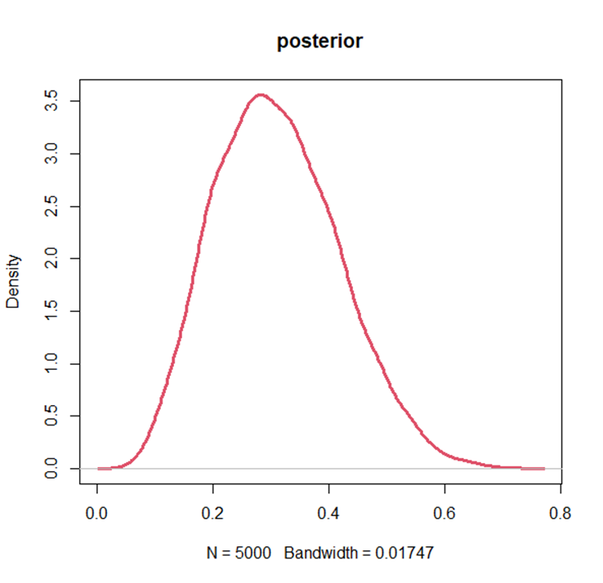
Posterior plots, a tale of 3 priors
Vague Prior
Jeffrey’s Prior
Informative Prior

Slide 7
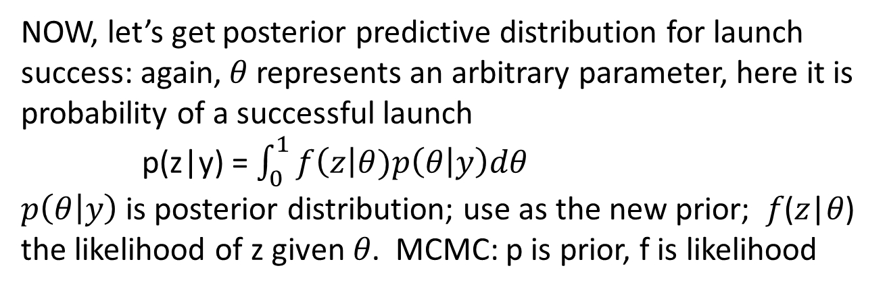
Credibility intervals for launch success probabilities
Prior | Lower credibility interval | Upper credibility interval
vague | 0.11 | 0.51
informative | 0.14 | 0.47
Jeffreys | 0.10 | 0.52
NOW, let’s get posterior predictive distribution for launch success: again, 𝜃 represents an arbitrary parameter, here it is probability of a successful launch
p(z|y) = $\int_{0}^{1}{f\left(z\right|θ)p\left(θ | y\right)dθ}$
$p\left(θ | y\right)$ is posterior distribution; use as the new prior; 𝑓(𝑧|𝜃) the likelihood of z given 𝜃. MCMC: p is prior, f is likelihood

Slide 8
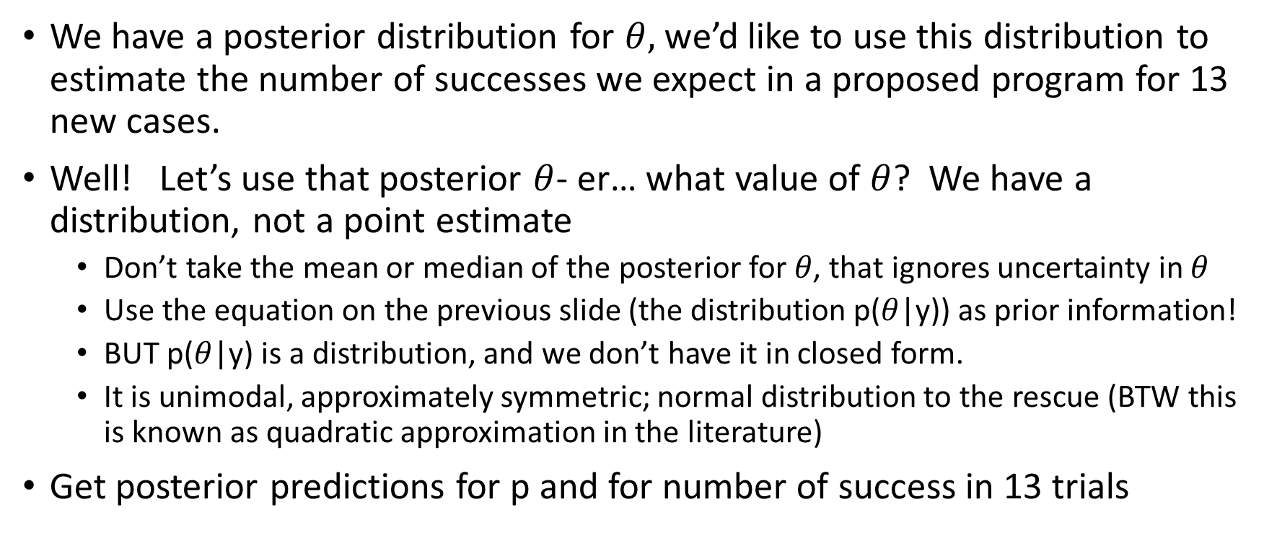
A few details on the approach
We have a posterior distribution for $θ,$ we’d like to use this distribution to estimate the number of successes we expect in a proposed program for 13 new cases.
Well! Let’s use that posterior $θ$- er… what value of $θ$? We have a distribution, not a point estimate
Don’t take the mean or median of the posterior for 𝜃, that ignores uncertainty in $θ$
Use the equation on the previous slide (the distribution p($θ$|y)) as prior information!
BUT p($θ$|y) is a distribution, and we don’t have it in closed form.
It is unimodal, approximately symmetric; normal distribution to the rescue (BTW this is known as quadratic approximation in the literature)
Get posterior predictions for p and for number of success in 13 trials

Slide 9
Steps for using rjags
Define the analysis model simplest case..
postPredModelSuccess_code <- “
model {
# likelihood
successes ~ dbin(p, trials)
# prior
x ~ dexp(0.1)
p <- ilogit(x)
}"

Slide 10
Steps 2, 3
Create a data list
data_list <- list(
successes = observed_successes,
trials = total_trials)
3. Initialize the parameters – values or a function
#initialize p with a function
initialP = function(){ list(p=runif(1))}

Slide 11
R code…
Set up rjags stuff
library(rjags)
# Define failure data
observed_successes <- 3
total_trials <- 11
# Specify the number of iterations, burn-in, and thinning (these were described in the DataWorks video)
n_iterations <- 10000
n_burnin <- 2000
n_thin <- 1

Slide 12
Steps 4 and 5
# Initialize JAGS model
jags_model <- jags.model(textConnection(model_code),
data = data_list, n.chains = 4, inits = initialP)
5. # Run the MCMC simulation
jags_samples <- coda.samples(jags_model, variable.names = "p", n.iter = n_iterations, n.burnin = n_burnin, thin = n_thin)
And get the results
summary(jags_samples)

Slide 13
jags model for rocket example
# Define the model
model_code <- "model {
# Likelihood: Binomial distribution
successes ~ dbin(p, trials)
# Prior: Uniform prior for binomial probability
#p ~ dunif(0, 1) # vague prior
#p ~ dbeta(0.5, 0.5) #Jeffreys prior
p ~ dbeta(2.7, 5.8) # informative prior
#x ~ dexp(0.1)
#logit p = x/(x+1) same as p <- ilogit(x)
#logit(p) <- x
#probit p = inverse normal CDF(x)
#probit(p) <- x #loglogistic #p <- ilogit(x) }"
Note: model_code can be inline (with textConnection function) or may be a text file

Slide 14
R code: create data list, initialize, run the model
# Create data list, jags model
data_list <- list( successes = observed_successes, trials = total_trials)
Initialize JAGS model
jags_model <- jags.model(textConnection(model_code),
data = data_list, n.chains = 3)
# Run the MCMC simulation
jags_samples <- coda.samples(jags_model, variable.names = "p", n.iter = n_iterations, n.burnin = n_burnin, thin = n_thin)
Cut to the code

Slide 15
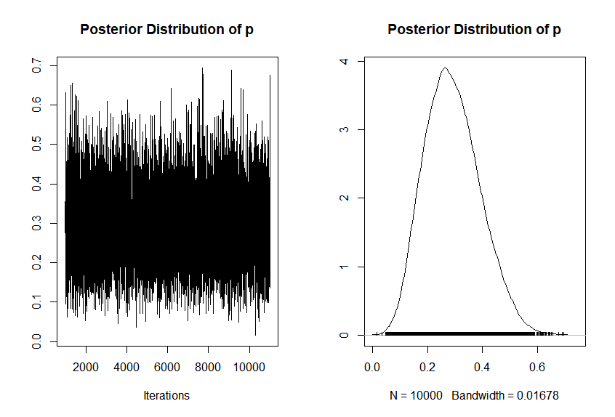
Results of the model
The posterior is unimodal, approximately symmetric, approximate it with a normal or t-distribution

Slide 16
Posterior analysis
# Load the coda package for posterior analysis
library(coda)
# Extract the posterior samples
posterior_samples <- as.mcmc(jags_samples[[1]])
# Summary statistics of the posterior distribution
summary(posterior_samples)
# Plot the posterior distribution
plot(posterior_samples, main = "Posterior Distribution of p")

Slide 17
Credibility intervals
Use kernal density
kd = density(posterior_samples)
plot(kd, lwd=3)
# find credibility interval
sortedSamples = sort(posterior_samples)
nSorted = length(sortedSamples)
lCred = sortedSamples[round(nSorted*0.05)]
uCred = sortedSamples[round(nSorted*0.95)]
print(paste('90% credibility interval: (',round(lCred,2), ',’ , round(uCred,2),')’)) abline(v = c(lCred, uCred), col='orange')

Slide 18
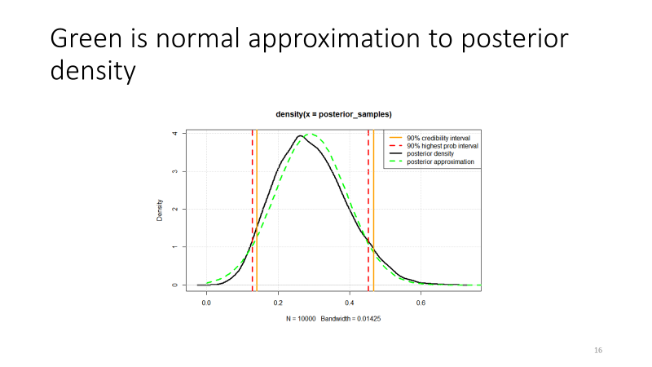
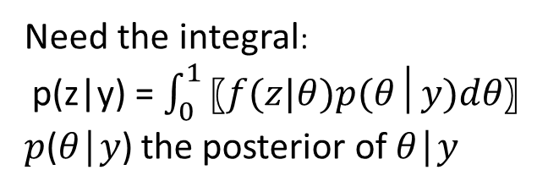
Posterior distribution for p, probability of a successful launch
Need the integral:
p(z|y) = $\int_{0}^{1}{〖f(z|θ)p(θ│y)dθ〗}$
𝑝(𝜃│𝑦) the posterior of 𝜃│𝑦

Slide 19
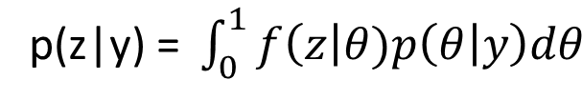

Use MCMC to get the predictive posteriors for $θ$ and n_success
Recall that
postPredModel_code <- “
model {
# Likelihood: Binomial distribution
successes ~ dbin(p, trials)
# Prior: normal approximation to posterior
p ~ dnorm(m, 1/s*s) # the new prior for predicted posterior for p
}"

Slide 20
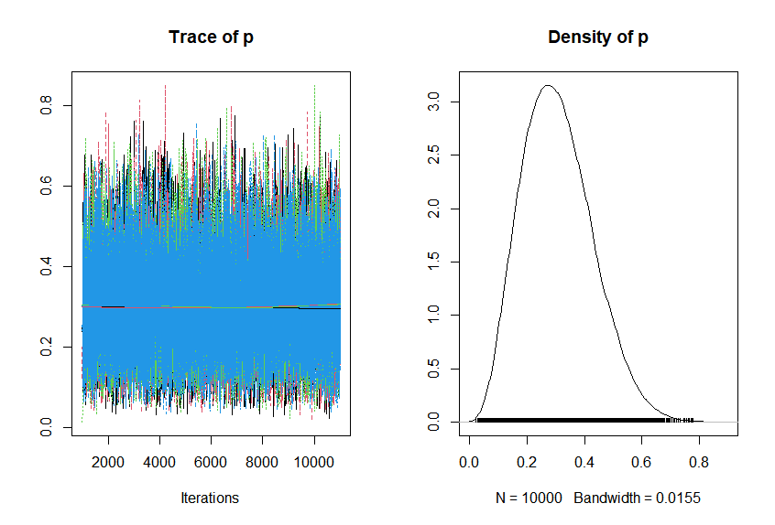

Integrate to get the posterior predictive for $θ$
Right is the posterior predictive for p
Now we need posterior predictive distribution for number of successes in 13 trials

Slide 21
Set up rjags for the posterior predictive
# data list
postData_list = list(successes = observed_successes, trials = total_trials, m = meanPost, s = stdPost)
# initialize the modeljags_model_Post <- jags.model(textConnection(postPredModel_code), data = postData_list, n.chains = 3)
# Run the MCMC simulation
jags_samples_Post <- coda.samples(jags_model_Post, variable.names = "p", n.iter = n_iterations, n.burnin = n_burnin, thin = n_thin)

Slide 22
Plot the posterior predictive distribution
Add Credibility interval
kd_PostP = density(post_Pred_samples)
plot(kd, lwd=3, col='red', lty=2)
lines(kd_PostP, lwd=3, xlab='probability of success’, col='black’)
legend('topright',c('predictive posterior','posterior'), col=c('black', 'red'), lty=c(1,2), lwd = c(3,3))grid()

Slide 23
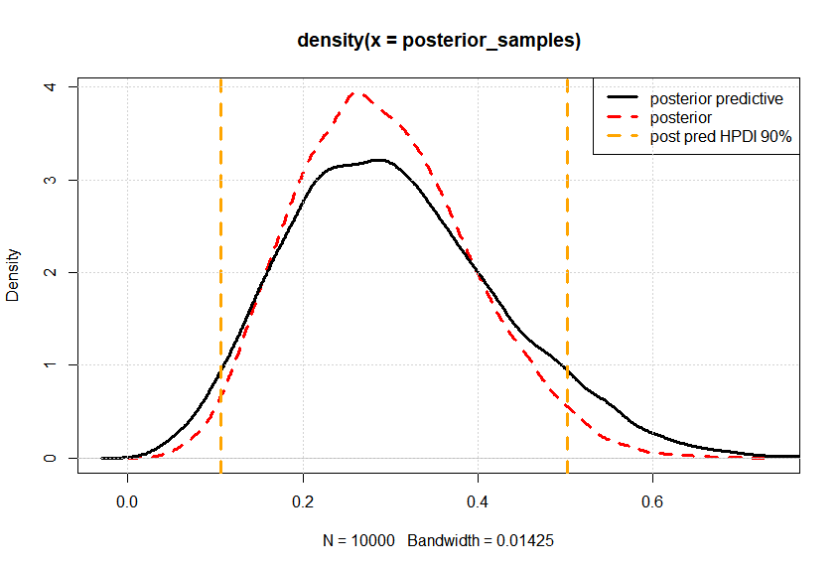
Predictive posterior for p, probability of a launch success
Note that the posterior predictive for p is slightly wider than the posterior distribution for p
This show that the posterior predictive distribution for p has incorporated uncertainty from posterior of p

Slide 24

Model n_success using posterior prediction for $p$
newTrials = 13
postPredModelSuccess_code <- “
model { # likelihood
successes ~ dbin(p, trials) #
# prior
p ~ dbeta(s1, s2) }"
S1 and s2 are parameters found by fitting the posterior predictive distribution to a beta
bd = as.numeric (post_Pred_samples)
fit_beta = fitdist(bd, 'beta')

Slide 25
Posterior predictive distribution for p
Posterior predictive distribution accounts for uncertainty about p, taken from the posterior distribution of p.
Posterior predictive distribution is based on the posterior distribution of p (and the original data, y, 3 successes, 11 trials)
But what value of p from the posterior prredictive distribution should be used to predict future performance (sound familiar)?
Using the mean or mode value of p from the posterior distribution ignores the uncertainty found in the posterior distribution
Incorporate this uncertainty by using the posterior distribution as a ‘new’ prior distribution

Slide 26
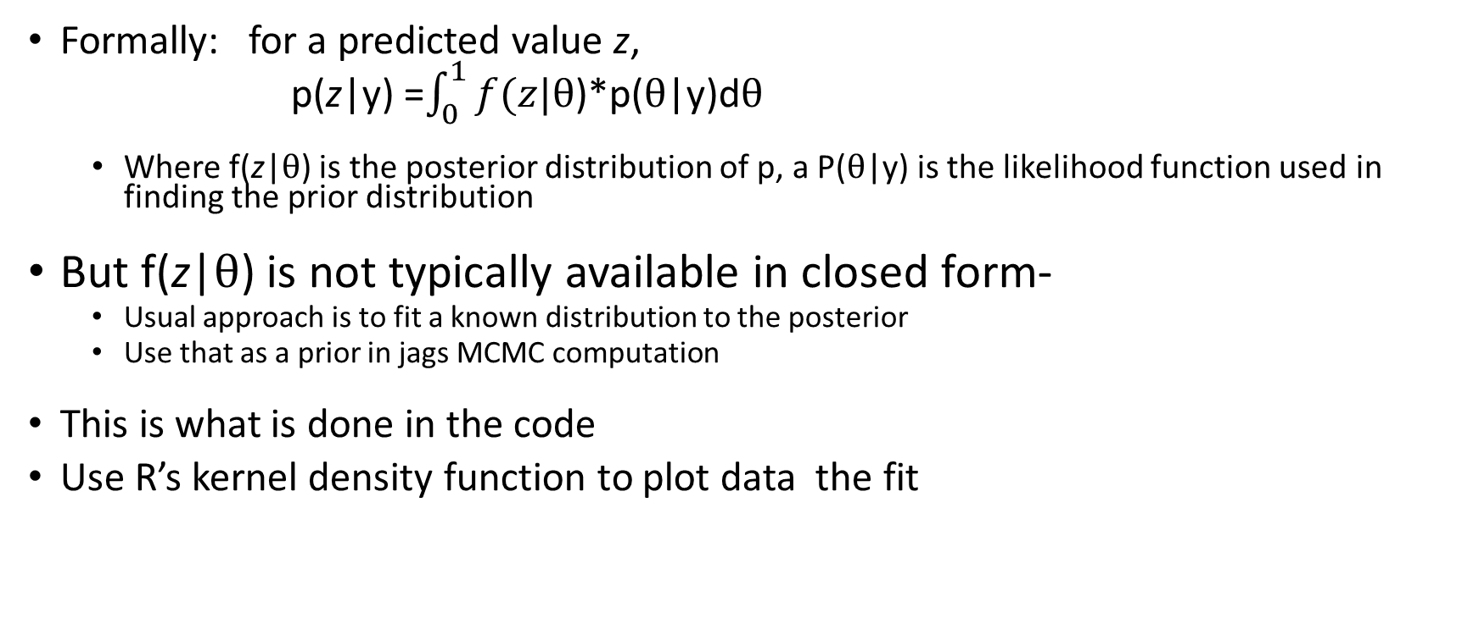
Number of Successes- predictive posterior distribution
Formally: for a predicted value z,
p(z|y) =$\int_{0}^{1}{f(z|θ}$)*p($θ$|y)d$θ$
Where f(z|$θ$) is the posterior distribution of p, a P($θ$|y) is the likelihood function used in finding the prior distribution
But f(z|$θ$) is not typically available in closed form-
Usual approach is to fit a known distribution to the posterior
Use that as a prior in jags MCMC computation
This is what is done in the code
Use R’s kernel density function to plot data the fit

Slide 27
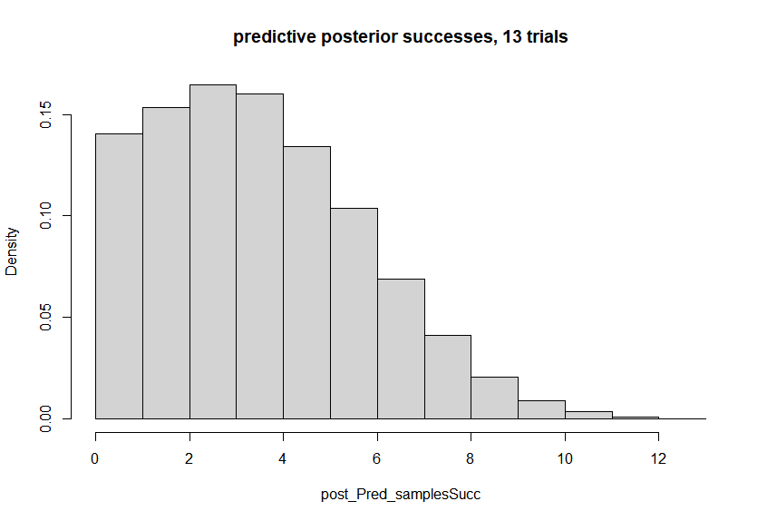
Now find the posterior predictive distribution for number of successes, 13 trials
13 trials, posterior predictive distribution for number of successes
Notice the most likely number of successes in 13 trials is 2
Most of the probability is in 4 or fewer successes.

Slide 28
Reference
V. E. Johnson, et al. A hierarchal model for estimating the early reliability of complex systems. IEEE Transactions on Reliability, 54-224-231, 2005
M. S. Hamada, et al. Bayesian Reliability, Springer Verlag, New York 2008

