Slide 1

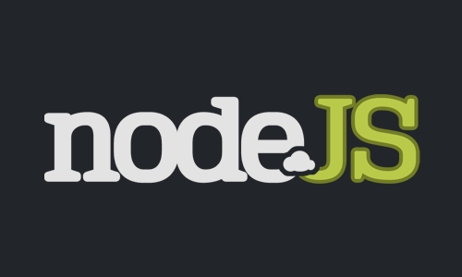
Introducing Node.js

Slide 2

About Your Speaker

Slide 3
What Is It?
Server side javascript framework
Written using Google V8 Engine
Uses CommonJS module system
Has the latest and greatest Ecmascript5 features

Slide 4
Non-Blocking I/O
The philosophy behind node.js is that system interactions should be non-blocking
Instead of this:
  var data = fs.readFile('foo.txt')
  console.log(data);
This:
  fs.readFile('foo.txt', function(data){
  console.log(data);
  });

Slide 5
This whole operation is asynchronous... my application doesn't have to wait for the file to be read in
Using javascript to do this makes it easier to adopt given the existing knowledge of using callbacks and listeners on the client side

Slide 6
Event Driven Architecture
This leads to a more event driven approach
Rather than returning something, calls should try to either
  Call a callback passed in
  Fire events that the caller listens for
Built in event system (EventEmitter)
  event.emit('data-recvd', evt)
  process.on('data-recvd', function(evt){
  });

Slide 7
Examples
Enough talking, let's see some examples
  Some file and process interaction
  A simple webserver
  Reverse proxy
  Websockets
  AMQP to integrate with existing applications

Slide 8
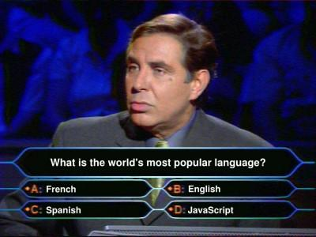
Ecmascript 5 Features

Slide 9
Ecmascript 5 Features
Array Extras
  Map, reduce, forEach, filter, every, some
JSON
Object Utilities
    Object.getOwnPropertyNames
    Object.create
    Object.defineProperties
    Object.getOwnPropertyDescriptor
Immutibility
  Object.freeze, Object.seal

Slide 10
Ecmascript 5 Features
Getters/setters
Function.prototype.bind
  Allows you to create a new function with the argument(s) pre-set
  Example
    function add(a,b){
    return a+b;
    }
    var fivePlus = add.bind(5)
    console.log(fivePlus(2)); // prints 7

Slide 11
Getting Started
Runs on nix and cygwin (no windows support yet)
Install the latest stable from nodejs.org
  Sorry, no installer. You'll need to build it yourself
Try the commandline repl out. If all is well, you're good to go!
Hack away

Slide 12
npm
Ruby has gem, node has npm (node package manager)
This is a must have for node.js development
  http://npmjs.org
Quick Install:
  curl http://npmjs.org/install.sh | sh
Can also be used to budle up your application's dependencies

Slide 13
Modules of Note
Some interesting modules to take note of and try out
  Express – simple sintatra clone (a dime a dozen these days)
  Vows – async BDD in javascript
  Socket.IO – websockets made easy
  Yui3 – adaption of YUI for node.js
  SEVERAL NoSQL modules
    Riak, redis, couchDB, mongoDB, tokyo cabinet, etc.

Slide 14
Hosting Options
Heroku (closed beta)
Joyent (open beta)
Nodjitsu (launching soon)
DIY (EC2, your own server, etc)

Slide 15
Cons
Evolving rapidly.
  It's not uncommon to see tutorials from several months ago that no longer work
Not very cross platform (yet)
Lots of duplicate modules
  Not that this is a bad thing, but for example there are TEN couchdb modules (because couchdb wrappers are simple to make)
No clustering support yet

Slide 16
Clustering Support
No real support yet, but it's on the way!
  EventEmitters backed by websockets
  Another using Redis built-in publish/subscribe mechanisms
  I've been hacking at EventEmitters backed by AMQP

Slide 17





Users

Slide 18
Join the Community!
irc.freenode.net #node.js
Google Groups node.js
File bugs/suggest features
Use and Contribute!

