Slide 1
WebSockets
The future is now

Slide 2
Why?
Web applications are demanding more and more real time event driven behavior
HTTP Limitations
  Half-duplex (traffic flows only in one direction)
  Adds latency and message overhead on each request
AJAX simulation
  Polling
  Comet (uses two connections and requires unneeded complexity)

Slide 3
What?
W3C Standard that comes with the new “HTML5 APIs” (File API, WebWorkers, etc)
Persistent, bidirectional communication channel between client and server.
Drops the polling overhead – only sends messages when there is something to send.

Slide 4
Use Cases
Chat (Lame, always used as an example)
Games
Real Time Collaboration
Real Time Notifications
Social Networking

Slide 5
How It Works

Slide 6
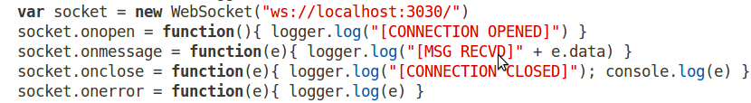
Create a Connection

Slide 7
Handshake
GET /resource HTTP/1.1
Upgrade: WebSocket
Connection: Upgrade
Host: wsock.example.com
Origin: http://wsock.example.com/origin
WebSocket-Protocol: /protocol/
HTTP/1.1 101 Web Socket Protocol Handshake
Upgrade: WebSocket
Connection: Upgrade
WebSocket-Origin: http://wsock.example.com
WebSocket-Location: ws://wsock.example.com/resource

Slide 8
Messages
“\x00Hello World\xFF”

Slide 9
That's Right!
Each message only has 2 bytes of overhead
  Compare this to the full HTTP headers attached to each message using the traditional polling setup
Greatly reduces throughput
  XHR: 100,000 clients polling every 10 seconds = (871 x 100,000) / 10 = 8,710,000 bytes = 66Mbps
  WS: 100,000 frames every 10 seconds = (2 x 100,000) / 10 = 20,000 bytes = 156Kbps

Slide 10
“Reducing kilobytes of data to 2 bytes... and reducing latency from 150ms to 50ms is far more than marginal
In fact, these two factors alone are enough to make WebSockets seriously interesting to Google.”
- Ian Hickson (Google, HTML5 Spec Lead)

Slide 11
Live Demo

Slide 12
InDepth: Events
onopen
onmessage
onerror
onclose

Slide 13
Open Standard
Not just client side javascript... also implemented in Flex, JavaFX, Silverlight, etc
Multiple serverside implementations exist
  Ruby: em-websocket
  Java: jwebsocket
  .NET: ????
  Node.JS: Socket.IO

Slide 14
Implementations
Open standard, implemented in many languages (Java, JavaFX, .NET, PHP, etc)
Browser Support
  Chrome, Firefox, Safari, Opera
    IE9 … Maybe...
Fallback support available through flash based client libraries
  http://code.google.com/p/jquery-graceful-websocket/

Slide 15
Cons
Growing Pains, spec is not final so could be subject to change
Low level... you must handle the buffer that builds up when the network is out
  How do we handle unexpected closes?
Do your research

Slide 16
Links
NodeJS (http://www.nodejs.org)
node-websocket-server (http://github.com/miksago/node-websocket-server)
WebSocket Spec (http://dev.w3.org/html5/websockets/)
Atmosphere java framework (https://atmosphere.dev.java.net/)
Resin Websocket tutorial (http://www.caucho.com/resin/examples/websocket-java/index.xtp)
Graceful Websocket Jquery client (http://code.google.com/p/jquery-graceful-websocket/)
This Demo (http://github.com/jamescarr/websockets-demo)

