Slide 1
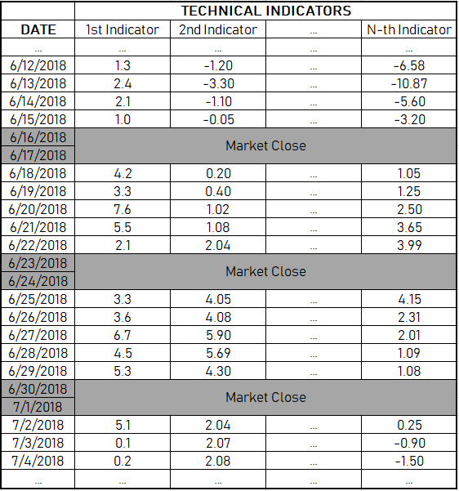
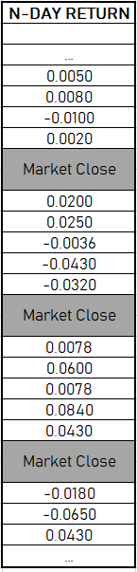
Sample 1
Sample 2
Sample 3
Sample M
Feature 1
Feature 2
Feature 3
Label:
Convert (-) to 0
Convert (+) to 1

Slide 2
X1
X2
Prediction
X3
Output Layer
Input Layer
Hidden Layer

