Slide 1
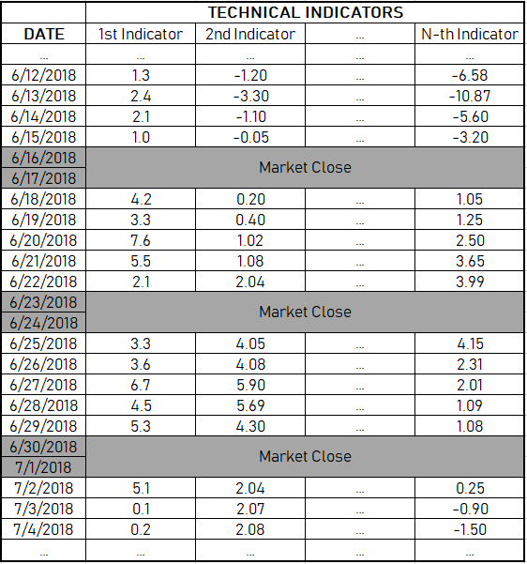
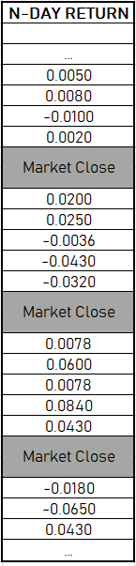
Sample 1
Sample 2
Sample 3
Sample M
Feature 1
Feature 2
Feature 3
Label:
Convert (-) to 0
Convert (+) to 1

Slide 2




$${\text{Price}\text{/}\text{SMA} \text{Ratio}}_{t}$$
$${\text{Bollinger} \text{Band} \text{Value}}_{t}$$
$${{\text{Prediction}}_{t} \text{= }\text{s}\text{ign}\text{(}\text{Return}}_{t+n})$$
$${\text{Volatility}}_{t}$$
Output Layer
Input Layer
Hidden Layer

Slide 3




$${\text{X}}_{1}$$
$${\text{X}}_{2}$$
$$\text{Prediction}$$
$${\text{X}}_{3}$$
Output Layer
Input Layer
Hidden Layer

