Slide 1



$$Y_{t}$$
NN Layer
$${Activation}_{t}$$
$$X_{t}$$

Slide 2
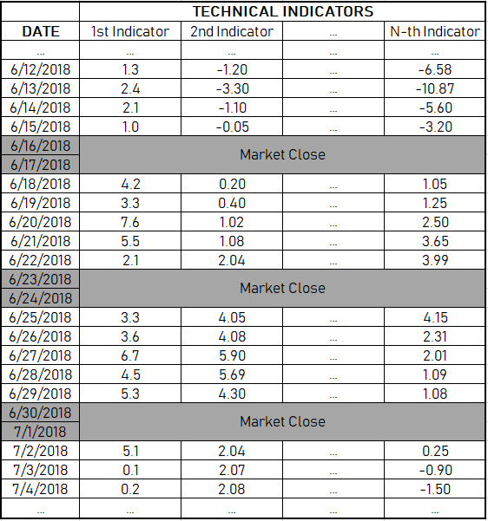
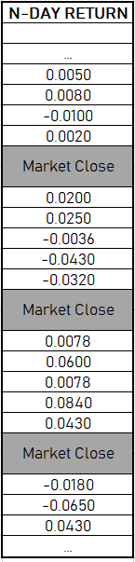
Sample 1
Sample 2
Sample 3
Sample M
Feature 1
Feature 2
Feature 3
Label:
Convert (-) to 0
Convert (+) to 1

Slide 3
Sample 1
Sample 2
Sample 3
Sample M
Feature 1
Feature 2
Feature 3
Label:
Convert (-) to 0
Convert (+) to 1

Slide 4
T = 4
Sample 1
Sample 4
Number of Indicators = N
Number of Samples = M
Number of Time Steps = T
Sample M - 1
Feature 1
Feature 2
Feature 3
Label:
Convert (-) to 0
Convert (+) to 1

Slide 5
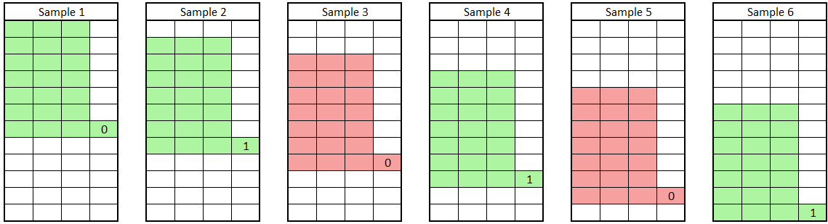
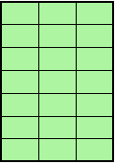
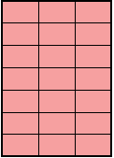
Date
The X dimension of this set of samples is (M x T x N)
The Y dimension of this set of samples is (M x 1)
M = Number of Samples
T = Number of Time Steps
N = Number of Features
t=1
t=2
t=3
t=4
t=5
t=6
t=7
m=1
m=1
m=2
m=2
m=3
m=3
m=4
m=4
m=5
m=5
m=6
m=6
n=1
n=2
n=3

