Slide 1
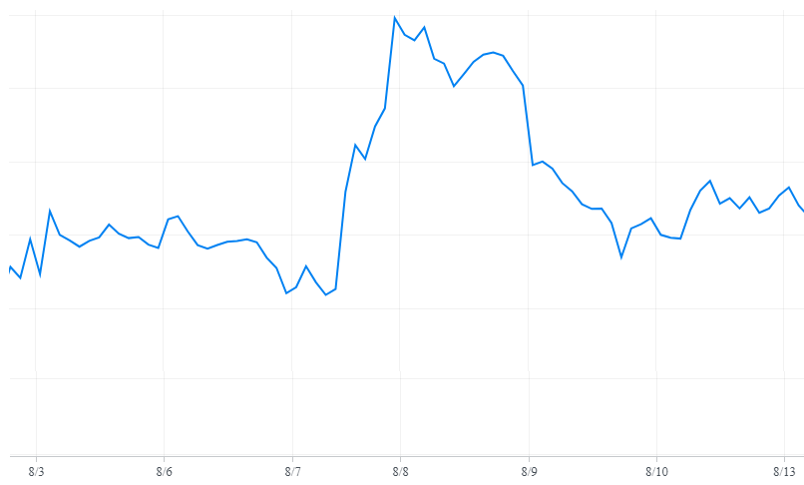
“Tesla issues mass recall on model X”
“Tesla revenue soars”
“Tesla Model 3 production is beating expectation”
Sell
Sell
Sell
Buy
Buy
Buy
News released in red region are labeled as negative (0) because stock slipped in that region
News released in green region are labeled as positive (1) because stock rose in that region

Slide 2
“Tesla issues mass recall on model X”
8/8/18 11:14am ET
“Tesla revenue soars” 8/3/18 10:23am ET
“Tesla Model 3 production beats expectation”
8/8/18 12:05pm ET
Figure 1. Labeling
News released in red region are labeled as negative (0) because stock slipped in that region
News released in green region are labeled as positive (1) because stock rose in that region

Slide 3
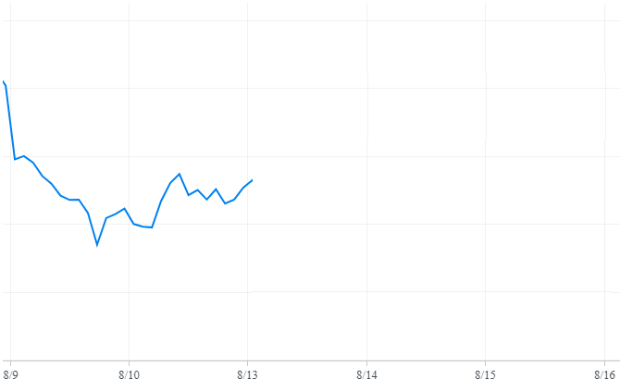
“Tesla turned profit finally” 8/13/18 10:05am ET
“Tesla to layoff 5% of workforce” 8/13/18 10:56am ET
“Tesla wins first place in safety award” 8/13/18 11:34am ET
Sell
?
Prediction via Voting: 2 Positive > 1 Negative
Learner recommends “Buy”
Buy

