Slide 1
Towards Scalable, Flexible, and Interpretable Self-Supervised Learning for Multiview Biomedical Data
James Chapman

Slide 2
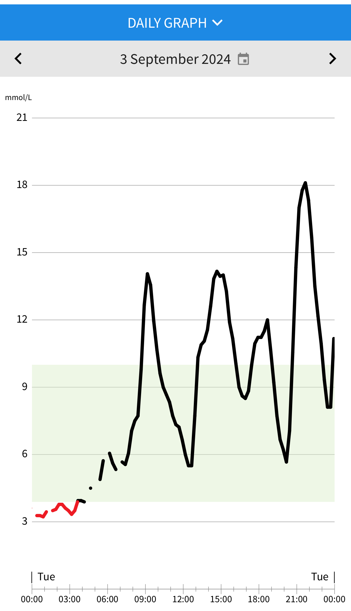
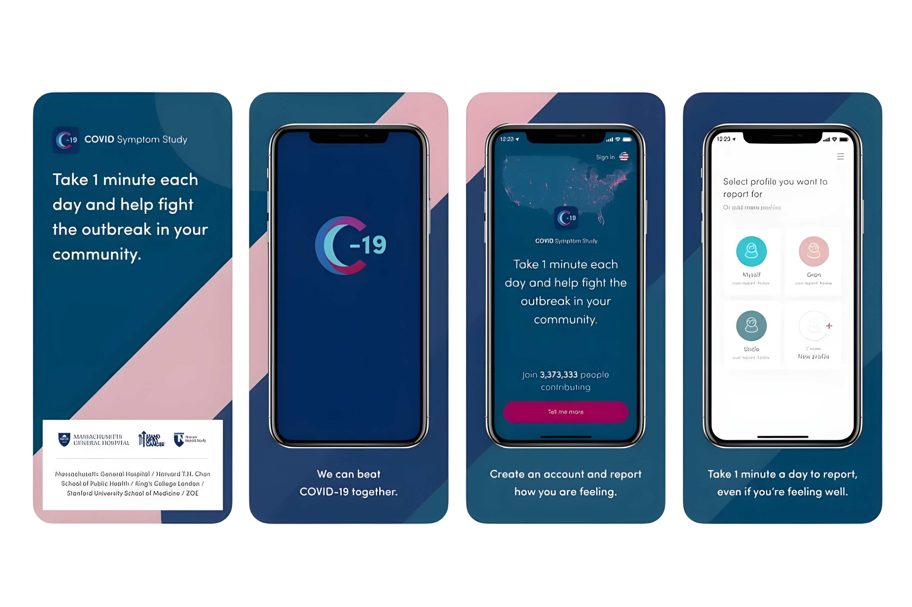

Slide 3
Context
Started working on Deep Learning for Brain Behaviour Associations
Discovered that neuroimaging data is *really* high-dimensional and hard to work with
And sample sizes are still small… but growing
… and most of the relevant code was in MATLAB

Slide 4
Research Objectives
Develop regularized Canonical Correlation Analysis (CCA) methods for improved interpretability
Create efficient algorithms for large-scale datasets
Extend CCA to deep learning and self-supervised settings
Provide open-source implementations for the research community

Slide 5
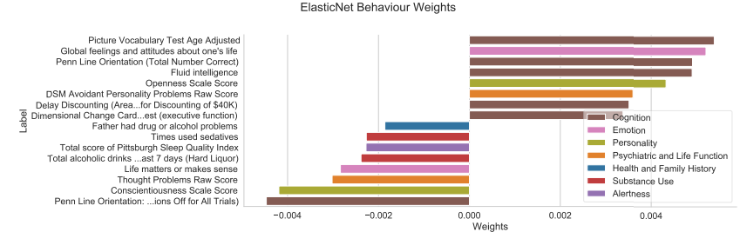
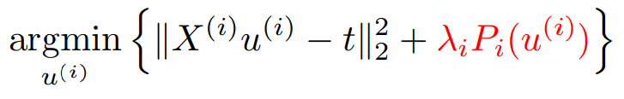
FRALS Framework
Addresses a known weakness of existing sparse CCA (Partial Least Squares) methods
Incorporates structured priors into CCA models through regularization (e.g., elastic net)
Enhances interpretability of CCA models

Slide 6
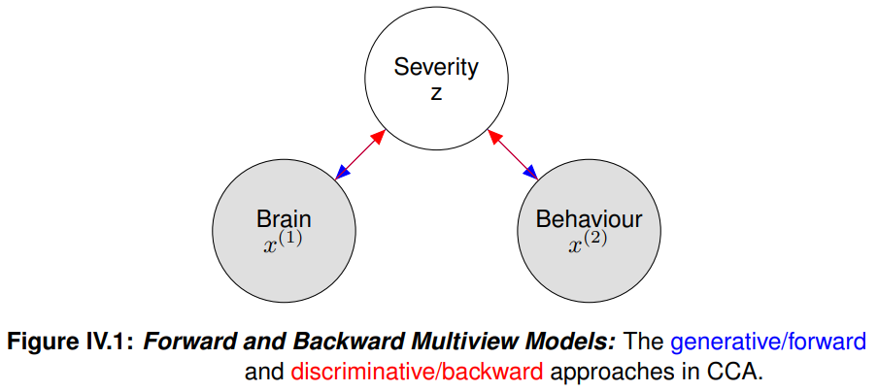
Weights & Loadings
Categorized methods into explicit and implicit latent variable models
Demonstrated the theoretical and practical robustness of loadings
Produced meaningful multiview simulated data with known ground truth at the scale of neuroimaging studies

Slide 7
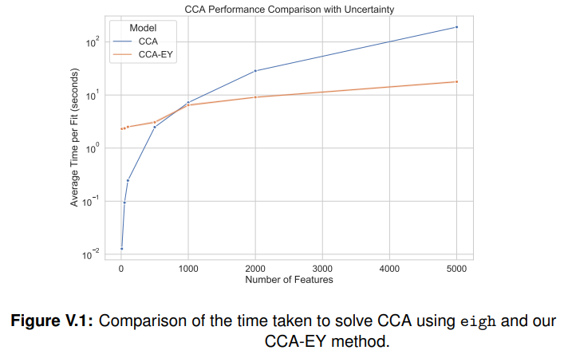
GEP-EY Algorithm
Efficient solution for generalized eigenvalue problems
Enables application of CCA and PLS to large-scale datasets (e.g., UK Biobank)
Outperforms existing methods in terms of scalability and convergence

Slide 8
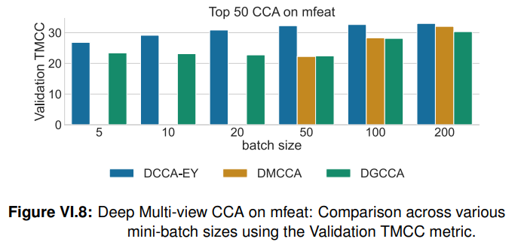
Deep Learning Extensions
DCCA-EY: Novel formulation of Deep CCA for stochastic settings
SSL-EY: New self-supervised learning method competitive with state-of-the-art with less tuning

Slide 9
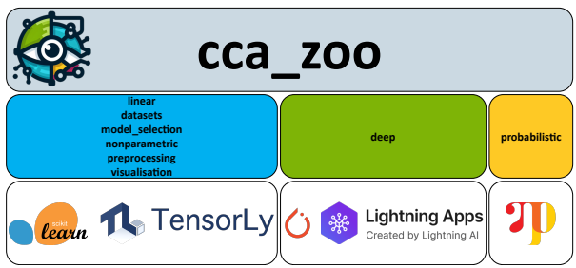
CCA-Zoo Software
Comprehensive Python library for multiview learning methods
Implements various CCA, PLS, and related techniques
Facilitates broader adoption and innovation in the research community

Slide 10
Impact
Can run (Multiview) CCA on UK Biobank on your laptop
Can run Deep (Multiview) CCA on a single GPU
190 stars on GitHub from people who have built on my small contributions

