Slide 1
GitHub Demo 11/8/2016
Agenda
What is version control?
Git (the language)
Interacting with GitHub
Examples of repositories

Slide 2
What Is Version Control?
Version control is software that helps a team manage the changes to their code or any other documents. (It doesn’t have to be just code!)
Benefits
Centralized
A complete long-term change history of every file
Branching and merging
Traceability

Slide 3

What is Git?
A free and open source distributed version control system
Origins of Git
Git was originally developed in 2005 by Linus Torvalds after some fight about the use of a software license for another version control system
Linus Torvalds also created Linux, an open source operating system in the early 1990s that’s actively developed and used in Android devices and other computer hardware

Slide 4
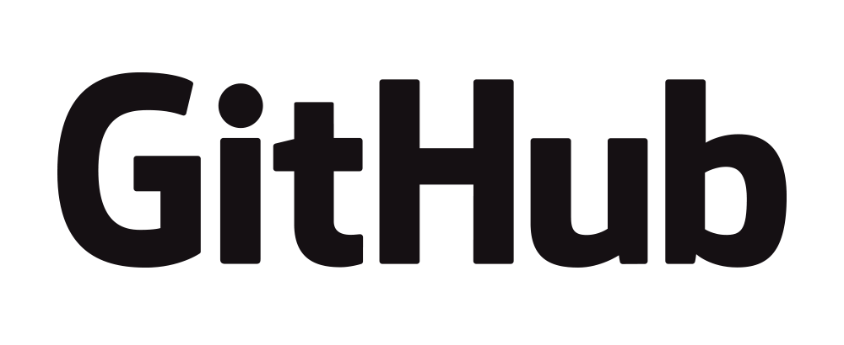
vs
GitHub is just a web-based platform for Git.
It takes all the abilities of version control in Git and adds user friendly collaboration and project management features.

Slide 5
GitHub Features and Lingo
Pull Request
Visual Representation of Branches
Repository (“Repo”)
Repositories is the name for the folder where the files you are tracking are hosted
Cloning/Initializing a Repo
Local/Remote
Pull Request
Branches

Slide 6
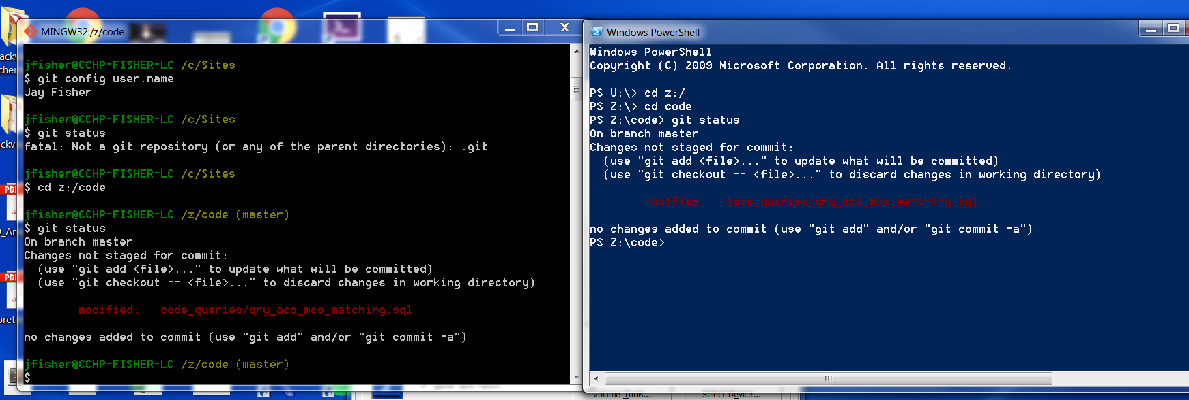
Ways to Interact With GitHub: Command Line
You can create, delete, and edit folders and files through text. You can also interact with Git and your GitHub account.
Benefits: you can use all of Git’s features through the command line.

Slide 7
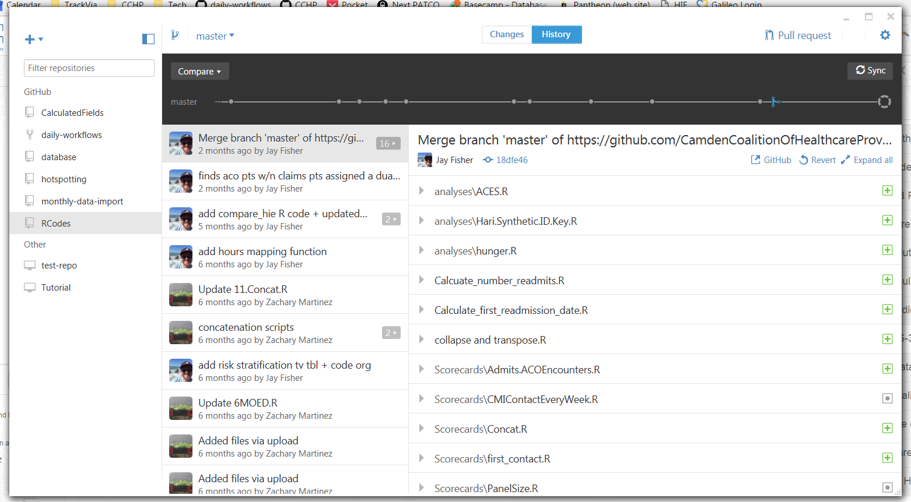
Ways to Interact With GitHub: GitHub Desktop Application (GUIs)

Slide 8
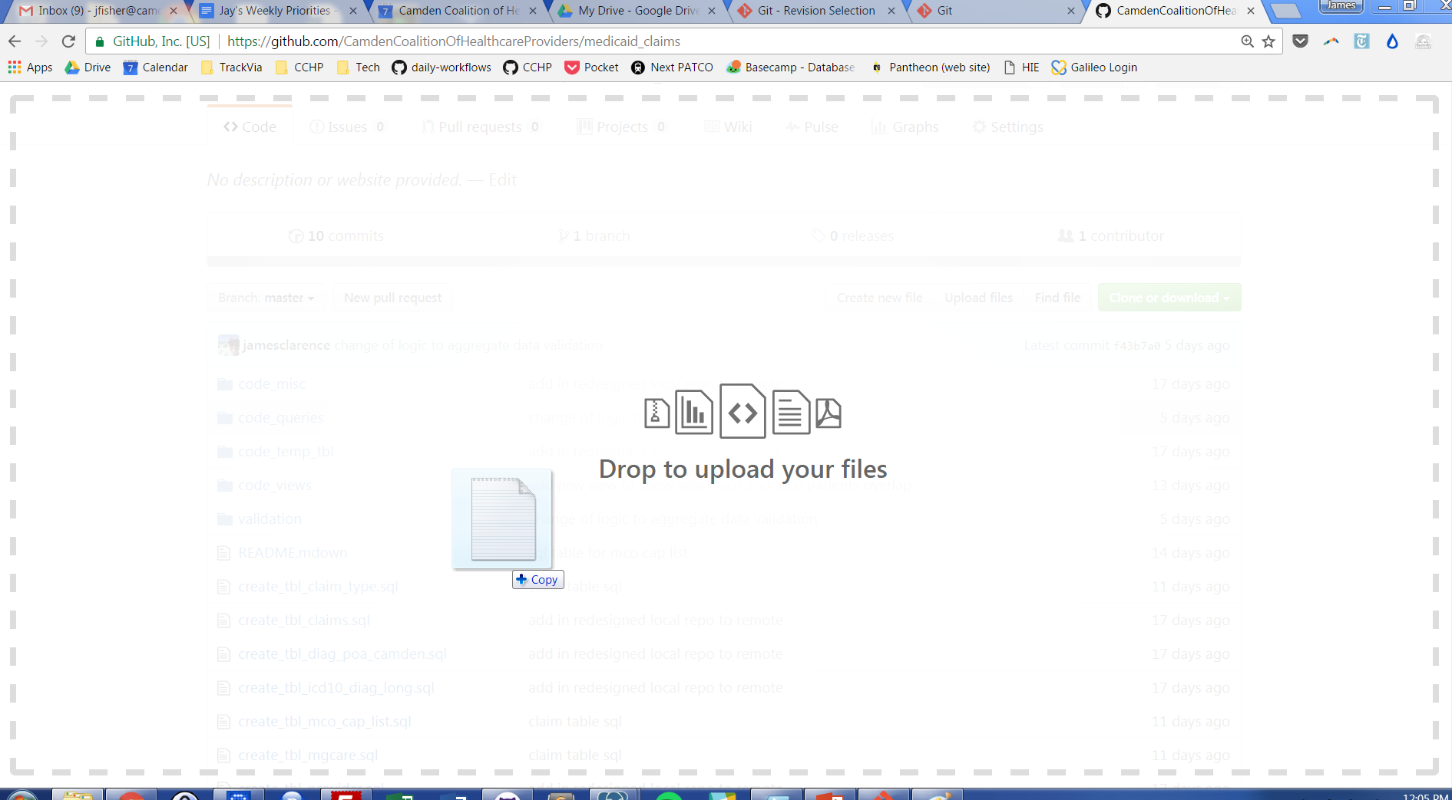
Ways to Interact With GitHub: Drag and Drop

Slide 9
Repository Examples
Camden Coalition

