Slide 1
GitHub Demo 11/8/2016
Agenda
What is version control?
What is Git?
Interacting with GitHub
Walk through a workflow example
Take a look at the Coalition’s GitHub page

Slide 2
What Is Version Control?
Version control is software that helps a team manage the changes to their code or any other documents. (It doesn’t have to be just code!)
Benefits
Centralized
A complete long-term change history of every file
Branching and merging
Traceability
Notes:
Version control is the idea behind Git.

Slide 3

What is Git?
A free and open source distributed version control system
Origins of Git
Git was originally developed in 2005 by Linus Torvalds after some fight about the use of a software license for another version control system
Linus Torvalds also created Linux, an open source operating system in the early 1990s that’s actively developed today and used in Android devices and other computer hardware

Slide 4
Git: Cons (And Pros)
Cons (and Pros)
One more thing to learn
Git is a separate programming language from the programming language in which you might want to track changes
Git is very particular
You have to go through the correct steps in the right order to get it to work.
Learning the Git workflow can help you think about your own workflow.
That said, there are a lot of ways to do the same thing
This depends on how you interact with GitHub

Slide 5

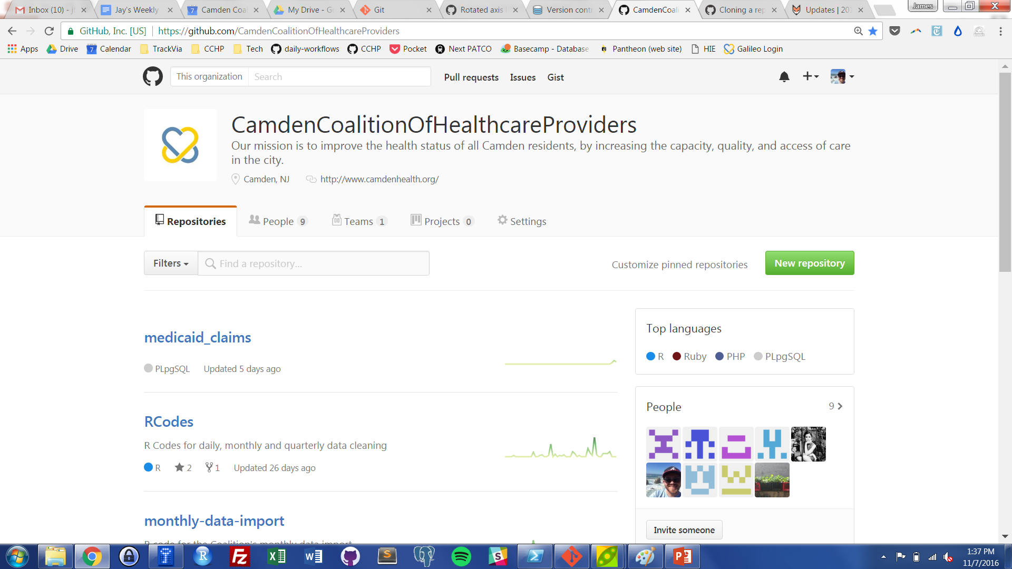
vs
GitHub is just a web-based platform for Git.
It takes all the abilities of version control in Git and adds user friendly collaboration and project management features.
Notes:
So that’s Git. What is GitHub?
-------------------------------------
It’s the most utilized public centralized source code location that amateur and professional software developers and companies use. Everyone from Facebook, Microsoft, R, the White House, the libraries of JavaScript that power nearly every web site you use are on GitHub.

Slide 6
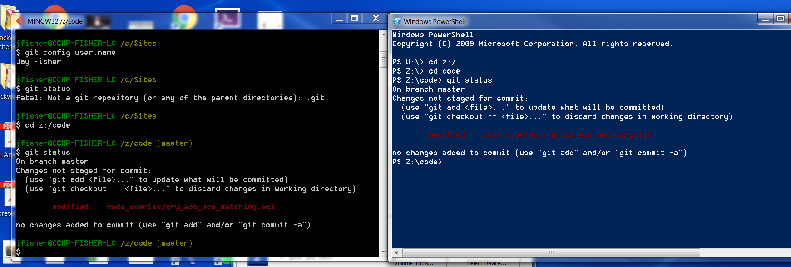
Ways to Interact With GitHub: Command Line
You can create, delete, and edit folders and files through text. You can also interact with Git and your GitHub account.
Benefits: you can use all of Git’s features through the command line.
Notes:
Now we’ll go over the different ways you can interact with GitHub.

Slide 7
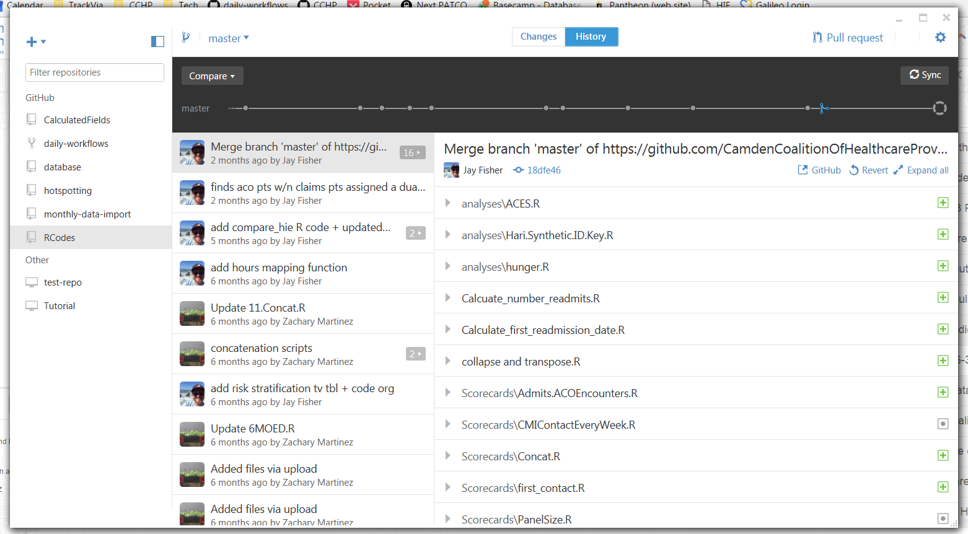
Ways to Interact With GitHub: GitHub Desktop Application (GUIs)
Notes:
I don’t really use this desktop application for GitHub too much. It helps visualize GitHub for you.

Slide 8
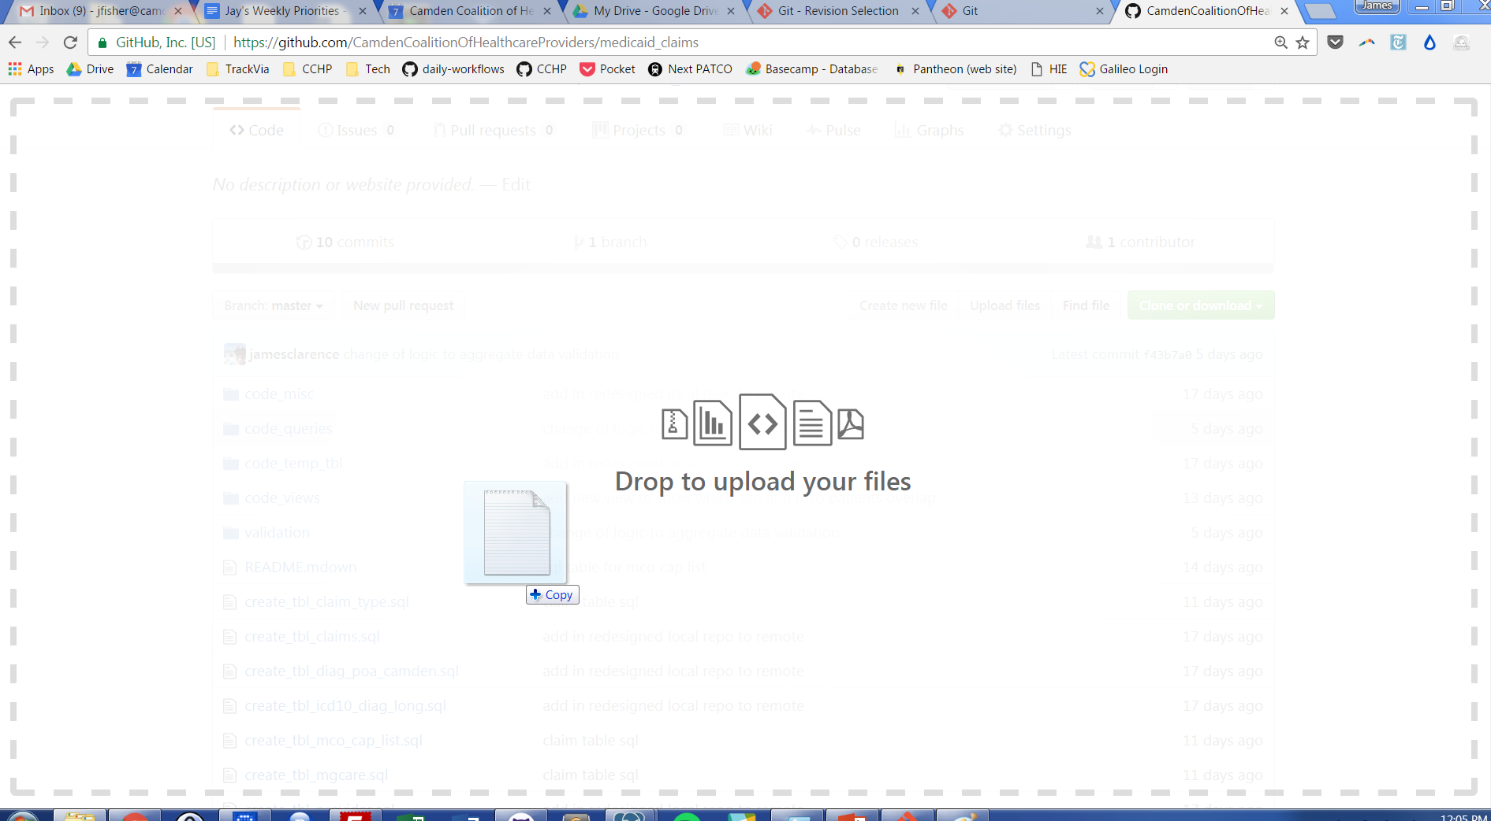
Ways to Interact With GitHub: Drag and Drop
Notes:
A newer feature of GitHub is dragging and dropping files directly into GitHub. This screenshot is from the GitHub web page. Downside: as far as I can tell, it doesn’t really allow for connecting your local computer to the remote GitHub repository (I’ll explain what those words mean in a second.)

Slide 9
GitHub Features and Lingo
Git and GitHub use a lot of version control terminology that’s only used in version control.
Meaning = Lots of very specific words with very specific meanings.
The following slides show one way in which you can use GitHub

Slide 10
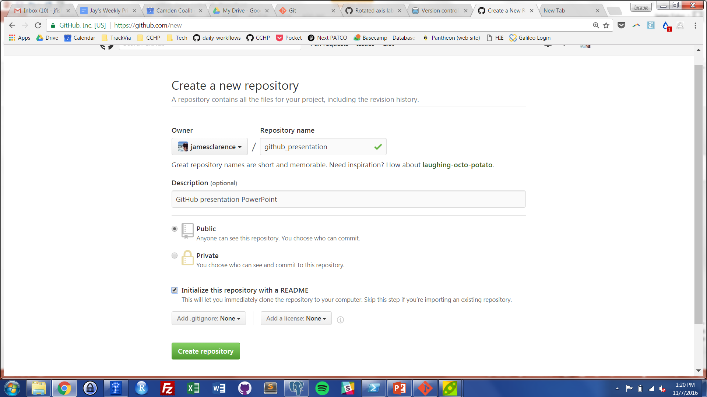
GitHub Lingo: Repositories
A repository (“repo”) is the name for the folder where the files you are tracking are hosted, both saved on your computer (local) and remote repo (GitHub)
Notes:
Right here, I’m on my GitHub account page. I’m creating a repository.

Slide 11
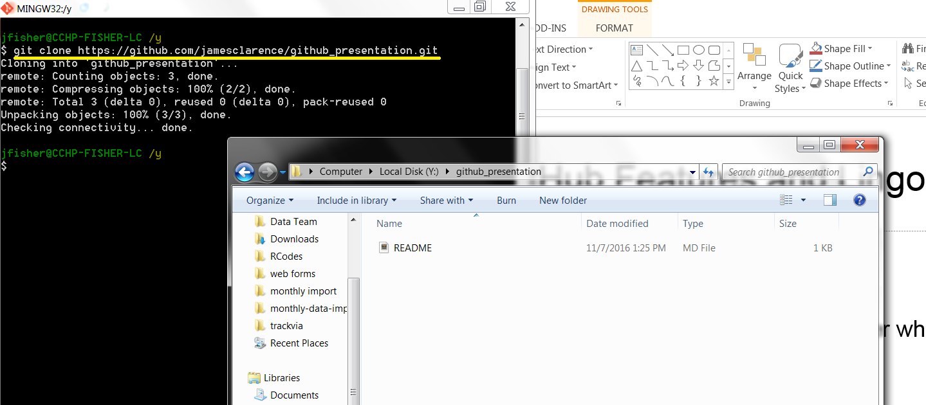
GitHub Lingo: Initializing/Cloning
To create a repo is to initialize it
To link a created repository is to clone it
Notes:
In this screenshot, I cloned the repository I created on GitHub to my local computer.

Slide 12
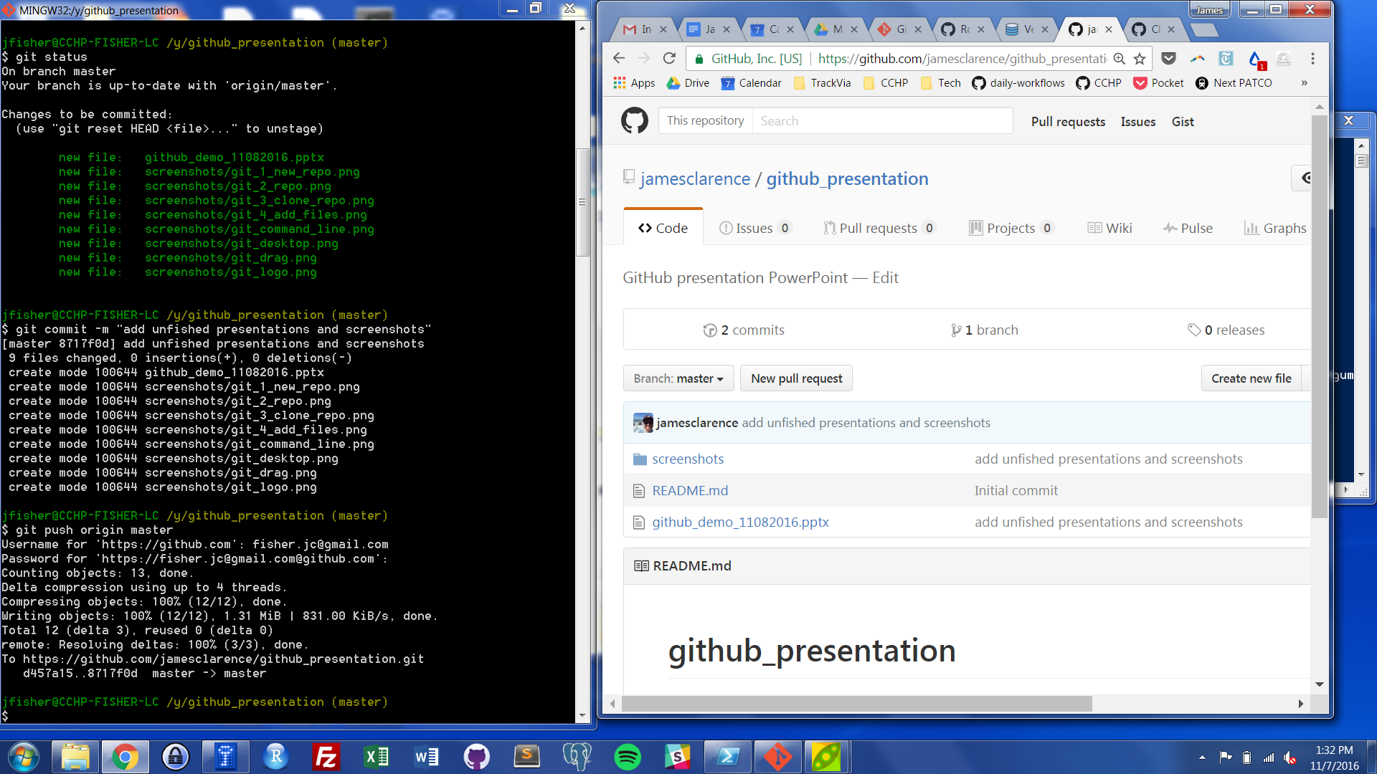
GitHub Lingo: Committing and Pushing Changes
After creating, adding, editing, or deleting files in local repo, you commit the changes and push them to GitHub.

Slide 13
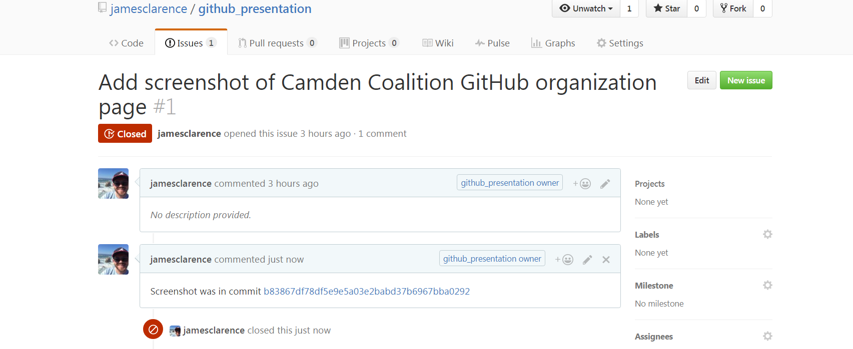
GitHub Lingo: Open and Close an Issue
Create (Open) an issue and close it when it is solved. You can also chat about it.
Notes:
One project management tool GitHub has is tracking Issues. It can be future features you want to add, bugs, proposed changes. People can discuss the issue, and you can close the issue when it is solved. Solved can mean the changes have been made, or it has been discussed and decided not to act on the issue.

Slide 14
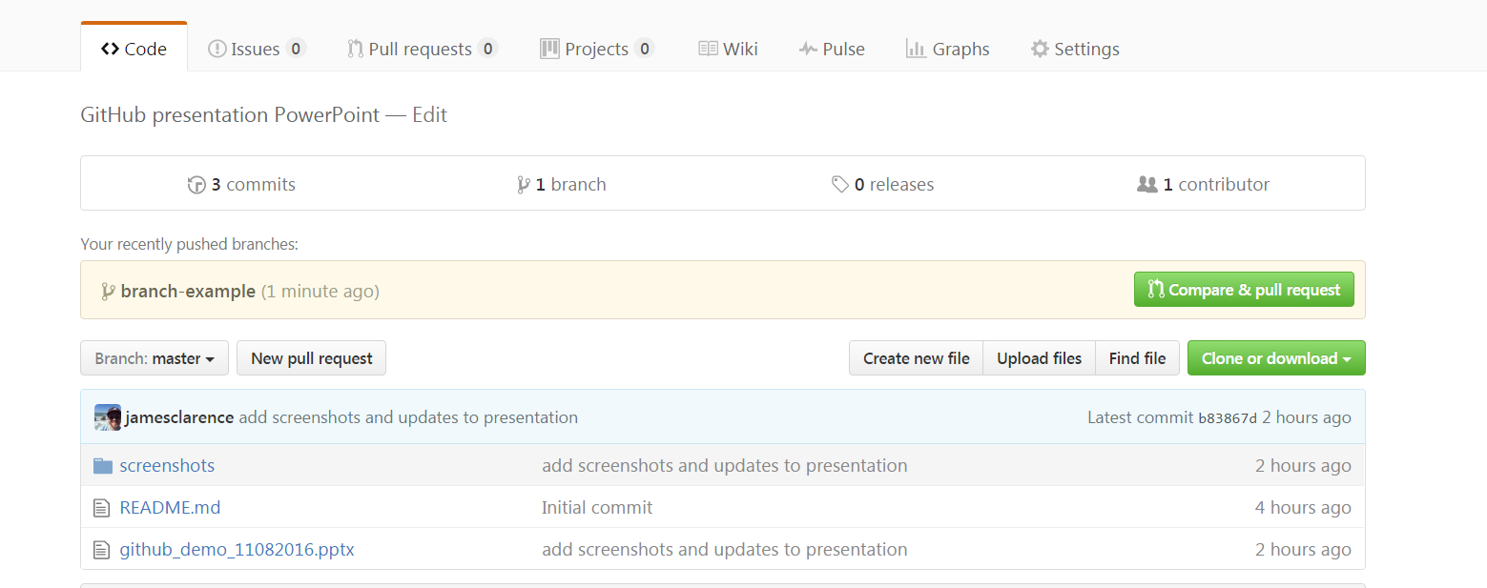
GitHub Lingo: Branching & Pull Requests
You can separate your work from the master branch and save it to another branch.
Notes:
Branching is one of the more powerful aspects of version control. You can copy the repo and make separate branch(es) and edit to your heart’s content. You can branch off of branches.

Slide 15
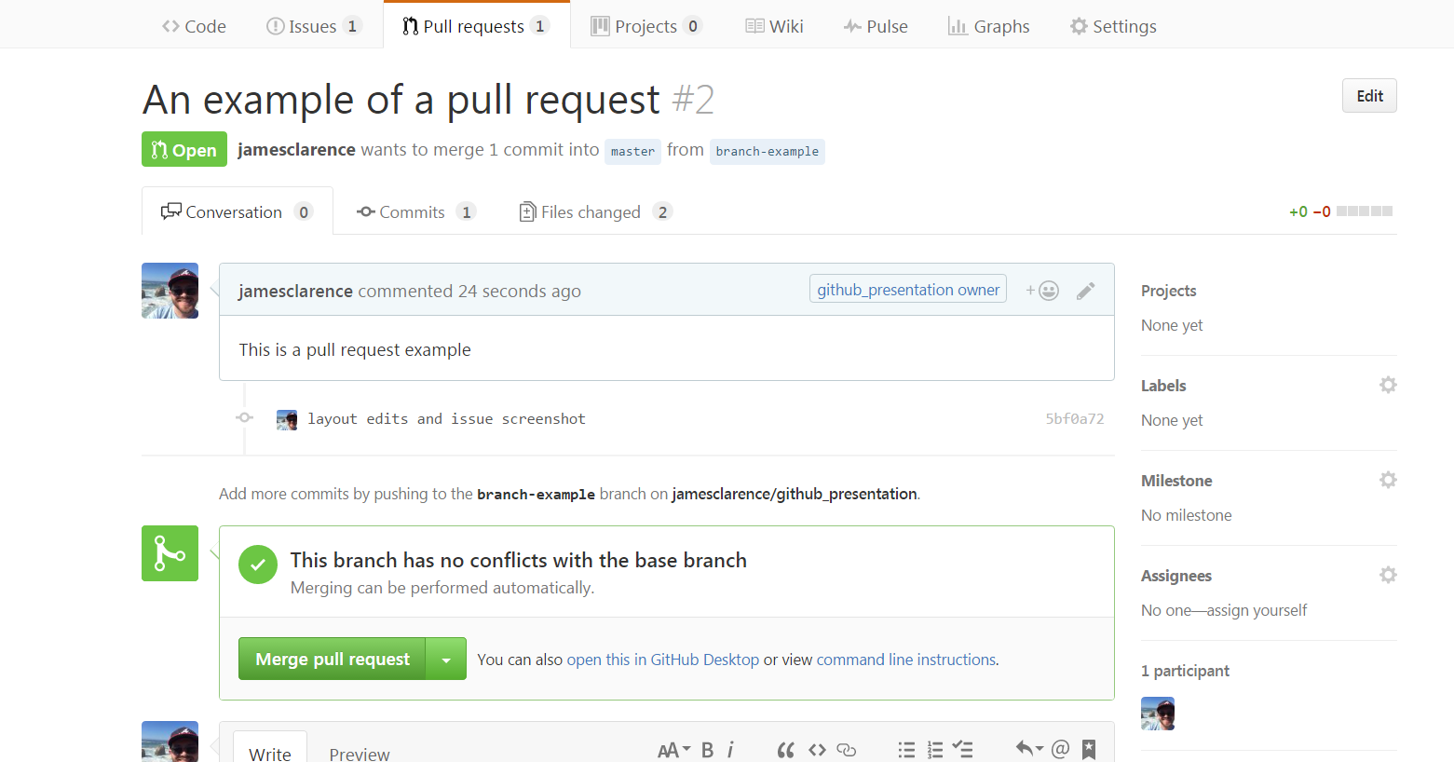
GitHub Lingo: Branching & Pull Requests
Create a pull request to notify repo owner of change.
Notes:
Once you’re done with your edits, you can make a pull request. A pull request notifies the repository owner that you have some proposed changes.

Slide 16
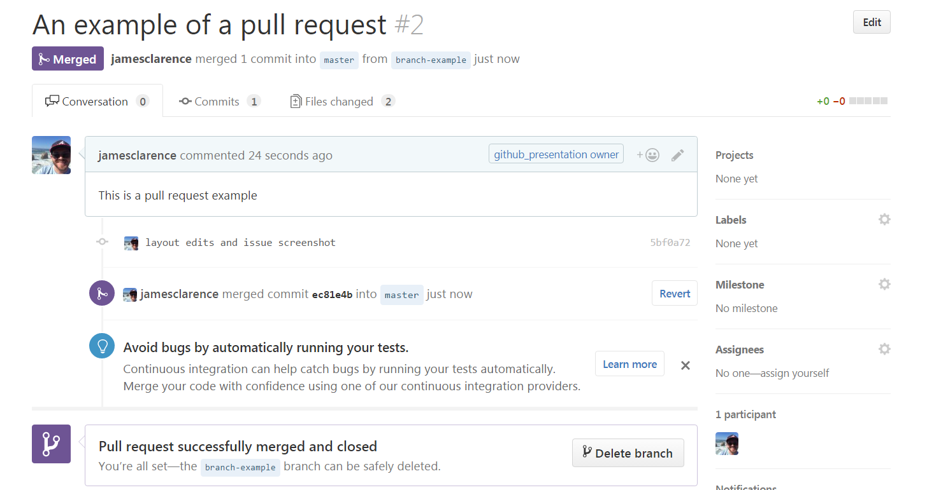
GitHub Lingo: Branching & Pull Requests
Repo owner can decide to pull the changes into master branch… or reject them.
Notes:
Once the repo owner(s) decide what to do with the pull request, the branches can be deleted or left. Whatever you want.

Slide 17
That’s the basics of GitHub
Any questions?
We’ll also take a quick look at the Camden Coalition’s GitHub organization page: https://github.com/CamdenCoalitionOfHealthcareProviders

