Slide 1
GitHub Demo 11/8/2016
Agenda
What is version control?
What is Git?
Interacting with GitHub
GitHub Example
Examples of repositories

Slide 2
What Is Version Control?
Version control is software that helps a team manage the changes to their code or any other documents. (It doesn’t have to be just code!)
Benefits
Centralized
A complete long-term change history of every file
Branching and merging
Traceability

Slide 3

What is Git?
A free and open source distributed version control system
Origins of Git
Git was originally developed in 2005 by Linus Torvalds after some fight about the use of a software license for another version control system
Linus Torvalds also created Linux, an open source operating system in the early 1990s that’s actively developed and used in Android devices and other computer hardware

Slide 4
Git: Cons (And Pros)
Cons (and Pros)
One more thing to learn
Git is a separate programming language from the programming language in which you might want to track changes
Git is very particular
You have to go through the correct steps in the right order to get it to work.
Learning the Git workflow can help you think about your own workflow.
That said, there are a lot of ways to do the same thing
This depends on how you interact with GitHub

Slide 5

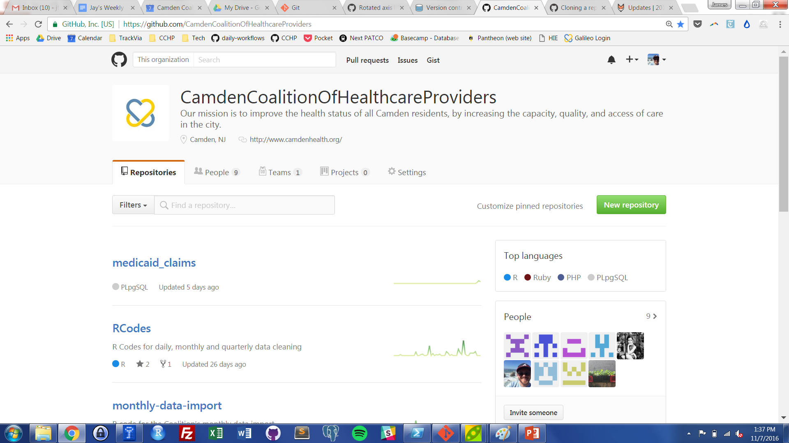
vs
GitHub is just a web-based platform for Git.
It takes all the abilities of version control in Git and adds user friendly collaboration and project management features.

Slide 6
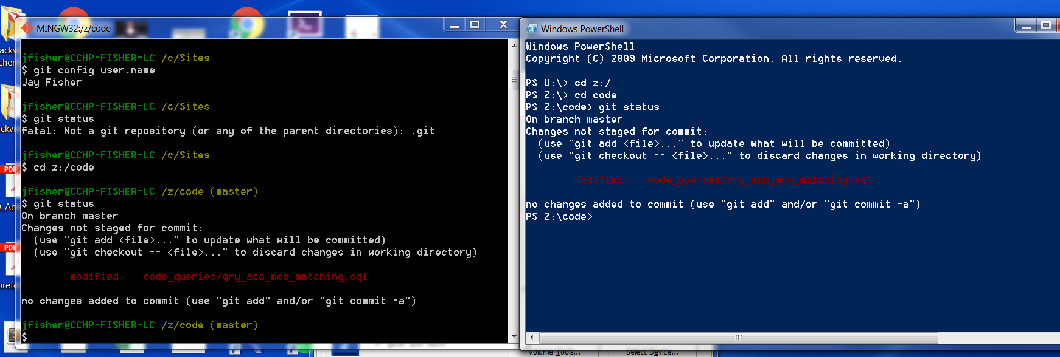
Ways to Interact With GitHub: Command Line
You can create, delete, and edit folders and files through text. You can also interact with Git and your GitHub account.
Benefits: you can use all of Git’s features through the command line.

Slide 7
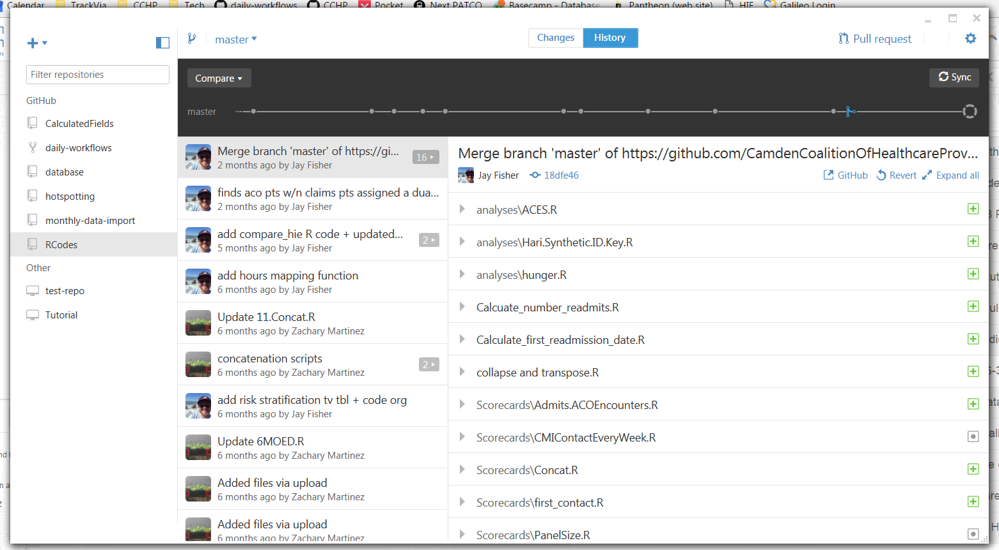
Ways to Interact With GitHub: GitHub Desktop Application (GUIs)

Slide 8
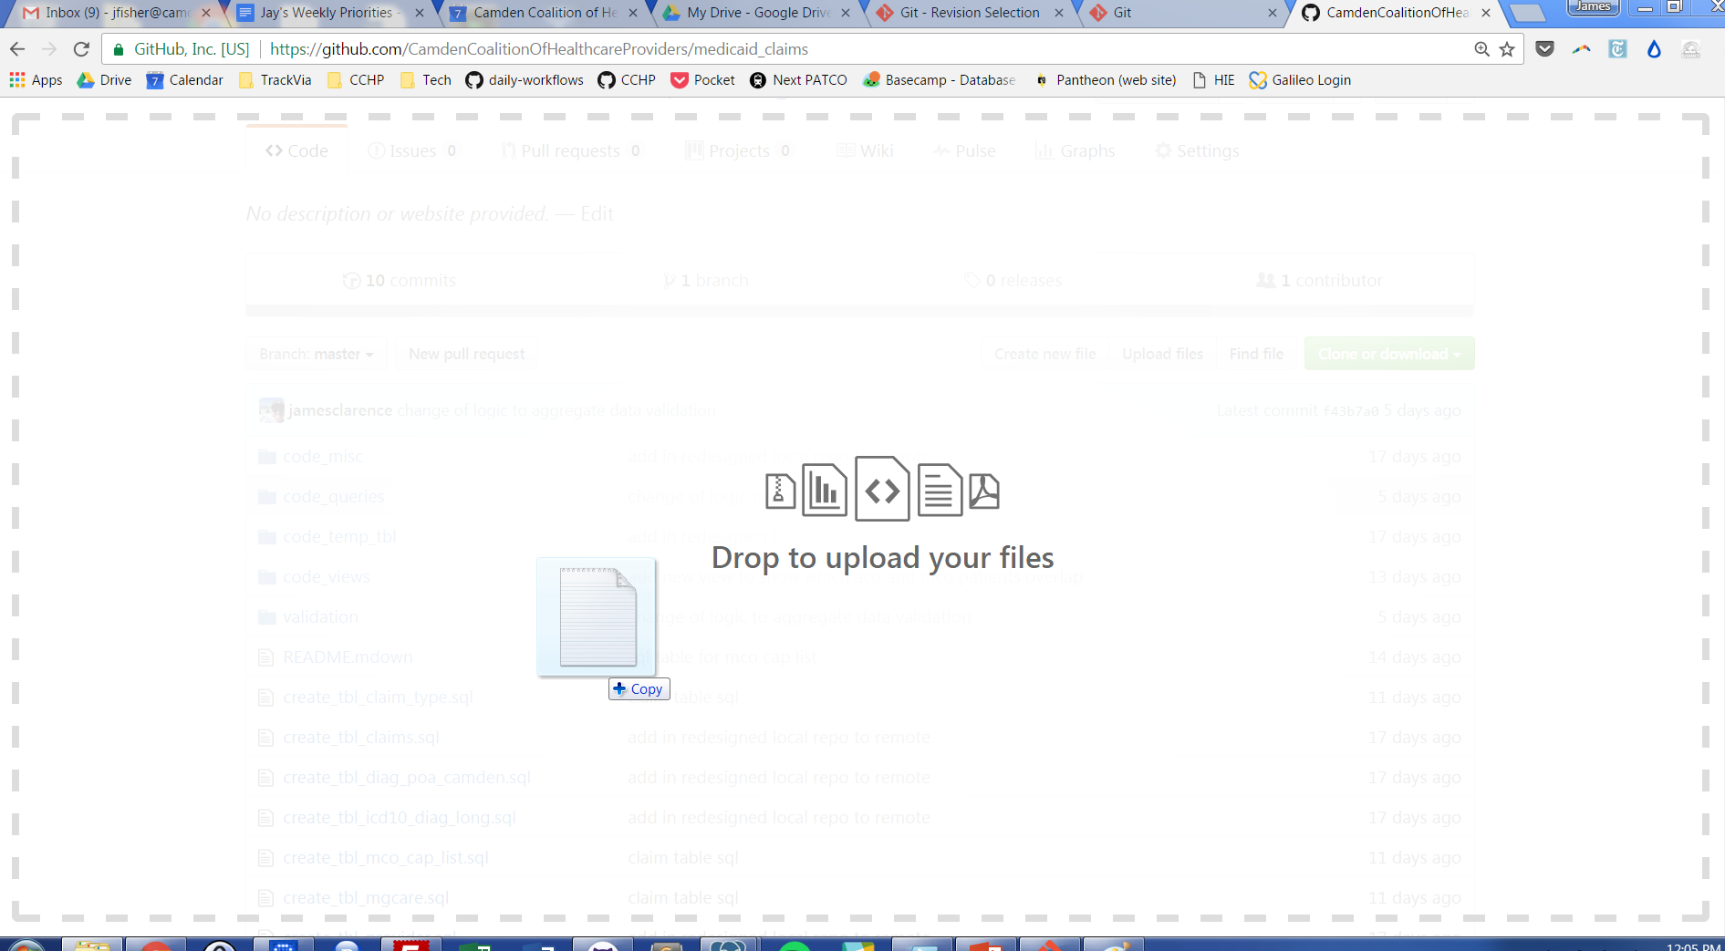
Ways to Interact With GitHub: Drag and Drop

Slide 9
GitHub Features and Lingo
Following slides show me using Git and GitHub tracking the changes of making this
Repository (“Repo”)
Repositories is the name for the folder where the files you are tracking are hosted
Cloning/Initializing a Repo
Local/Remote
Pull Request
Visual Representation of Branches
Pull Request
Branches

Slide 10
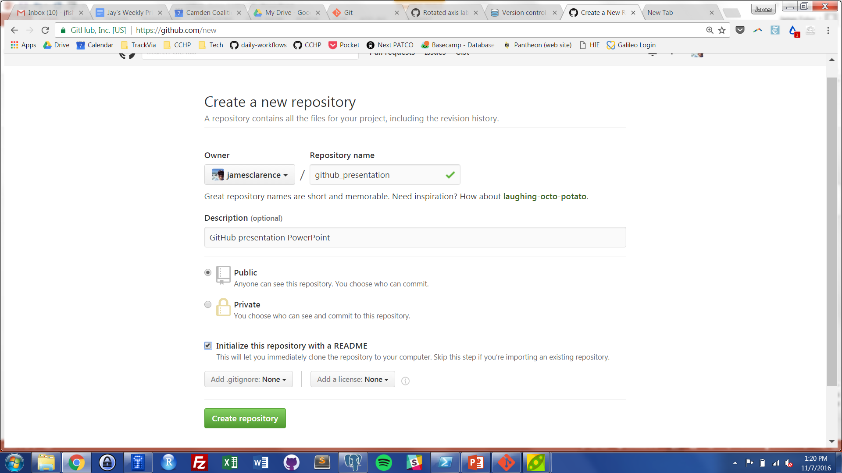
GitHub Lingo: Repositories
A repository (“repo”) is the name for the folder where the files you are tracking are hosted, both saved on your computer (local) and remote repo (GitHub)

Slide 11
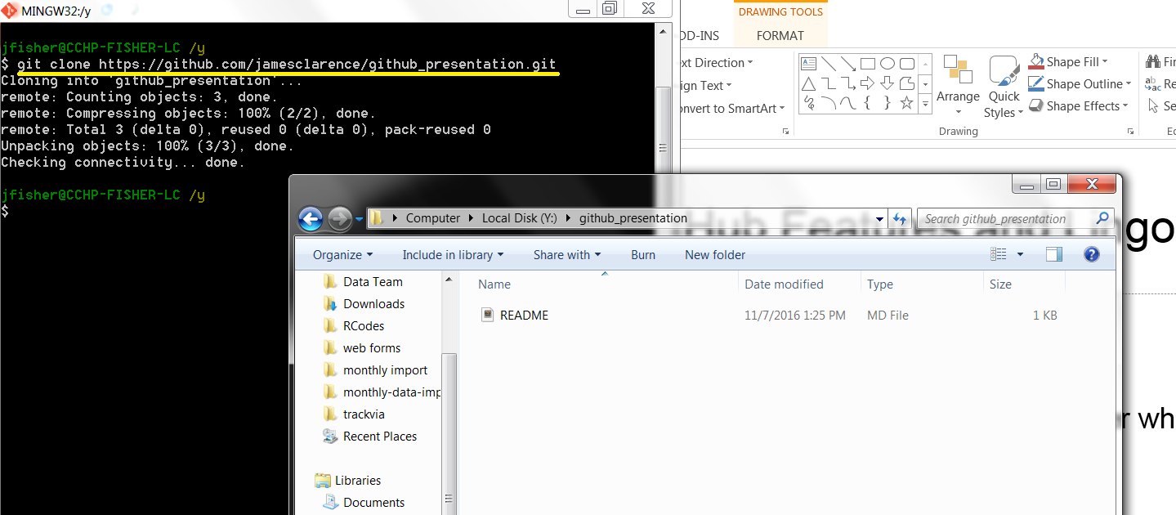
GitHub Lingo: Initializing/Cloning
To create a repo is to initialize it
To link a created repository is to clone it

Slide 12
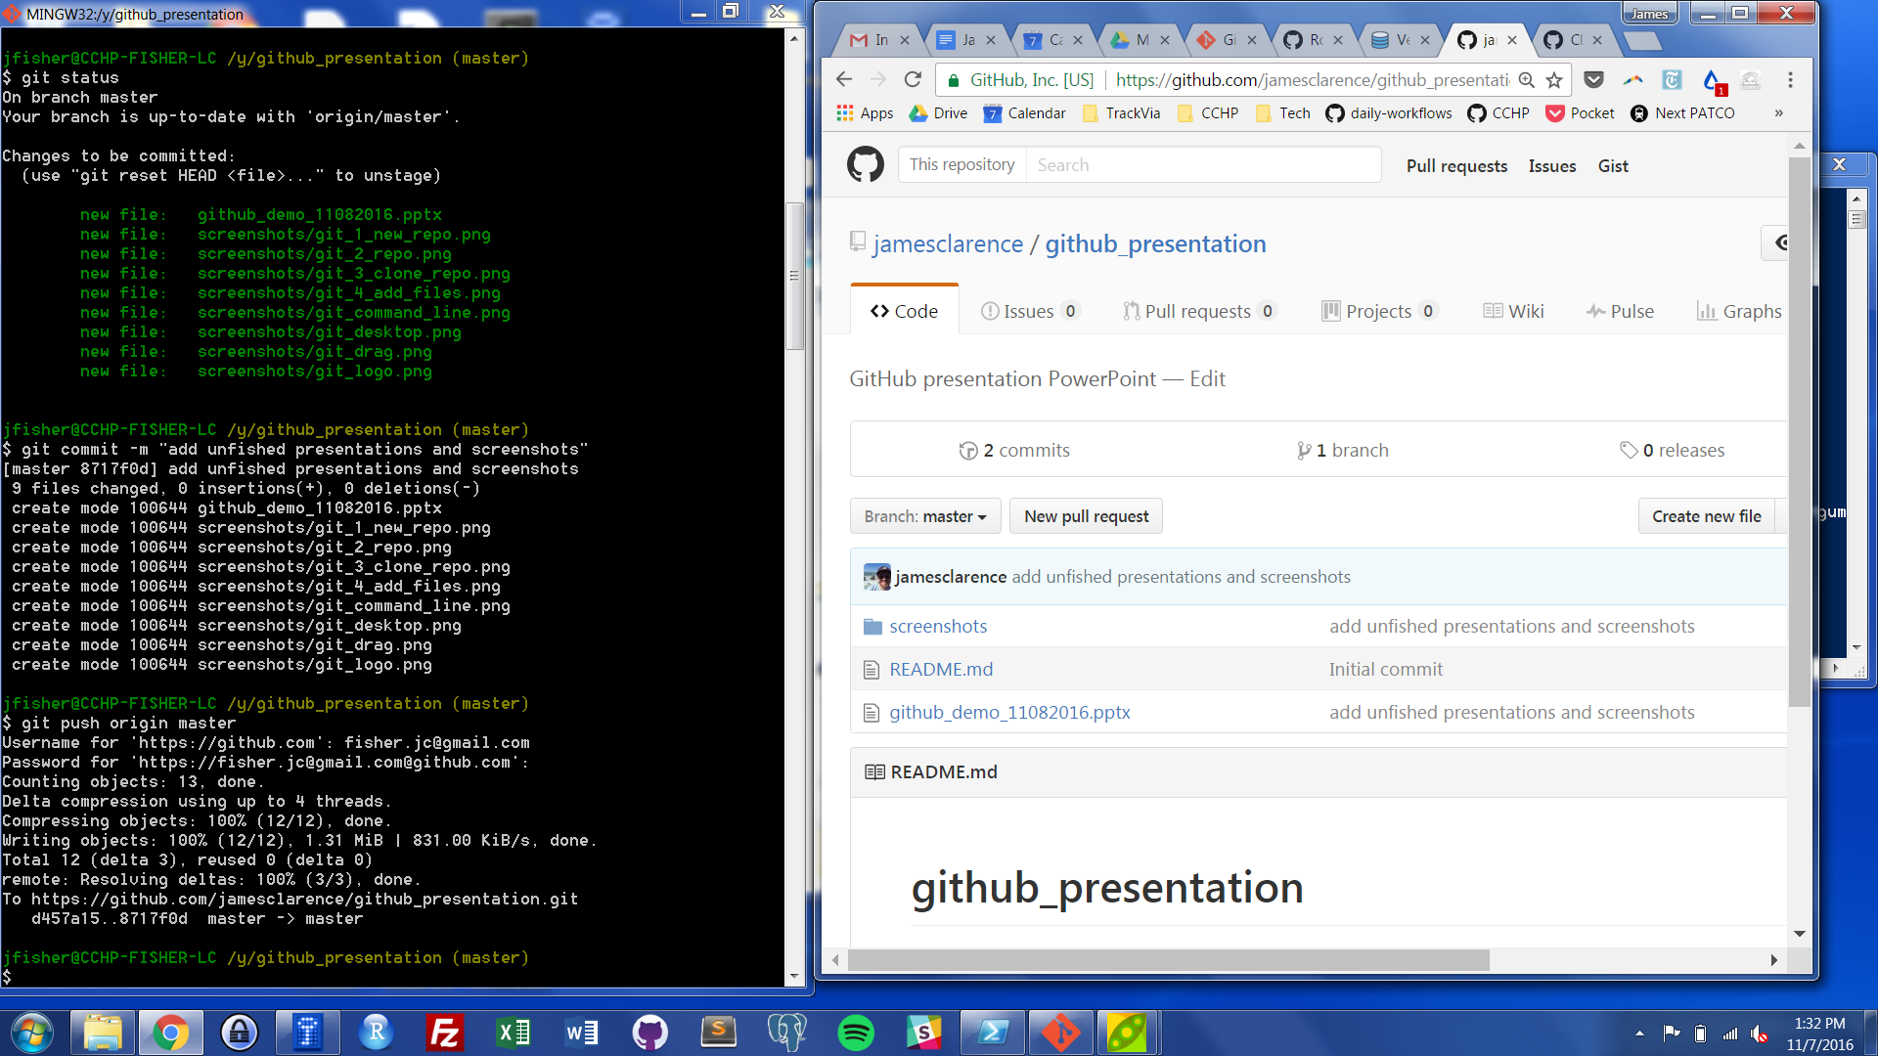
GitHub Lingo: Committing and Pushing Changes
After creating, adding, editing, or deleting files in local repo, you commit the changes and push them to GitHub.

Slide 13
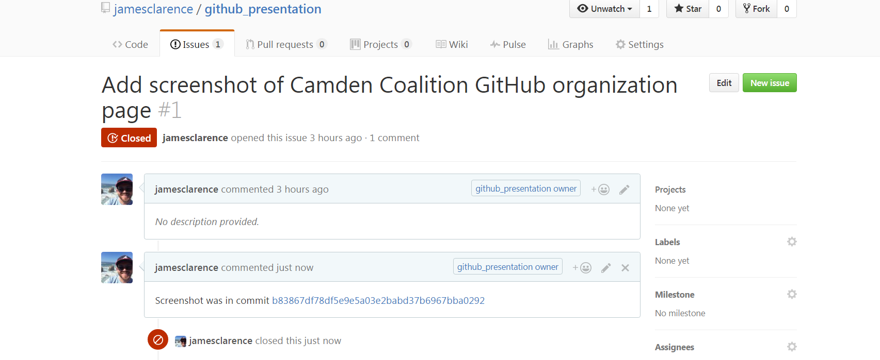
GitHub Lingo: Open and Close an Issue
Create (Open) an Issue and close it when it is solved. You can also chat about it.

Slide 14
GitHub Lingo: Branching & Pull Requests
You can separate your work from the master “branch” and save it to another branch.
Create a pull request to notify repo manager of change.
Repo manager can decide to “pull” the changes into master branch… or reject them.

