Slide 1
James Clay Guide Capstone
Big Mountain Resort ticket price analysis

Slide 2
The Big Mountain Resort needs to select a better value for their ticket price, and overall increase revenue. It is hypothesized ticket price will be majorly based on the number of fast quad chairlifts and runs, the total snow making acreage, and total vertical drop.
H
1
Context
4
Constraints within solution space
The BM Resort is seeking to increase revenue by re-evaluating their ticket pricing. After a large ~1.5mil increase in operating costs, appealing to more customers and utilizing more of the available acreage is key.
Access to data pertaining to number of rides taken, maintenance data, and total visitors.
2
Criteria for success
5
Stakeholders to provide key insight
A ticket pricing model that recoups the ~1.5mil increased operations costs within 1 year.
Determination of most used and essential facilities on the resort.
Director of Operations, Jimmy Blackburn
Database Manager, Alesha Eisen
3
Scope of solution space
6
Key data sources
Number of visitor data is not available.
Database manager has 1 csv file.
H
D
E
I
P
Notes:
Hypothesis: Create a Hypothesis with an emphasis on SMART principles. (S – Specific, M – Measurable, A – Achievable, R – Realistic, T – Timebound). If you cannot do this, you do not have a good grasp on the business problem.
Context: With context, we have clearly identified the problem at hand and have elucidated on how our initiative may solve this problem, alongside the commercial implications this will have on the business.
Criteria for Success: Clearly defining the criteria for success ensures that the scope of your work is clearly defined and understood. Otherwise, if this isn’t defined – your work will never end which will result in mismatched expectations.
Scope of Solution Space: Scoping out the solution space ensures that the business initiative is SPECIFIC for a certain segment or area. This prevents solutions that have been developed being scaled and applied for all other business units that the solution may not be responsible or scalable for.
Constraints within Solution Space: Looking forward, what are the foreseeable problems we are likely to encounter? Could this be stakeholder resistance? Could this be we don’t have access to the right data?
Stakeholders to provide key insight: Who are the people I need to speak to, to get the answers I need for my data analysis?
What key data sources are required?
Based off my discussions with the key stakeholders – can we clearly list out all the data sources we need so we can make a highly targeted request as opposed to a scatter-gun approach where we ask for a bit of everything?

Slide 3
Problem Identification
Permanently closure of up to 10 of the least used runs.
Increase the vertical drop by adding a run to a point 150 feet lower down but requiring the installation of an additional chair lift to bring skiers back up, without additional snow making coverage.
Same as number 2 but adding 2 acres of snow making coverage.
Increase the longest run by 0.2 mile to boast 3.5 miles length, requiring an additional snow making coverage of 4 acres.

Slide 4
Recommendation and key findings
A ticket price increase of approximately 9 dollars, for a new total price of 90 dollars, would be recommended.
Increase total vertical drop of resort by 150 feet.
Add one additional run and chairlift on the new vertical drop.

Slide 5
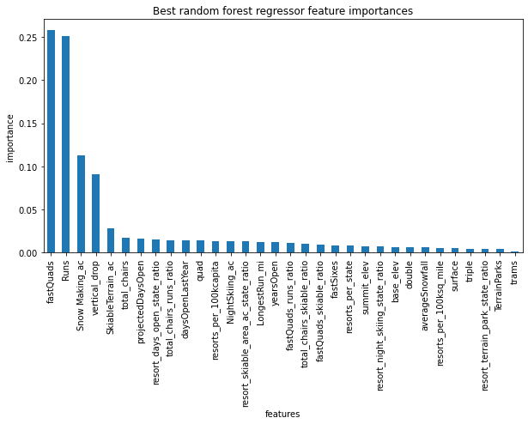
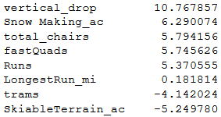
Feature Modeling
Linear Regression Model
Random Forest regressor

Slide 6
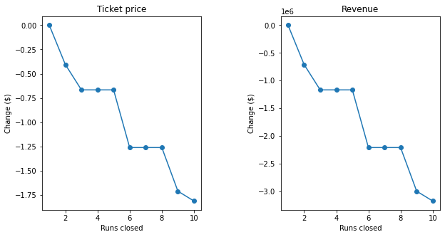
Analysis of ride closure on ticket price

Slide 7
Summary and conclusion
Closing 1 run may not affect recommended ticket price, but any more than that would decrease the value of the ticket. Closure of 1-5 have a slight decrease, but any more would be a sharp decrease.
Increasing the vertical drop by adding a run to a point 150 feet lower down and requiring the installation of an additional chair lift to bring skiers back up, without additional snow making coverage, is recommended.
Increasing the longest run by 0.2 mile to boast 3.5 miles length, and subsequently requiring an additional snow making coverage of 4 acres did not affect the recommended ticket price.

