Slide 1
Zendesk Design Challenge
(Or how I stopped worrying and learned to love Zendesk!)

Slide 2
1.
Audience Types

Slide 3

Assumptions about apps audience
Support Expectations
Users in this context expect support which is seamless:
- involves high-quality, fast communication
- involves direct contact with a human agent
- is backed-up by robust but clear documentation and help
- assists them through their issues lifecycle

Slide 4
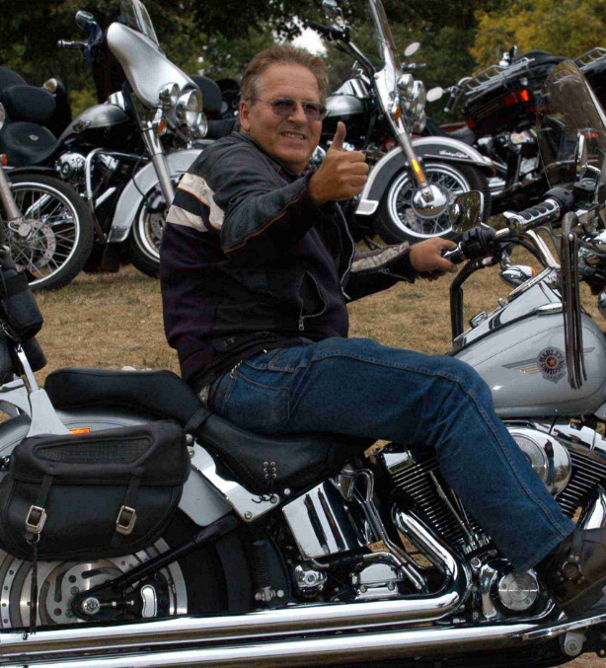
Bob: Persona
Bob is 46 years old. He is married with one child. His income is over $80k. His motorcycle is the households third vehicle. He likes Zed Zeppelin, his Harley Davidson Roadster and is a software developer. He precedes the digital generation but is highly technically proficient. He expects his accessories and apps to ‘just work’.
Statistically - Bob is our ‘typical’ user.

Slide 5
I have always wished for my computer to be as easy to use as my telephone, my wish has come true as I can no longer use my telephone

Slide 6
Persona Mapping
Easy-to-Use
Bob does not expect to have to ‘learn’ how to use our app or how to engage with support. He expects to understand it by looking at it and to be able to use it through use metaphors he already understands.
Involves Human Interaction
Bob is paying for support at the moment of app set-up and so expects direct human interaction and assistance whenever he needs it.
Non-Invasive
Bob expects to not be spammed or to be the target of marketing based on his use of support or based on his engagement with the app. He does expect to be contacted with respect to this apps use case but otherwise left alone.

Slide 7
2.
Features

Slide 8
Features
Zendesk Talk
BikeGuard uses the Zendesk Talk sdk in order to give customers the ability to call a support agent when a suspected theft of their vehicle occurs or to track the progress of a current case.
Zendesk Chat
BikeGuard uses the Zendesk Chat sdk in order to give users the ability to have progress based conversations based on cases or for support using the application (e.g. installation of device)
Zendesk Mobile SDK
BikeGuard uses the Zendesk Mobile sdk to give users the ability to access FAQs and to get policy information with respect to the handling of their case.

Slide 9
3.
Implementation Details

Slide 10
Big concept
BikeGuard will provide motorcycle users with peace of mind and security in a theft situation

Slide 11

But let’s have a cup of tea first
Hmmm...

Slide 12
3 hours, 17 minutes and 14 seconds
Basic Conceptualization
Business Concept
Storyboard
Related Research
Basic Implementation
Basic Android Application
Integration Hooks
Basic UI Work

Slide 13
And don’t forget the presentations
Documentation
Questions and FAQs Online
Presentation
Video presentations
Slide Decks
ReadMe

Slide 14
4.
Metrics for Success

Slide 15
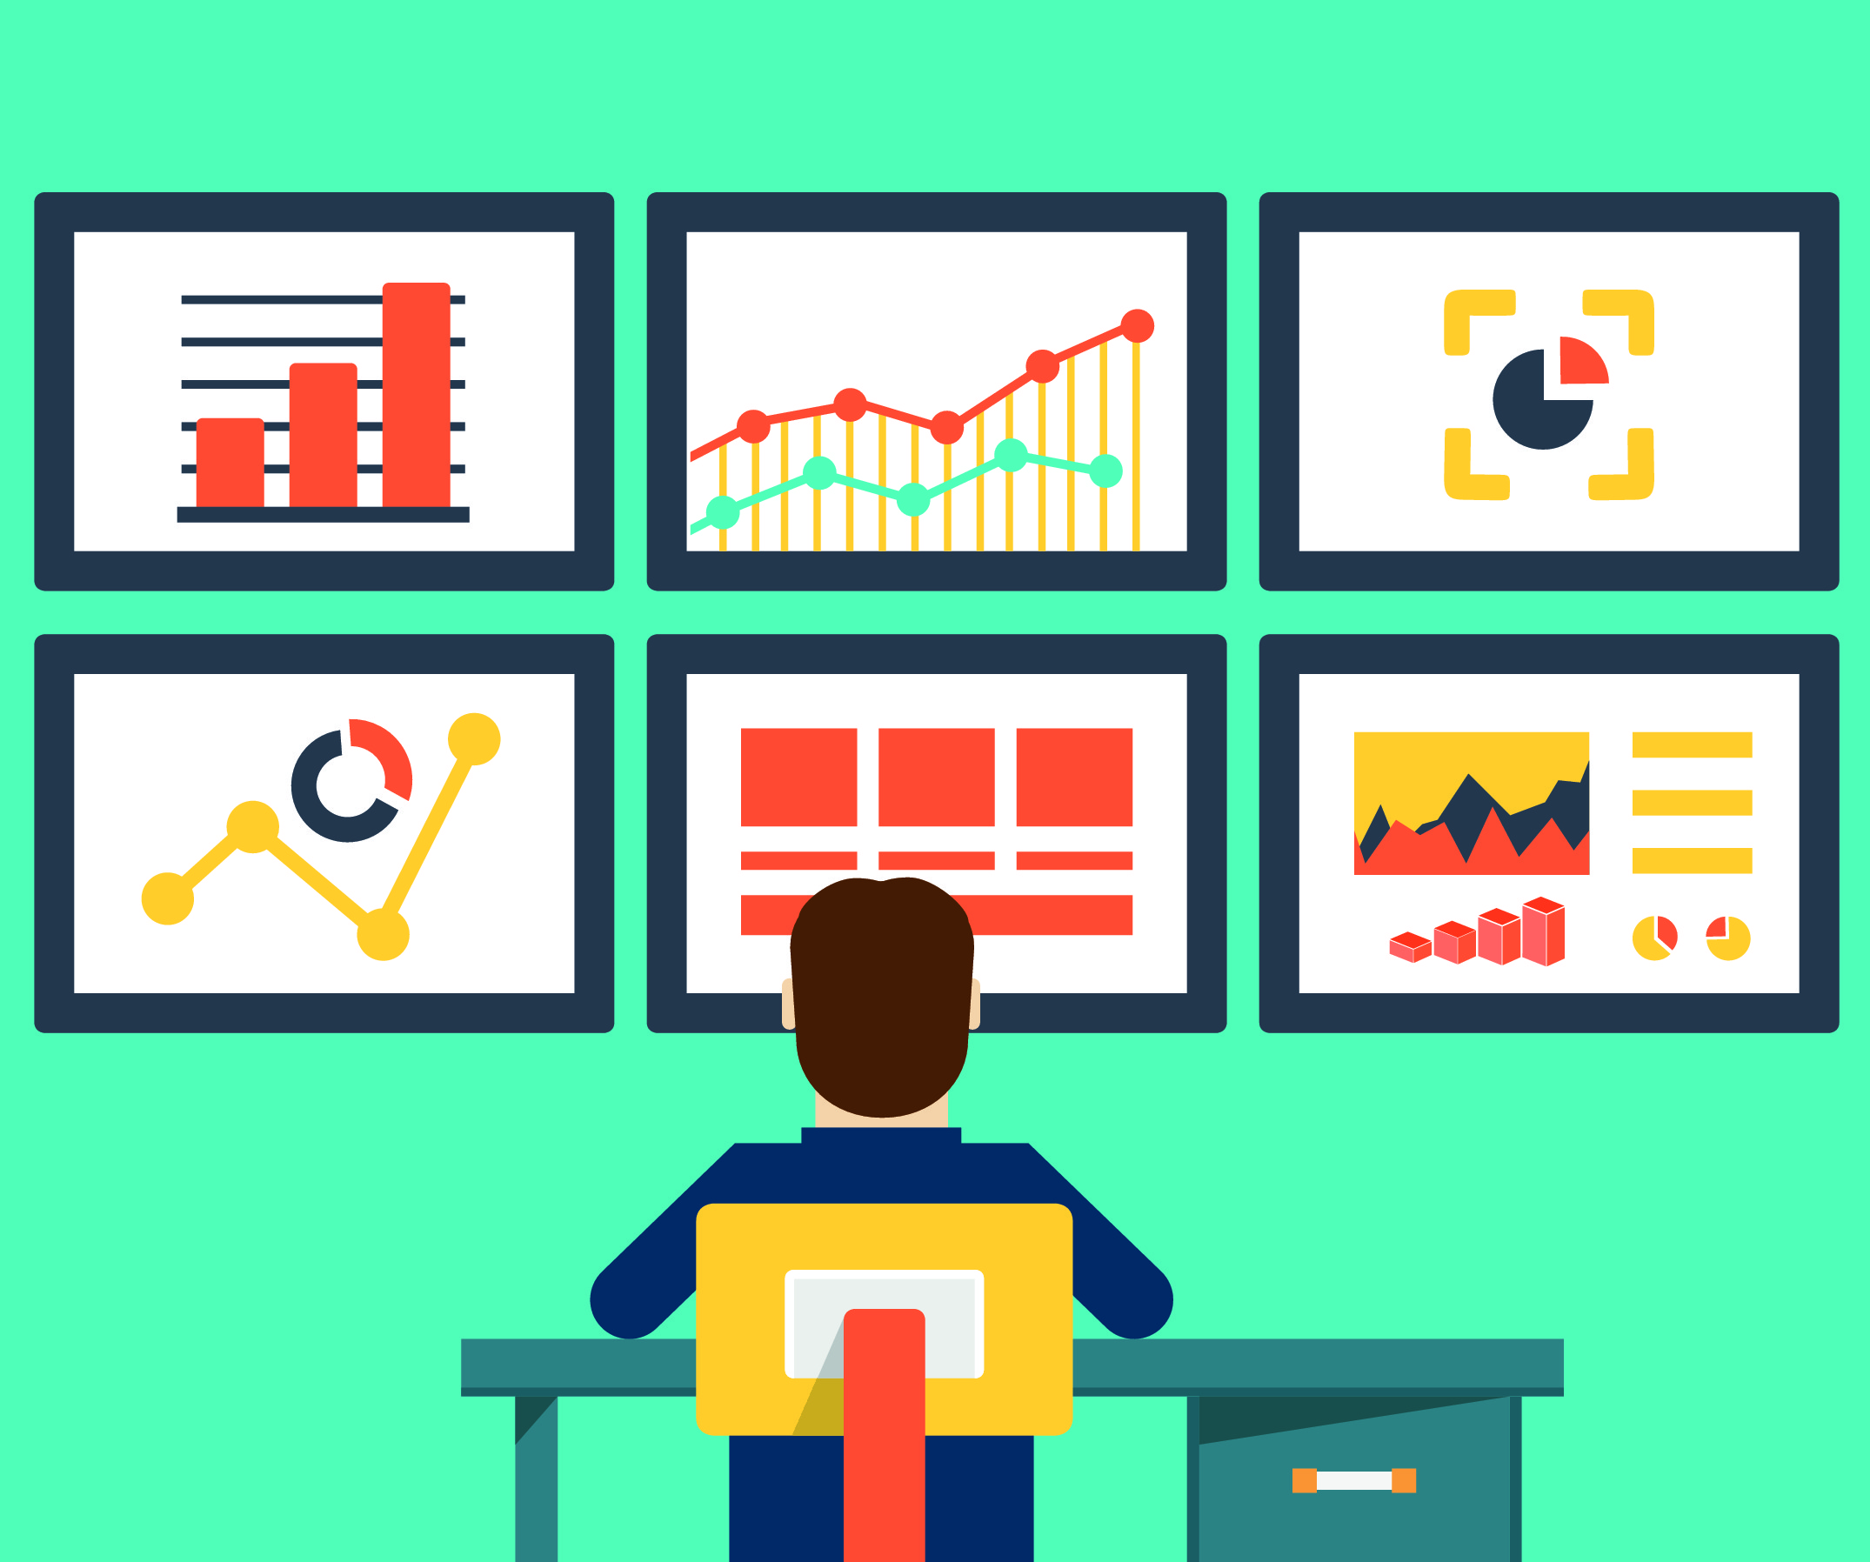
This guy is so playing Tetris on his phone

Slide 16
Are we winning?
App Stats
App installs and patterns of app installs (increasing, leveling, falling) as well as reviews provide useful metrics.
Cash Money
App subscription purchases and subscription renewals also a very useful source of feedback.
Zendesk Chat Monitor
Provides me with statistics for measuring everything from response times to satisfaction ratings for chat interfactions
Zendesk Talk
The dashboard provides me with statistics on call wait times and call lengths. In this context, reduced wait times or no wait times are critical.
Zendesk Reporting
BikeGuard depends on calls becoming tickets. Tickets will be regularly monitored by customers and internally.
Customer Interactions
BikeGuard expects multiple interactions with single customers and can use that context as a rich soure of feedback.

Slide 17
5.
What I learned...

Slide 18
89,526,124
Is a crazy big number...

Slide 19
Thoughts
Existing Zendesk tools and documentation do a very good job of making integrations quick and seamless.
It helps but it isn’t essential to have a business context when thinking about supportability.
Getting support right is a game-changer.
And many others besides...

