Slide 1
Chapter 1:
Data Storage

Slide 2
Chapter 1: Data Storage
1.1 Bits and Their Storage
1.2 Main Memory
1.3 Mass Storage
1.4 Representing Information as Bit Patterns
1.5 The Binary System
1-<number>

Slide 3
Chapter 1: Data Storage (continued)
1.6 Storing Integers
1.7 Storing Fractions
1.8 Data and Programming
1.9 Data Compression
1.10 Communications Errors
1-<number>

Slide 4
Bits and Bit Patterns
Bit: Binary Digit (0 or 1)
Bit Patterns are used to represent information
  Numbers
  Text characters
  Images
  Sound
  And others
1-<number>

Slide 5
Boolean Operations
Boolean Operation: An operation that manipulates one or more true/false values
Specific operations
  AND
  OR
  XOR (exclusive or)
  NOT
1-<number>

Slide 6
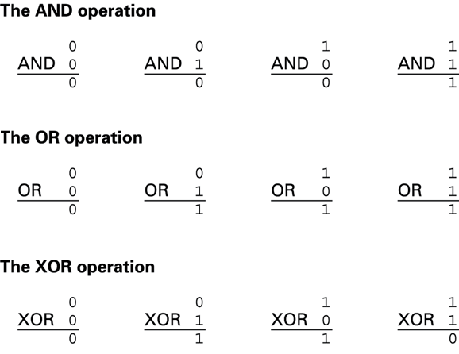
Figure 1.1 The possible input and output values of Boolean operations AND, OR, and XOR (exclusive or)
1-<number>

Slide 7
Gates
Gate: A device that computes a Boolean operation
  Often implemented as (small) electronic circuits
  Provide the building blocks from which computers are constructed
  VLSI (Very Large Scale Integration)
1-<number>

Slide 8
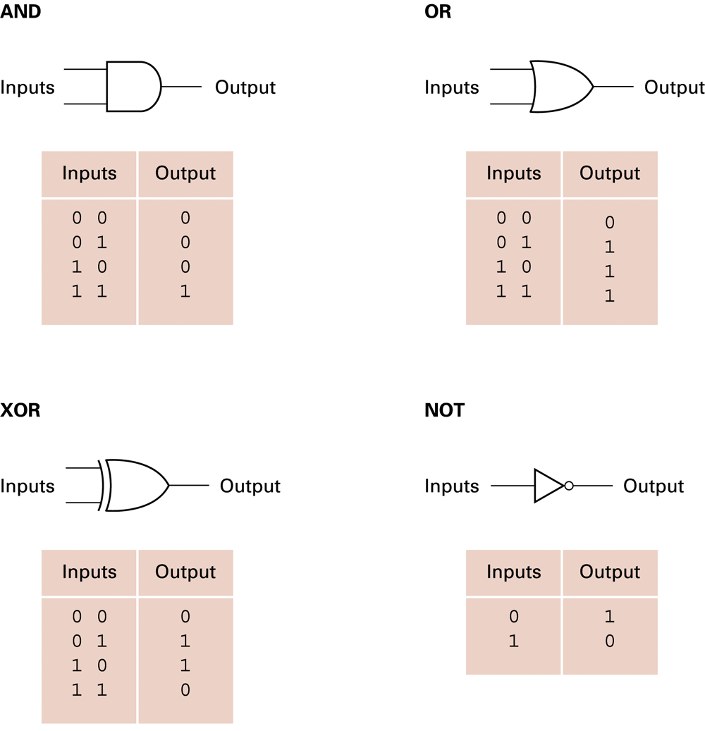
Figure 1.2 A pictorial representation of AND, OR, XOR, and NOT gates as well as their input and output values
1-<number>

Slide 9
Flip-flops
Flip-flop: A circuit built from gates that can store one bit.
  One input line is used to set its stored value to 1
  One input line is used to set its stored value to 0
  While both input lines are 0, the most recently stored value is preserved
1-<number>

Slide 10
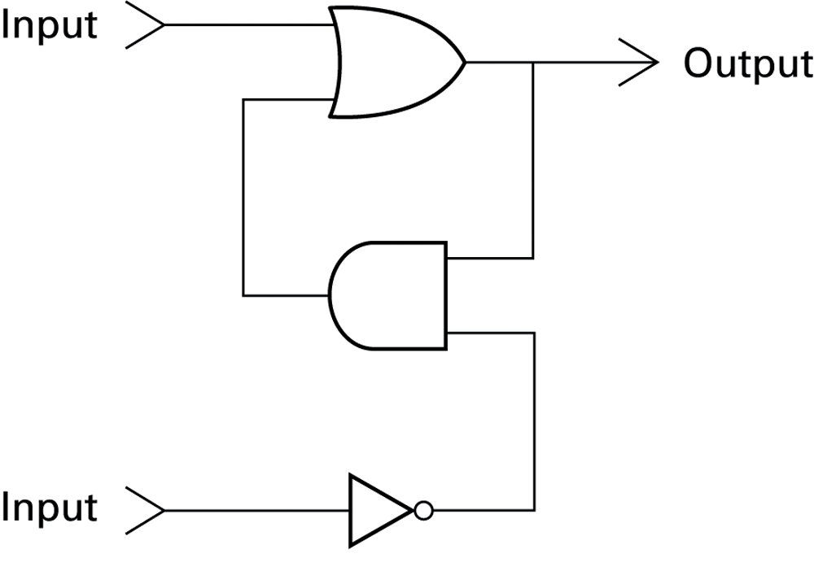
Figure 1.3 A simple flip-flop circuit
1-<number>

Slide 11
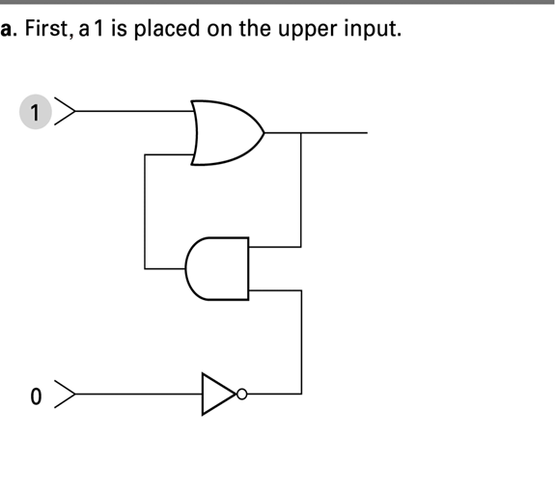
Figure 1.4 Setting the output of a flip-flop to 1
1-<number>

Slide 12
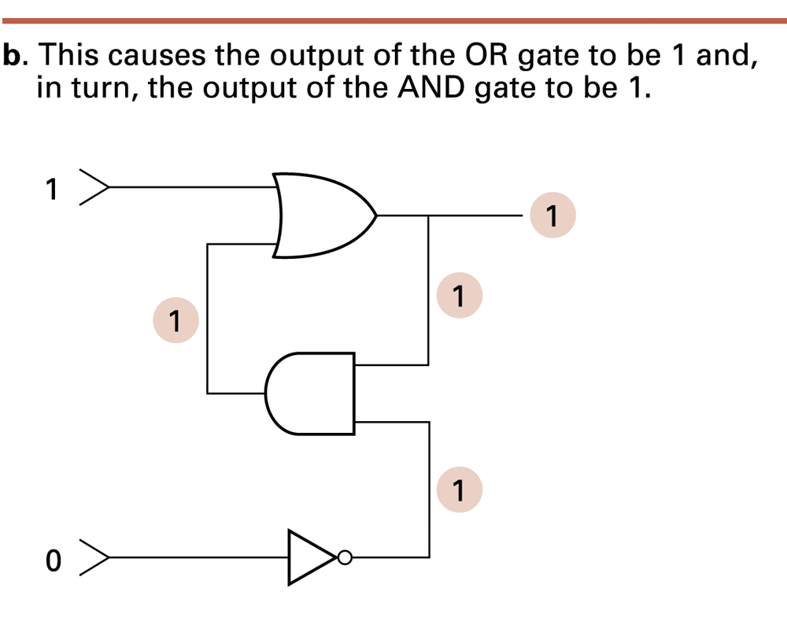
Figure 1.4 Setting the output of a flip-flop to 1 (continued)
1-<number>

Slide 13
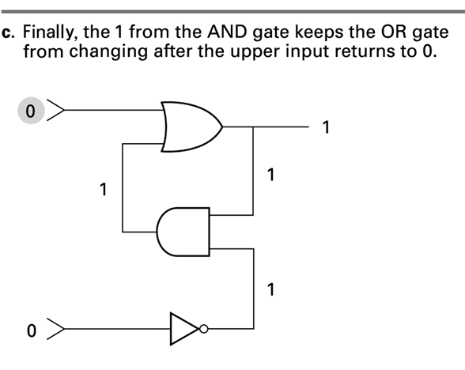
Figure 1.4 Setting the output of a flip-flop to 1 (continued)
1-<number>

Slide 14
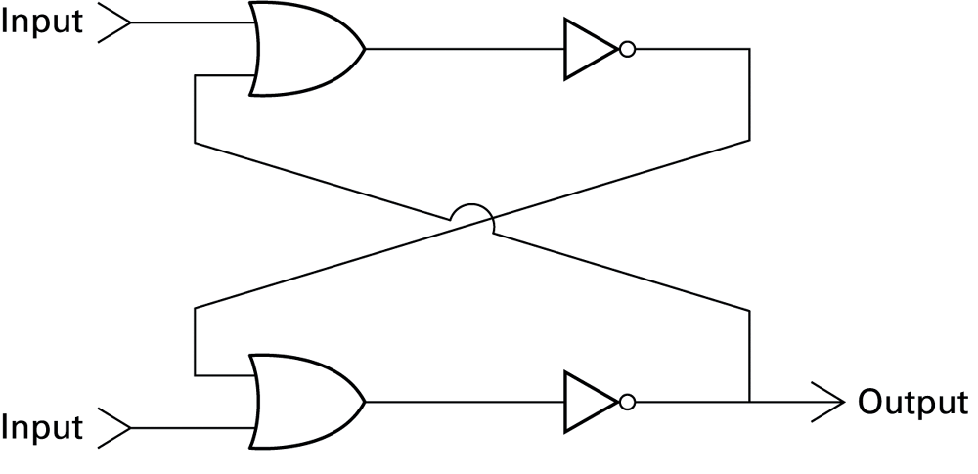
Figure 1.5 Another way of constructing a flip-flop
1-<number>

Slide 15
Hexadecimal Notation
Hexadecimal notation: A shorthand notation for long bit patterns
  Divides a pattern into groups of four bits each
  Represents each group by a single symbol
Example: 10100011 becomes A3
1-<number>

Slide 16
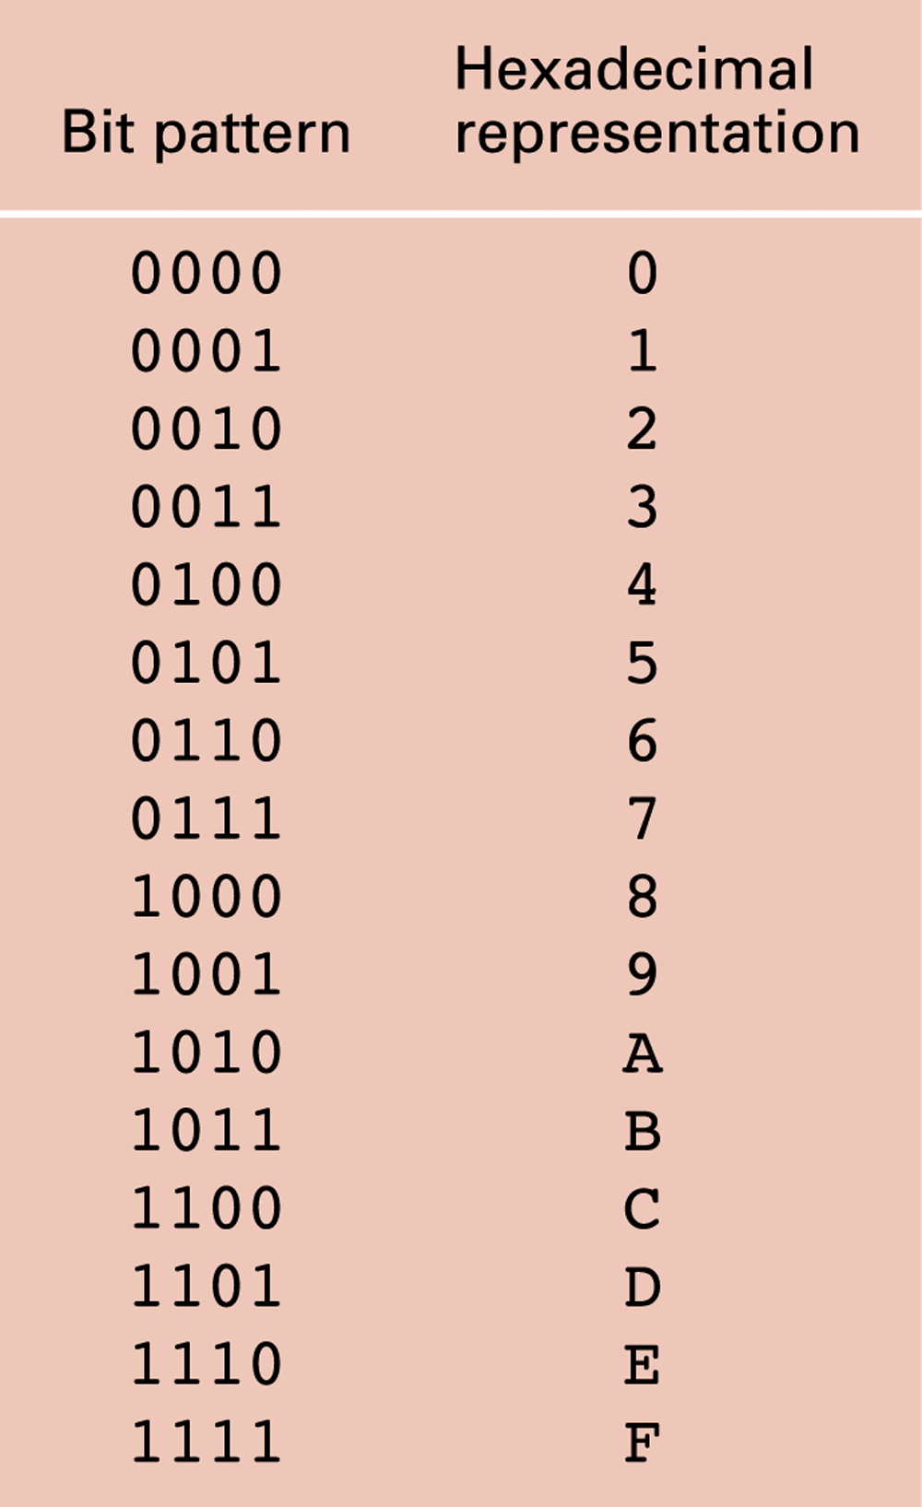
Figure 1.6 The hexadecimal coding system
1-<number>

Slide 17
Main Memory Cells
Cell: A unit of main memory (typically 8 bits which is one byte)
  Most significant bit: the bit at the left (high-order) end of the conceptual row of bits in a memory cell
  Least significant bit: the bit at the right (low-order) end of the conceptual row of bits in a memory cell
1-<number>

Slide 18
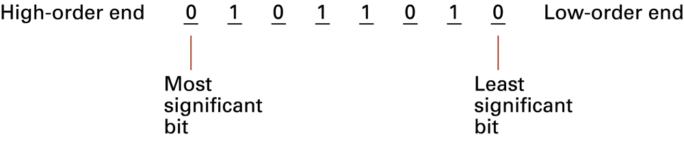
Figure 1.7 The organization of a byte-size memory cell
1-<number>

Slide 19
Main Memory Addresses
Address: A “name” that uniquely identifies one cell in the computer’s main memory
  The names are actually numbers.
  These numbers are assigned consecutively starting at zero.
  Numbering the cells in this manner associates an order with the memory cells.
1-<number>

Slide 20
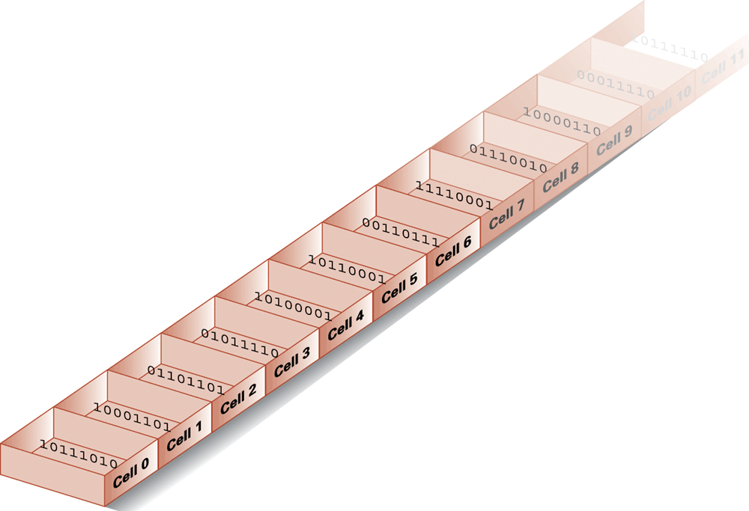
Figure 1.8 Memory cells arranged by address
1-<number>

Slide 21
Memory Terminology
Random Access Memory (RAM): Memory in which individual cells can be easily accessed in any order
Dynamic Memory (DRAM): RAM composed of volatile memory
1-<number>

Slide 22
Measuring Memory Capacity
Kilobyte: 2¹⁰ bytes = 1024 bytes
  Example: 3 KB = 3 times1024 bytes
Megabyte: 2²⁰ bytes = 1,048,576 bytes
  Example: 3 MB = 3 times 1,048,576 bytes
Gigabyte: 2³⁰ bytes = 1,073,741,824 bytes
  Example: 3 GB = 3 times 1,073,741,824 bytes
1-<number>

Slide 23
Mass Storage
Additional devices:
  Magnetic disks
  CDs
  DVDs
Advantages over main memory
  Less volatility
  Larger storage capacities
  Low cost
  In many cases can be removed
  Magnetic tape
  Flash drives
  Solid-state disks
1-<number>

Slide 24
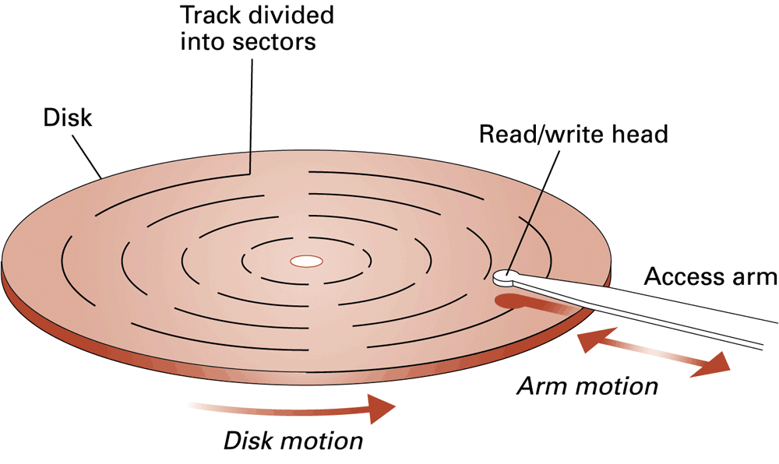
Figure 1.9 A magnetic disk storage system
1-<number>

Slide 25
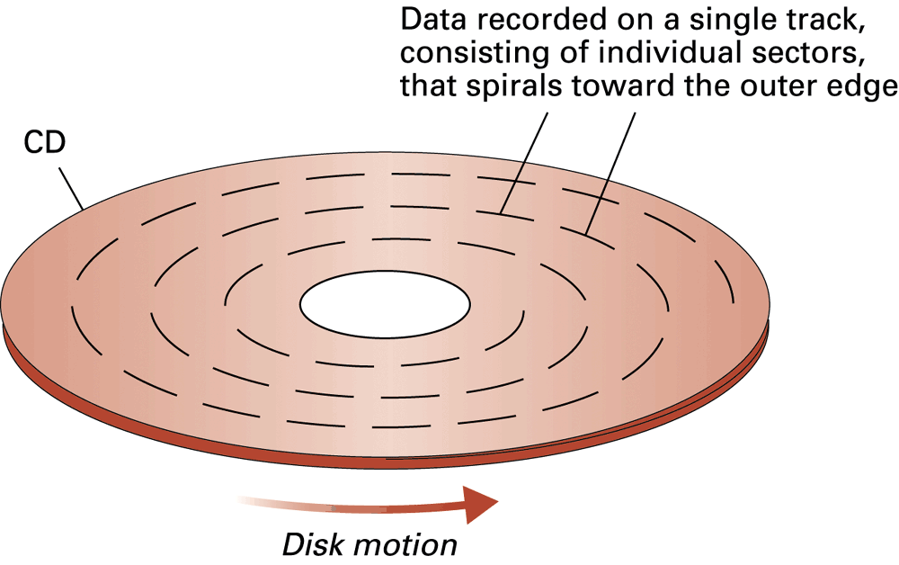
Figure 1.10 CD storage
1-<number>

Slide 26
Flash Drives
Flash Memory – circuits that traps electrons in tiny silicon dioxide chambers
Repeated erasing slowly damages the media
Mass storage of choice for:
  Digital cameras
SD Cards provide GBs of storage
  Smartphones
1-<number>

Slide 27
Representing Text
Each character (letter, punctuation, etc.) is assigned a unique bit pattern.
  ASCII: Uses patterns of 7-bits to represent most symbols used in written English text
  ISO developed a number of 8 bit extensions to ASCII, each designed to accommodate a major language group
  Unicode: Uses patterns up to 21-bits to represent the symbols used in languages world wide, 16-bits for world’s commonly used languages
1-<number>

Slide 28
Figure 1.11 The message “Hello.” in ASCII or UTF-8 encoding
1-<number>

Slide 29
Representing Numeric Values
Binary notation: Uses bits to represent a number in base two
Limitations of computer representations of numeric values
  Overflow: occurs when a value is too big to be represented
  Truncation: occurs when a value cannot be represented accurately
1-<number>

Slide 30
Representing Images
Bit map techniques
  Pixel: short for “picture element”
  RGB
  Luminance and chrominance
Vector techniques
  Scalable
  TrueType and PostScript
1-<number>

Slide 31
Representing Sound
Sampling techniques
  Used for high quality recordings
  Records actual audio
MIDI
  Used in music synthesizers
  Records “musical score”
1-<number>

Slide 32
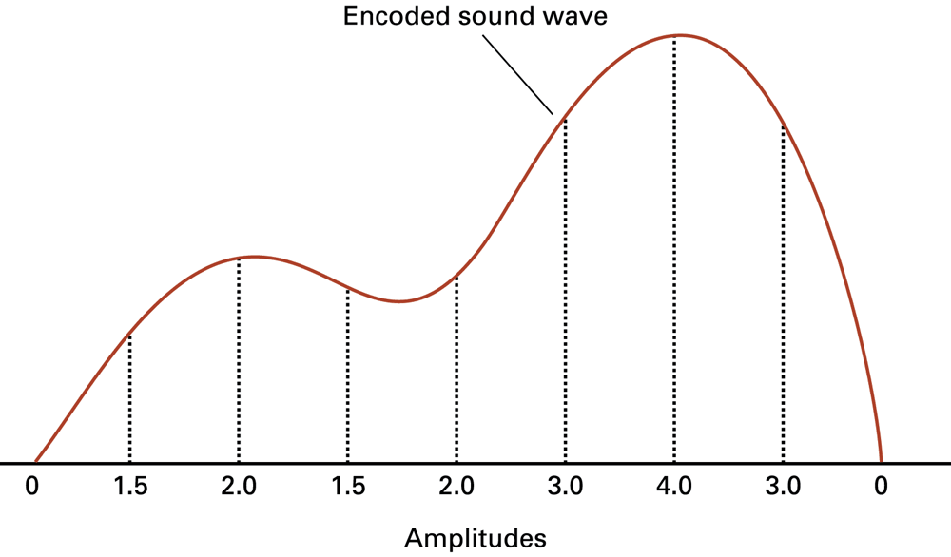
Figure 1.12 The sound wave represented by the sequence 0, 1.5, 2.0, 1.5, 2.0, 3.0, 4.0, 3.0, 0
1-<number>

Slide 33
The Binary System
The traditional decimal system is based
on powers of ten.
The Binary system is based on powers
of two.
1-<number>

Slide 34
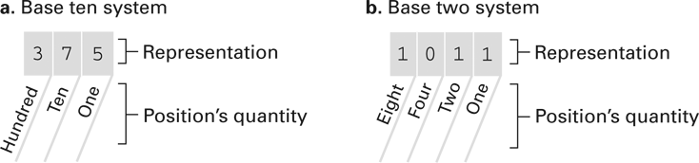
Figure 1.13 The base ten and binary systems
1-<number>

Slide 35
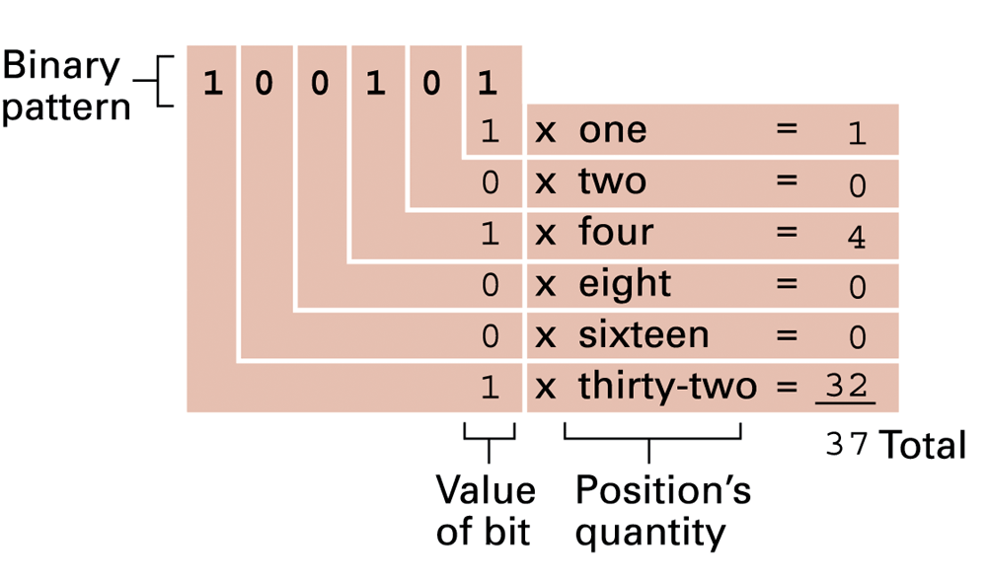
Figure 1.14 Decoding the binary representation 100101
1-<number>

Slide 36
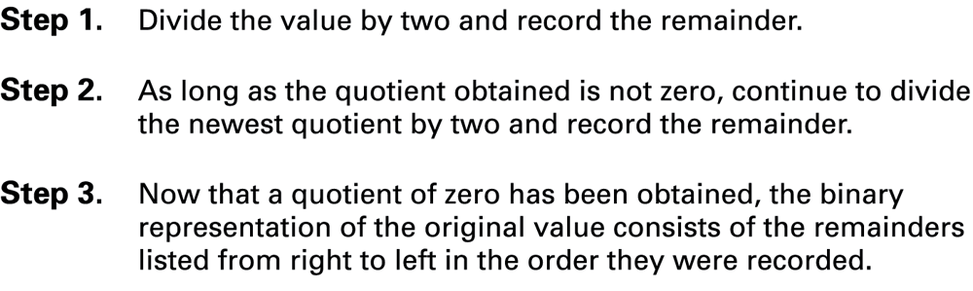
Figure 1.15 An algorithm for finding the binary representation of a positive integer
1-<number>

Slide 37
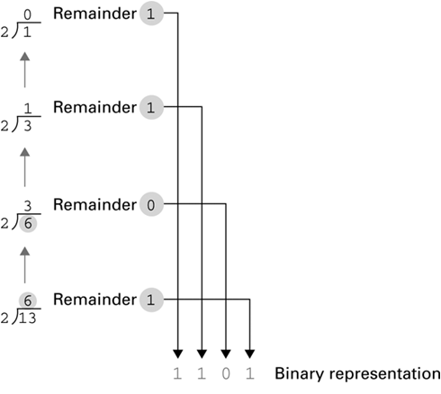
Figure 1.16 Applying the algorithm in Figure 1.15 to obtain the binary representation of thirteen
1-<number>

Slide 38
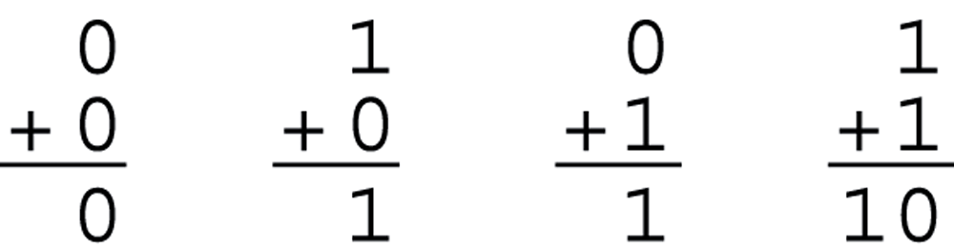
Figure 1.17 The binary addition facts
1-<number>

Slide 39
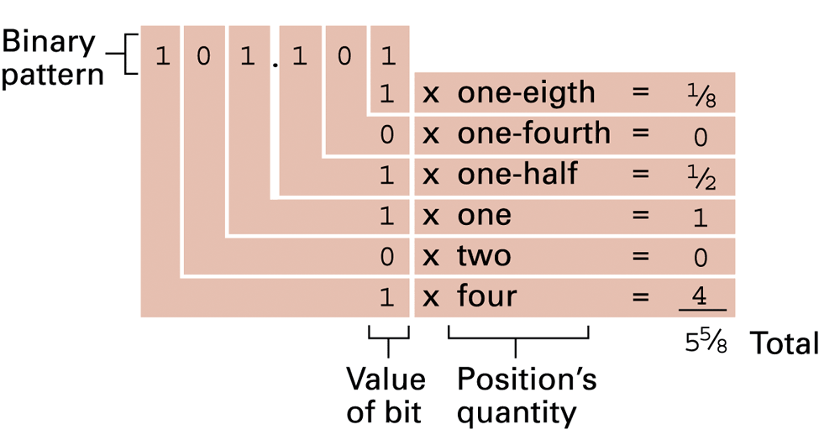
Figure 1.18 Decoding the binary representation 101.101
1-<number>

Slide 40
Storing Integers
Two’s complement notation: The most popular means of representing integer values
Excess notation: Another means of representing integer values
Both can suffer from overflow errors
1-<number>

Slide 41
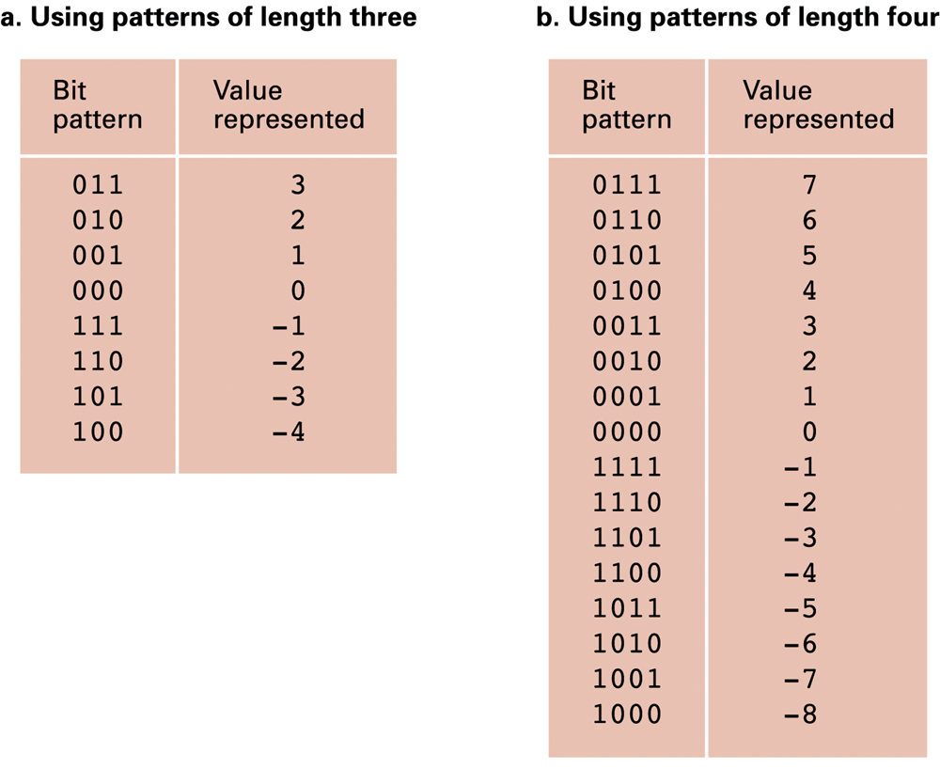
Figure 1.19 Two’s complement notation systems
1-<number>

Slide 42
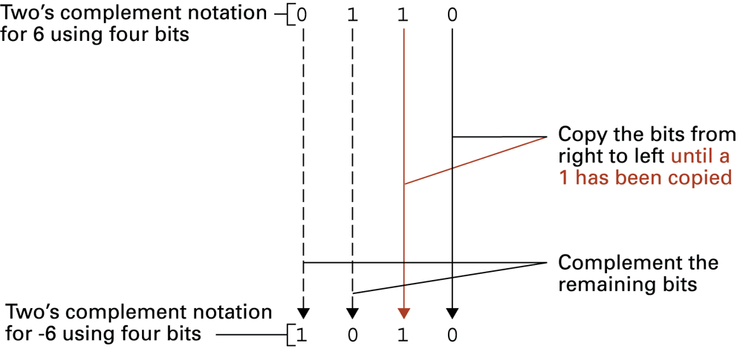
Figure 1.20 Coding the value -6 in two’s complement notation using four bits
1-<number>

Slide 43
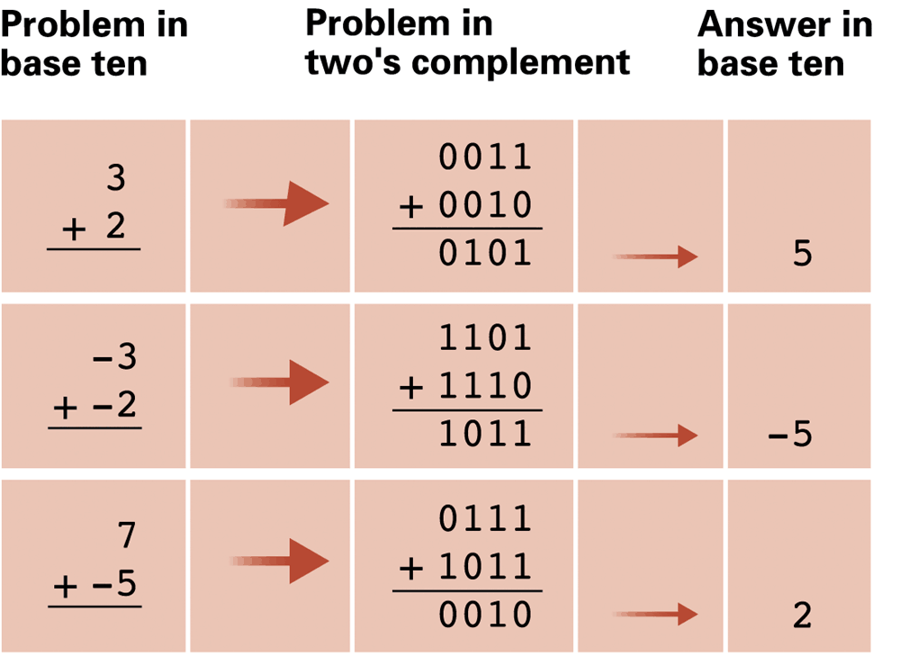
Figure 1.21 Addition problems converted to two’s complement notation
1-<number>

Slide 44
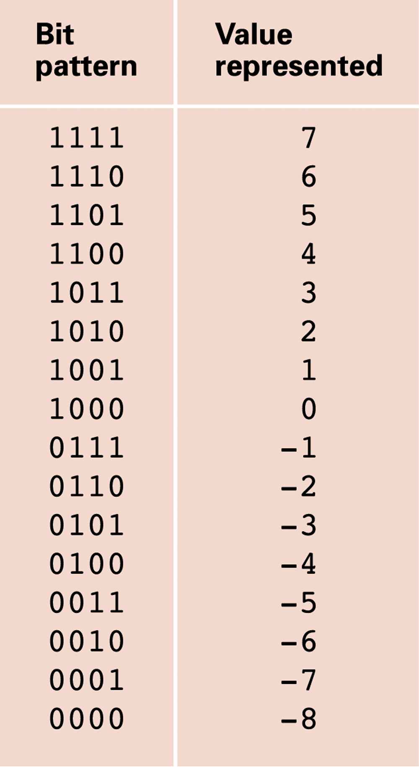
Figure 1.22 An excess eight conversion table
1-<number>

Slide 45
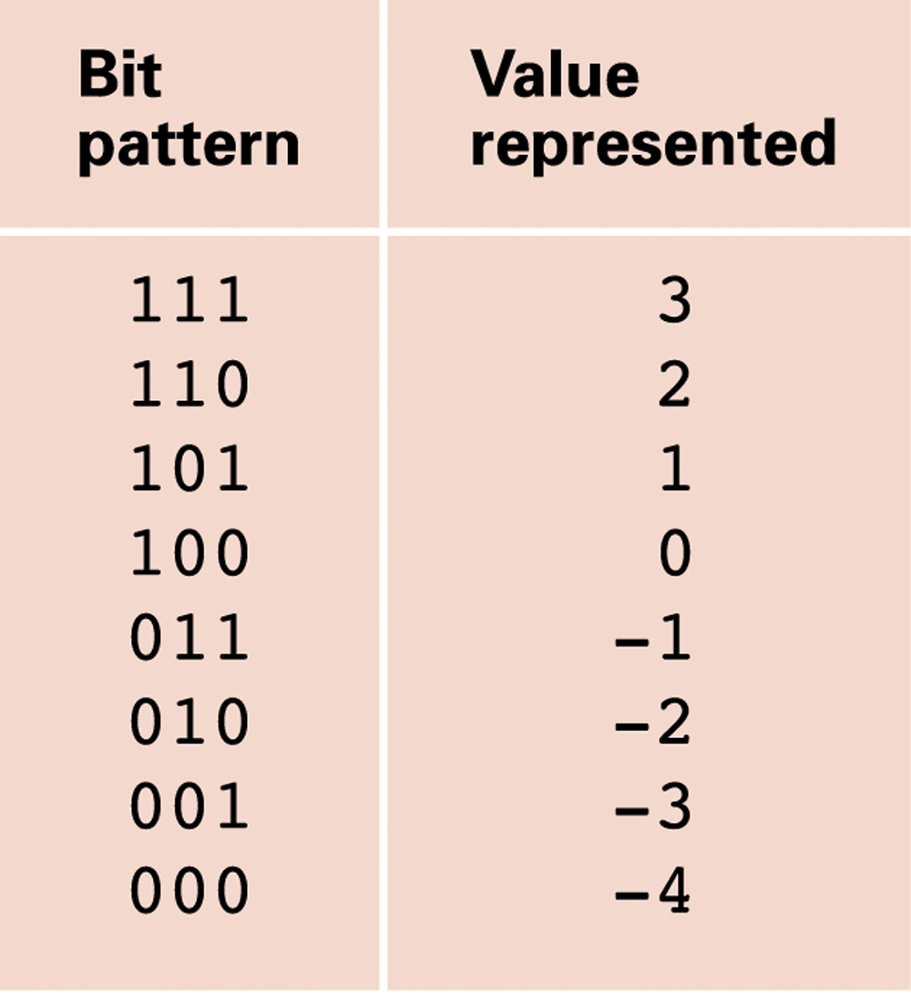
Figure 1.23 An excess notation system using bit patterns of length three
1-<number>

Slide 46
Storing Fractions
Floating-point Notation: Consists of a sign bit, a mantissa field, and an exponent field.
Related topics include
  Normalized form
  Truncation errors
1-<number>

Slide 47
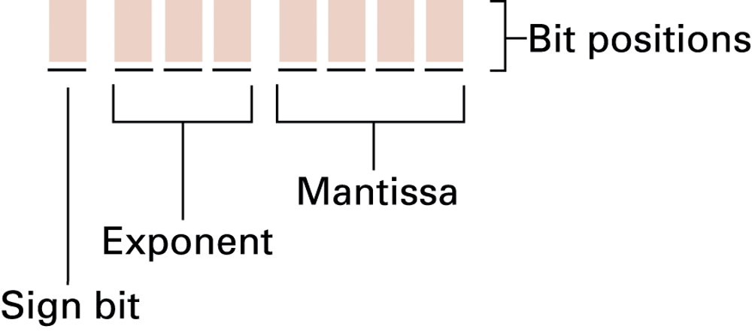
Figure 1.24 Floating-point notation components
1-<number>

Slide 48
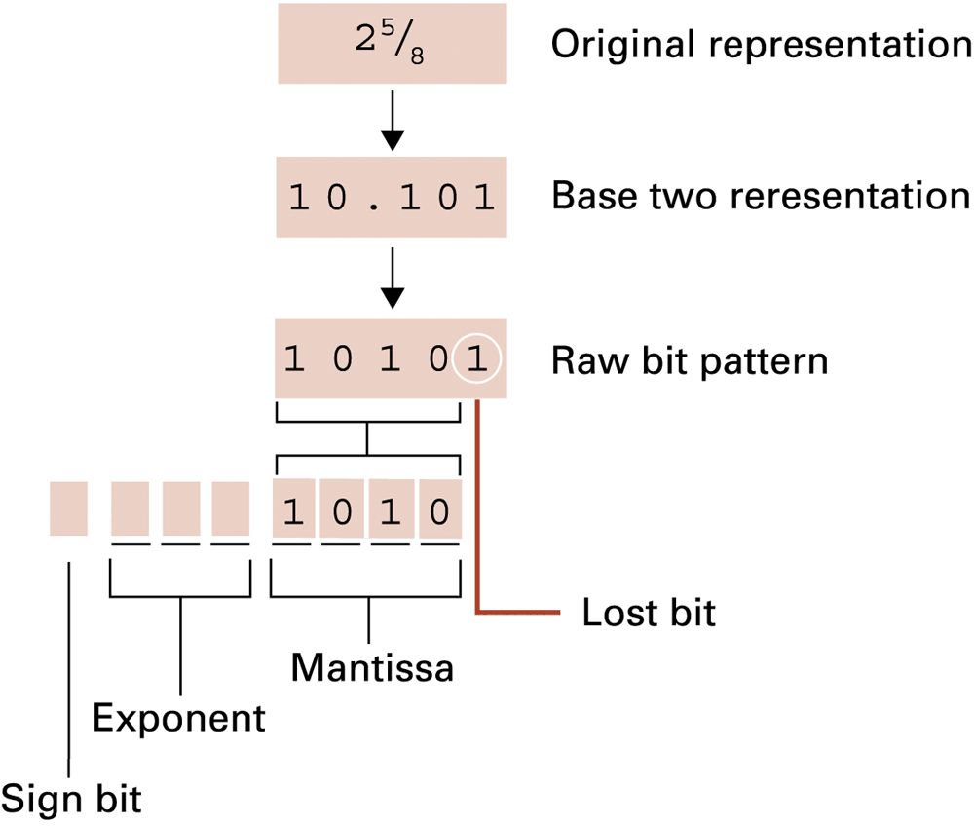
Figure 1.25 Encoding the value 2 ⁵⁄₈
1-<number>

Slide 49
Data and Programing
A programming language is a computer system created to allow humans to precisely express algorithms using a higher level of abstraction.
1-<number>

Slide 50
Getting Started with Python
Python: a popular programming language for applications, scientific computation, and as an introductory language for students
Freely available from www.python.org
Python is an interpreted language
  Typing:
    print('Hello, World!')
  Results in:
  Hello, World!
1-<number>

Slide 51
Variables
Variables: name values for later use
Analogous to mathematic variables in algebra
    s = 'Hello, World!'
    print(s)
    my_integer = 5
    my_floating_point = 26.2
    my_Boolean = True
    my_string = 'characters'
    my_integer = 0xFF
1-<number>

Slide 52
Operators and Expressions
    print(3 + 4) # Prints 7
print(5 – 6) # Prints -1
print(7 * 8) # Prints 56
print(45 / 4) # Prints 11.25
print(2 ** 10) # Prints 1024
s = 'hello' + 'world'
s = s * 4
print(s)
1-<number>

Slide 53
Currency Conversion
# A converter for currency exchange.
USD_to_GBP = 0.66 # Today's exchange rate
GBP_sign = '\u00A3' # Unicode value for £
dollars = 1000 # Number dollars to convert
# Conversion calculations
pounds = dollars * USD_to_GBP
# Printing the results
print('Today, $' + str(dollars))
print('converts to ' + GBP_sign + str(pounds))
1-<number>

Slide 54
Debugging
Syntax errors
    print(5 +)
    SyntaxError: invalid syntax
    pront(5)
    NameError: name 'pront' is not defined
Semantic errors
  Incorrect expressions like
  total_pay = 40 + extra_hours * pay_rate
Runtime errors
  Unintentional divide by zero
1-<number>

Slide 55
Data Compression
Lossy versus lossless
Run-length encoding
Frequency-dependent encoding
(Huffman codes)
Relative encoding
Dictionary encoding (Includes adaptive dictionary encoding such as LZW encoding.)
1-<number>

Slide 56
Compressing Images
GIF: Good for cartoons
JPEG: Good for photographs
TIFF: Good for image archiving
1-<number>

Slide 57
Compressing Audio and Video
MPEG
  High definition television broadcast
  Video conferencing
MP3
  Temporal masking
  Frequency masking
1-<number>

Slide 58
Communication Errors
Parity bits (even versus odd)
Checkbytes
Error correcting codes
1-<number>

Slide 59
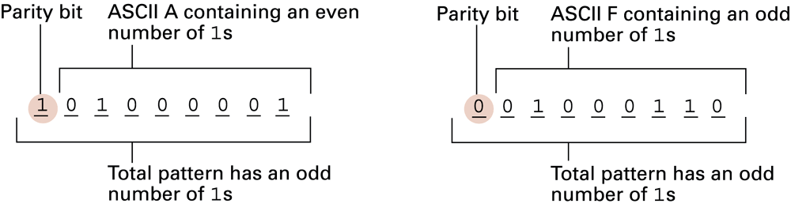
Figure 1.26 The ASCII codes for the letters A and F adjusted for odd parity
1-<number>

Slide 60
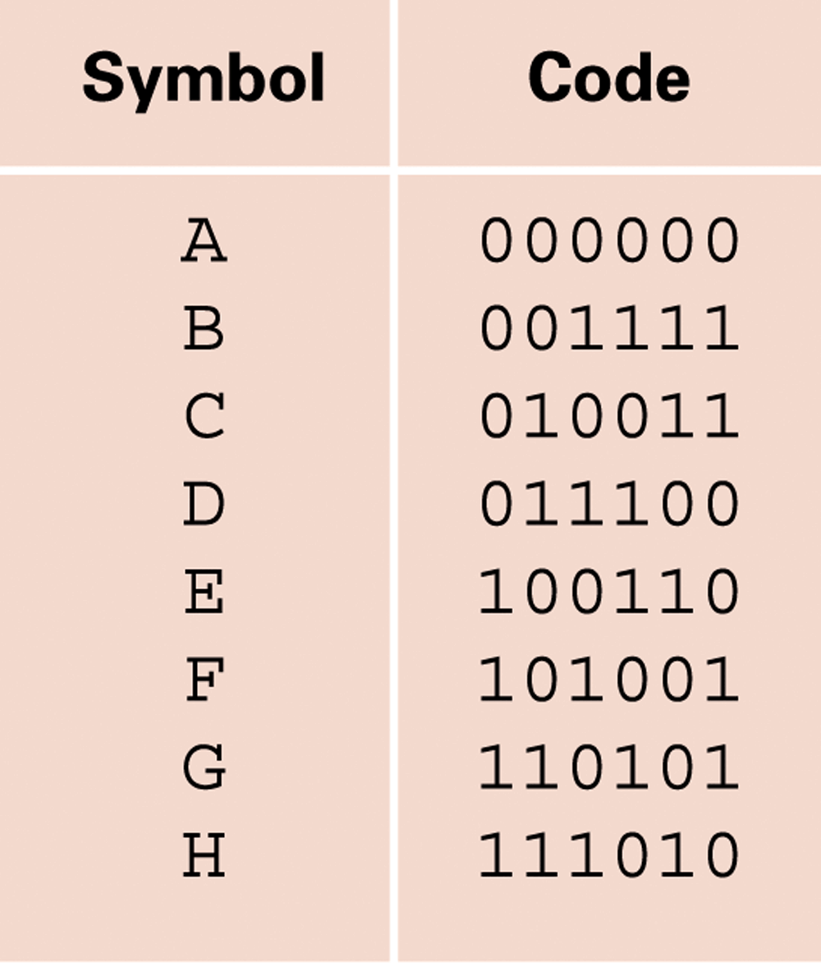
Figure 1.27 An error-correcting code
1-<number>

Slide 61
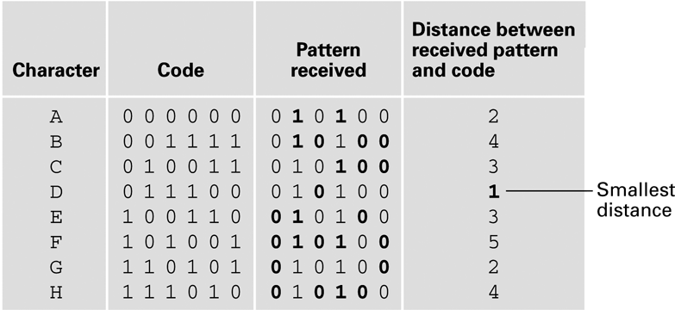
Figure 1.28 Decoding the pattern 010100 using the code in Figure 1.27
1-<number>

Slide 62
End
of
Chapter

