Slide 1
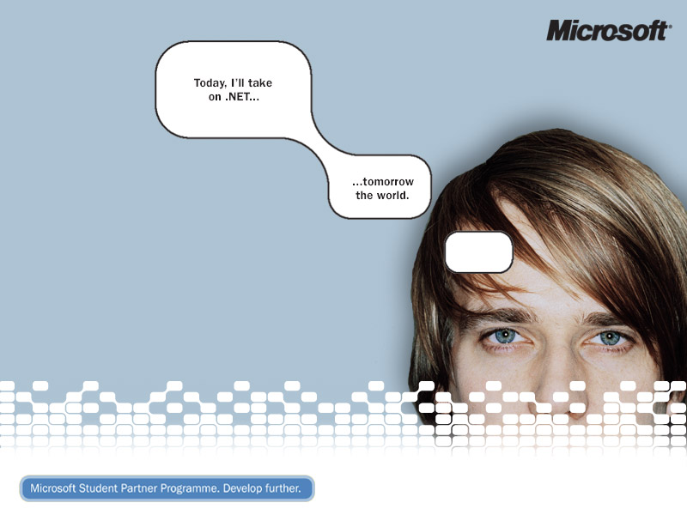
Microsoft Student Partner Programme
Mike Bright, James Crowley
& David Richardson

Slide 2
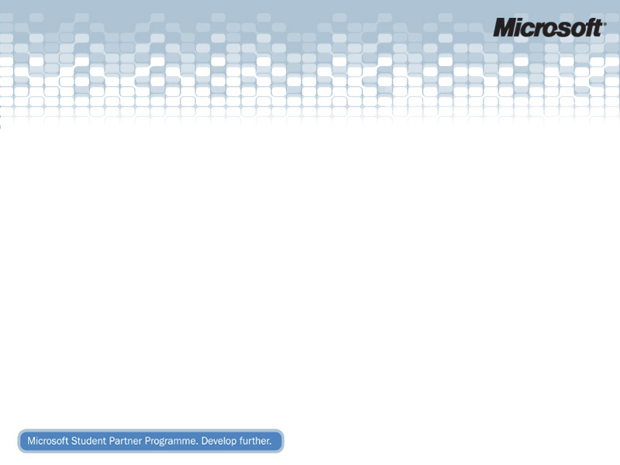
MSP Programme
Who Are We?
Overview
Student’s Perspective
MSP Activities
Microsoft’s Perspective
Summary
Notes:
Overview of this presentation

Slide 3
Who Are We?
Mike Bright
  University College Chester
  MSP 2003 - 2005
David Richardson
  University of Edinburgh
  MSP 2003 – 2005
James Crowley
  University of Oxford
  MSP 2004 – 2005 & New MVP
  http://www.developerfusion.co.uk/ (Shameless plug!)
Notes:
A short introduction from each of the MSPs

Slide 4
What is the MSP Programme?
The Microsoft Student Partner (MSP) Programme is not that much like the MVP programme!
Less emphasis on expertise & knowledge
Concentrates on finding enthusiastic and talented individuals who can help, encourage and share their enthusiasm with other students interested in technology
Rewarding current participation not past involvement
Notes:
Don’t need in-depth technical knowledge. Don’t even have to be running a computer society! Or doing a computer science course. Or necessarily in Microsoft technology (though open mindedness could help in that respect). Just need an enthusiasm for technology, and a willingness to share it with other students.
So, this year we have 70 Students from 35 Universities across UK and Ireland.

Slide 5
What’s in it for the MSPs?
Free Stuff !!
  MSDN Universal
  Social and Technical Meet-ups
  Chance to win Xbox, smart phones, pda’s…
Further Develop Skills
  .NET & MS Technology
  Soft Skills (Not just tech talk!)
Great for CV
Notes:
Why would anyone want to take part? Well, MSPs get a copy of MSDN universal (always nice). 3 social/technical events in a year, to keep us up to date – talks about stuff like Xbox, MSN Search, Microsoft TV, Longhorn

Slide 6
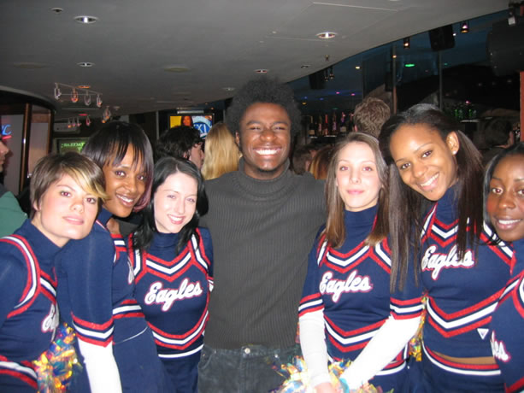
Social Evening – Leicester Sq.
Notes:
A clear idea of what the MSP programme is really about – this was at our last social in Leicester Square, on the night of the superbowl. Somehow everyone managed to crawl out of bed the next morning and get to the meeting on time!

Slide 7
MSDN AA – Free software for students
Allows free access to software for students & teaching staff for “academic” purposes.
Some departments more willing to jump on board than others. Oxford signed up in 2002, but is only now getting around to giving students access, after 2 years of constant nagging from two MSPs!
Windows XP / 2003 Server, Visual Studio, Visio, Project, SQL Server, Exchange, BizTalk, MapPoint and more…
Notes:
Okay, so aside from enjoying free socials and software, what do we get up to?
One of the things we’re fighting against is a common attitude in academia to avoid bleh. A good example of this is MSDN AA. For £500 ya get free software for all students and staff. Oxford quite happily signed up, handed it out to staff – but didn’t bother giving anything to the students.

Slide 8

Imagine Cup
Competition Initiated by Microsoft 3 years ago
Originally A Programming Competition
Some rounds now open to high school level (14-18 year olds)
This years finals are being held in Yokohama Japan (July-August).
Notes:
Quick Check to see who's heard of the imagine cup??? Any MVP’s here helped out by reviewing applications?
Imagine Cup was introduced by Microsoft 3 years ago as a way of drawing the academic community together on a world wide level.
By introducing a global competition, Microsoft exposed the talents in the industry to each other.
3 years later the competition has expanded way beyond the original targets, with a selection of 9 invitationals not just programming ones.
Now available to younger age groups not just undergraduate with opening up of some invitationals to 14-18 year olds
The competition consists of 3 main stages, Submission of application, selection to UK finals, then selection to Worldwide finals;
This years competition finals are being held in Yokohama Japan. ☺

Slide 9
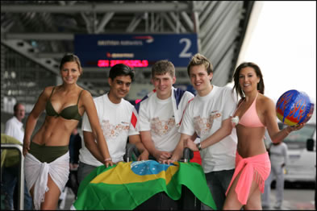
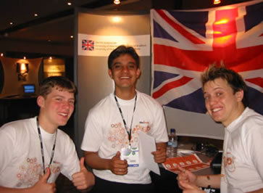
Imagine Cup 2004
Team faraday last year (UK Winners)…
  10k students worldwide participated in IC 2004; 4,500 from the UK!
Notes:
Hehe, last years Winner Team Faraday at the airport before there trip to the world wide finals in Brazil. With an application called the Juice.
The juice was about :
Help students adjust to life at university
Provide good communication between students and faculty
‘Take me drunk, I’m home’
Find places to go out
Various academic stuff
Using Bespoke web services, and a web and mobile front end to the application
Important figure to note : 10k students worldwide participated in IC 2004; 4,500 from the UK!

Slide 10
Imagine Cup 2005
This years theme is “Dissolving Boundaries”
Sponsorship from BT, 3i and Capgemini.
This years invitational areas;
  Software Design, Office Design, Algorithm, Gaming, I.T Professional Quiz’s, Rendering, Short film, Web Dev, Technology Business Plan.
For more information on the invitationals and where to point people who should enter :
http://imagine.thespoke.net
Notes:
This years theme is dissolving boundaries, Pushing design to the point where boundaries between countries and technology fringes no long exist.
With many corporate sponsors this year including, BT, 3I and Capgemini, the UK Finals are being held at the BT Tower located in London.
This years competition areas have been expanded to 9 invitationals, these include;
Software Design, Office Design, Algorithm, Gaming, I.T Professional Quiz’s, Rendering, Short film, Web Dev, Technology Business Plan.
Loads of information available on theSpoke.

Slide 11
Tech.Ed (MSP Star Award Prizes)
3 awards given out for;
  Recognises outstanding contribution to the MSP community
Award comprises;
  Expenses paid trip to Tech.Ed Europe, Amsterdam
Great experience to relate with developers and Ms Staff, and to see amazing new technology.
Notes:
The star awards are given out for outstanding contribution to the MSP community.
I went last year (because I’m outstanding baby! Joke), for my contribution to the programme and my contribution (programming) to Project Hurricane which is an ASP.NET Web based portal developed by some of the early MVS/MSPs.
It wad a great experience, got to see cool people like Scott Guthrie (ASP.NET Product Manager), and to nearly meet Don Box…. ☺
Two other guys went, one of which now works for Microsoft in Redmond and the other owns his own business.

Slide 12
Gen ‘05
Demos, presentations and access to Microsoft recruitment staff.
2,427 people attended Gen ‘05, held in Glasgow, Birmingham, Leeds, Hertfordshire and Southampton
Notes:
Talk about the GEN 05 events
Media Centre, Windows Mobile, Recruitment etc

Slide 13
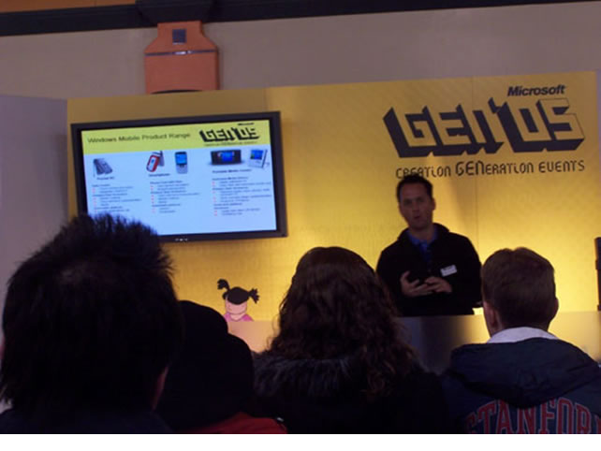
Gen ’05 Glasgow
Notes:
Pic of Gen 05 Glasgow

Slide 14
Xbox LAN Parties
MSP Organised X-Box Events
Working With University Gaming Societies
Halo, Rainbow 6, Rally Sport Challenge 2, …
X-Box Prizes for the Winners
Notes:
X-box stuff, not all work !

Slide 15
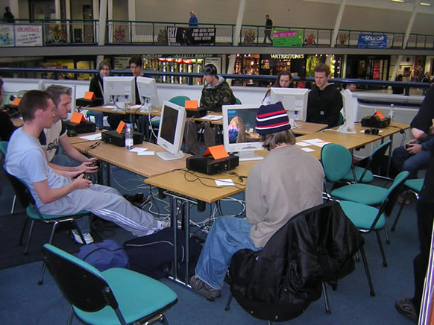
Xbox LAN Parties
Students hard at work…

Slide 16
Microsoft’s Perspective
Academia is renowned for being hostile to Microsoft
Increase Adoption of MS Technology
Raise Student Awareness of MS
Route into Top Universities in UK and Ireland
Talking to the Experts (ie. Students)
Notes:
What is the goal of this for Microsoft?
Tap into academia
Raise student awareness of Microsoft technology in particular the .NET framework
MSPs will act as ambassadors for Microsoft within their native universities.
Build a network of students and increase adoption
Academia has previously been hostile to Microsoft, students can change this attitude over time
The main people who can influence the work done in universities are the students
.NET projects
Community involvement
Influence curriculum

Slide 17
Summary
People
+
Technology
=
MSP Programme
Notes:
Probably the most important slide, the programme revolves around PEOPLE. (in my opinion)
Technology is worthless without good PEOPLE and we should stress that the true value in the programme lies in the MSPs themselves.
No other company has a programme like this!!

Slide 18
Questions ???
Thanks for Listening !
Notes:
Suggest that MSPs make great Graduate recruits or Interns. Ask the MVP audience for their ideas on how the two programmes can interact with each other ?

