Slide 1
PLAGUE
Project 1
James Dawson

Slide 2


Slide 3


Slide 4
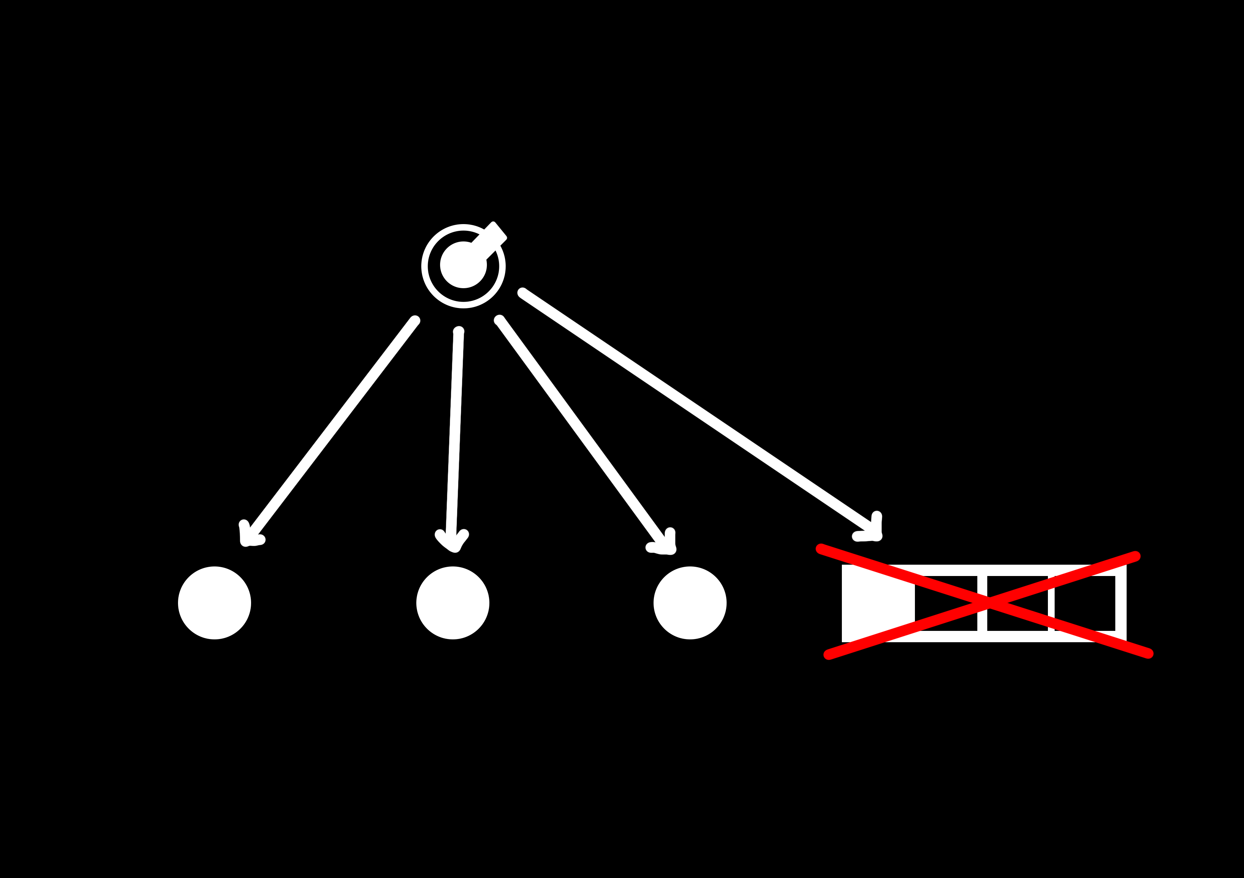

Slide 5
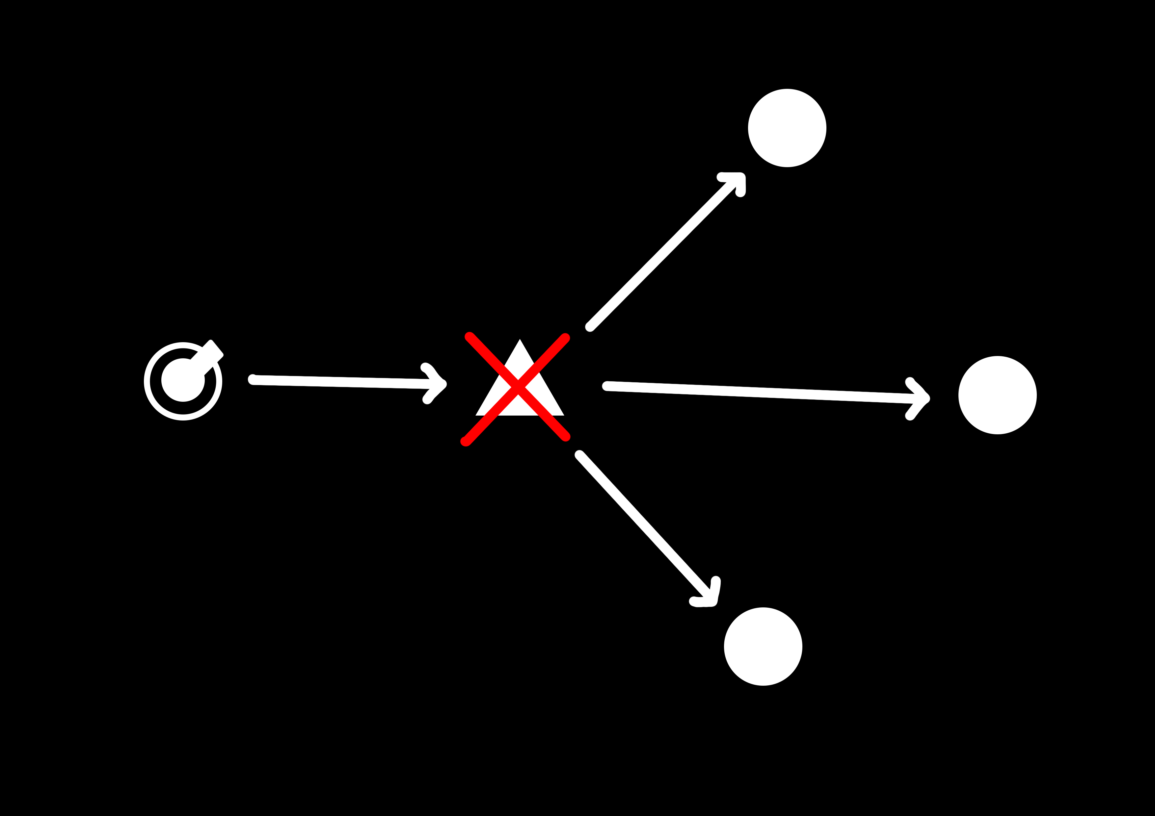

Slide 6
DEMO

Slide 7
PLAGUE
Project 1
James Dawson

